Slide 1
MYCORRHIZAE

Slide 2
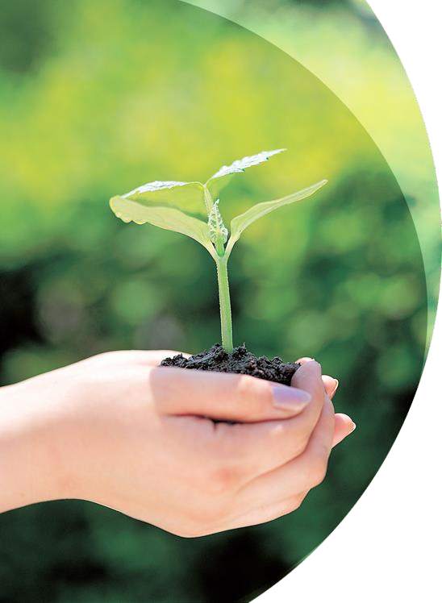
What are Mycorrhizae?

Slide 3

The word Mycorrhizae was first used by german researcher A.B Frank in 1885 and originates from the Greek mycos, meaning “fungus” and “rhiza” meaning “root”.
Mycorrhizae is a symbiotic mutualistic relationship between special soil fungi and fine plant roots: it is neither the fungus nor the root but rather the structures from these two partners.

Slide 4
Since the association is mutualistic, both organisms benefit from the associations.
The fungus receives carbohydrates (sugars) and growth factors from the plant, which in turn receives many benefits, including increased nutrient absorption.
In this association, the fungus takes over the role of the plant’s root hairs and acts as an extension of the root systems.

Slide 5
Mycorrhizae are highly evolved, mutualistic associations between soil fungi and plant roots. It is commonly known as root fungi.
This asoociation are members of the fungus kingdom (Basidomycetes, Ascomycetes and Zygomycetes) and most vascular plants.
Host plant receives mineral nutrients while the fungus photosynthetically derived carbon compounds from the plants.

Slide 6
Mycorrhizal associations involve 3-way interactions between host plants, mutualistic fungi and soil factors.
Host plant
Soil factors
Fungi

Slide 7
Types of Associations

Slide 8

Types of Associations
Mycorrhizas are commonly divided into ectomycorrhizas (extracellular) and endomycorrhizas (Intracellular).
The two types are differentiated by the fact that the hyphae of
  ectomycorrhizal fungi do not penetrate individual cells within the root
  endomycorrhizal fungi penetrate the cell wall and invaginate the cell membrane.

Slide 9
Endomycorrhizas are variable and have been further classified as arbuscular, ericoid, arbutoid, monotropoid, and orchid mycorrhizas.
Arbuscular mycorrhizas, or AM (formerly known as vesicular-arbuscular mycorrhizas, or VAM), are mycorrhizas whose hyphae enter into the plant cells, producing structures that are either balloon-like (vesicles) or dichotomously branching invaginations (arbuscules).

Slide 10
Ectomycorrhizas, or EcM, are typically formed between the roots of around 10% of plant families, mostly woody plants including the birch, dipterocarp, eucalyptus, oak, pine, and rose families, orchids, and fungi belonging to the Basidiomycota, Ascomycota, and Zygomycota.
Some EcM fungi, such as many Leccinum and Suillus, are symbiotic with only one particular genus of plant, while other fungi, such as the Amanita, are generalists that form mycorrhizas with many different plants.

Slide 11
Association | Occurrence
Vesicular Arbuscular Mycorrhizal (VAM) plants | Plants with VAM are common in most habitats
Ectomycorrhizal (ECM) plants | Trees with ECM are dominant in coniferous forests, especially in cold boreal or alpine regions ECM trees and shrubs common in many broad-leaved forests in temperate or Mediterranean regions Also occur in some tropical or subtropical savanna or rain forests habitats

Slide 12
Ectomycorrhizae

Slide 13

Most conspicuous and easily recognized
Best characterized
Plant roots are enclosed by a sheath of fungal hyphae – fungal mycelium penetrates between cells in cortex of the root
Fungal tissue may account for up to 40% mass of root
Hyphae also extend out into the soil – extramatrical hyphae

Slide 14


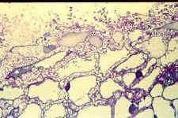
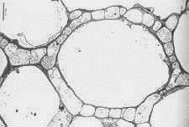
Contains a fungal sheath
Parenchyma of root cortex is surrounded by hyphae – Hartig net

Slide 15
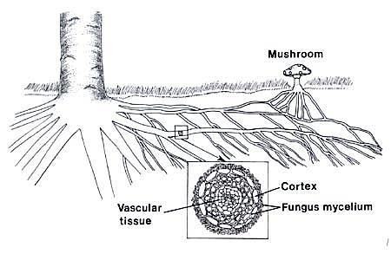


Slide 16
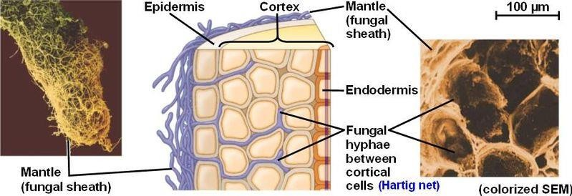

Slide 17
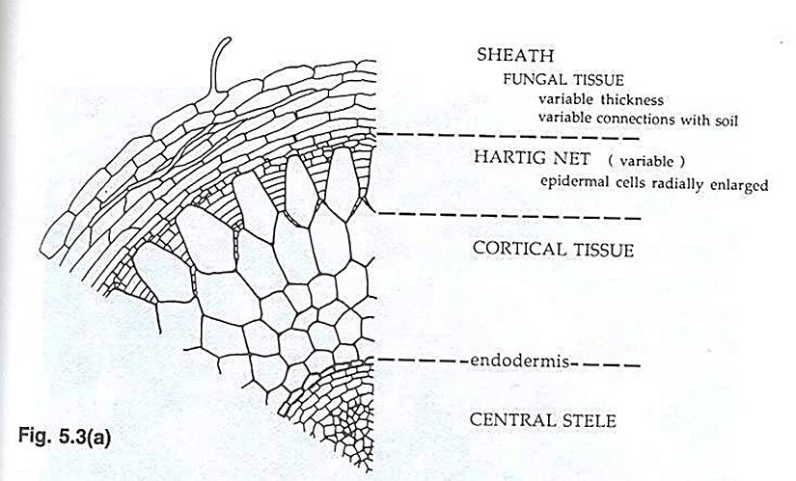

Slide 18

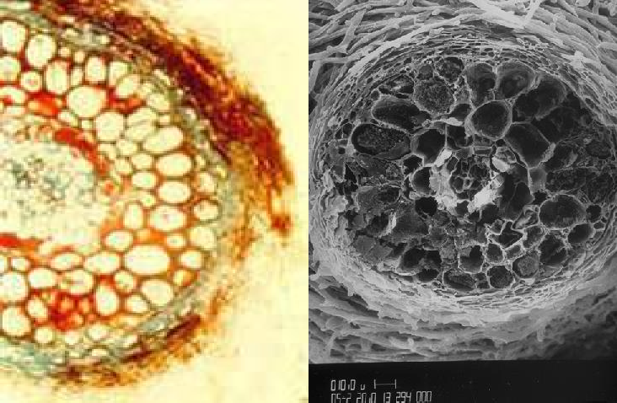
Ectomycorrhizal root

Slide 19

Absorbing roots are those that are affected
Become thicker and repeatedly branched after infection

Slide 20
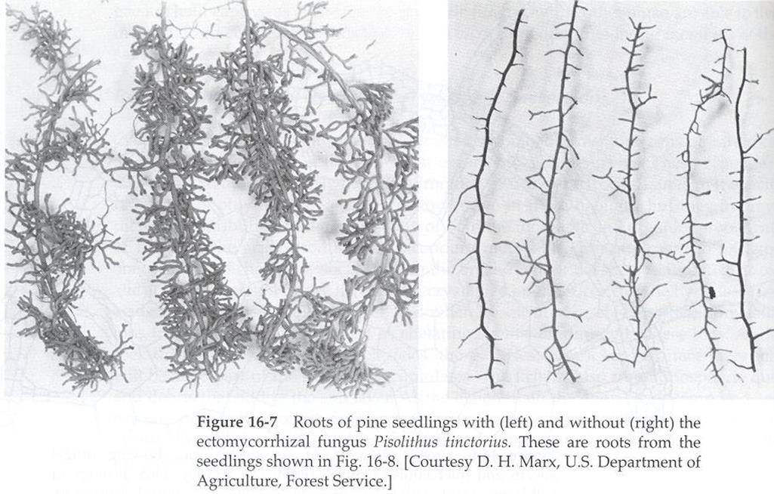
Roots of Pine seedlings with (left) and without (right) the ectomycorrhizal fungus Pisolithus tinctorius

Slide 21
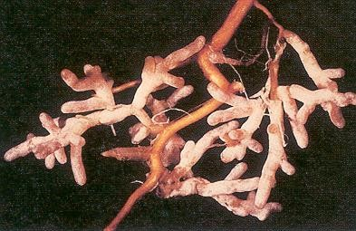
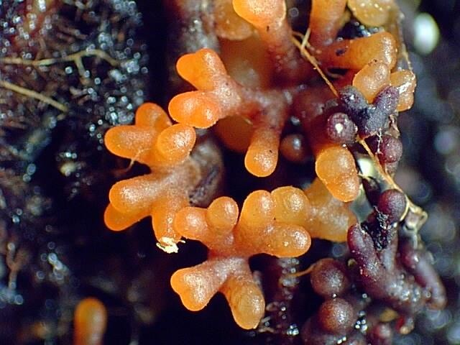
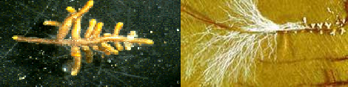
Ectomycorrhizae

Slide 22

2000 plant species – primarily temperate trees and eucalyptus
Major species of coniferous and deciduous trees
Rare to find uninfected trees
In some trees, the association is obligate, in others facultative
Mycorrhizal association important in forestry

Slide 23
Ectomycorrhizae Symbionts
Basidiomycetes – Agaricales (many mushroom species), Lycoperdales, Sclerodermatales, few Aphyllophorales
  Pisolithus tinctorus – used to form commercial inoculum for nursery trees, common in southern pine
Ascomycota – Pezizales – cup fungi and truffles
Over 5000 species of fungi have been shown to form ectomycorrhizae

Slide 24

Great deal of variability
Most tree species form mycorrhizal associations with a number of different fungal species
May have different mycorrhizal fungi on roots of one plant
Some fungi are fairly specific and will form associations with only one plant species – these mushrooms are common in stands of that tree
Others are not specific

Slide 25

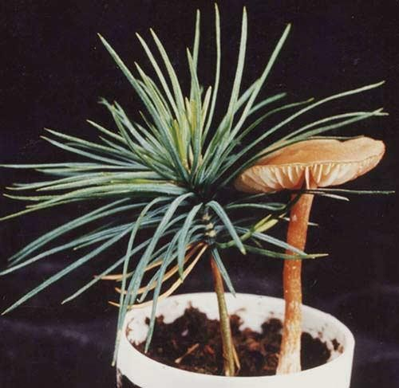
Douglas fir has been extensively studied and 2000 species of fungi have been identified from its roots
In forests, a high percentage of fruiting bodies are mycorrhizal fungi

Slide 26

Census of fruiting bodies produced by different species
Soil cores – separate and identify mycorrhizal roots by morphology, Hartig net
Recently molecular methods have been used to identify the fungi present in mycorrhizal roots – e.g. RFLP (Restriction Fragment Length Polymorphism)
RFLP is a technique that exploits variations in homologous DNA sequences, known as polymorphisms, in order to distinguish individuals, populations, or species or to pinpoint the locations of genes within a sequence.

Slide 27

Ectomycorrhizal fungi
Can also grow saprotrophically
Many have been cultured
Most that have been studied do not have the capability to degrade complex plant polymers (e.g. cellulose and lignin)
Depend on soluble carbohydrates
Many have organic growth factor requirements – vitamins, amino acids
Not decomposers but depend on plant

Slide 28

Benefits to fungus
Provided with source of C and energy
Plants provided with CO₂ demonstrated that C appears in fungus
Sucrose from plant converted into trehalose, mannitol by fungus
Estimates that up to 10% (or more) of photosynthate produced by trees is passed to mycorrhizae and other rhizosphere organisms

Slide 29

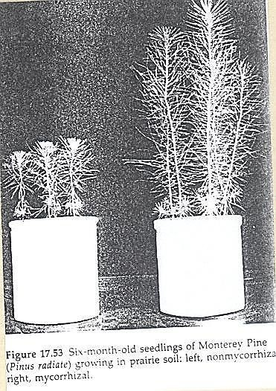
Benefits to trees
Numerous studies have shown that tree growth is better when mycorrhizae are present

Slide 30


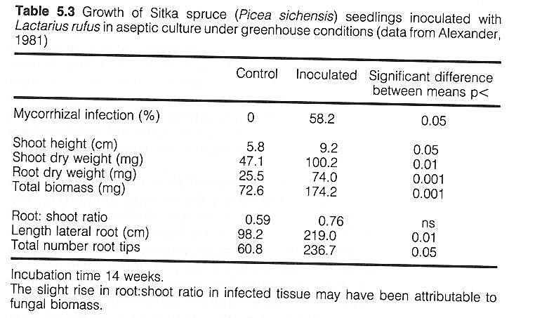
Benefits to trees

Slide 31

Benefits to trees
Fungi increase supply of inorganic nutrients to tree
P is insoluble in most soils
Extramatrical hyphae extend over a larger volume of soil than roots can – increase ability to absorb insoluble nutrients such as P

Slide 32


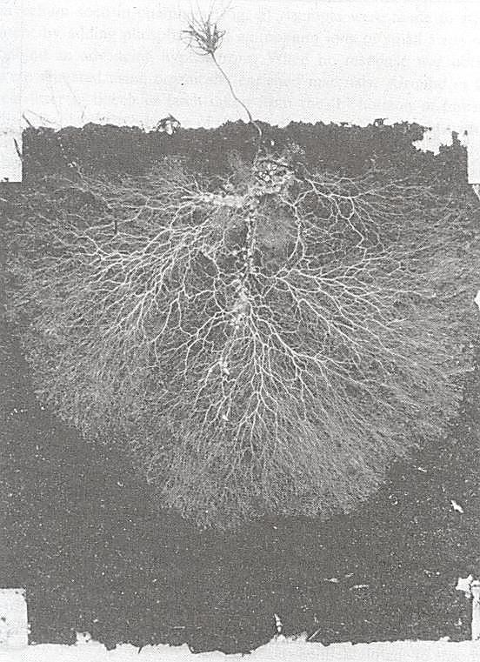
Extramatrical hyphae

Slide 33

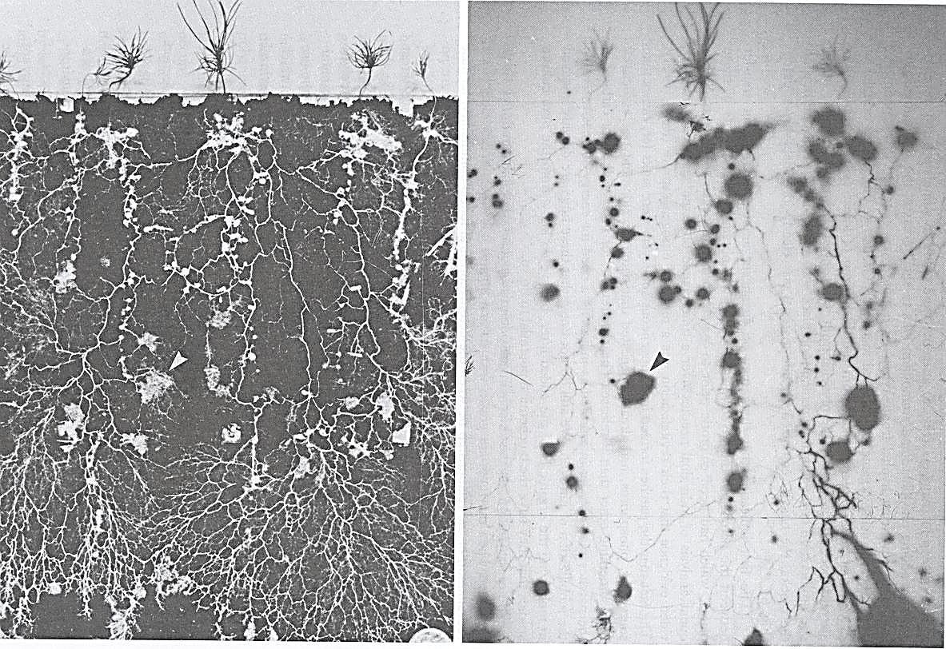
Volume of soil explored

Slide 34
Benefits to trees
Plant hormones produced by fungus changes the physiological state of roots – physiologically active root area for nutrient and water absorption is increased.
Increases tolerance of plant to drought, high temperatures, pH extremes, heavy metals
Increases resistance to infection by root pathogens – provides a physical barrier

Slide 35
Vesicular Arbuscular mycorrhizae (VAM)

Slide 36

Vesicular Arbuscular mycorrhizae
VAM is a type of mycorrhiza in which the fungus penetrates the cortical cells of the roots of a vascular plant.
Characterized by the formation of unique structures, arbuscules and vesicles by fungi of the phylum Glomeromycota (VAM fungi).
VAM fungi help plants to capture nutrients such as phosphorus, sulfur, nitrogen and micronutrients from the soil.
It is believed that the development of the arbuscular mycorrhizal symbiosis played a crucial role in the initial colonisation of land by plants and in the evolution of the vascular plants.

Slide 37
Vesicular Arbuscular mycorrhizae
VAM – much less known about these associations than about ectomycorrhizae
Appear to be the most common type of mycorrhizal association with respect to the number of plant species that form them
Found in species in all divisions of terrestrial plants – widely distributed in annuals, perennials, temperate and tropical trees, crop and wild plants
Estimated to occur on 300,000 plant spp.

Slide 38

Arbuscular mycorrhizal fungi
All are in the Zygomycota in the Glomales – or newly proposed phylum Glomeromycota
Include 130 species in 6 genera
All are obligate biotrophs
Form large spores that superficially resemble zygospores, but not formed from fusion of gametangia – azygospores or chlamydospores
Spore diameters range from 50 to 400 μm

Slide 39

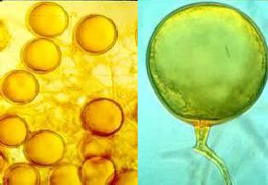
Spores

Slide 40

Specificity
Few species of fungi and many species of plants – very low specificity
One fungal species may form association with many different plant species
Much different than biotrophic parasites that have a limited host range

Slide 41

Morphology
Root morphology is not modified
To detect, must clear and stain root to observe fungal structures
Fungi form both extracellular and intracellular hyphae
Intracellular hyphae analogous to haustoria – called arbuscules – tree like branching pattern
Thought to be site of nutrient exchange between fungus and plant

Slide 42


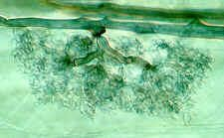
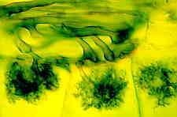
Arbuscules
Surrounded by plant cell membrane
Typically disintegrate after ca 2 weeks in plant cell and release nutrients
Thought to be site of nutrient exchange

Slide 43

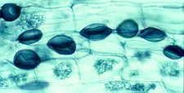
Vesicles
Intercellular hyphae may also form large swellings – vesicles – at ends of hyphae or intercalary
Typically rich in lipids & thought to be involved in storage.

Slide 44

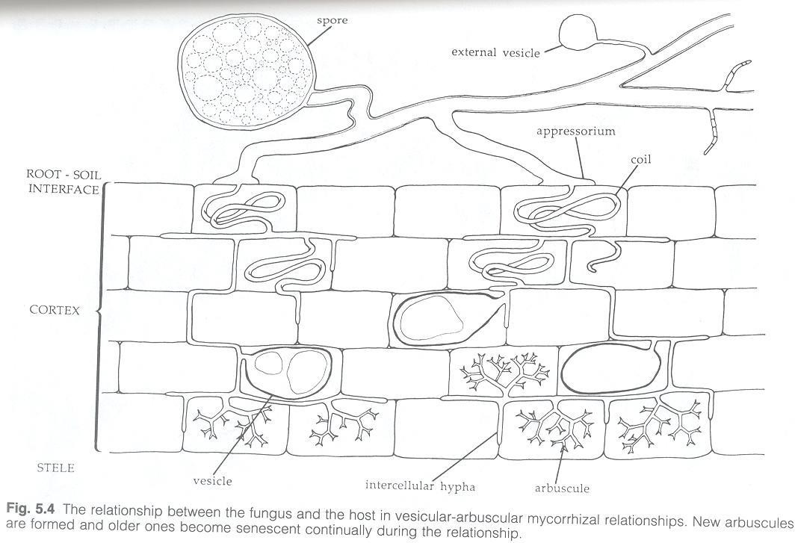
AM

Slide 45

Arbuscular mycorrhizae
Not as well characterized as ectomycorrhizae
Root is not altered in morphology – difficult to determine when roots are infected – must clear and stain followed by microscopic examination
Fungi are obligate biotrophs – cannot be grown in axenic culture – so difficult to conduct experiments

Slide 46

Interaction
Fungus receives organic nutrition from plant – since they are biotrophs, don’t
know what their requirements are
Fungus produces extramatrical hyphae that take up inorganic nutrients from soil – particularly P, may also supply N as they may produce proteinases
Increase drought tolerance – many common desert plants are heavily mycorrhizal
May also increase resistance to root pathogens

Slide 47

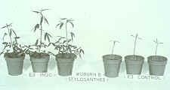
Effect of AM
Growth of plants that are infected better – particularly if soil is poor in nutrients

