Slide 1
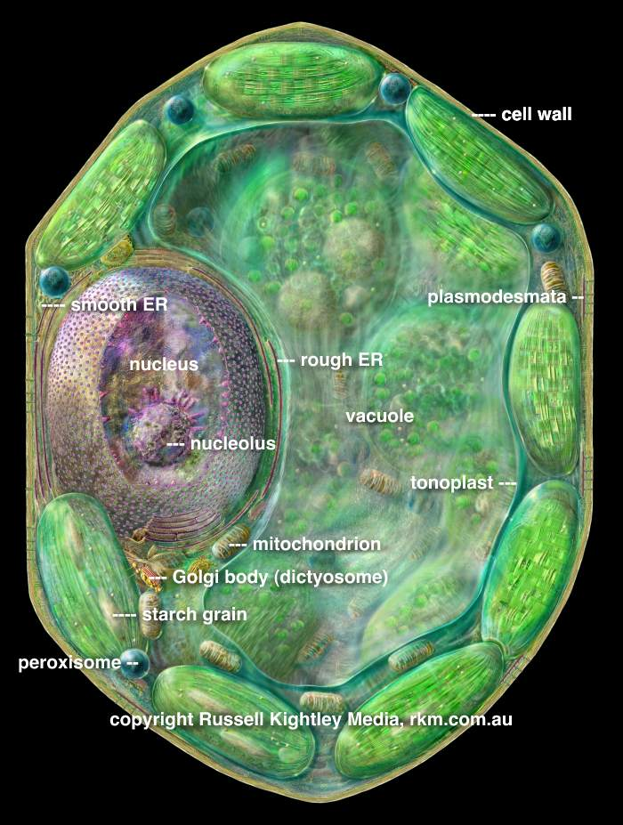
The Plant Cell

Slide 2
What is Cell?
The cell is the functional basic unit of life. It was discovered by Robert Hooke and is the functional unit of all known living organisms. It is the smallest unit of life that is classified as a living thing, and is often called the building block of life.

Slide 3
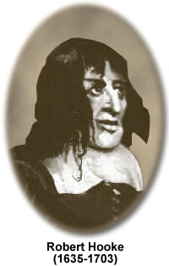
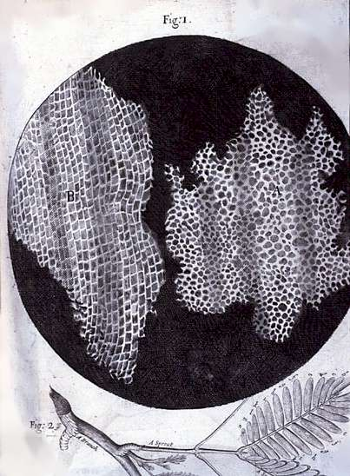
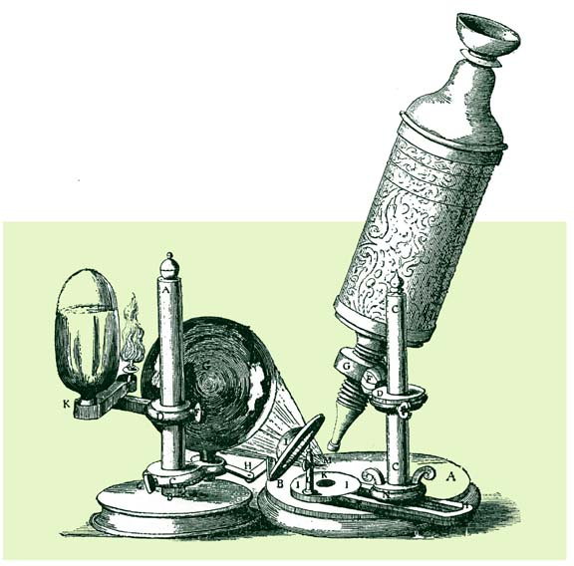
Robert Hooke, a 17th C. British physicist, first used the term “cell’ to describe the units he observed in a sliver of corky bark.

Slide 4
Unicellular and multicellular
Organisms, such as most bacteria, are unicellular (consist of a single cell). All blue green algae, some higher algae (diatoms, Cosmarium, Chlorella, Microcystis, Pinnularia, Haematococcus etc.) and group of protozoa are the good examples of unicellular organisms.
Other organisms, such as humans, are multicellular (other group of plants and animals).
Humans have about 100 trillion cells

Slide 5
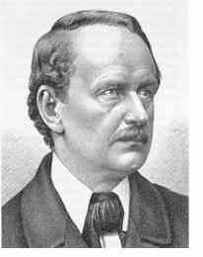
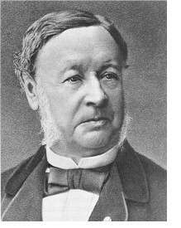
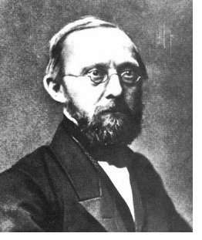
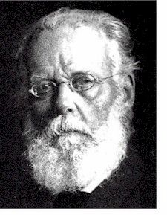
Schleiden
Schwann
Virchow
Weismann
The German biologists Schleiden and Schwann proposed in the 1830s that cells are the structural units of life. This idea has come to be known as the Cell Theory.

Slide 6
Cell Theory
1. All organisms are composed of cells.
2. Cells are the smallest living things.
3. Cells arise only from pre-existing cells.

Slide 7
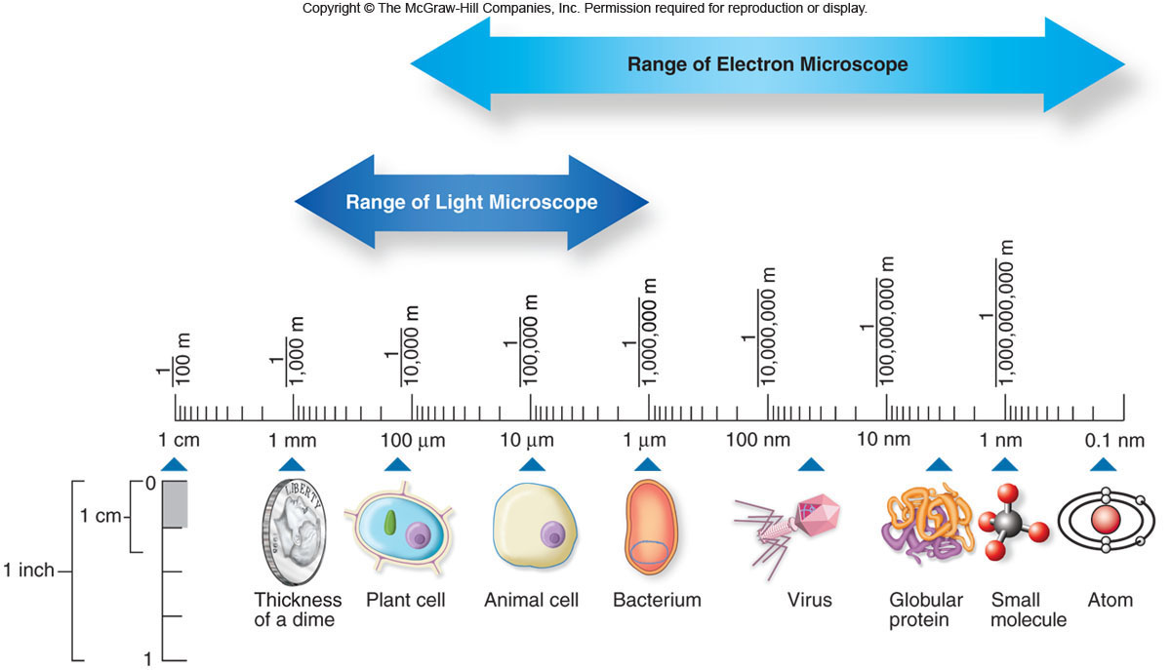
How big is a plant cell?
A. B. C. D. E.
Notes:
lev70065_02_01.jpg

Slide 8
All cells have certain structures in common.
1. Genetic material – in a nucleoid or nucleus
2. Cytoplasm – a semifluid matrix
3. Plasma membrane – a phospholipid bilayer
4. Ribosomes

Slide 9
Cell is basic unit and building blocks of life
Cell "building blocks of life" is the smallest unit of all organisms. The cell was first discovered by Robert Hooke in 1665. The word cell is derived from a Latin word ―cella” which means small room.
Cell is considered as basic biological, structural and functional unit of all living organisms. Cells consist of cytoplasm enclosed within a membrane, which contain many vital macromolecules such as proteins and nucleic acids.
The cell is a unit of biological activity delimited by a semi-permeable membrane and capable of self-reproduction in a medium free of other living systems.
However, exception is observed in viruses because they are capable to self-multiply only using the cellular machinery of other organisms.

Slide 10
Types of Cell
There are two types of cells: eukaryotic and prokaryotic. Prokaryotic cells are those cells which have nuclear material without nuclear membrane. For ex- bacteria and blue green algae.
The cell having well- organized nucleus with a nuclear membrane are called eukaryotic cells.

Slide 11
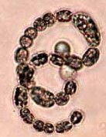
Comparison of Prokaryotic and Eukaryotic Cells
Prokaryotic cells:
e.g., bacteria
Relatively simple structure
Lack nucleus and other membrane-bound organelles
ca. 1 - 10 um diam.
Eukaryotic cells:
e.g., plant & animal cells
Nucleus and other membrane-bound organelles present
ca. 100 um diam.

Slide 12
Prokaryotic Cells
Prokaryotic cells lack a membrane-bound nucleus.
-genetic material is present in the nucleoid
Two types of prokaryotes:
-Domain Archaea
-Domain Bacteria

Slide 13
Prokaryotic Cells
Prokaryotic cells possess
-genetic material in the nucleoid
-cytoplasm
-plasma membrane
-cell wall
-ribosomes
-no membrane-bound organelles

Slide 14
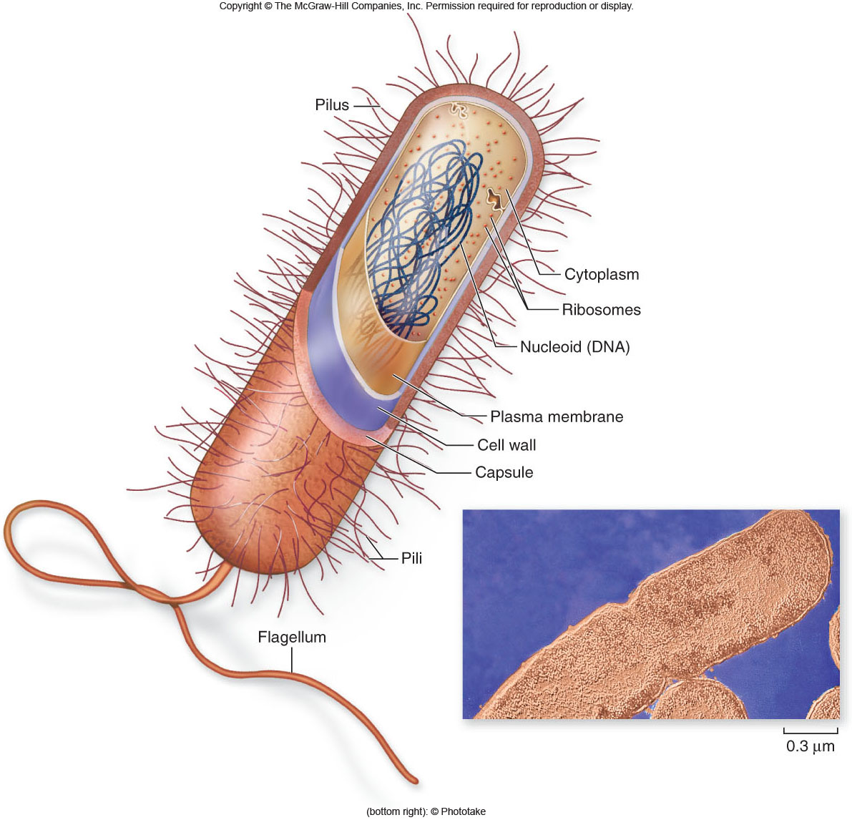
Prokaryotic Cells

Slide 15
Prokaryotic Cells
Prokaryotic cell walls
-protect the cell and maintain cell shape
Bacterial cell walls
-may be composed of peptidoglycan
-may be Gram positive (lots of peptidoglycan) or Gram negative (small amount of peptidoglycan)

Slide 16
Eukaryotic Cells
Eukaryotic cells
-possess a membrane-bound nucleus
-are more complex than prokaryotic cells
-compartmentalize many cellular functions within organelles and the endomembrane system
-possess a cytoskeleton for support and to maintain cellular structure

Slide 17
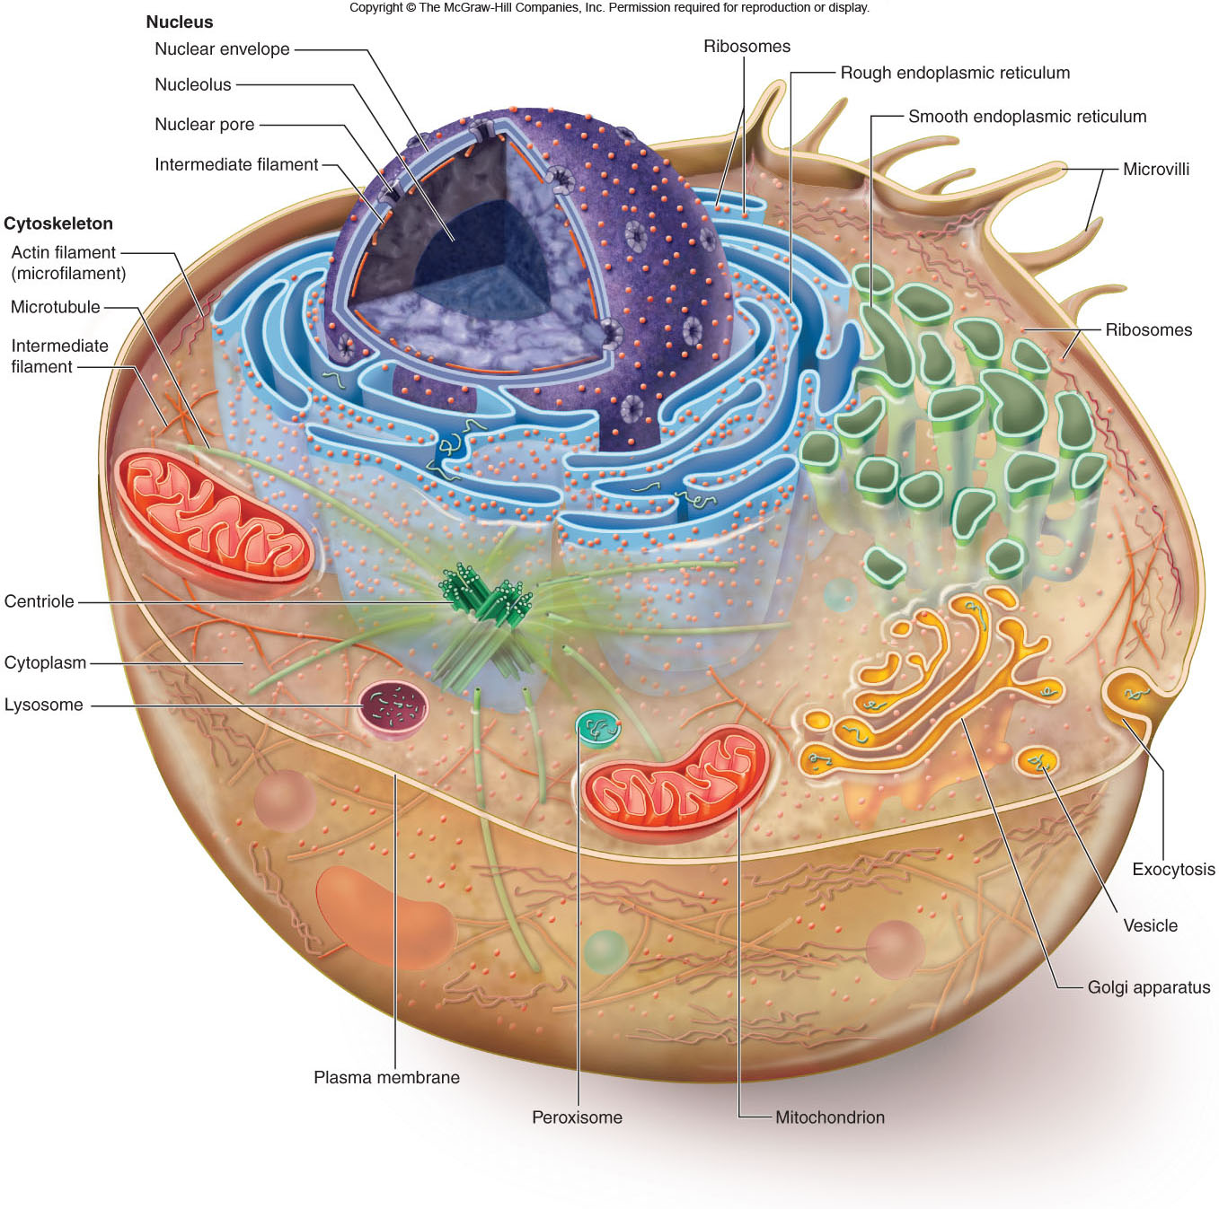
Eukaryotic Cells

Slide 18
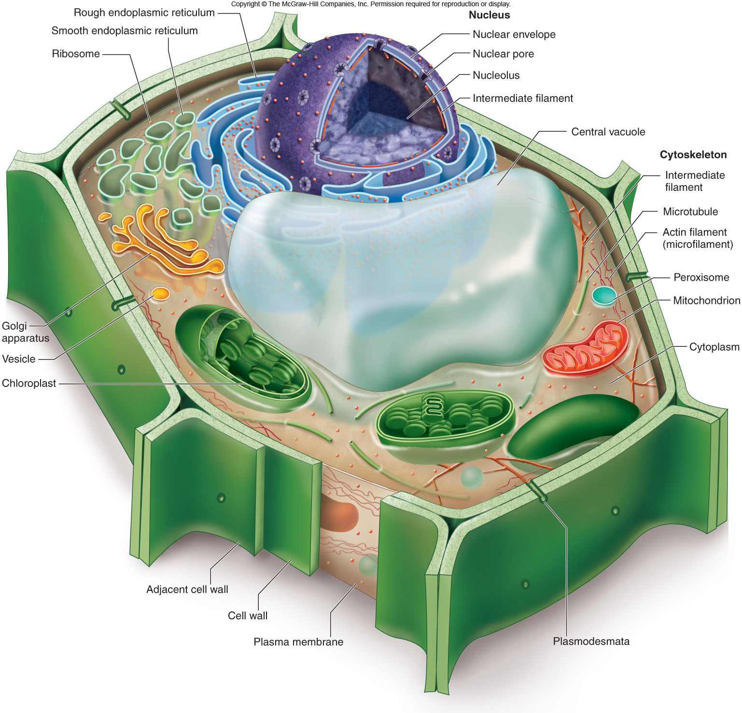
Eukaryotic Cells

Slide 19
Eukaryotic Cells
Nucleus
-stores the genetic material of the cell in the form of multiple, linear chromosomes
-surrounded by a nuclear envelope composed of 2 phospholipid bilayers
-in chromosomes – DNA is organized with proteins to form chromatin

Slide 20
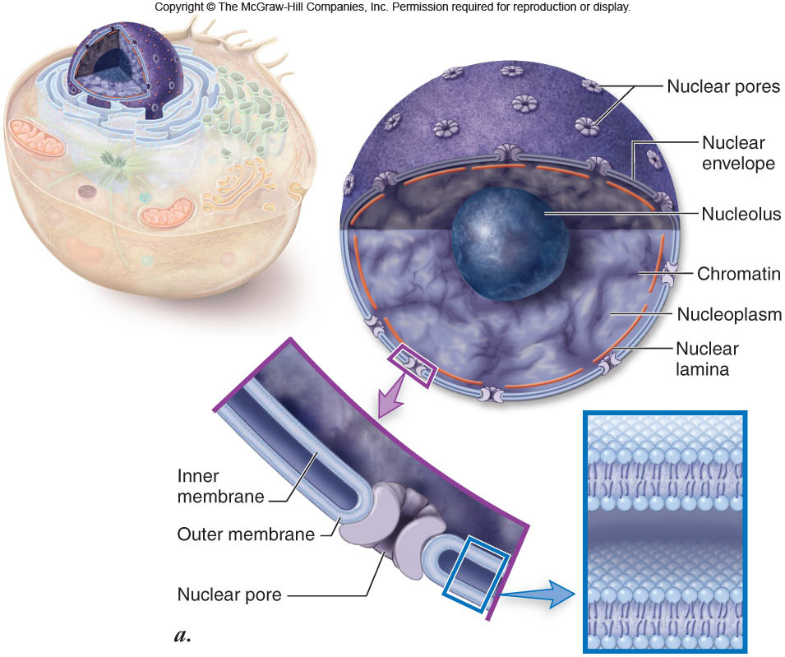
Eukaryotic Cells

Slide 21
Eukaryotic Cells
Ribosomes
-the site of protein synthesis in the cell
-composed of ribosomal RNA and proteins
-found within the cytosol of the cytoplasm and attached to internal membranes

Slide 22
Endomembrane System
Endomembrane system
-a series of membranes throughout the cytoplasm
-divides cell into compartments where different cellular functions occur
1. Endoplasmic reticulum
2. Golgi apparatus
3. Lysosomes

Slide 23
Endomembrane System
Rough endoplasmic reticulum (RER)
-membranes that create a network of channels throughout the cytoplasm
-attachment of ribosomes to the membrane gives a rough appearance
-synthesis of proteins to be secreted, sent to lysosomes or plasma membrane

Slide 24
Endomembrane System
Smooth endoplasmic reticulum (SER)
-functions:
-synthesis of membrane lipids
-calcium storage
-detoxification of foreign substances

Slide 25
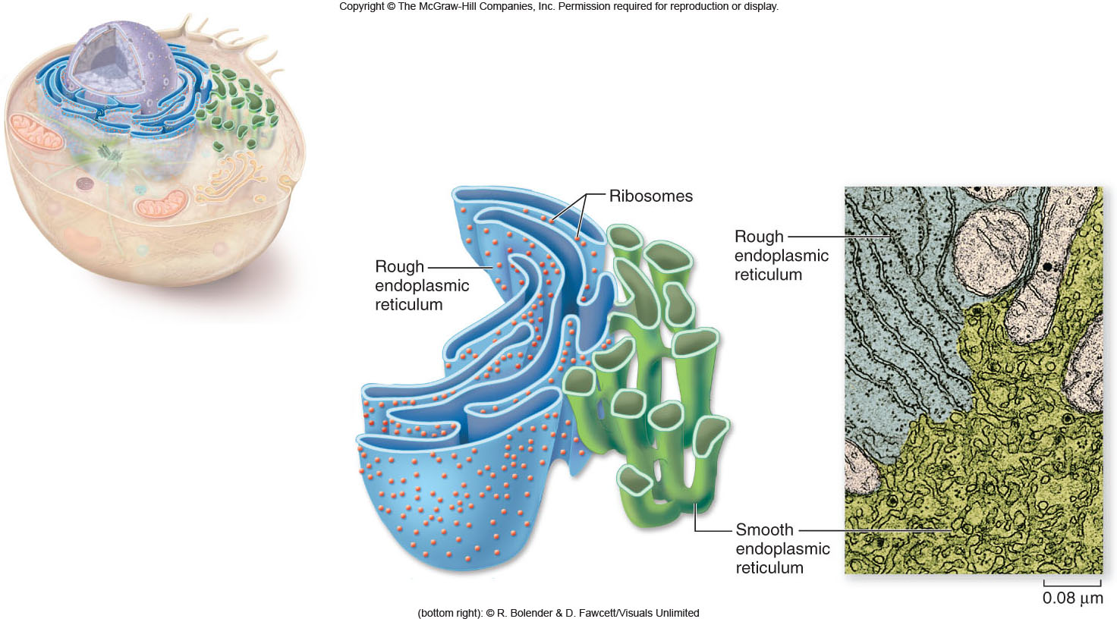
Endomembrane System

Slide 26
Endomembrane System
Golgi apparatus
-flattened stacks of interconnected membranes
-packaging and distribution of materials to different parts of the cell
-synthesis of cell wall components

Slide 27
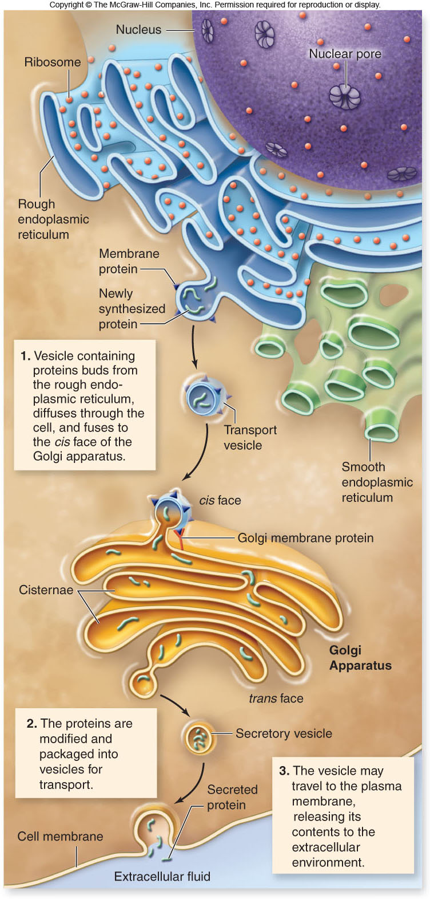

Slide 28
Endomembrane System
Lysosomes
-membrane bound vesicles containing digestive enzymes to break down macromolecules
-destroy cells or foreign matter that the cell has engulfed by phagocytosis

Slide 29
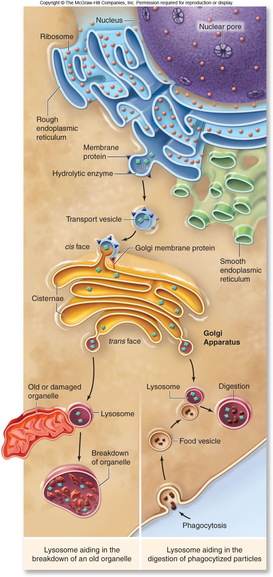

Slide 30
Endomembrane System
Microbodies
-membrane bound vesicles
-contain enzymes
-not part of the endomembrane system
-peroxisomes contain oxidative enzymes and catalase

Slide 31
Endomembrane System
Vacuoles
-membrane-bound structures with various functions depending on the cell type
There are different types of vacuoles:
-central vacuole in plant cells
-contractile vacuole of some protists
-vacuoles for storage

Slide 32
Mitochondria
Mitochondria
-organelles present in all types of eukaryotic cells
-contain oxidative metabolism enzymes for transferring the energy within macromolecules to ATP (AKA: Cellular Respiration)
-found in all types of eukaryotic cells

Slide 33
Mitochondria
-surrounded by 2 membranes
-smooth outer membrane
-folded inner membrane with layers called cristae
-matrix is within the inner membrane
-intermembrane space is located between the two membranes
-contain their own DNA – mtDNA – maternally inherited – circular plasmid

Slide 34
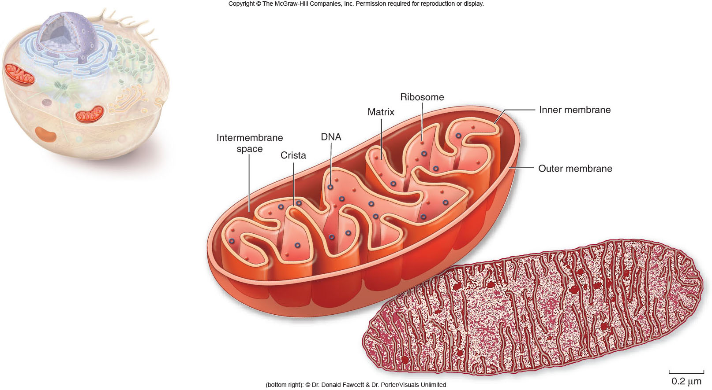
Mitochondria

Slide 35
Chloroplasts
Chloroplasts
-organelles present in cells of plants and some other eukaryotes
-contain chlorophyll for photosynthesis
-surrounded by 2 membranes
-thylakoids are membranous sacs within the inner membrane
-grana are stacks of thylakoids
- also have own DNA – circular plasmid

Slide 36
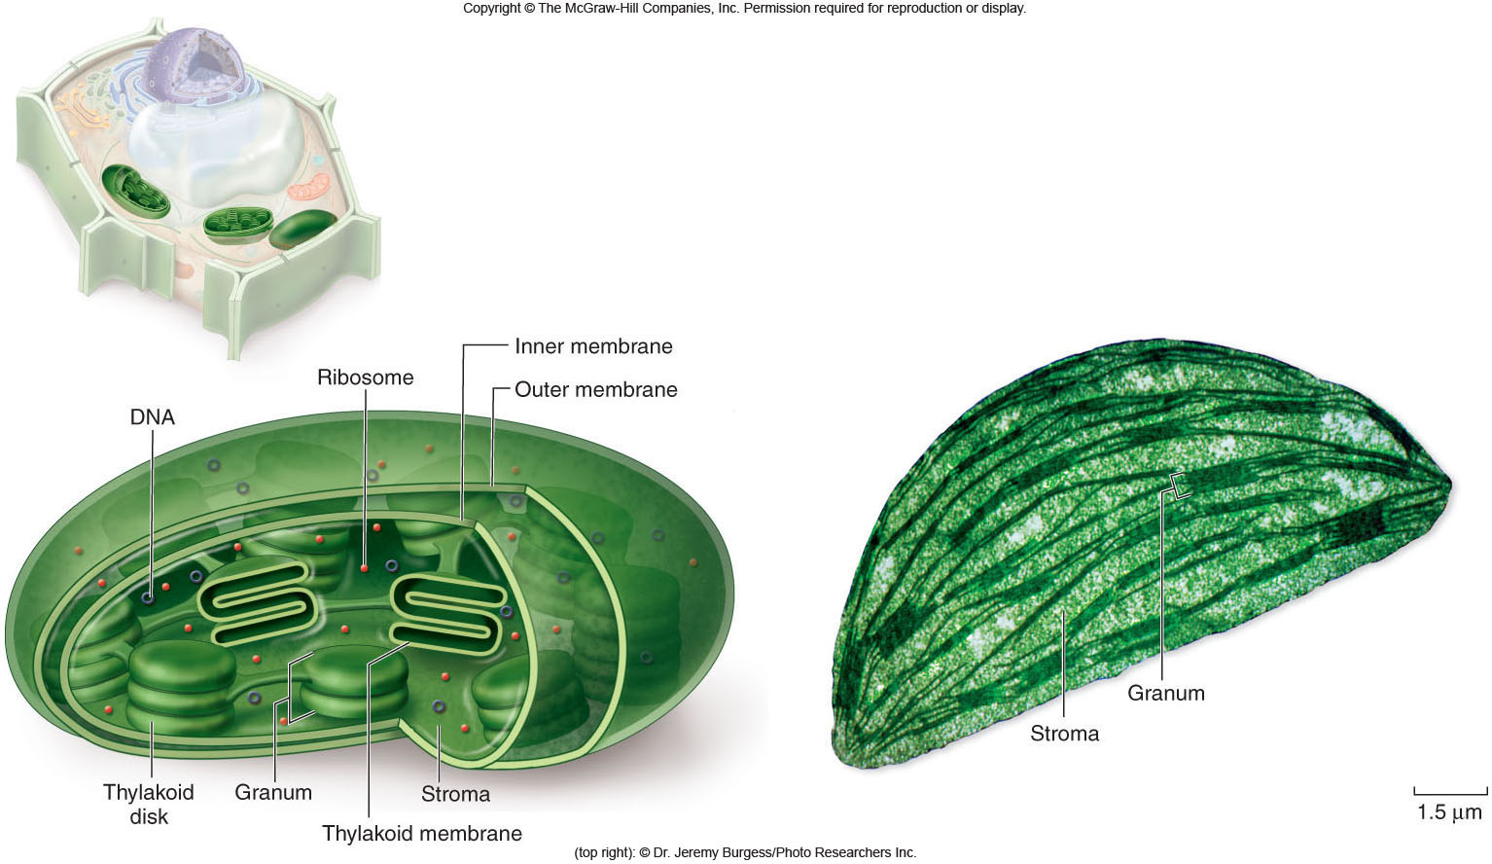
Chloroplasts

Slide 37
Mitochondria & Chloroplasts
Endosymbiosis
-proposal that eukaryotic organelles evolved through a symbiotic relationship
-one cell engulfed a second cell and a symbiotic relationship developed
-mitochondria and chloroplasts are thought to have evolved this way

Slide 38
Mitochondria & Chloroplasts
Much evidence supports this endosymbiosis theory.
Mitochondria and chloroplasts:
-have 2 membranes
-possess DNA and ribosomes
-are about the size of a prokaryotic cell
-divide by a process similar to bacteria

Slide 39
Endosymbiont Theory
This theory states that the organelles of eukaryotic cells are the descendants of once free-living prokaryotes that took up residence in a larger cell, establishing a symbiotic relationship.
This association evolved into the well-studied eukaryotic cell Chloroplasts and mitochondria provide the best examples of this theory. Both organelles resemble free-living prokaryotes.
In fact, as long ago as the 1880s some biologists observed that chloroplasts of eukaryotic cells resembled cyanobacteria (blue-green algae). Both chloroplasts and mitochondria have structures that are associated with free-living cells. For example, they contain both DNA and ribosomes, which are bacterial in size and nature, allowing them to synthesize some of their own proteins.
Both chloroplasts and mitochondria can divide to produce new chloroplasts and mitochondria in a manner very similar to prokaryotic cell division. The inner membranes of both organelles closely resemble the plasma membrane of prokaryotes. These features, as well as additional biochemical similarities, provide support for the validity of the Endosymbiont Theory.

Slide 40
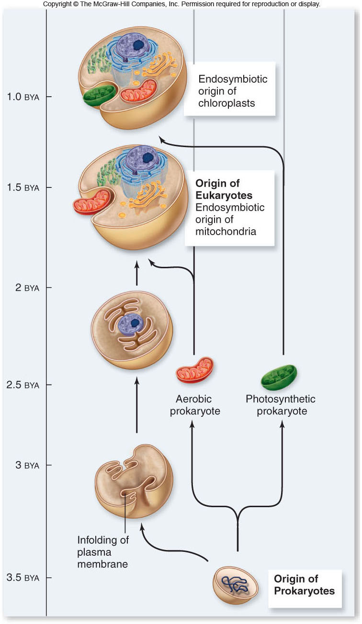
Mitochondria & Chloroplasts

Slide 41
Cytoskeleton
Cytoskeleton
-network of protein fibers found in all eukaryotic cells
-supports the shape of the cell
-keeps organelles in fixed locations
-helps move materials within the cell

Slide 42
Cytoskeleton
Cytoskeleton fibers include
-actin filaments – responsible for cellular contractions, crawling, “pinching”
-microtubules – provide organization to the cell and move materials within the cell
-intermediate filaments – provide structural stability

Slide 43
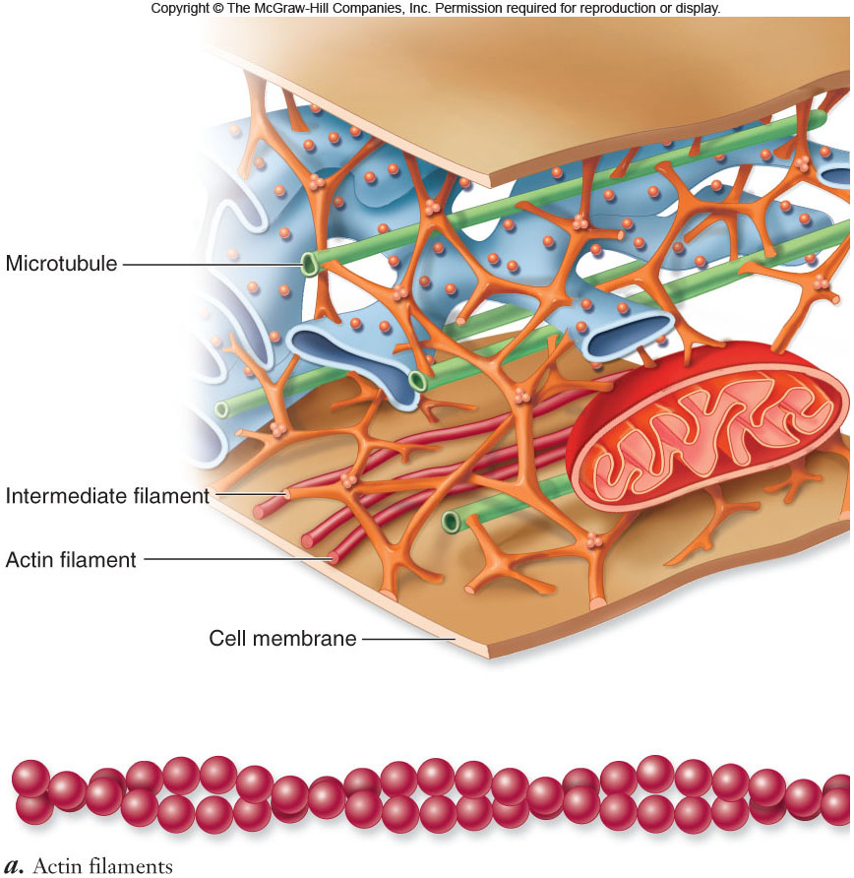
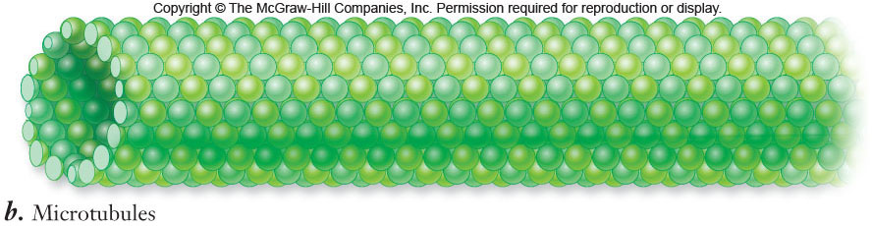
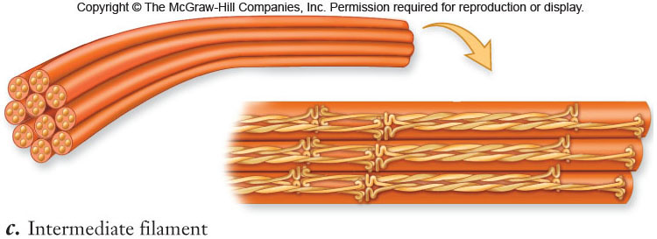
Cytoskeleton

Slide 44
Cell Movement
Cell movement takes different forms.
-Crawling is accomplished via actin filaments and the protein myosin.
-Flagella undulate to move a cell.
-Cilia can be arranged in rows on the surface of a eukaryotic cell to propel a cell forward.

Slide 45
Cell Movement
The cilia and flagella of eukaryotic cells have a similar structure:
-9+2 structure: 9 pairs of microtubules surrounded by a 2 central microtubules
-Cilia are usually more numerous than flagella on a cell.

Slide 46
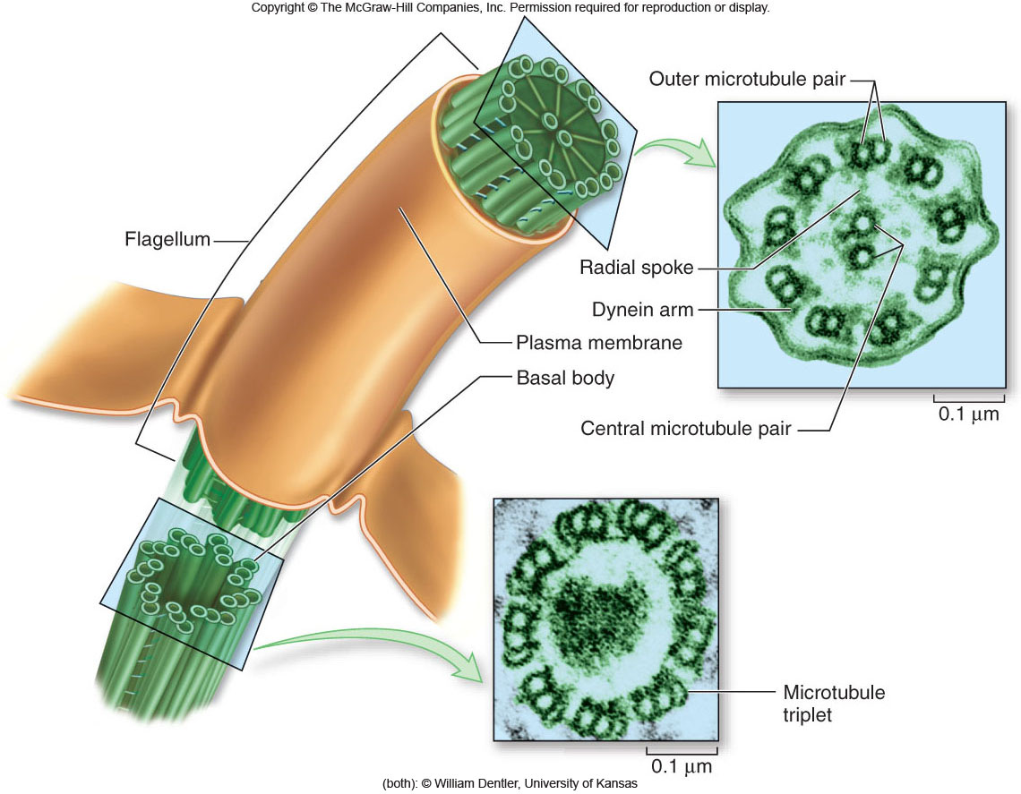
Cell Movement

Slide 47
Extracellular Structures
Extracellular structures include:
-cell walls of plants, fungi, some protists
-extracellular matrix surrounding animal cells

Slide 48
Extracellular Structures
Cell walls
-present surrounding the cells of plants, fungi, and some protists
-the carbohydrates present in the cell wall vary depending on the cell type:
-plant and protist cell walls - cellulose
-fungal cell walls - chitin

Slide 49
Extracellular Structures
Extracellular matrix (ECM)
-surrounds animal cells
-composed of glycoproteins and fibrous proteins such as collagen
-may be connected to the cytoplasm via integrin proteins present in the plasma membrane

Slide 50
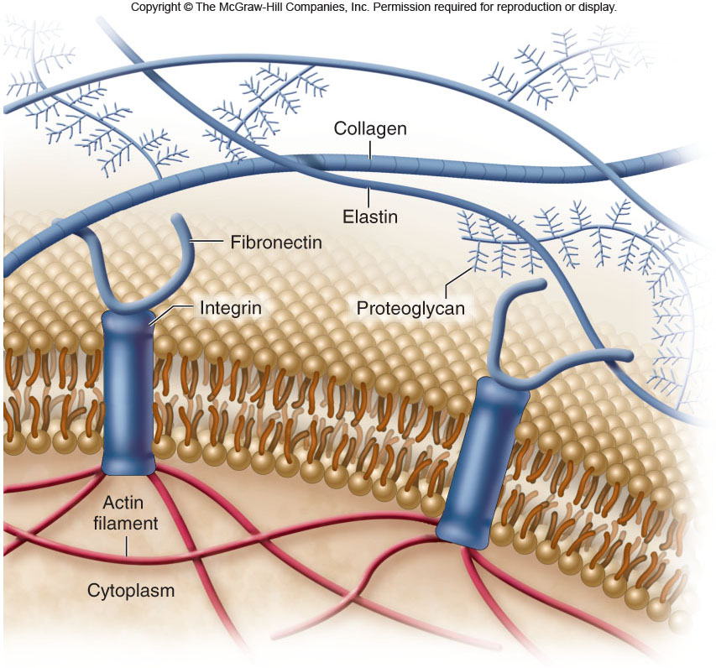
Extracellular Structures

Slide 51
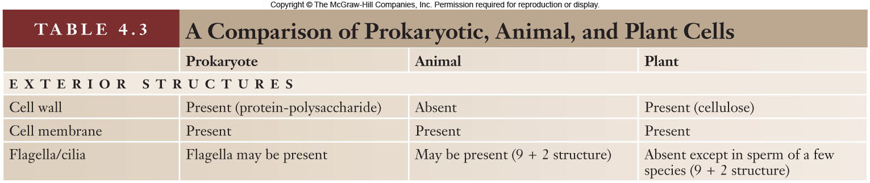

Slide 52
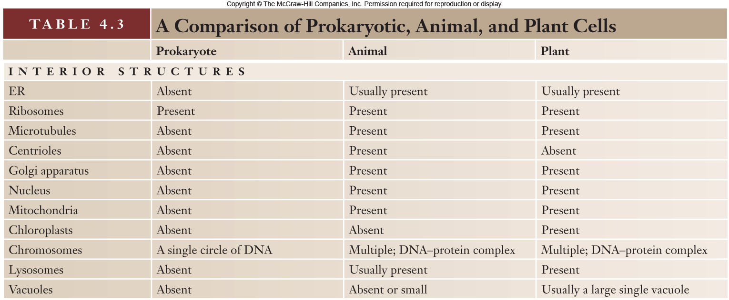

Slide 53
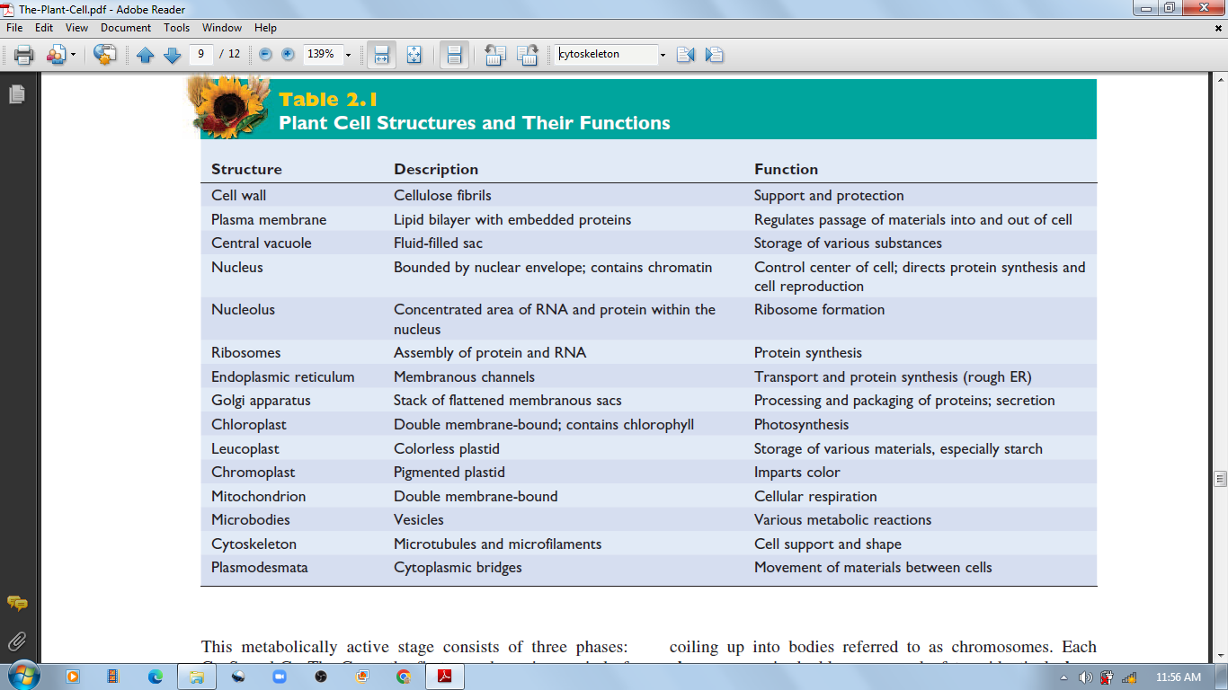
The Plant Cell and their function

