Slide 1

WOOD
Wood is the secondary xylem of seed-plants.
A tree trunk is composed of the following basic parts, listed in order beginning with the outer layer:
- The bark is dead tissue; and its function is to protect the tree from weather, insects, disease, fire, and injury.
- The phloem is a thin layer comprised of living cells, and its basic function is to transport food around the tree.
- The cambium is living tissue. This very thin layer of a tree produces both new phloem on one side and new xylem on the other.
- The largest part of a trunk is the xylem, which is composed of both sapwood and heartwood.

Slide 2



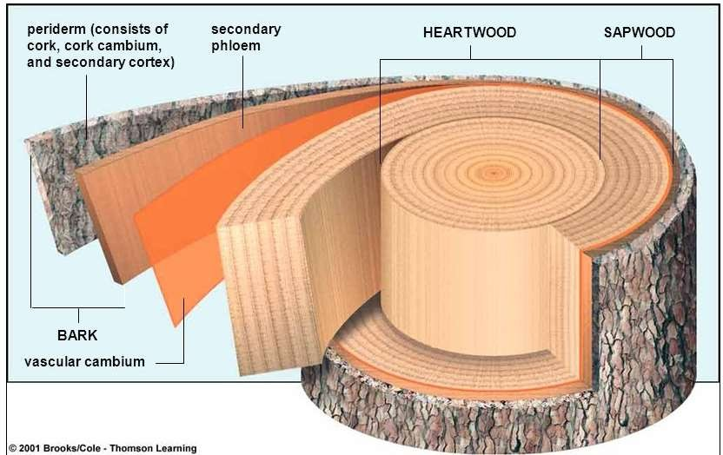

Slide 3

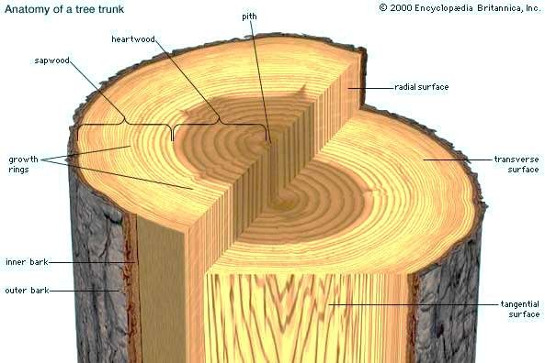
SAPWOOD
Also referred to as “Alburnum”
It is the living, outermost portion of a woody stem, branch or root of a plant where sap flows
It is usually light in color
Cells contain more water and lack darkly staining chemical substances commonly found in heartwood
Sapwood performs two functions:
  Adding support to the tree
  Transportation of nutrients and xylem sap.

Slide 4
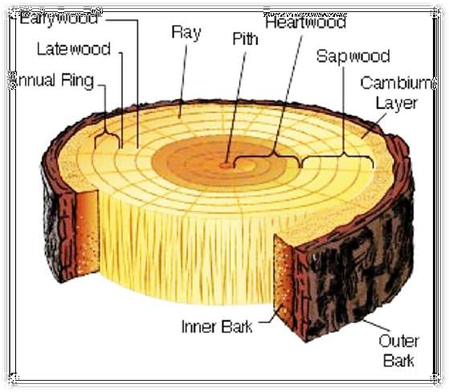
HEARTWOOD
Also referred to as “Duramen”
Heartwood is the dead, inner wood of a stem, branch or root of a plant.
Cell contain substances that make it dark in colour. Eg: Tannins, resin, gums etc
It is mechanically strong, resistant to decay
  The main function of heartwood is to support the tree

Slide 5
DIFFERENCE BETWEEN SAPWOOD AND HEARTWOOD
Sapwood
1. It is outer wood of an old stem.
2. It is light coloured.
3. Living cells are present.
4. Sapwood is the functional part of the secondary xylem or wood.
5. The tracheary elements are not plugged by tyloses.
6. Tracheary elements do not possess any deposition in their lumen.
7. Sapwood or alburnum is lighter.
8. It is less durable because it is susceptible to attack by pathogens and insects.
Heartwood
1. It is the central wood of an old stem.
2. Heartwood is dark coloured.
3. Living cells are absent.
4. Heartwood is the non-functional part of secondary xylem.
5. The tracheary elements are plugged by tyloses.
6. Tracheary elements have deposition of tannins, resins, gums, etc.
7. Heartwood is heavier.
8. It is more durable due to its little susceptibility to the attack of pathogens and insects

Slide 6
POROUS AND NONPOROUS WOOD
These two types of wood are recognised on basis of presence and absence of pores of commerce i.e. vessels.
The wood in which vessels are not found is called non porous wood such as that of gymnosperms. The non-porous wood is technically called soft wood.
Whereas in dicotyledonous or angiospermic wood which has vessels in xylem is known as porous wood. the porous wood is called hard wood.
Soft wood or hard wood terms are not at all related with softness or hardness of timber, e.g. hard wood of Bombax ceiba is very soft and soft wood of Pinus and Cedrus is very hard.
The structure and composition of porous wood is more complex than non porous wood. In transverse section, the pores (or vessels) may appear circular or oval outline.

Slide 7
RING AND DIFFUSE POROUS WOOD
Several woods of commercial value are identified on basis of arrangement of pores. On basis of distribution of pores the woods can be classified into ring porous and diffuse porous.
Ring Porous Wood
In the ring porous wood, pores of early wood are larger than those of late wood and therefore, these appear distinctly arranged in the form of a conspicuous ring, such as in most temperate angiospermic trees. Ring porous wood is characteristic of Lagerstroemia, Morus, Tectona, Toona etc.
Diffuse Porous Wood:
In diffuse porous wood, the pores are more or less uniformly distributed throughout the ring because there is no appreciable difference between early and late woods. Such as, in most tropical angiospermic trees. Most of the Indian hard woods come under category. Diffuse porous wood is characteristic of Artocarpus, Acacia, Michelia, Adina, Terminalia, Mangifera, Shorea, Bombax, Dalbergia etc.

Slide 8
Characteristic features of Ring Porous Wood
The vessels are of different diameter in it.
The vessels are not uniformly distributed throughout the wood.
Vessels with wide and smaller diameter are formed in the early and the later part of the growth season respectively.
Vessels with wide diameter of early wood and vessels of smaller diameter of late, summer or autumn wood are distinguishable.
The development of vessel is sudden and rapid.
The vessels are longer in length than those of diffuse porous wood.
The rate of transport of water in plant with ring porous wood is ten times faster than those with diffuse porous wood.

Slide 9
Characteristic features of Diffuse Porous Wood
The vessels are more or less equal in diameter in it.
The vessels are uniformly distributed throughout the wood.
Vessels with more or less equal diameter are formed throughout the growth ring.
Vessels of early wood and late wood are indistinguishable.
The development of vessel is slow.
The vessels are shorter in length than those of ring porous wood.
The rate of transport of water in plants with diffuse porous wood is slower than those with ring porous wood.

Slide 10
EARLY AND LATE WOOD
The activity of fascicular cambium is affected by environmental fluctuations.
Such fluctuations are pronounced in temperate regions in a span of year where spring and autumn are extreme seasons and well marked.
During these seasons, the cambium shows marked variation in the activity, and as such there is annual alteration of growing and quiescent (very slow grow) periods.
The cambium remains inactive in winter but most active in the spring season.

Slide 11
EARLY AND LATE WOOD
The secondary wood formed during spring season is profuse and consists of large vessels with wider lumen. This part of the wood is called spring wood or early wood.
In summer or autumn, the activity of cambium is highly reduced, therefore, the secondary wood formed is not profuse and consist mainly the fibres and narrow vessels. This part of the wood is called summer wood or autumn wood or late wood.
In a transverse section of stem, early and late woods appear in the form of distinct concentric rings which are commonly called annual rings. Hence, an annual ring consists of two parts, the spring ring and the autumn ring which are formed in a span of one year.
The successive annual rings are formed year after year and likewise, these can be used in determining the age of a tree. Determination of age of a tree by counting the annual rings is called dendrochronology.

Slide 12
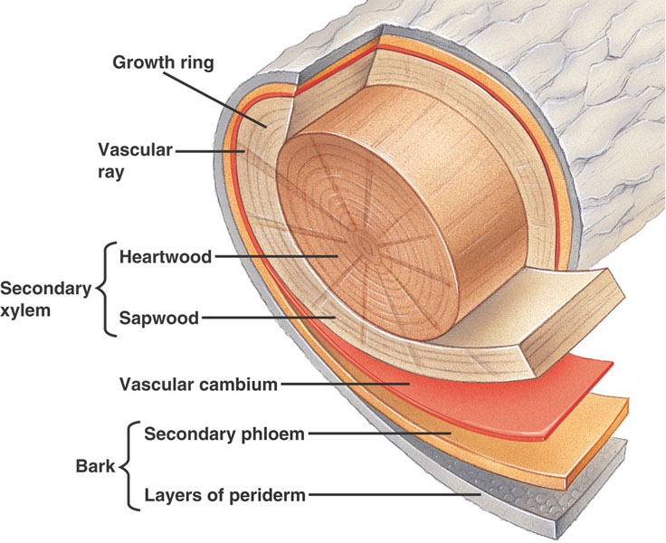
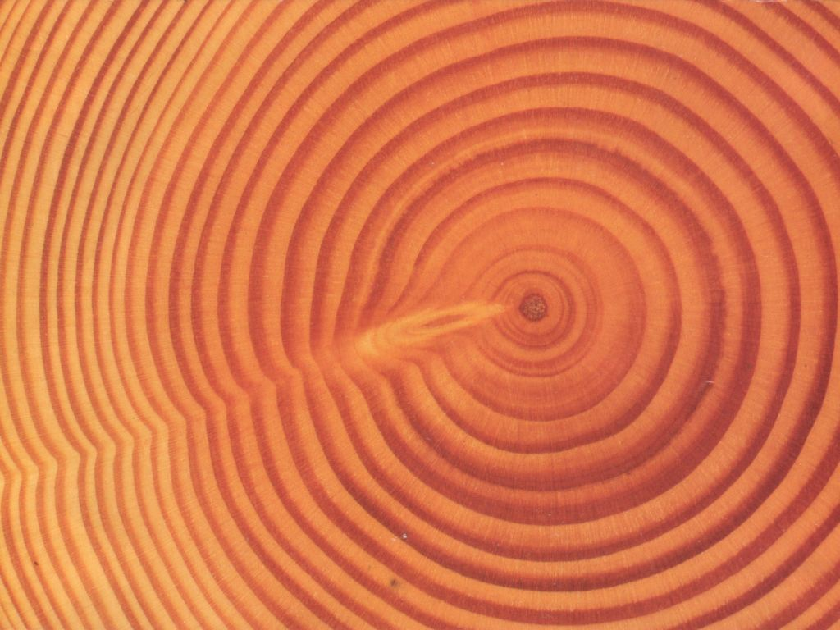

Slide 13
EARLY AND LATE WOOD
The variation in structure of spring and autumn wood is according to the requirements of the plant during these periods.
In spring season, the vegetative activity is at peak and there is an increase in transpiring surface. So there is a great demand of rapid conduction of water and mineral salts and to meet it the cambium actively divides to form additional water channels with broader vessels.
On the contrary, during autumn season, there is a leaf fall and less vegetative growth. There is no need of having well developed system of water conduction.
Therefore, the activity of cambium is highly reduced and as a result, the autumn wood has relatively narrow vessels.

Slide 14
EARLY AND LATE WOOD
The seasonal activity of the cambium may be disturbed by the influence of external climatic conditions like drought, defoliation, and disease.
As a result normal development of secondary vascular tissues is checked and two or more rings are formed in a year.
These are called multiple annual rings or false annual rings.
In tropical regions, the climate is normally uniform and is generally wet so the number of growing rings formed does not correlate with age of the tree.
Such growth rings are called growth marks. Sometimes, two rings may be produced in a year in tropical trees.

Slide 15
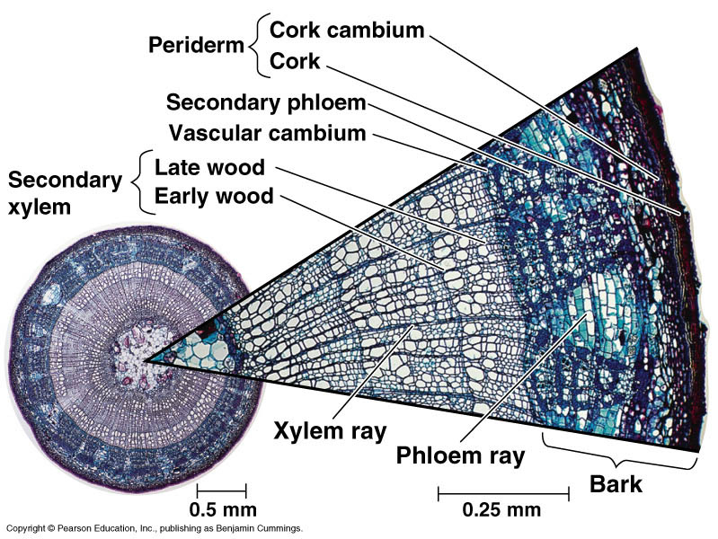
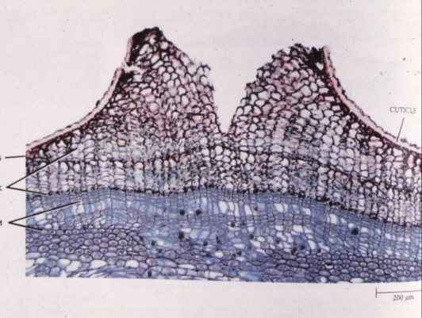
Cork Cambium – the Periderm
A second sheath of meristem develops in the secondary phloem, outside the vascular cambium, called the cork cambium. It produces the periderm, which replaces the epidermis in secondary growth.
Cork cells – main component of the periderm, produced by the cork cambium to the outside. They are lined with suberin and dead at maturity. Impermeable to water (and gases).
Lenticels – openings in the cork layer to allow the living cells of the stem to respire

Slide 16


Secondary growth maintain the two basic functions of vascular tissue:
Conduction and Support
There are basically two types of dermal tissue in vascular plants:
Epidermis and Periderms
Epidermis and cortex form during primary growth
They are replaced by the periderm in plants that have secondary growth
Periderm is produce by the cork cambium
It consist of; cork, phelloderm, and cork cambium cells

Slide 17
Unlike the vascular cambium, Cork cambium (Phellogen) does not grow in diameter.
Every year, or sometimes less frequently, a new cork cambium forms inside the old one, creating another layer of periderm inside the old periderm
In a stem, the first cork cambium arises from parenchyma cells in the outermost layers of the cortex.
Cork (Phellem) forms to the outside of the cork cambium (Phellogen). It consists of dead cells when mature.
Phelloderm is a thinner layer of living parenchyma cells that forms to the inside of each of the many cork cambia.

Slide 18
Each new cork cambium arise from cortex tissue to the inside until eventually the cortex is used up in this manner
As the diameter of the stem expands due to the action of the vascular cambium, the cortex expands.
Since no cell division occurs in the cortex, the expansion eventually causes the cortex to break apart and fall off the stem
Subsequent cork cambia then arise from the secondary phloem to the inside

Slide 19
In roots, the initial cork cambium forms after changes in the endodermis and pericycle
Endodermis is no longer needed since water and minerals are no longer absorbed
Pericycle no longer give rise to branch roots but instead widens as it is pushed towards the outside
From the outer layers of this enlarged pericycle emerges the first cork cambium, which forms a layer of periderm.
The outermost layers of the root – endodermis, cortex and epidermis – become stretched and eventually rupture and peel off
leaving the periderm as the outer covering

Slide 20






BARK
Bark is the part of a stem or root surrounding the wood.
Bark has two distinct regions:
Inner bark consist of living secondary phloem, dead phloem b/t the vascular cambium and the innermost cork cambium, and remaining cortex.
Outer bark consists of dead tissue – including dead secondary phloem and all the layers of periderm outside of the cork cambium

Slide 21
BARK
As the periderm layer builds up in the outer bark, the outermost layers gradually crack and peel off
Bark is typically much thinner than the woody portion of a stem or root.
The rough texture of the bark is due to the splitting of older layers of periderm
Outer bark dead tissues provides protection whiles the inner bark secondary phloem helps to transport sugar and organic molecules

Slide 22

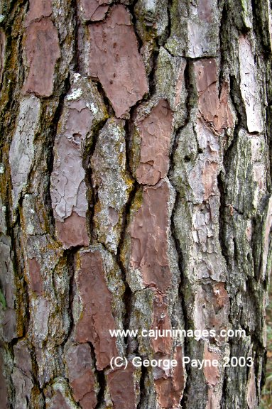
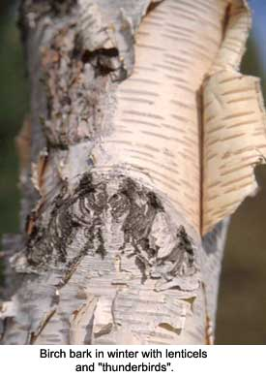
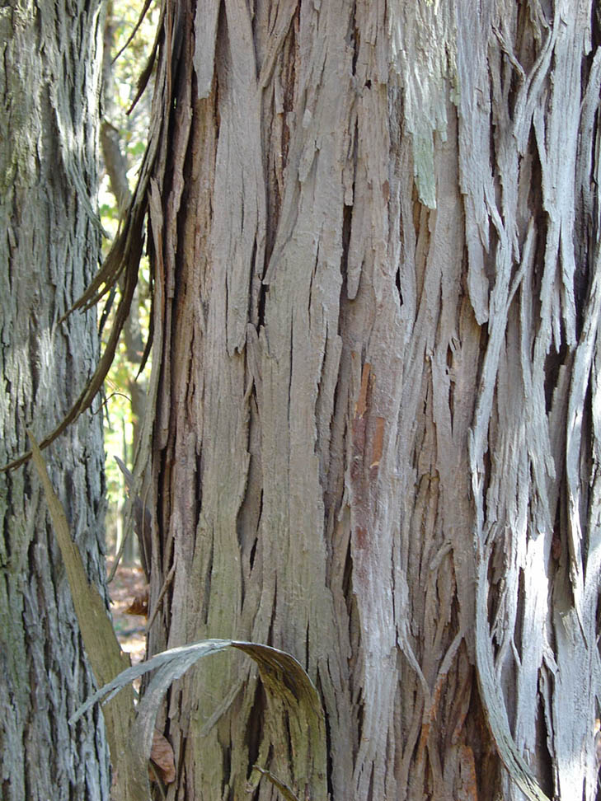
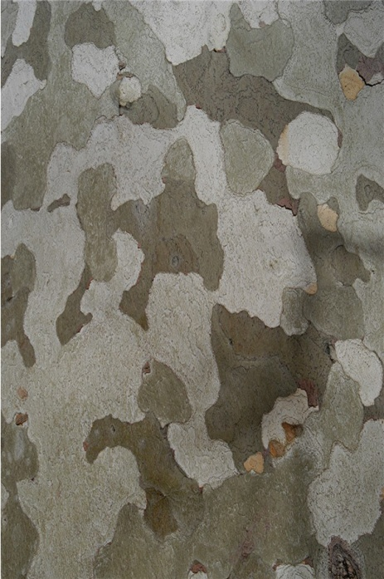
Bark – all tissue outside the vascular cambium
-can be removed without killing the tree
As the tree expands, this tissue is stretched and eventually split and sloughed off. Structure of periderm determines the pattern.

Slide 23
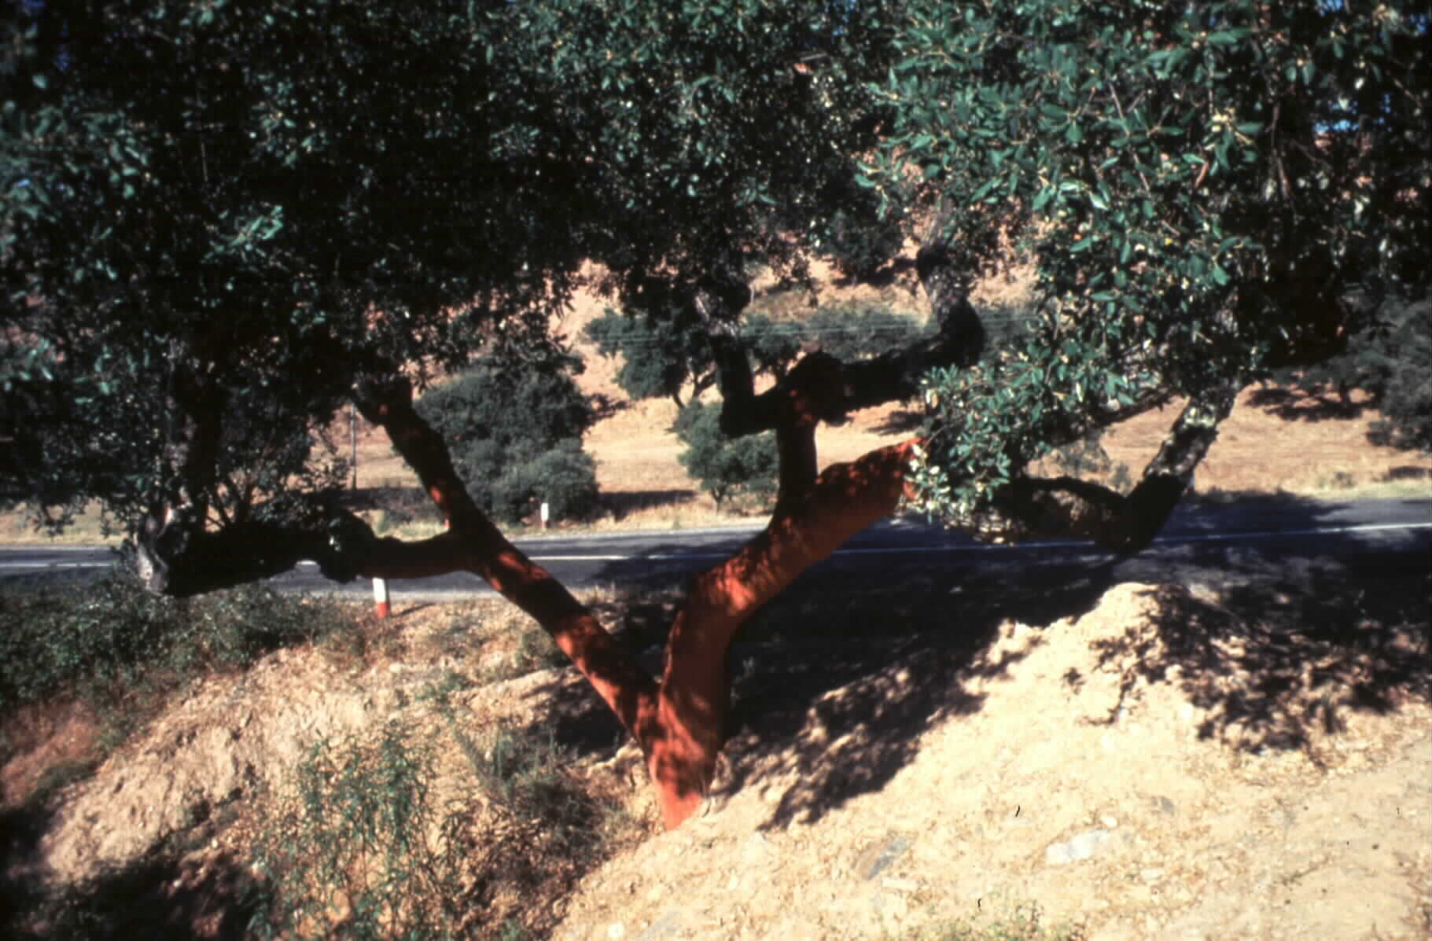
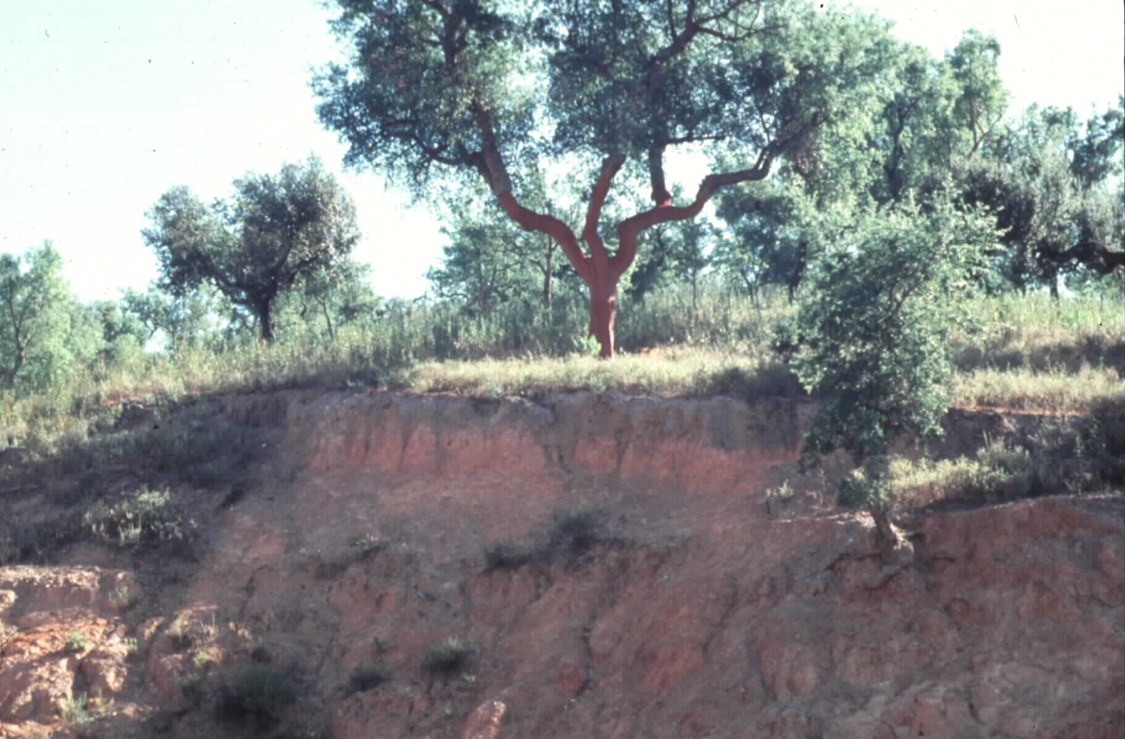
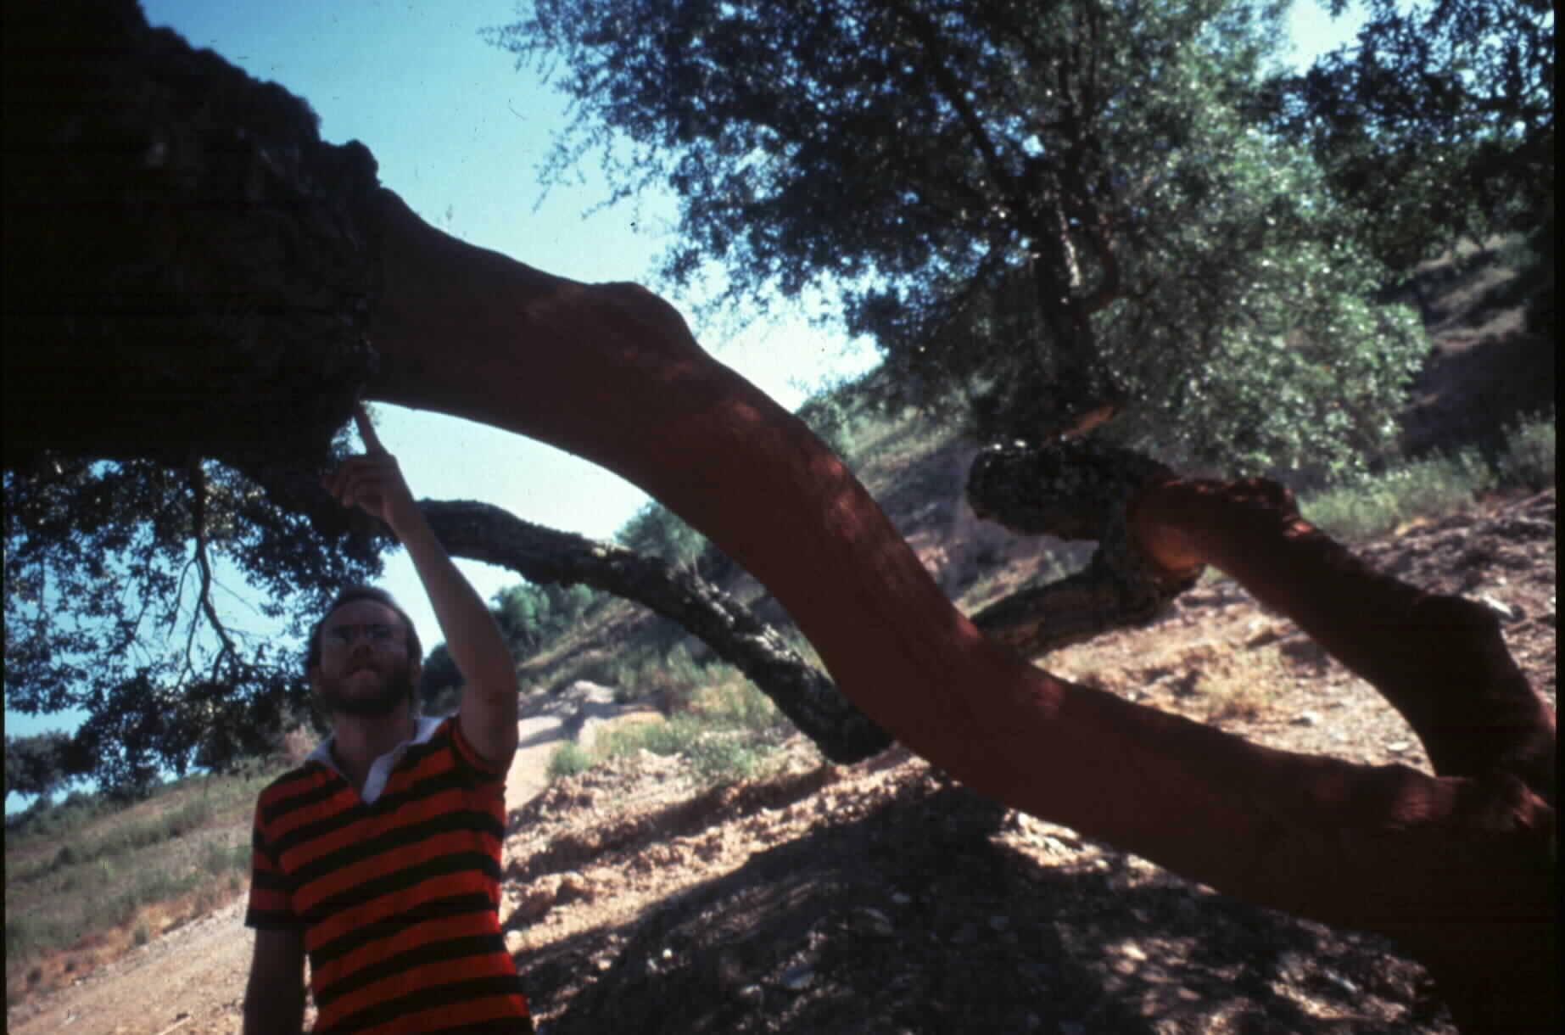
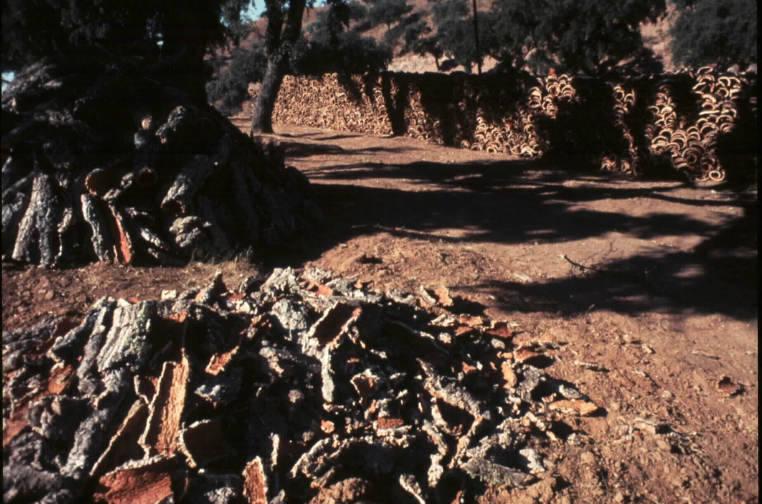
Cork oaks in Portugal – a renewable resource

Slide 24
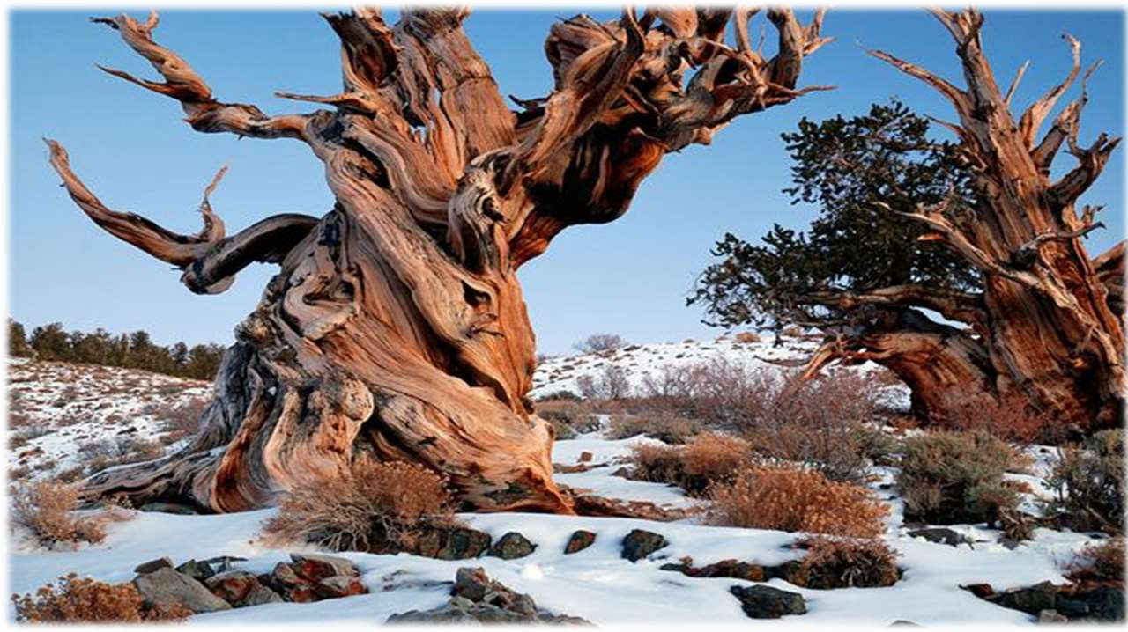
Bristlecone pines

