Slide 1
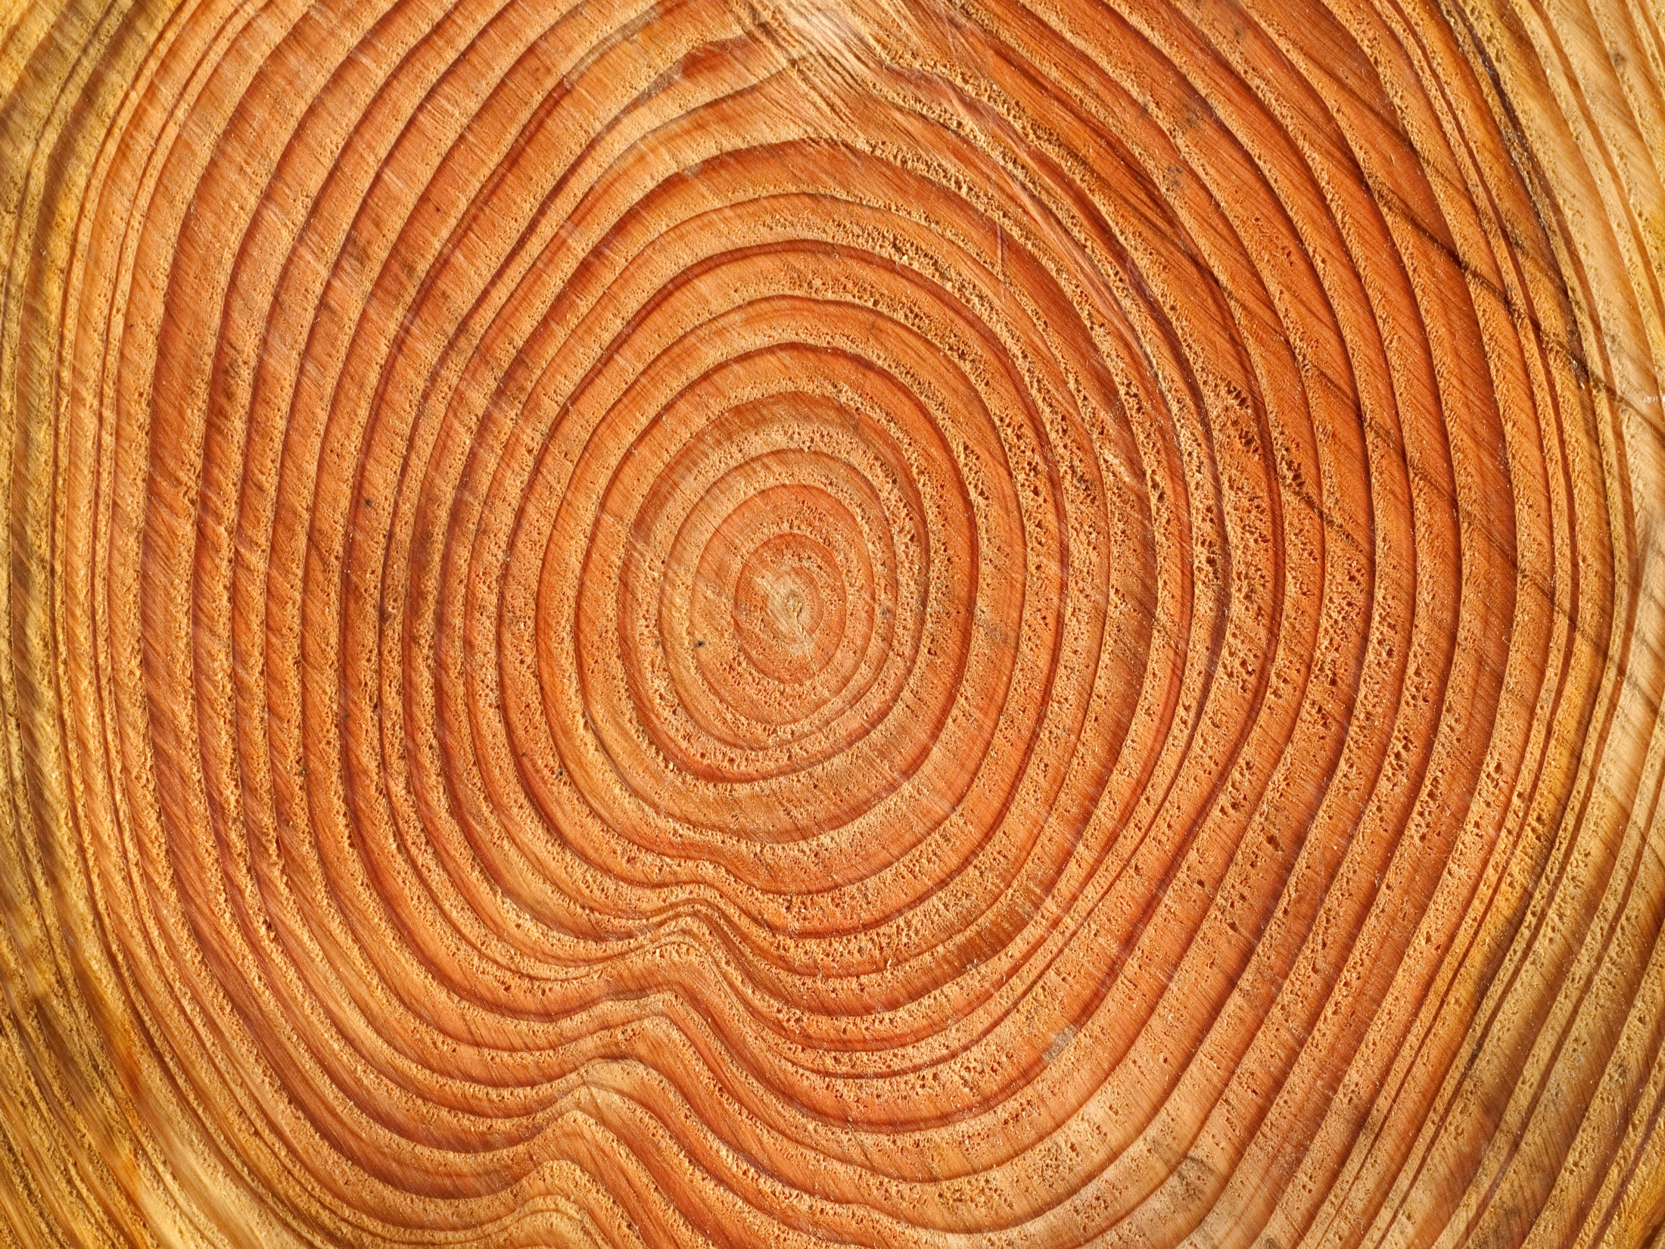

VASCULAR CAMBIUM & SEASONAL ACTIVITY & ITS ROLE IN STEM & ROOT

Slide 2
Vascular Cambium
The vascular cambium is a lateral meristem that develops either as longitudinal strands or as a hollow cylinder.
In the woody dicotyledons and gymnosperms the primary vascular tissues of the stem and root exist for only a relatively short period, and their function is taken over by the secondary vascular tissues which are produced by the cambium.
In many herbaceous angiosperms, and also in most of the lower vascular plants, cambium is absent or vestigial.

Slide 3
Secondary growth occurs in all gymnosperms, many dicots and just a few monocots.
Secondary growth of the plant body allows for the plant to increase in size radially and is brought about by the lateral meristems.
There are two lateral meristems: the vascular cambium gives rise to secondary phloem and secondary xylem, whereas the Phellogen gives rise to periderm.

Slide 4
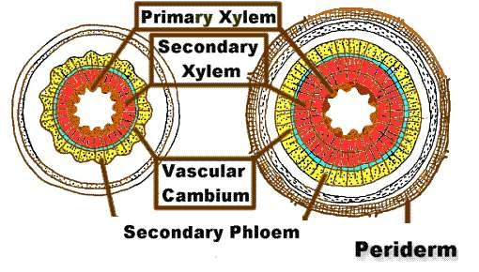
VASCULAR CAMBIUM
The vascular cambium (pl. cambia or cambiums) is a lateral meristem in the vascular tissue of plants.
The vascular cambium is a cylindrical layer of cambium that runs through the stem of a plant that undergoes secondary growth.

Slide 5
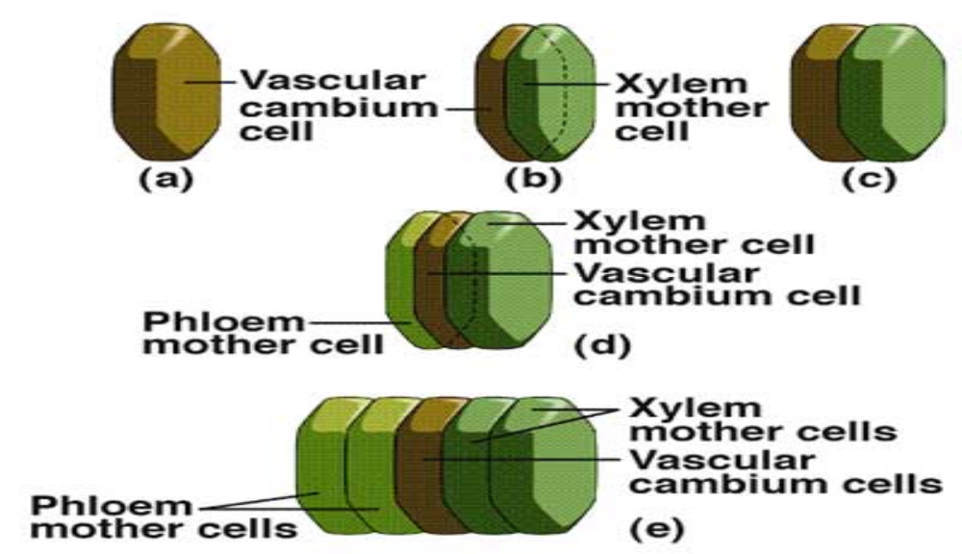
The vascular cambium is unlike the primary meristems of the plant (root and shoot apex) in that it produces new cells and tissues which add to the axial system (i.e. the conducting system) as well as to the radial system (i.e. the lateral transport pathway), whereas the apical meristems of the shoot and root add only to the axial system.

Slide 6
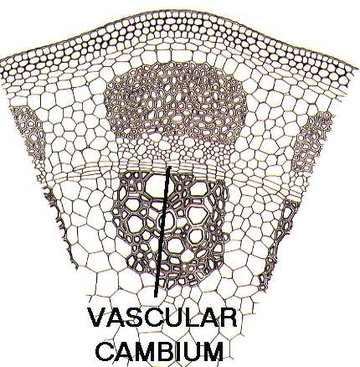
VASCULAR CAMBIUM

Slide 7
LOCATION OF VASCULAR CAMBIUM
In Dicots:
The vascular cambium in dicot stems and roots is located between the xylem and the phloem in the stem and root of a vascular plant, and is the source of both the secondary xylem growth inwards, towards the pith) and the secondary phloem growth (outwards).

Slide 8
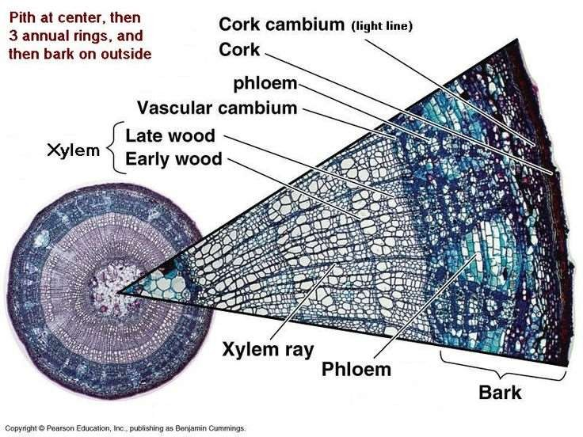

Slide 9
In Monocots:
Monocot
bamboos,
stems, such as
do not
corn, palms and
vascular
have a
cambium and do not exhibit secondary growth by the production of concentric annual rings. They cannot increase in girth by adding lateral layers of cells as in conifers and woody dicots.

Slide 10
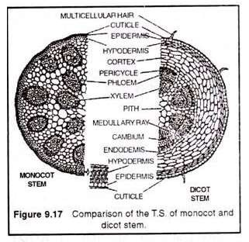

Slide 11
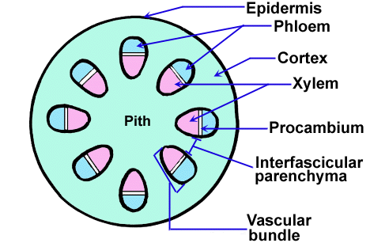
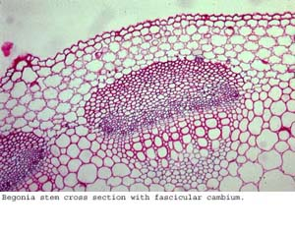
GENERAL DEVELOPMENT AND STRUCTURE OF THE VASCULAR CAMBIUM
In certain plants, including monocotyledons, all the cells of the procambium undergo differentiation into primary vascular tissues. In almost all the dicotyledons, and gymnosperms a portion of the procambium remains meristematic even after the completion of primary growth and develops into the cambium of the secondary body. The cambium that arises within the bundles of primary vascular tissue of the stem is called fascicular cambium

Slide 12
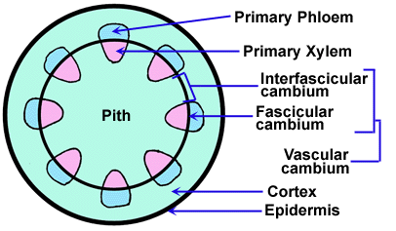
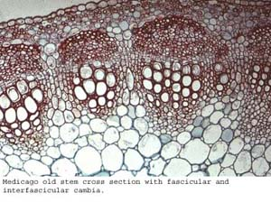
The strip of fascicular cambium usually become joined by additional strips of cambium which constitute the interfascicular cambium. The interfascicular cambium is not a continuation of the pro­cambium but develops from the interfascicular parenchyma. Therefore this part of the cambium constitutes a secondary meristem also from the point of view of its origin.

Slide 13
Thus a complete hollow cylinder of cambium is developed which is present throughout the length of the-main plant axis and to which narrower cylinders of cambium, belonging to the stem and root branches, are connected. Sometimes the cambium extends into the leaves.
In most dicotyledons and gymnosperms the cambial cylinder develops between the primary xylem and phloem, a position that is retained throughout the life of the plant. From this position the cambium produces the secondary xylem centripetally and the secondary phloem centrifugally.
In certain dicotyledonous plants, e.g. Chenopodiaceae, the secondary thickening of the axis is anomalous and it is brought about in a manner that differs from that described above.

Slide 14
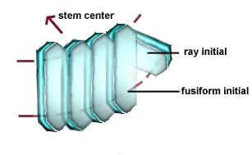
TYPES OF CELLS
Vascular cambium between the
is a
very thin layer that lies
primary xylem inside and primary
phloem on outside. They contain meristematic cells that can form the secondary xylem inside and secondary phloem outside. There are two kinds of meristematic cells called fusiform initials which are vertically elongated and ray initials which are horizontally elongated.

Slide 15
The cambium usually consists of two types of cells.
Fusiform initials which are elongated cells with tapered ends. These cells are very long and in old trunks of Sequoia sempervirens, for example, they reach a maximum length of 8.7 mm .
Ray initials which are much smaller cells than those of the above type and which are almost isodiametric.

Slide 16
Fusiform initials, which are elongated but broadly flattened on the tangential face, and ray initials, which are shorter cells, somewhat elongated on their radial axis.
Fusiform initials produce axial elements of secondary vascular tissues, such as fibers, tracheids, vessel members, companion cells, sieve-tube elements and axial parenchyma

Slide 17
Growth Pattern in Wood and Bark
The continue source of wood in a tree is due to the presence of vascular cambium
Vascular cambium produce the secondary phloem that conducts food within the inner bark
Two types of meristematic cells form the vascular cambium:
- Fusiform and Ray initials.
These initials undergo periclinal and anticlinal cell division.
Periclinal cell divisions add to the length of a stem or root
Anticlinal cell divisions increase the diameter of the vascular cambium

Slide 18
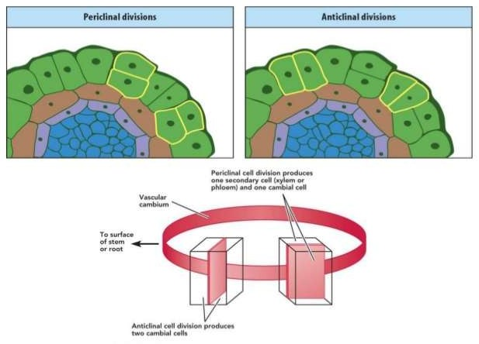

Slide 19

From Latin fusus, “spindle”
Elongated spindle shape cells arranged in vertical row
Arise within the vascular bundles and produce new vascular tissue
Xylem inside and phloem outside
Fusiform initial divides so that one daughter cell becomes either xylem or phloem
A fusiform initial can also divide to produce two fusiform initials that remain within the vascular cambium
Fusiform initials and conducting cells are aligned lengthwise - parallel to the surface of the stem or root.

Slide 20
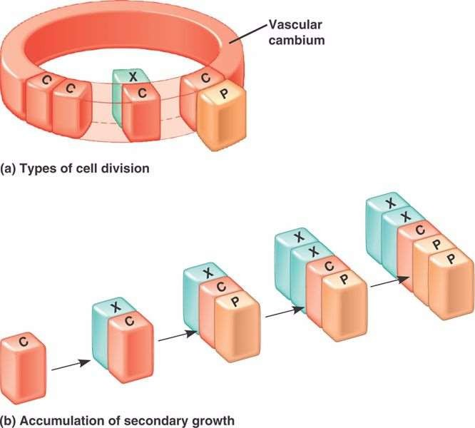

Slide 21
Cell divisions of the fusiform initials typically produce more xylem than phloem
Growth of the xylem is visible each year as a ring
the ring formation is due to the different size of the new cells every season
Xylem ring accumulate year after year, but the innermost rings no longer conduct water and minerals.

Slide 22


Horizontal arranged cells in the vascular cambium
Helps in producing phloem rays and xylem rays
Ray initials arise b/t the vascular bundles and are often cubical cells
They produce cubical parenchyma cells
These cells serve mainly for storage and also sideways transport
Ray initials division leads to the formation of daughter cells and parenchyma cells
Rays are common in dicots, where they are often more than one cell wide

Slide 23
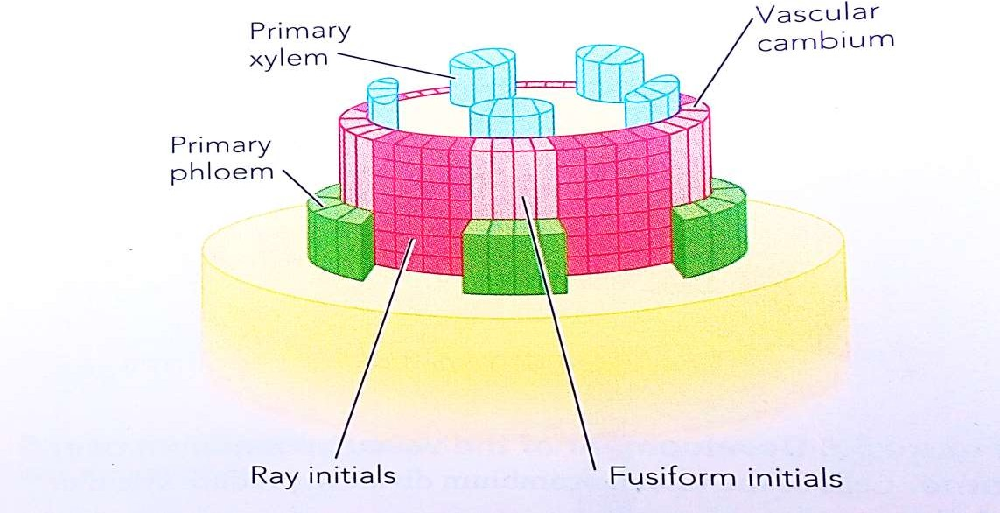

Slide 24
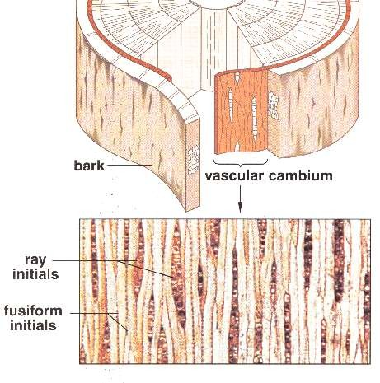
FUSIFORM INITIALS & RAY INITIALS

Slide 25
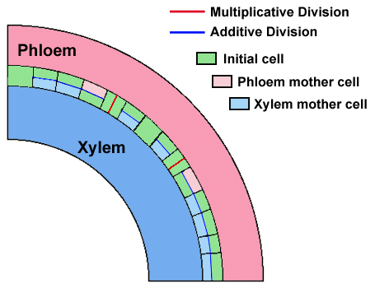
Divisions in Vascular Cambium
If we look closely at the cells of the vascular cambium we see two patterns of division. Initial cells can undergo multiplicative divisions (red line in the following diagram) or they can undergo additive divisions (blue line).

Slide 26
Multiplicative divisions produce more initial cells and result in the increased circumference of the vascular cambium.
Of the two cells produced from an additive division one is retained as an initial cell that will divide again, and the other will become a phloem mother cell or a xylem mother cell. These mother cells will differentiate into their respective cell types.

Slide 27
SEASONAL ACTIVITY OF CAMBIUM
Cambium of some plants remains active for the entire period of their life, i.e., cambial cells divide and resulting cells mature to form xylem and phloem elements.
This type of seasonal activity usually found in the plants present in the tropical regions, and not all plants show cambial activity.
Percentage of ringless trees in the rain forests of; India - 75%, Amazon - 43% and Malaysia -15%.
In the tropical rain forest, relatively few species of trees, such as teak, have visible annual rings. The difference between wet and dry seasons for most trees is too subtle to make noticeable differences in the cell size and density between wet and dry seasonal growth.

Slide 28
In regions with definite seasonal climate; seasonal activity of cambium ceased with onset of unfavorable conditions; In Autumn, it enters the dormant state and lasts for the end of summer; In Spring, cambium again becomes active.
Duration of cambial activity is also affected by day- length, e.g., In Robinia pseudoacacia, cambium is dormant under short-day condition.

Slide 29
SECONDARY GROWTH IN STEM
The cambium cells formed in circular section from the beginning onwards.
The cambial ring is partially primary
in cross
(fascicular
cambium) and partially secondary (interfascicular cambium).
Periderm originates from the cortical cells (extra stelar in origin).
In Dicot stem, for mechanical support xylem is with comparatively smaller vessels, greater fibers and less parenchyma.
More amount of cork is produces for protection.
Lenticels on periderm are very prominent.

Slide 30
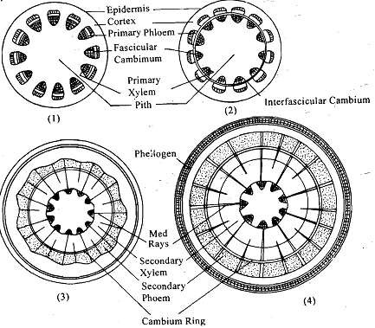

Slide 31
SECONDARY GROWTH IN ROOT
The cambial ring formed is wavy in the beginning and later becomes circular.
The cambium ring is completely secondary in origin.
Periderm originates from the pericycle (intra stelar in origin).
In Dicot root, xylem is with big thin walled vessels with few fibers and more parenchyma.
Less amount of cork is produced as root is underground.
Lenticels on periderm are not very prominent.

Slide 32
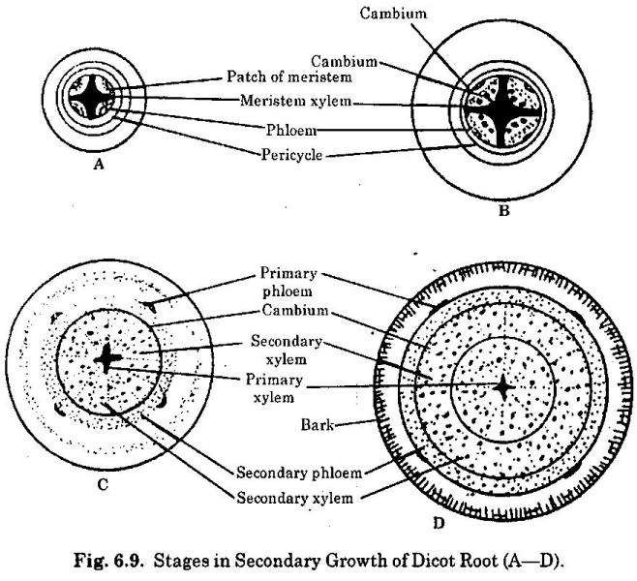

Slide 33
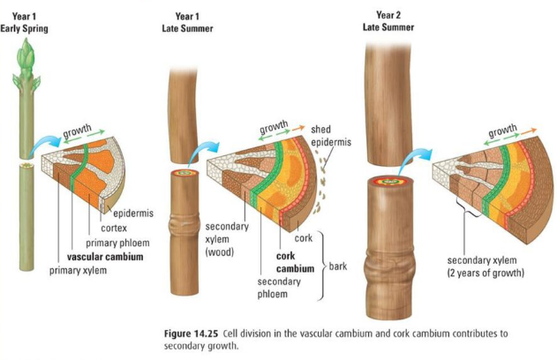

Slide 34
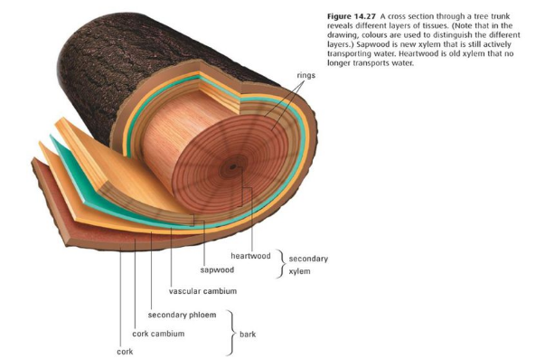

Slide 35


