Slide 1
METABOLISM

Slide 2
The entire spectrum of chemical reactions occurring in the living system is collectively referred to as metabolism.
Metabolism is the total amount of the biochemical reactions involved in maintaining the living conditions of the cells in an organism.
Metabolism encompasses the various biochemical processes, reactions, and conversions that transform one form of energy to another.
All living organisms require energy for different essential processes and for producing new organic substances.
Any molecule that is synthesized or utilized in metabolism is a physically-recognizable form of energy.

Slide 3
In Biology, the definition of metabolism goes by “life-sustaining chemical reactions involving biologically-active chemical compounds and molecules”.
Therefore, metabolism is the biological way to conserve energy in some or the other form when different types of organisms produce or metabolize biologically-active chemical molecules.
The entire process of nutrition has two main parts- ingestion of food and utilization of food for energy. In every living organism, let it be a simple prokaryotic bacterial cell or a eukaryotic cell, the process of nutrition is the same.
The food which we eat happens to be useless until and unless it undergoes metabolic changes.
During metabolism, biomolecules present in the food get utilized to extract the energy from the cell. In addition, conversion and formation of the biomolecules take place. In other words, the transformation of one compound results in the formation of another molecule. For example, the proteins we obtained from the food are metabolized into amino acids, which are later utilized to synthesize another protein required by the cell.

Slide 4
The concept of metabolic reactions concentrates on the utilization of food for energy. Ingested food needs to be utilized for the turnover. The nutrition is the key and energy extraction is the target of metabolism. The dynamic state of body constituents and the concept of metabolism are discussed below in detail.
When we refer to biologically-active molecules, we are actually referring to chemical molecules that have biological activity and play a pivotal role in sustaining essential biological pathways.
There are primarily 4 basic biochemicals: carbohydrates, lipids, nucleic acids, and proteins. Apart from these four, there are two more biochemicals that are generally studied. They are coenzymes and minerals.
All these molecules play some of the most vital roles without which the proper functioning, coordination, and efficiency of biological systems is not possible.
It is therefore important to learn about each of them in more detail and gain some useful insights about their roles and purposes in metabolic activities.

Slide 5
Types of Metabolism
Metabolism is the sum total of all the chemical reactions taking place in the cells of the living organisms. This involves both breaking and making of biomolecules. Catabolism and anabolism are two types of metabolism.
Catabolism (breaking of bonds) is the destructive metabolism involves the breakdown and degradation of complex biomolecules to simpler monomers of biochemicals.
The degradative processes concerned with the breakdown of complex molecules to simpler ones, with a concomitant release of energy constitute catabolism.
The process involves a series of metabolic pathways that are engaged in the conversion of macromolecules into simpler molecules that can be utilized as building blocks for other molecules that are required by cells to function such as glycogen, proteins and other triglycerides.
Few of these molecules are simply broken down into waste by products which may enter an alternate route to obtain usable energy. Some catabolic processes are –Citric acid cycle, Glycolysis, Lipolysis (breakdown of triacylglycerols), Oxidative deamination (amino a converted to keto acid), Muscle tissue breakdown.

Slide 6
Anabolism (making of bonds) is the constructive metabolism involves synthesis and production of complex molecules from simpler monomers of biochemicals.
The biosynthetic reactions involving the formation of complex molecules from simple precursors constitute anabolism. Thus anabolism is the sequence of enzyme catalyzed reactions in which nutrients are used to form comparatively complex molecules in the living cells with moderately simpler structures.
The process of anabolism is also referred to as biosynthesis. The process includes the production of components of cells such as proteins, carbohydrates, lipids which require energy in the form of ATP which are energy rich compounds.
These compounds are synthesized during the breakdown processes such as catabolism. Anabolinc processes in growing cell control catabolic processes.

Slide 7
A clear demarcation between catabolism and anabolism is rather difficult.
Since there are several intermediates common to both the processes. The term amphibolism is also in use for reactions which are both catabolic and anabolic in nature. For eg. Citric acid cycle (Krebs cycle) – it is amphibolic pathway because it functions in both the degradative and biosynthetic processes.
The anabolic and catabolic pathways are not reversible and operate independently.
As such the metabolic pathways occur in specific cellular locations (mitochondria, microsomes, etc.) are controlled by different regulatory signals.
Intermediary metabolism refers to the entire range of catabolic and anabolic reactions, not involving nucleic acid. Energy metabolism deals with the metabolic pathways concerned with the storage and liberation of energy.

Slide 8
All metabolic changes take place in multiple reactions and follow a particular pathway called the metabolic pathway. The metabolic pathway includes a series of reactions.
The metabolite flow, the rate, and direction at which metabolism takes place are called the dynamic state of body constituents. All metabolic reactions are catalyzed by a set of proteinaceous compounds called enzymes.
Hence, metabolism is an enzyme-catalyzed reaction which provides biomolecules, needed by the cells for growth, maintenance, and repair etc.
Thus the purposes of metabolic pathways can be summarized in the below three points:
  To extract energy from the food for cellular activities.
  To convert food to building blocks, to synthesize biomolecules such as carbohydrates, proteins, lipids and nucleic acids.
  To eliminate waste and toxic products.

Slide 9
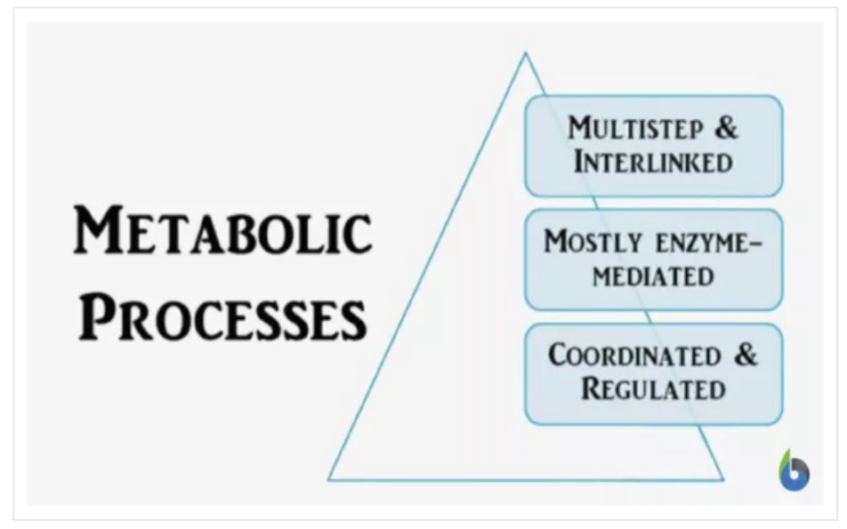
Metabolic processes are tightly-regulated, interlinked processes that aid in molecular conversions from one form to another

Slide 10
Regulation of metabolism
For life to proceed in orderly fashion, the flow of metabolites participating in anabolic and catabolic pathways must be regulated.
Regulation of metabolic processes is achieved in a number of ways. Since all cellular reactions are catalysed by specific enzymes, the rate of metabolic pathway depends on the concentrations (also called levels) and catalytic efficiency of enzymes of that pathway.
Not all the enzymes of any pathway are under regulatory control, nor it is necessary to do so from the cellular economy point of view. An overall regulation is achieved by modulation of the rates of only some reactions which occur at critical points along the pathway, e.g., the first step or a branching point where more than one pathway meet, etc.

Slide 11
As the environments of most organisms are constantly changing, the reactions of metabolism must be finely regulated to maintain a constant set of conditions within cells, a condition called homeostasis.
Metabolic regulation also allows organisms to respond to signals and interact actively with their environments.
Two closely linked concepts are important for understanding how metabolic pathways are controlled.
Firstly, the regulation of an enzyme in a pathway is how its activity is increased and decreased in response to signals.
Secondly, the control exerted by this enzyme is the effect that these changes in its activity have on the overall rate of the pathway (the flux through the pathway).
For example, an enzyme may show large changes in activity (i.e. it is highly regulated) but if these changes have little effect on the flux of a metabolic pathway, then this enzyme is not involved in the control of the pathway.
Flux, or metabolic flux is the rate of turnover of molecules through a metabolic pathway. Flux is regulated by the enzymes involved in a pathway.

Slide 12
There are multiple levels of metabolic regulation - intrinsic and extrinsic regulation
In intrinsic regulation, the metabolic pathway self-regulates to respond to changes in the levels of substrates or products; for example, a decrease in the amount of product can increase the flux (the rate of turnover of molecules) through the pathway to compensate. This type of regulation often involves allosteric regulation of the activities of multiple enzymes in the pathway.
Extrinsic control (regulation) involves a cell in a multicellular organism changing its metabolism in response to signals from other cells. These signals are usually in the form of water-soluble messengers such as hormones and growth factors and are detected by specific receptors on the cell surface. These signals are then transmitted inside the cell by second messenger systems that often involved the phosphorylation of proteins.
Protein phosphorylation is a posttranslational modification (PTM) consisting of the addition of phosphate groups to specific amino acid residues on proteins.

Slide 13
ENZYME
Enzymes are central to metabolism since these are the biocatalysts catalyzing almost all cellular reactions.
These include slow but thermodynamically feasible reactions at ambient cellular conditions, which include biological pH, temperature, as well as the molar concentrations of the reactants and the products.
The metabolic pathways need to be modified in response to the cellular needs. This occurs through regulation of the activity of various enzymes.

Slide 14
General Characteristics of Enzymes
Usually a protein, acting as catalyst in specific biochemical reaction
Every reaction in the cell requires its own specific enzyme
Each cell in the human body contains 1,000s of different enzymes
Most enzymes are globular proteins
A few enzymes are made of RNA
Catalyze biochemical reactions involving nucleic acids
Enzymes undergo all the reactions of proteins
Enzymes denaturation due to pH or temperature change
A person suffering high fever runs the risk of denaturing certain enzymes

Slide 15
Discovery
Discovered in yeast for the first time, the biocatalysts were called “enzyme” by Wilhelm Kuhne in 1878 (Greek en - in; zyme – yeast) i.e. “in yeast”
Earlier Louis Pasteur had called these vital factors present in intact yeast cells as “ferments,” since these were thought to be responsible for carrying out fermentation.
Chemical nature of enzymes was not established till the time Sumner crystallized urease from jack beans and established their proteinaceous nature in 1926.
Earlier enzymes were thought to be small biologically active molecules analogous to hormones. Sumner postulated that all enzymes were proteins.
It was after John Northrop and Moses Kunitz had crystallized trypsin and pepsin in 1930 that Sumner’s conclusions were widely accepted.
Sumner was awarded the Nobel Prize in 1946.

Slide 16
Haldane postulated that the weak bonding between enzyme and substrate might be responsible for the reactions catalyzed by them.
Since then thousands of enzymes have been isolated and characterized.
A new science called “enzymology” developed, which dealt with study of enzymes.
Barring ribozymes (catalytic RNA molecules), all enzymes are proteins. While some of the enzymes consist of proteins only (simple proteins), in others a non-protein part is also part of their structures (conjugated proteins).

Slide 17
Structure and composition of Enzymes
The enzymes which are wholly made up of proteins are called simple enzymes, eg. Urease, amylase, pepsin, trypsin, etc.
Most of the enzymes are made up of two parts – the protein and non protein part. Such enzymes are called conjugated enzymes.
Major part of enzyme is a protein part called apoenzyme.
The protein part is supplemented with non-protein part which is essential for enzymatic activity.
The non protein part, when tightly bound to apoenzyme, is called prosthetic group, but if it is not tightly bound, it is known as coenzyme or cofactor.
The complete enzyme including the prosthetic group and/or coenzyme is often called holoenzyme.

Slide 18
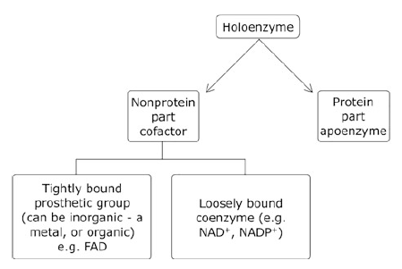
Enzymes consist of non-protein part in addition to the proteinaceous structure

Slide 19
The enzymes consist of following structures
Protein part or Apoenzyme
Protein part of apoenzyme constitute the major portion of an enzyme. Different enzymes possess different sequences of amino acids and variable length of protein molecules.
The specific sequence of amino acids in a protein molecule provides specific nature of enzymes which is important for the biological activity.
The proteins are colloidal in nature and therefore provide a very large surface area per unit volume, which is characteristic of enzymes.
Only a few enzymes are entirely made up of protein. Mostly they are associated with prosthetic group or coenzymes.
Proteolytic enzymes for example, are entirely proteins. They do not possess non protein part.

Slide 20
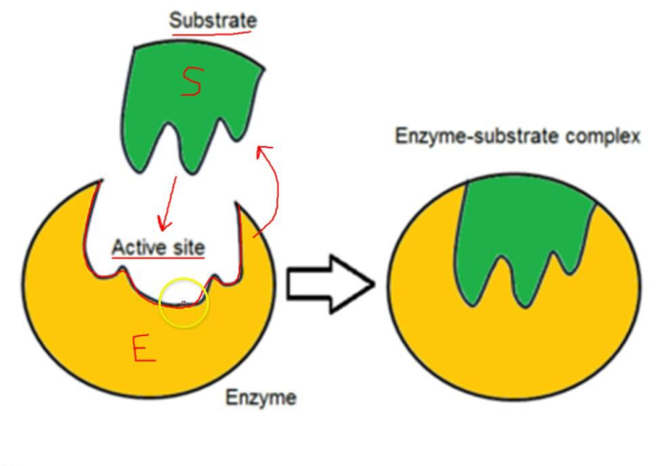
Active site
Experimental finding demonstrate that the enzyme catalyses the reaction by combining with the substrate.
The substrate physically comes in contact with the specific site in the protein molecule. The surface of folded protein possess specific binding site known as active site.
The active site may thus be defined as that particular part of the protein which binds to the substrate to form an enzyme substrate complex.
Some enzymes possess only one active site, while others have several such sites. The substrate binding site is termed as active site, while regulatory substances are bind with the regulatory site.

Slide 21
Prosthetic group
Many enzyme require the presence of an essential non-protein part for efficient performance of their function.
The non protein part which is tightly bound to enzyme is termed as prosthetic group.
The simple prosthetic groups are metalic ions, such as Cu, Zn, Mn, Mo, etc.
Other prosthetic groups are organic compounds which include cytochrome, flavoproteins, pyridoxal phosphate, heme iron or biotin etc.
These groups are associated with the active sites of enzyme molecules and in some cases they undergo a reversible chemical change.

Slide 22
Cofactors and Coenzymes
The non-protein part of these enzyme (conjugated proteins) is called cofactor. The term cofactor is usually employed for inorganic ions such as chloride (Cl-) and magnesium (Mg2+). In case where cofactor is inorganic, such as metals (Mg2+, Zn2+, Fe2+), the enzymes are called as metalloenzymes.
The organic cofactors are called coenzymes.
Cofactors may be loosely bound with the enzyme proteins or may be tightly associated through a covalent bond.
Cofactors, which are tightly associated with the protein part of the enzymes, are called prosthetic group, which may be inorganic or organic in nature
Coenzymes bind loosely to the active site of enzymes

Slide 23
Sometimes both metal and the organic molecules are required as the cofactors for enzyme activity. In case of cytochromes, the prosthetic group heme, along with a metal ion (Fe3+), is bound to enzyme protein through hydrogen bonding, hydrophobic interactions, and the covalent bonding to a specific site of the enzyme protein.
The functionally active enzyme, in case of conjugated proteins, is called holoenzyme, and the protein portion of the enzyme is called apoenzyme.
There is no clear cut distinction between ‘prosthetic group’ and coenzymes. It is conveniently defined that the prosthetic groups are tightly bound to enzymes whereas the coenzymes are loosely attached. Since these substances are intimately concerned with the overall reactions, they are termed as cofactors or coenzymes.

Slide 24
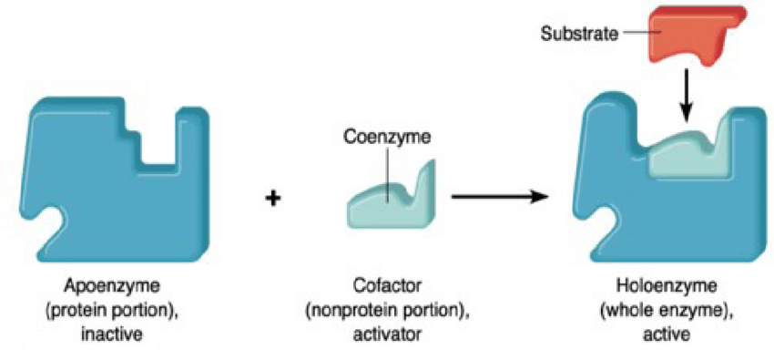

Slide 25
Nomenclature and Classification of Enzymes
After thousands of enzymes had been discovered, different strategies were adopted for nomenclature of enzymes -
By adding suffix “-ase” to the name of the substrate: Substrate is the substance on which the enzyme acts upon. For example, enzymes acting upon proteins were called proteinases, those acting upon lipids were called as “lipases,” and the ones acting on nucleic acid were named as “nucleases.” Specific names were also given to enzymes acting on specific substrates, such as “urease,” “lecithinase,” or “maltase,” for the enzymes acting on urea, lecithine, or maltose, respectively.
Another strategy adopted to name the enzymes was to add suffix “-ase” to the kind of reaction catalyzed by the enzymes, e.g., isomerases (which catalyze isomerization), hydrolases (catalyzing hydrolysis reactions), transaminases (catalyzing transamination), etc.
Both of the above systems of naming the enzymes appeared inadequate since the naming was either based on the type of molecules on which the enzyme acted upon or the type of reaction catalyzed by them. Another system was adopted in which some of the enzymes were named both on the basis of substrate utilized and the reaction catalyzed by them. For example, succinic acid dehydrogenase signifies both the name of the substrate succinic acid as well as the reaction catalyzed by them dehydrogenation.

Slide 26

To maintain uniformity in naming enzymes the International Union of Biochemistry and Molecular Biology (IUBMB) set up an Enzyme Commission (EC) on enzyme nomenclature, which gave its first recommendations in 1961. Some of the recommendations given by EC are as follows:
Each enzyme can have a trivial name, which is short and is easy to use. The systematic name of the enzyme however should be formed according to the definite rules showing the action of the enzyme as much as possible.
It should have two parts: the first name denotes the substrate, the second one with the suffix “-ase” which specifies the reaction catalyzed by them. Additional information, if there is any, is given in parenthesis. For example, malate dehydrogenase which catalyzes the following reaction:

Slide 27
2. All enzymes were classified into six classes depending upon the type of reaction catalyzed by them. Each enzyme is given a classification number. The classification number is known as Enzyme Commission (EC) number assigned by the nomenclature committee of IUBMB.
The classification number has four digits, e.g., if the classification number of an enzyme is a, b, c, and d.
Classification number ‘a’ stands for the number of the class given in the classification number, ‘b’ is the number of subclass, ‘c’ is the number of sub-subclass, while ‘d’ represents the number of sub-sub-subclass which specifies the actual substrate of the enzyme which distinguishes it from other enzymes catalyzing similar reactions.

Slide 28

In the following enzyme-catalyzed reaction:
The trivial name of the enzyme is hexokinase/glucokinase, which is commonly used. The systematic name of the enzyme catalyzing the reaction is ATP: glucose phosphotransferase which indicates that the enzyme catalyzes transfer of phosphoryl group from ATP to glucose.
The classification number (Enzyme Commission number) is E.C 2.7.1.1. The first number 2 signifies class number (transferase); the second number 7 is about the phosphate group transferred; the third number 1 is about the number of the sub-subclass which signifies a phosphotransferase with a hydroxyl group as an acceptor, while the last digit 1 is the number of sub-subsubclass which includes D-glucose as the phosphoryl group acceptor.

Slide 29
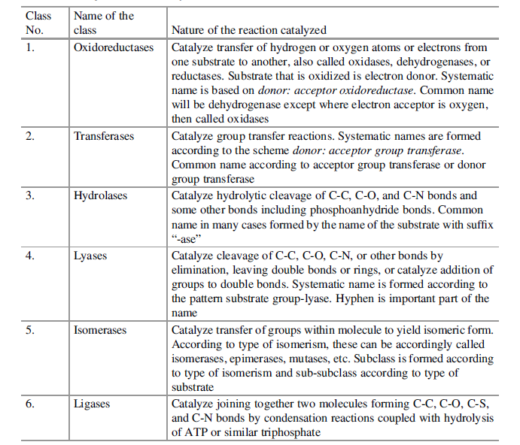

Slide 30
