Slide 1
Mineral nutrition in plants
(Macro and Micro nutrients)

Slide 2
Mineral Nutrition in plants
Plants are Autotrophic, plants act as soil miners
Definition: The study of how plants obtain, distribute, metabolize, and utilize mineral nutrients.
“Mineral”: An inorganic element acquired mostly in the form of inorganic ions from the soil
“Nutrient”: A substance needed to survive or necessary for the synthesis of organic compounds

Slide 3
Criteria of essentiality:
An element is considered essential
If without it , the plant cannot complete its life cycle
When mineral action is specific and cannot be replaced by other element
If the mineral is directly involved in nutrition, as a necessary component or as an activator of enzyme

Slide 4
Classifying mineral nutrients
Criteria for classification:
Amount required or present in plant tissue
Metabolic need for the mineral nutrient
Biochemical function(s) for the mineral nutrient
Mobility within the plant
Macroelements/ macronutrients (1000μg/g of dry matter)
C, H₂, O₂, N₂, S, P, K, Ca and Mg
Microelements/ micronutrients (100μg/g of dry matter)
Fe, Cu, Co, Zn, Mn, Mo, Bo, Na, Cl and Si.

Slide 5
Carbon, hydrogen and oxygen:
Not minerals
Framework elements
Chief constituents of cell wall and protoplasm
No life can exist without them
Deficiency results in stunted and poor growth

Slide 6
Source : soil (nitrates, nitrites and ammonium ions),
- Component of proteins, enzymes, amino acids, nucleic
acids, chlorophyll
Functions :
Protein synthesis, formation of protoplasm, nucleic acids alkalloids, NAD, NADP
- C/N ratio (Carbohydrate: Nitrogen ratio)
High C/N ratio → Plants become more reproductive
Low C/N ratio → Plants become more vegetative
- Transamination
NO₃⁻ → NH₂ → Glutamic acid → Other amino acids
Nitrogen in Plants:

Slide 7
Deficiency symptoms:
Stunted growth, lateral buds dormant, lowering of respiratory rates
Chlorosis of older leaves, the leaves die and then fall off
Delayed or suppressed flowering
Fruits and seeds small and weak
Anthocyanin production and accumulation in stem , petiole and lower leaves
Increased starch content and decreased proteins
Necrosis at advanced stage
Deposition of excess lignin on cell walls
Cells become smaller and thick walled, reduction in size of nuclei and cell lumen

Slide 8
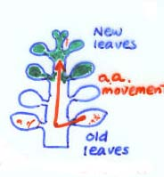
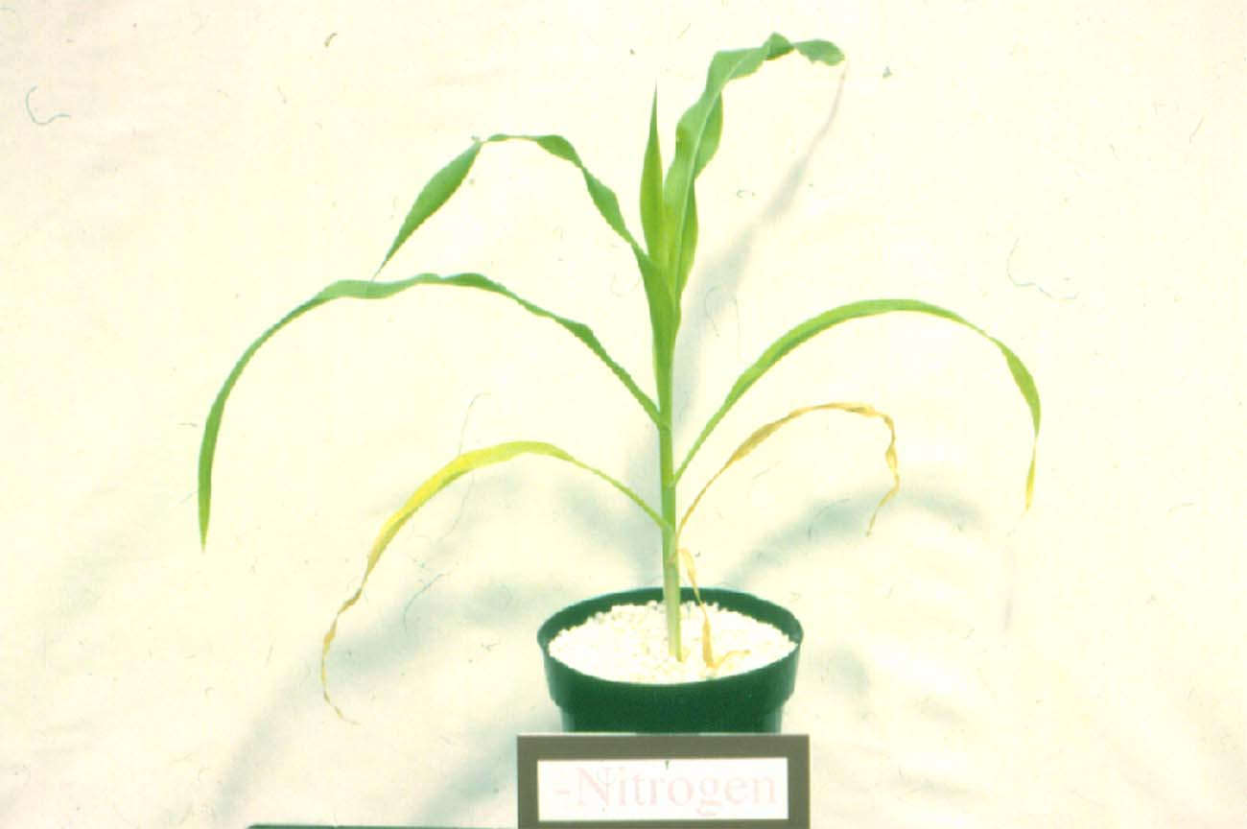
Nitrogen (N) Deficiency Symptoms
Yellowing of mature lower leaves- nitrogen is highly mobile in plants

Slide 9
Phosphorus (P)
1) Source: soil (H₂PO⁻₄ HPO⁻₄ )
- Mineral apatite [Ca₅F(PO₄)₃]
- Relatively stable in soil
- Has a low mobility (top dressing not effective)
2) Functions in Plants
- Component of nucleic acid (DNA, RNA),
phospholipids, coenzymes, high-energy phosphate
bonds (ADP, ATP)
- Seeds are high in P

Slide 10
Deficiency symptoms:
Stunted growth
Dark green coloration
Leaves, petioles and fruits develop necrosis
Older leaves affected first, become dark brown due to mobility of P in young leaves
distortion in shape, leaf-fall, anthocyanin and carbohydrate accumulation
Fertilizers:
Superphosphate (may contain F), Ammonium phosphate Bone meal

Slide 11
Potassium (K)
1) Soil Relations
- Present in large amounts in mineral soil
- Low in organic soils
2) Plant Functions
- Activator of many enzymes
- Regulation of water movement across membranes and
through stomata (Guard cell functions)

Slide 12
Deficiency symptoms:
Stunted growth with shortened internodes
Older leaves affected first due to mobility of K to younger leaves
Mottled chlorosis
Development of necrotic lesions at the tip and margins
Tip turns down wards and margin rolls inwards
Fertilizers:
KCl, murate of potash
K₂ SO₄, KNO₃

Slide 13
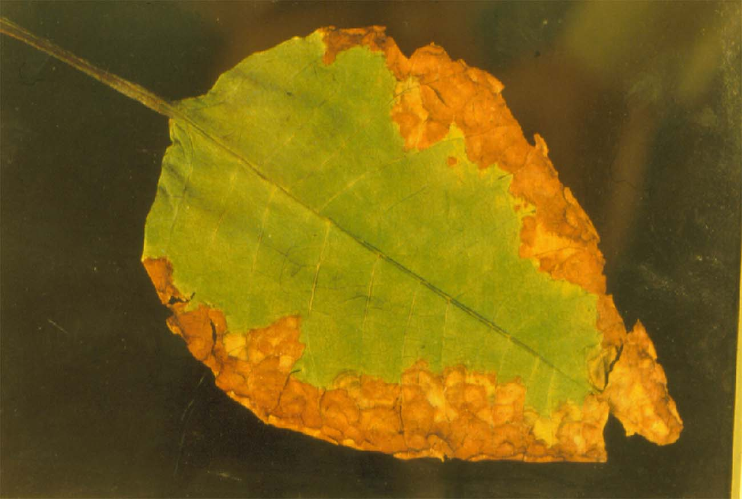
Leaf Margin Necrosis in Poinsettia
Potassium (K) Deficiency

Slide 14
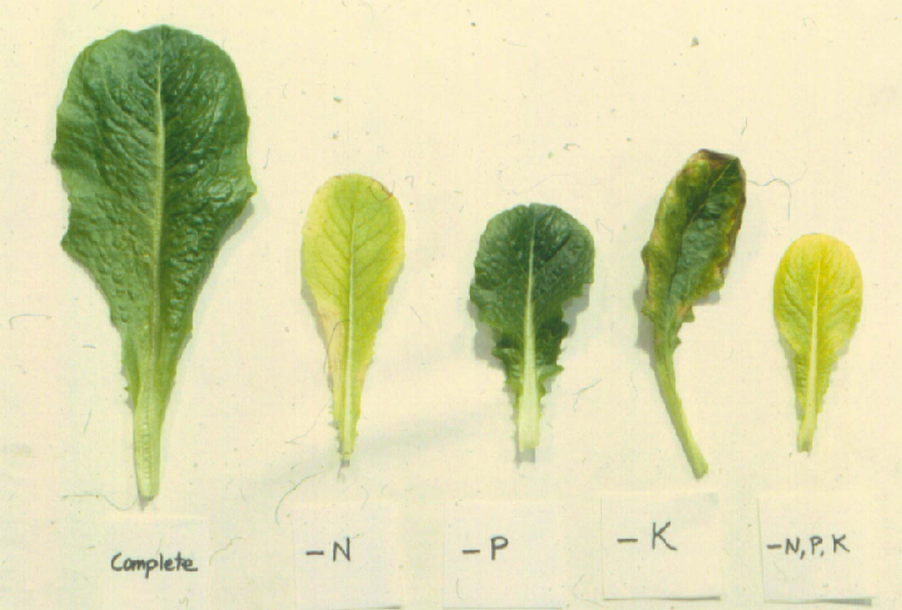
Macronutrients N, P, K Deficiencies: Leaf Lettuce
Control

Slide 15
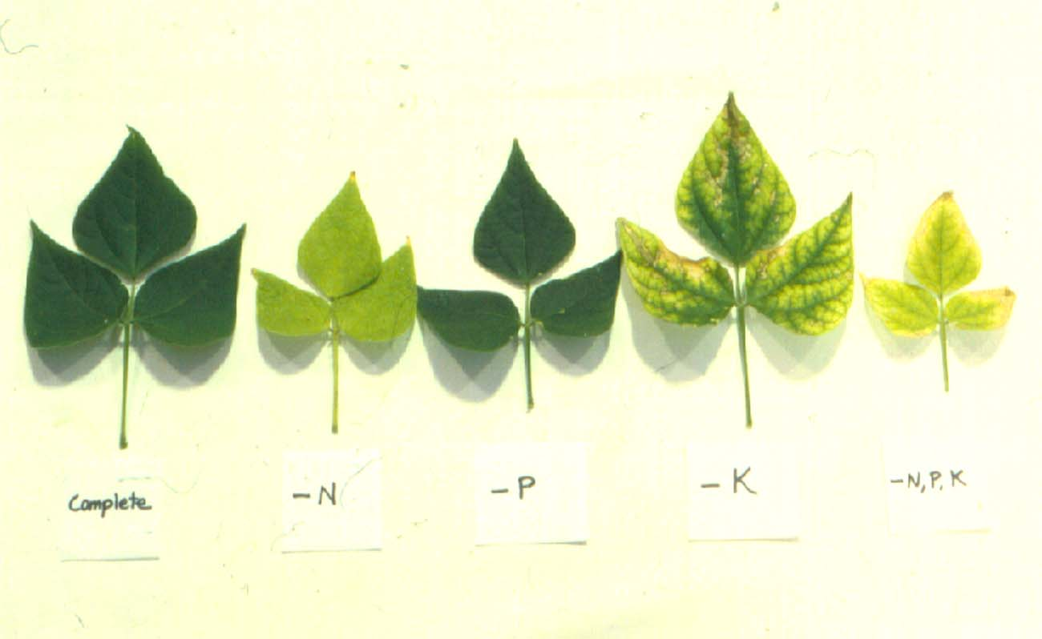
Macronutrient Deficiencies: Beans

Slide 16
Calcium (Ca)
1) Soil Relations
- Present in large quantities in earth’s surface (~1%
in US top soils)
- Influences availability of other ions from soil
2) Plant Functions
- Component of cell wall
- Involved in cell membrane function
- Largely present as calcium pectate in middle
lamela
Calcium pectate is immobile in plant tissues

Slide 17
Deficiency symptoms:
Roots short, stubby, brown
Stem collapses, subsequent termination of growth in apical regions or distortion of growing shoot tips
Young leaves show chlorosis near margin
Rigid brittle cell wall, cell enlargement, vacuolation
Fertilizers:
CaCO₃, MgCO₃, bone meal

Slide 18
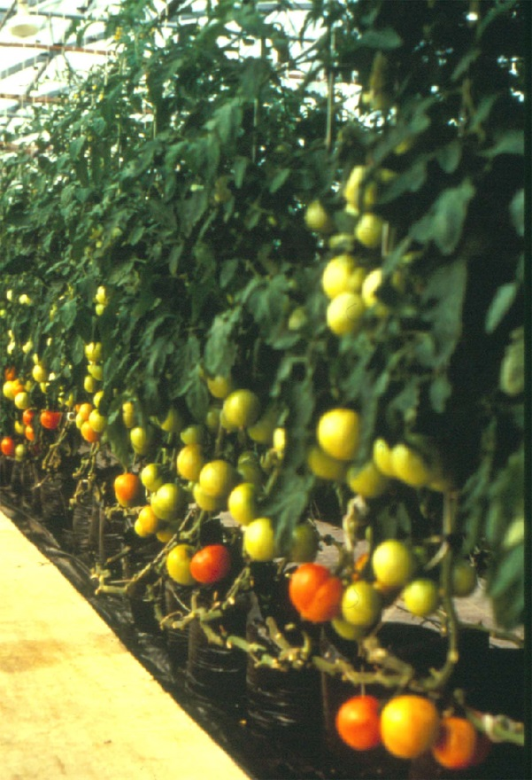
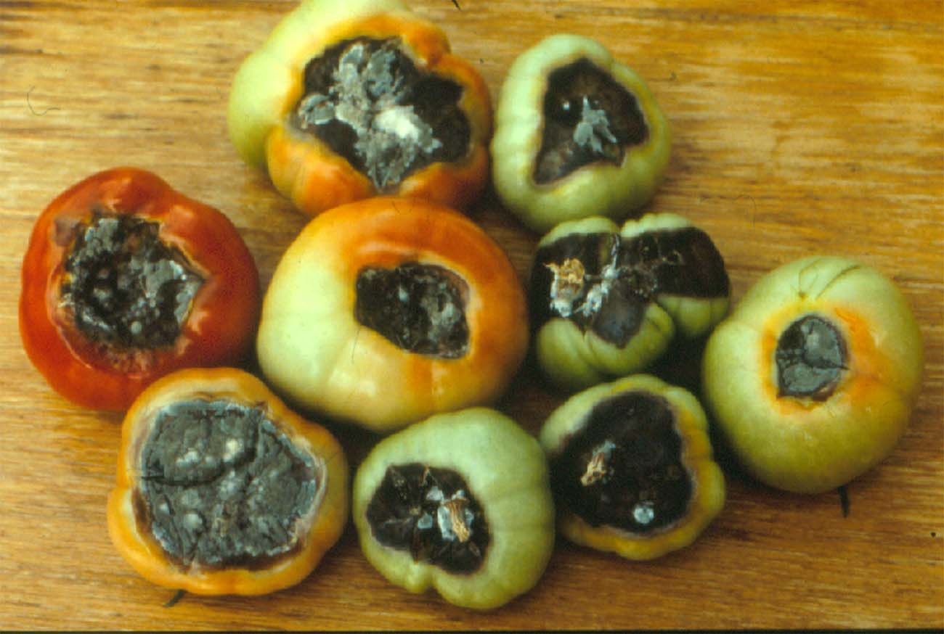
Blossom End Rot of Tomato: Calcium Deficiency
Right - Hydroponic tomatoes grown in the greenhouse, Left - Blossom end rot of tomato fruits induced by calcium (Ca⁺⁺) deficiency

Slide 19
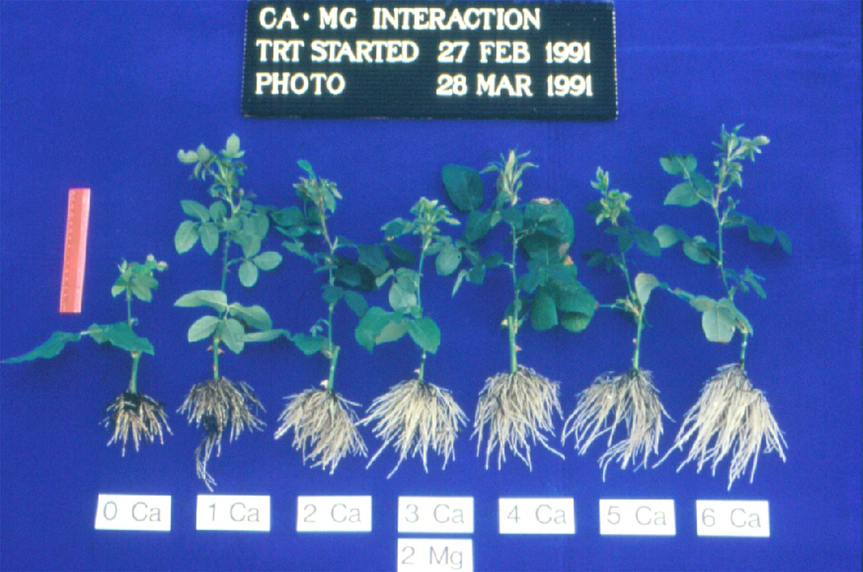
Influence of Calcium on Root Induction on Rose Cuttings

Slide 20
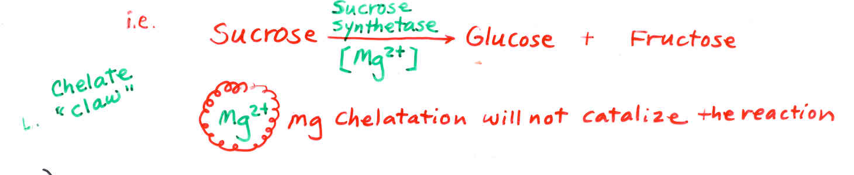
Magnesium (Mg)
1) Soil Relations
- Present in soil as an exchangeable cation (Mg²⁺)
- Similar to Ca²⁺ as a cation
2) Plant Functions
- Core component of chlorophyll molecule
- Catalyst for certain enzyme activity

Slide 21
Deficiency symptoms:
Older leaves affected first
Extensive interveinal chlorosis followed by anthocyanin pigmentation and necrotic spotting
Extensive chlorenchyma development and scanty pith formation
Fertilizers
Dolomite (mixture of CaCO₃·MgCO₃)
Epsom salt (MgSO₄)
Magnesium nitrate [Mg(NO₃)₂]
Magnesium sulfate (MgSO₄)

Slide 22
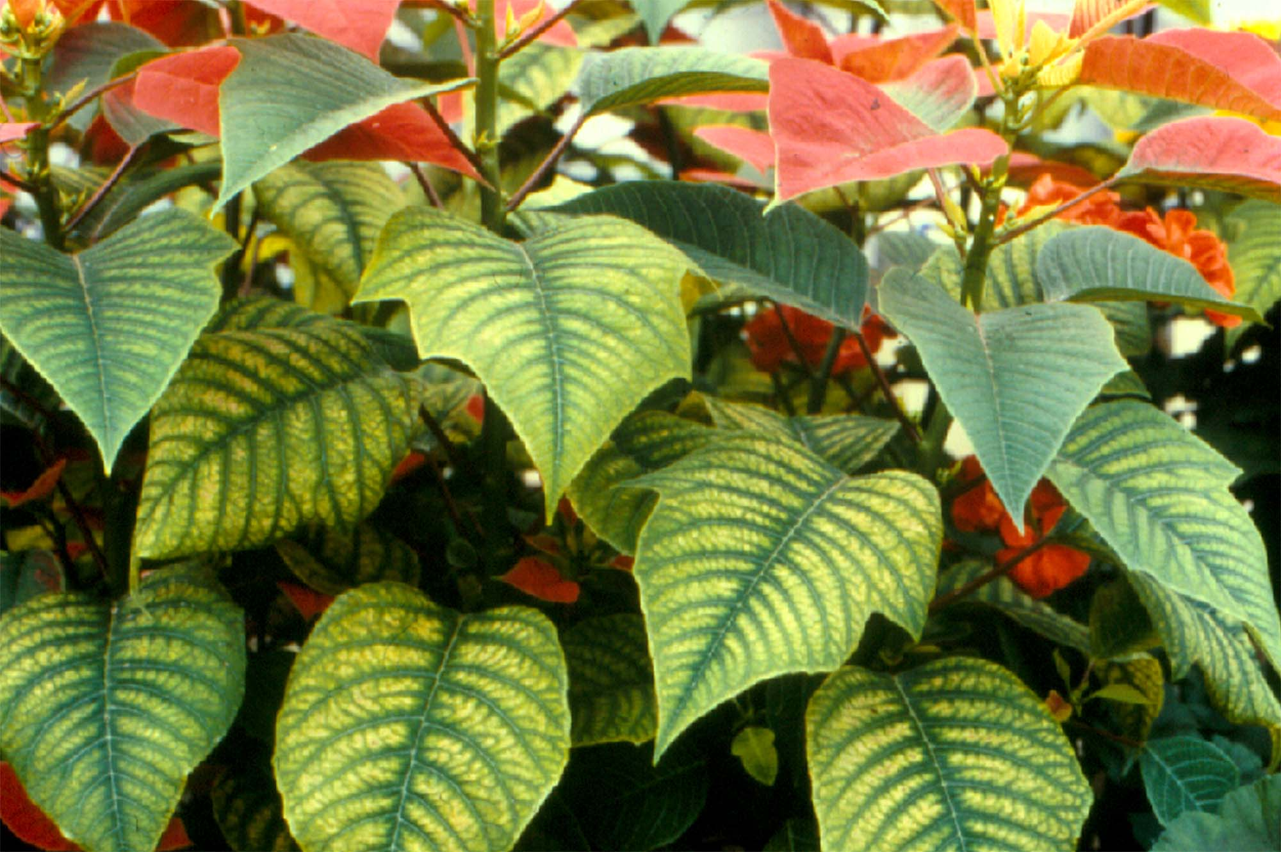
Magnesium (Mg) Deficiency on Poinsettia
Interveinal Chlorosis on Mature Leaves

Slide 23
Sulphur (S)
1) Soil Relations
- Present in mineral pyrite (FeS₂, fool’s gold), sulfides (S-mineral complex), sulfates (involving SO₄⁻²)
- Mostly contained in organic matter
- Acid rain provides sulfur
2) Plant Functions
- Component of amino acids (methionine, cysteine)
- Constituent of coenzymes and vitamins
- Responsible for pungency and flavor (onion, garlic,
mustard)

Slide 24
Deficiency symptoms:
Chlorosis of entire leaf
Younger leaves affected first
Leaf tips and margins rolled inwards and rapid leaf fall
Terminal bud growth inhibited
lateral buds develop prematurely
Fertilizers
Gypsum (CaSO₄), Magnesium sulfate (MgSO₄)
Ammonium sulfate [(NH₄)₂SO₄], Elemental sulphur (S)

Slide 25
Micronutrients
Micronutrient elements
  Iron (Fe)
  Manganese (Mn)
  Boron (B)
  Zinc (Zn)
  Molybdenum (Mo)
  Copper (Cu)
  Chlorine (Cl)
Usually supplied by irrigation water and soil
Deficiency and toxicity occur at pH extremes

Slide 26
Iron (Fe)
- Component of cytochromes (needed for photosynthesis)
- Essential for N fixation (nitrate reductase) and respiration
Deficiency Symptom:
Fe is immobile and therefore symptoms are strictly local
Interveinal chlorosis on young leaves, followed by chlorosis of veins, Iron chlorosis develops when soil pH is high
young leaves may become white and develop necrotic lesions

Slide 27
Remedy for iron chlorosis:
1) Use iron chelates
FeEDTA (Fe 330) – Stable at pH < 7.0
FeEDDHA (Fe 138) – Stable even
when pH > 7.0
2) Lower soil pH
Iron is in more useful form (Fe²⁺)

Slide 28
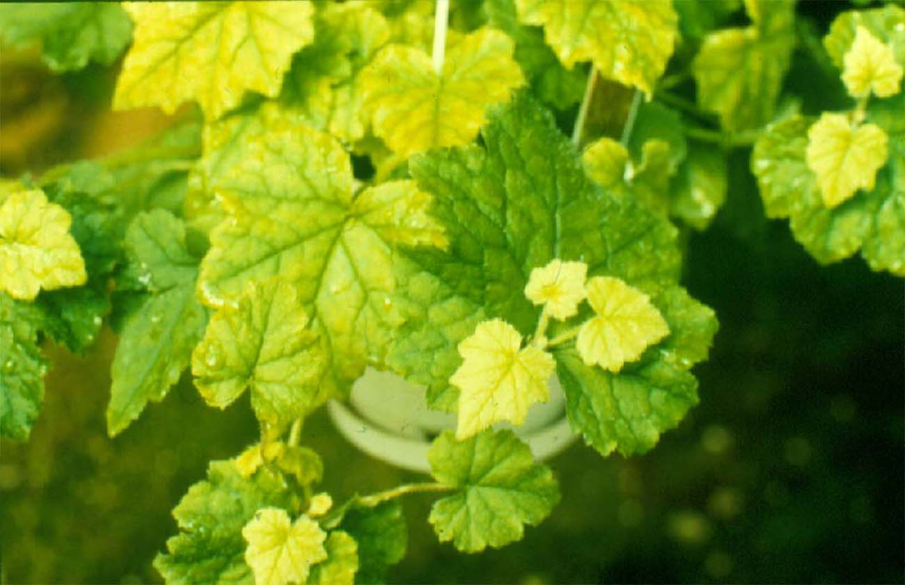
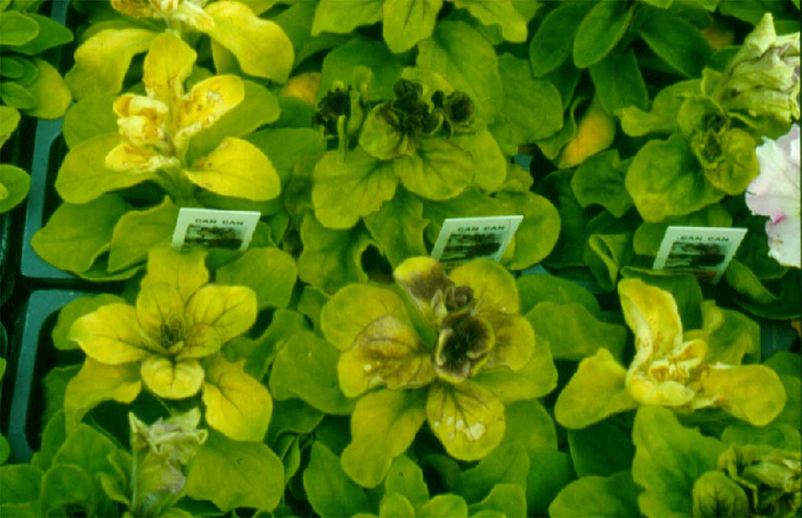
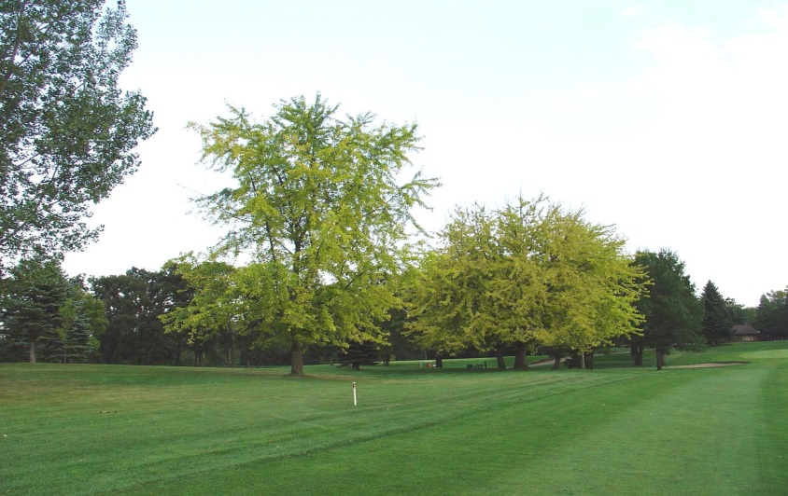
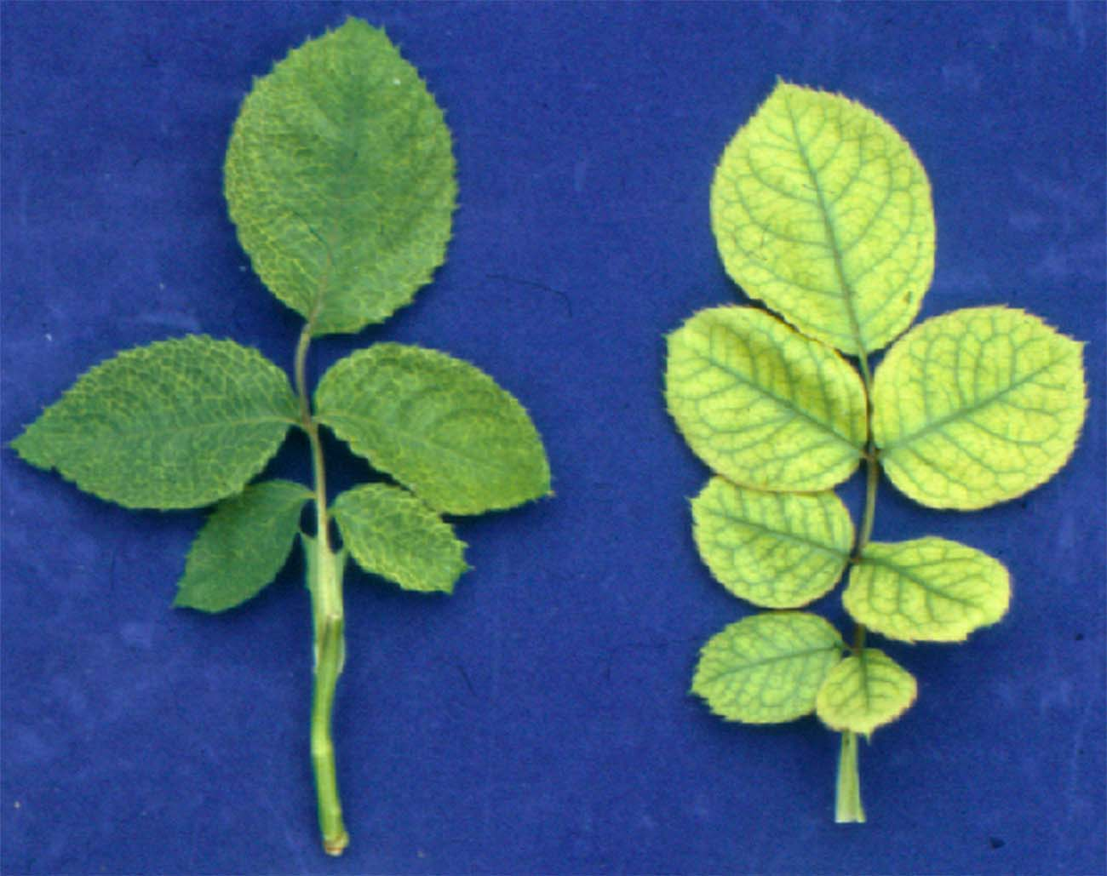
Iron (Fe) Deficiency Symptoms
1
2
3
4
A
B
1-Piggyback Plant, 2- Petunia, 3-Silver Maple, 4-Rose
(A-normal, B-Fe-deficient)

Slide 29
Manganese (Mn)
Functions:
-Required for chlorophyll synthesis, O₂ evolution during
photoshynthesis
- Activates some enzyme systems
Deficiency:
Deficiency occurs at high pH and Toxicity occurs at low pH
Mn is immobile,
Mottled chlorosis of interveinal areas of new leaves,
chloroplast affected markedly; loose chlorophyll and starch
grains, become yellowish, vacuolated and granular and finally
disintegrate
Fertilizers:
Manganese sulfate, Mn EDTA(chelate)

Slide 30
Boron (B)
Functions:
carbohydrate metabolism, flowering, pollen germination, N metabolism
Deficiency:
Boron deficiency in citrus was first identified in commercial Florida citrus more than 60 years ago.
severe drought conditions, heavy lime applications, or irrigation with alkaline water.
Boron deficiency is known as “hard fruit” because the fruit is hard and dry due to lumps in the rind caused by gum impregnations.

Slide 31
Shoot apices die, Root tip elongation inhibited
roots tubers distorted
New growth distorted and malformed,
flowering and fruitset depressed,
Branches at the end of the twig die back, fruit splitting, leaf edge burns
young leaves show small water-soaked spots or flecks that become translucent as the leaves mature.
Associated with this symptom is a premature shedding of leaves beginning at the treetop that soon leaves the tree almost completely defoliated.
tree dieback and bushy upright growth similar to that of Zn deficiency.
Fertilizers:
Borax, calcium borate

Slide 32
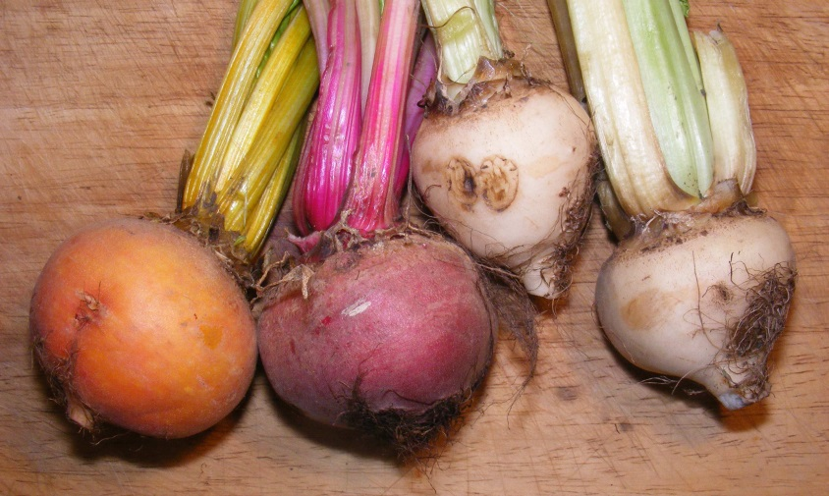
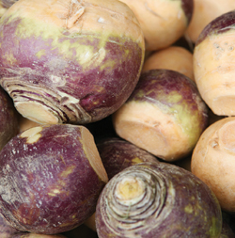
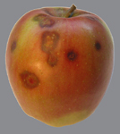
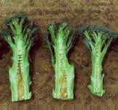
Heart rot of beet Water core of turnips
Drought spot of apples
Stem crack of celery

Slide 33
Zinc (Zn):
Functions: Protein synthesis, IAA synthesis
Deficiencies:
Zn is immobile, toxicity at low pH
Stunted growth
Chlorosis of older leaves at tips and margins
Leaves become small and internodes shortened to give rosette form

Slide 34
Molybdenum (Mo)
Functions: - Required for nitrate reductase activity, vitamin synthesis
Nitrate reductase
NO₃⁻ —————————————→ NH₂
Mo
Root-nodule bacteria also requires Mo
Mo is immobile
Deficiency: Occurs at low pH
In Florida, Mo deficiency in citrus is commonly called “yellow spot.”
Mottled Chlorosis of interveinal areas of leaves, marginal necrosis and
infolding of leaves
As the leaves age, the yellow spots develop deposits of brown gum on the lower leaf surfaces, which may eventually turn black.
In many cases, an infection of anthracnose causes the areas covered by the spots to die and drop out, leaving small holes in the leaves.
When the deficiency is severe, the mottled areas become necrotic and leaf wilts and trees become almost defoliated during the winter.

Slide 35
Symptoms are seldom observed on fruit except when the deficiency is severe. Under this condition, large irregular brown spots surrounded with yellow discoloration may develop on the fruit. The discoloration goes only into the peel
Flowers abscise before fruit setting
Whip tail disease in Crucifers: Partial or complete withering of leaf lamina, distorted leaf
Fertilizer: Sodium Molybdate, Ammonium molybdate

Slide 36
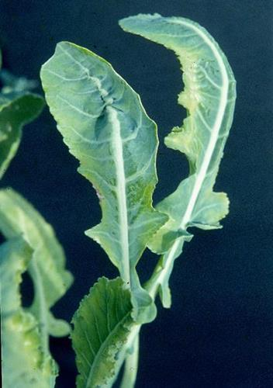
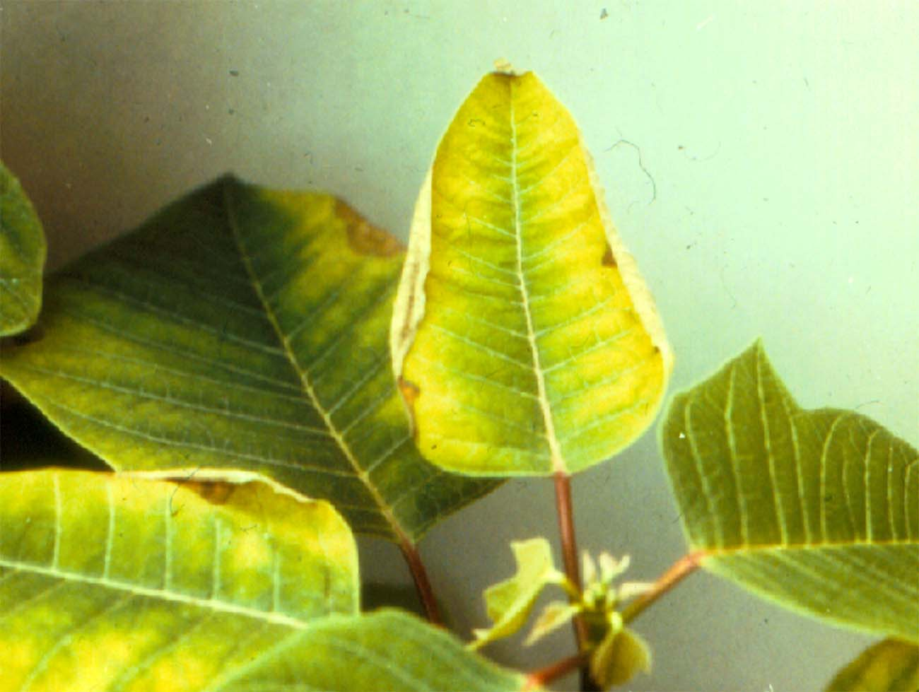
Molybdenum Deficiency on Poinsettia
Whip tail disease of crucifer

Slide 37
Copper (Cu)
Essential component of several enzymes of chlorophyll synthesis, carbohydrate metabolism
Deficiencies:
Copper deficiency is known as “dieback”, “ammoniation”, and “exanthema.”
These names are derived from the dying back of the twigs, frequent association with heavy application of N (ammonia) and excrescences on the surface of the twigs and fruit.
Excessive applications of N fertilizers, giving rise to the term “ammoniation.”

Slide 38
Necrosis of young leaf tip proceeds towards margins, gives withered appearance
unusually vigorous large dark green foliage with a “bowing up” of the midrib.
The twigs are also unusually vigorous, long, soft, angular, frequently “S” shaped, and somewhat drooping
As the deficiency becomes acute and the twigs start to die, some of the weak twigs will bear very small leaves of yellowish-green color, which drop quickly, leaving the twig denuded.
In cereal plants, yellowing of leaf tip, seed setting failure

Slide 39
Exanthema characterized by gummosis accompanied by dieback and glossy brownish blotches on leaves and fruits
Fruit symptoms are most pronounced on oranges. Brown-stained areas of hardened gum on the rind of the fruit may precede the appearance of leaf and twig symptoms.
The brown-stained areas on the fruit darken and converge as time progresses and may become almost black by the time the fruit is half grown

Slide 40
Sodium (Na):
Deficiency symptoms:
Water balance affected
In halophytes, C4 pathway obstructed
In CAM plants carbondioxide fixation and photosynthesis disturbed

Slide 41
Cobalt (Co)
Deficiency symptoms:
Nitrogen fixation is hampered in symbiotic organisms
Leghaemoglobin metabolism disturbed
In Rhizobium Cobalt deficiency decreases the activity of enzyme ribonucleotide reductase

Slide 42
Chlorine (Cl)
Chloride is necessary for gas exchange, photosynthesis and protection against diseases in plants.
Opening of stomata with an increase in potassium.
A subsequent increase in chloride balances out the positive charge of the potassium to prevent plant damage.
Deficiency symptoms:
inhibits photosynthesis,
disturbs osmotic potential ,
obstructs stomatal opening, threatening plant health.

Slide 43
Silicon (Si)
In Diatoms silicon deficiency affects the silicified wall formation
Growth of Diatoms is affected adversely
essential for certain grasses to have naturally high concentration of Si.

Slide 44
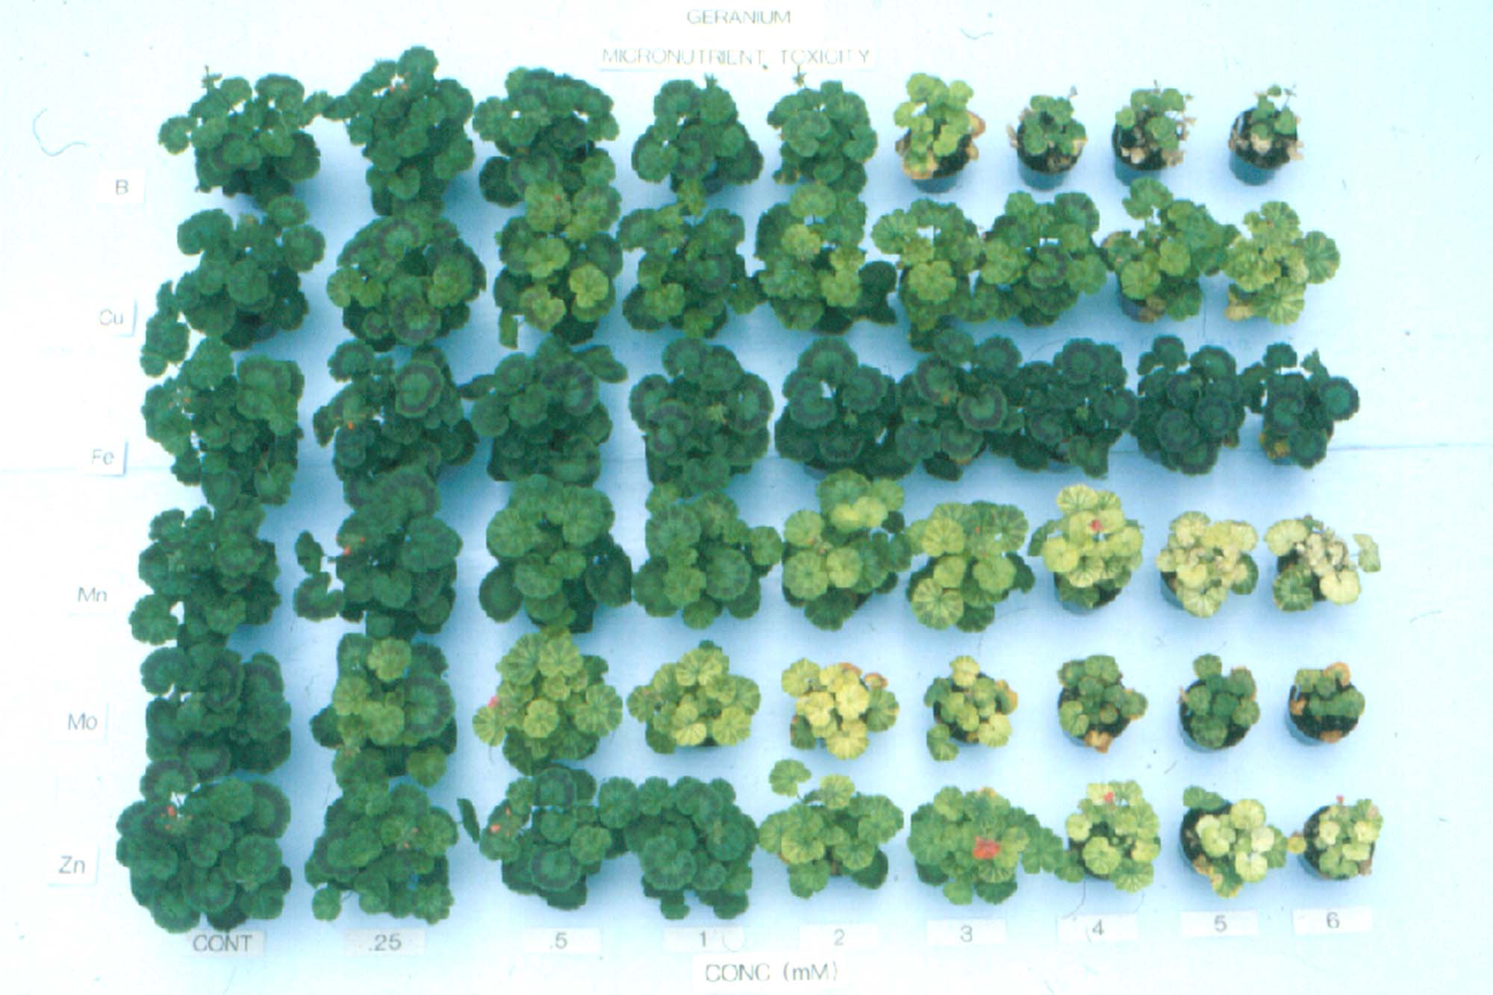
Micronutrient Toxicity on Seed Geranium
B
Cu
Fe
Mn
Mo
Zn
Cont
0.25
0.5
1
2
3
4
5
6
Concentration (mM)

Slide 45
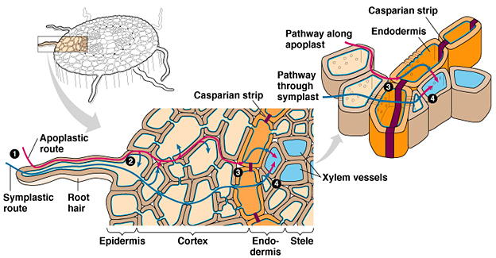
Uptake of water and nutrients by roots

Slide 46
Thank you……

