Slide 1
Mineral Nutrition

Slide 2
The basic needs of all living organisms are essentially the same. They require macromolecules, such as carbohydrates, proteins and fats, and water and minerals for their growth and development.
Green plants are autotrophic in the sense that they are independent of outside sources of organic substances. They require inorganic matter from outside and synthesize their own organic matter.
Since the inorganic elements required by the plants are chiefly obtained from the soil, where they are present in the form of minerals, they are called elements or mineral elements. Such nutrition is called mineral nutrition.
Mineral nutrition focuses primarily on –
Essential macro and micro elements and their role in plants (deficiency, symptoms, disease and functions)
Inorganic plant nutrition (study the methods to identify elements essential to growth and development of plants and the criteria for establishing the essentiality).

Slide 3
ESSENTIAL MINERAL ELEMENTS
Most of the minerals present in soil can enter plants through roots.
In fact, more than 60 elements of the 105 discovered so far are found in different plants.
Some plant species accumulate selenium, some others gold, while some plants growing near nuclear test sites take up radioactive strontium.
There are techniques that are able to detect the minerals even at a very low concentration (10-8 g/mL).
The question is, whether all the diverse mineral elements present in soil, for example, gold and selenium etc. are really necessary for plants? How do we decide what is essential for plants and what is not?

Slide 4
FUNCTIONS OF MINERAL ELEMENTS IN PLANTS
Constituents of Plant body: Permanent constituents of molecules found in the protoplasm and cell wall. Eg. Sulphur in Protein, Magnesium in Chlorophyll; C, H & O2 are used in carbohydrate production.
Influence in the Osmotic pressure of cells: Plant cells contain dissolved mineral salts in their cell sap, which influence their osmotic pressure.
Acidity and buffer action: Mineral elements affects the H-ion concentration.
Permeability of cytoplasmic membrane: It is affected by the presence of various cations and anions in the external medium.
Toxic effects: Many mineral elements in their ionic form have marked toxic effect upon protoplasm. Eg. Arsenic, Mercury, etc.
Catalytic effects: Several minerals participate in catalytic systems of plants.
Antagonistic effects: Some of the mineral elements antagonise the usual effects of other elements.

Slide 5
Criteria for Essentiality
The criteria for essentiality of an element are given below:
The element must be absolutely necessary for supporting normal growth and reproduction. In the absence of the element the plants do not complete their life cycle or set the seeds.
(b) The requirement of the element must be specific and not replaceable by another element. In other words, deficiency of any one element cannot be met by supplying some other element.
(c) The element must be directly involved in the metabolism of the plant. Based upon the above criteria only a few elements have been found to be absolutely essential for plant growth and metabolism.
These elements are further divided into two broad categories based on their quantitative requirements.
(i) Macronutrients, and
(ii) Micronutrients

Slide 6
Macronutrients are generally present in plant tissues in large amounts (in excess of 10 mmole Kg –1 of dry matter).
The macronutrients include carbon, hydrogen, oxygen, nitrogen, phosphorous, sulphur, potassium, calcium and magnesium. Of these, carbon, hydrogen and oxygen are mainly obtained from CO2 and H2O, while the others are absorbed from the soil as mineral nutrition.
Micronutrients or trace elements, are needed in very small amounts (less than 10 mmole Kg –1 of dry matter).
These include iron, manganese, copper, molybdenum, zinc, boron, chlorine and nickel. In addition to the 17 essential elements named above, there are some beneficial elements such as sodium, silicon, cobalt and selenium. They are required by higher plants.

Slide 7
Essential elements can also be grouped into four broad categories on the basis of their diverse functions. These categories are:
(i) Essential elements as components of biomolecules and hence structural elements of cells (e.g., carbon, hydrogen, oxygen and nitrogen).
(ii) Essential elements that are components of energy-related chemical compounds in plants (e.g., magnesium in chlorophyll and phosphorous in ATP).
(iii) Essential elements that activate or inhibit enzymes, for example Mg2+ is an activator for both ribulose bisphosphate carboxylaseoxygenase and phosphoenol pyruvate carboxylase, both of which are critical enzymes in photosynthetic carbon fixation; Zn2+ is an activator of alcohol dehydrogenase and Mo of nitrogenase during nitrogen metabolism.
(iv) Some essential elements can alter the osmotic potential of a cell. Potassium plays an important role in the opening and closing of stomata.

Slide 8
METHODS TO STUDY THE MINERAL REQUIREMENTS OF PLANTS
In 1860, Julius von Sachs, a prominent German botanist, demonstrated, for the first time, that plants could be grown to maturity in a defined nutrient solution in complete absence of soil. This technique of growing plants in a nutrient solution is known as hydroponics.
Since then, a number of improvised methods have been employed to try and determine the mineral nutrients essential for plants. The essence of all these methods involves the culture of plants in a soil-free, defined mineral solution. These methods require purified water and mineral nutrient salts.
After a series of experiments in which the roots of the plants were immersed in nutrient solutions and wherein an element was added /removed or given in varied concentration, a mineral solution suitable for the plant growth was obtained. By this method, essential elements were identified and their deficiency symptoms discovered. Hydroponics has been successfully employed as a technique for the commercial production of vegetables such as tomato, seedless cucumber and lettuce. It must be emphasised that the nutrient solutions must be adequately aerated to obtain the optimum growth.

Slide 9
Sand culture - In this process the plants are grown in sand supplemented with nutrient solution. Suitable vessels are filled with pure quartz sand thoroughly washed with acids and then with distilled water. Artificial nutrient solution is added into the sand from time to time. The sand culture is preferred over solution culture for many type of investigations because it provides solid media and natural aerated condition for root growth.
Aeroponics – It is a system for growing plants with their roots bathed in the nutrient mist (a cloud of moisture in the air). The rooted plants are placed in a special type of box with their shoots exposed to air and roots inside the box. The nutrient solution is kept in the bottom of the box. Then the nutrient mist is sprayed to the roots with the help of computer. This system is recently being developed particularly for research purposes because the plants show good root hair development. Plants grow well in aeroponics primarily because of the highly aerobic environment as the roots are exposed constantly to a nutrient mist. They are constantly grown under controlled conditions. The plants of Citrus and Olive have been successfully grown aeroponically.

Slide 10
Classifying mineral nutrients
Amount required or present in plant tissue.
Metabolic need for the mineral nutrient.
Biochemical function(s) for the mineral nutrient.
Mobility within the plant.

Slide 11
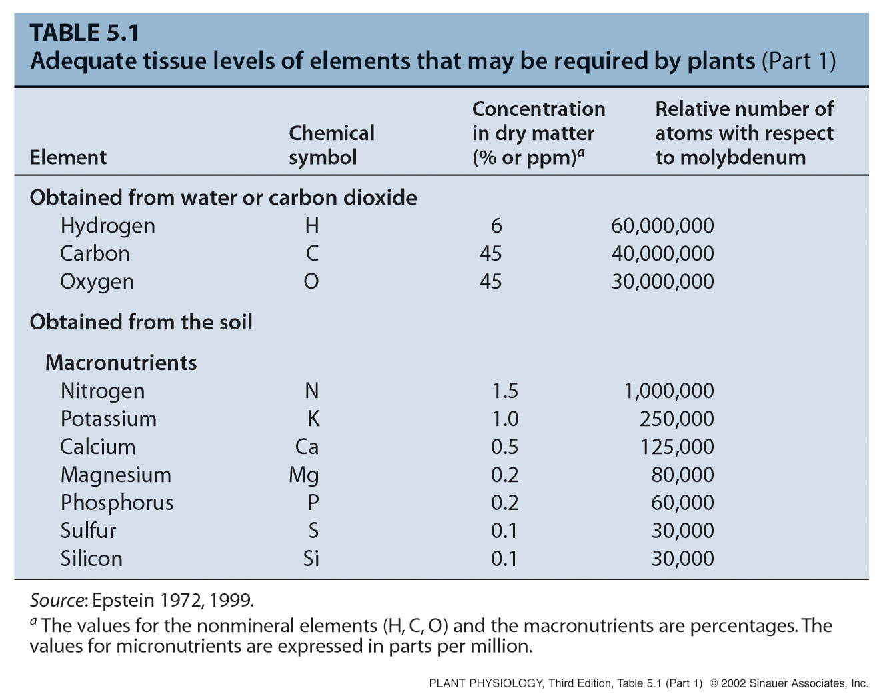
Mineral macronutrients

Slide 12
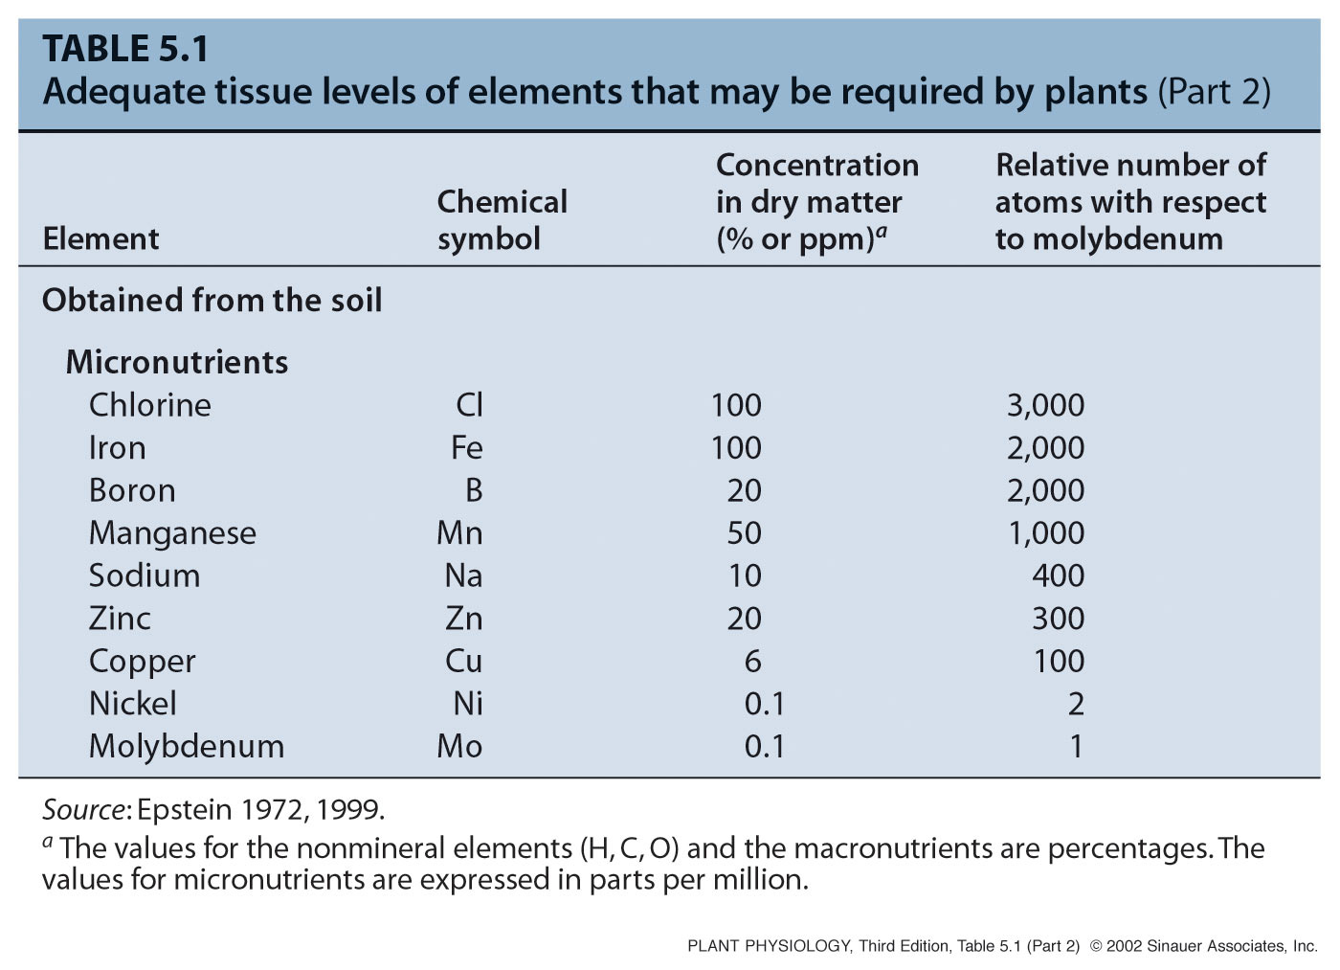
Mineral micronutrients

Slide 13
Difference between trace element & tracer element
Trace element | Tracer element
1. These are nutrient elements require by the plants for their growth and metabolic activities. | 1. These are radioactive isotopes of elements which are artificially incubated into the plants. They metabolized by the plants as the normal elements.
2. Those elements are required by the plants in a very minute amount and therefore they are called trace elements or microelements. | 2. These elements can be detected by Geiger-Muller counter and therefore, they can be traced in the plant systems. These elements are used for detecting various metabolic pathways in plant systems.
3. The example of trace elements are – iron, boron, manganese, zinc, copper, molybdenum, chlorine, nickel, etc. | 3. The example of tracer elements are – Radioactive isotopes of carbon (¹⁴C), Nitrogen (¹³N), Sulphur (³⁵S), Sodium (²⁴Na), Potassium (⁴²K), Magnesium (²⁸Mg), etc.

Slide 14
Nutrient deficiencies
Mineral nutrient deficiencies occur when the concentration of a nutrient decreases below this typical range
Deficiencies of specific nutrients lead to specific visual, often characteristic, symptoms reflective of the role of that nutrient in plant metabolism

Slide 15
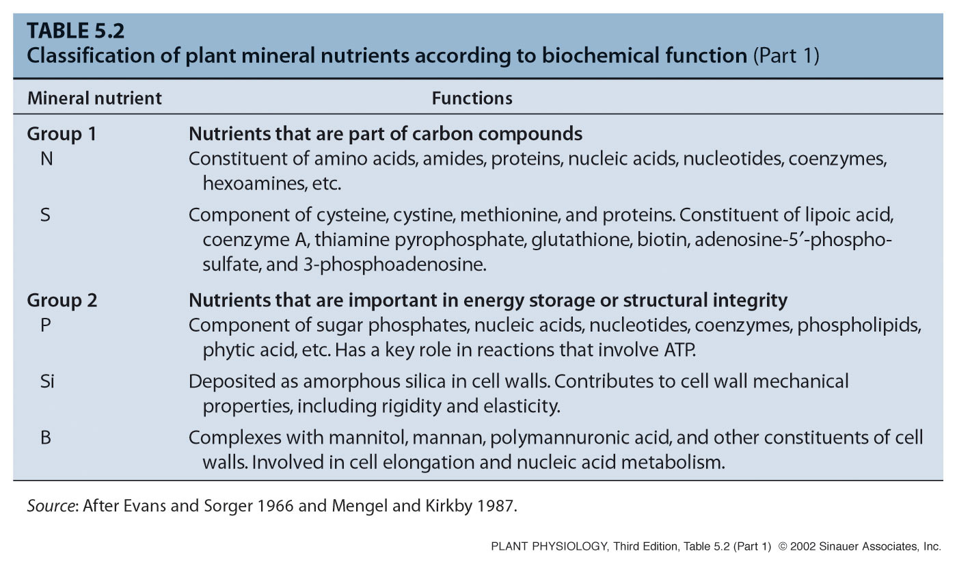
Biochemical functions of mineral nutrients

Slide 16
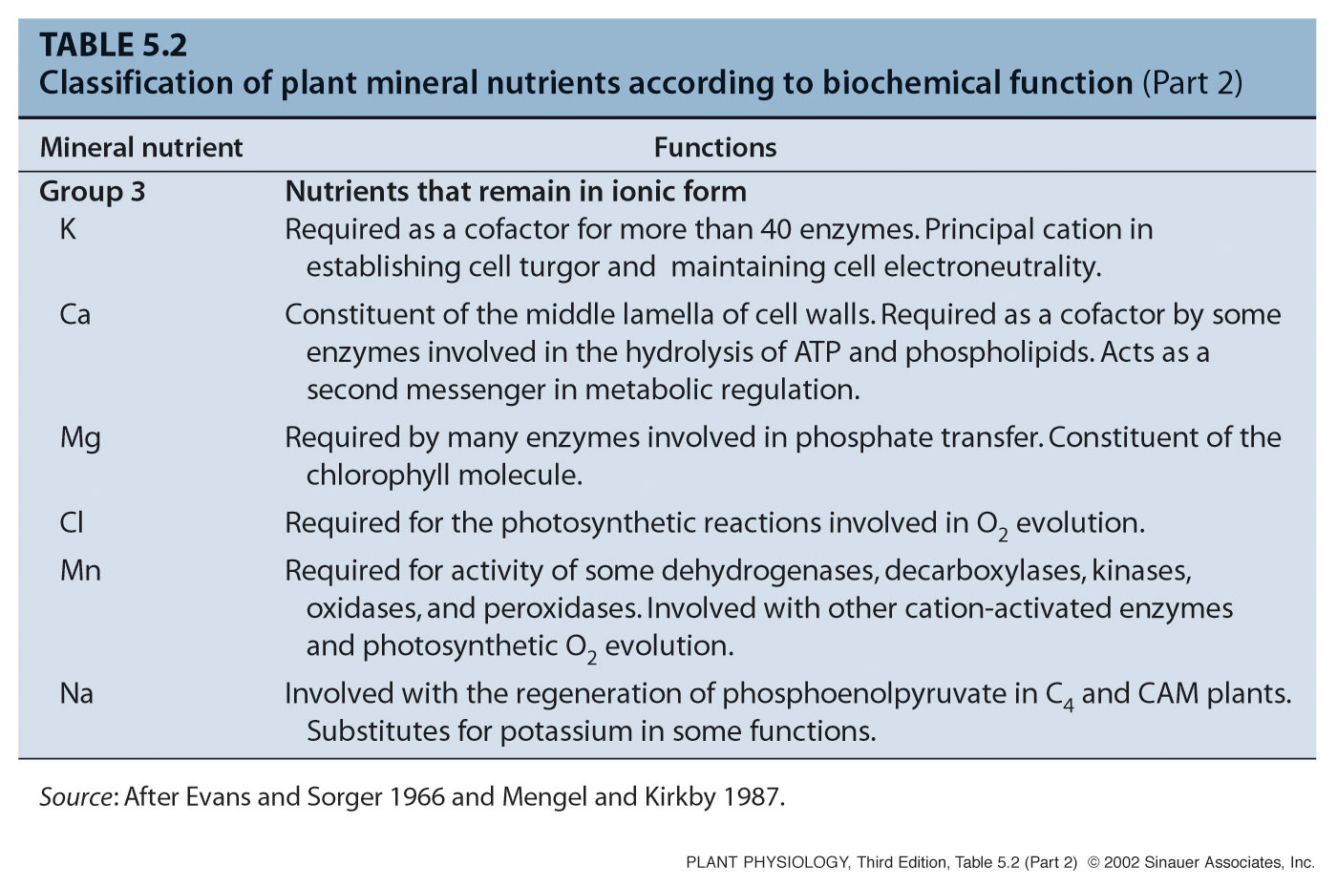
Biochemical functions of mineral nutrients

Slide 17

THANK YOU

