Slide 1
Edmund Husserl
&
PHENOMENOLOGY

Slide 2
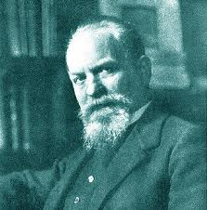
Introduction…
Edmund Husserl (1859-1938)was a Czecho-Austro- German mathematician turned philosopher best known as the founded of the discipline phenomenology.
It is a new approach to the study of consciousness.
Husserl sought to put philosophy on a radical new path, with a new vision and new method.

Slide 3
contd…
Husserl was one of the great systematic philosopher of the Western tradition, joining Aristotle and Kant in the top rank of system-builders.
Husserl proposed that all philosophy, and indeed all science and all knowledge, be grounded in what he came to call transcendental phenomenology, seeking the ideal meaning of various types of experience from perception and imagination to judgement and knowledge formation.

Slide 4

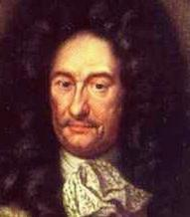
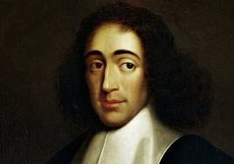
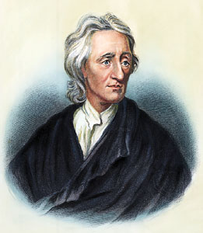
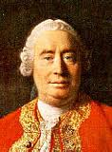
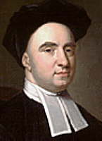
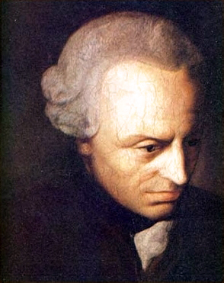
The early philosophers….
The rationalists like Descartes, Leibnitz, Spinoza had held that knowledge is founded ultimately on reason.
The empiricist like Locke, Hume, Berkeley countered that knowledge is founded ultimately on sense perception.
Then Kant's critique of pure reason (and of pure sensation) laid out a synthesis of rationalist and empiricist doctrines mapping the mind’s contribution to the structure of space time, and things as we know them.

Slide 5
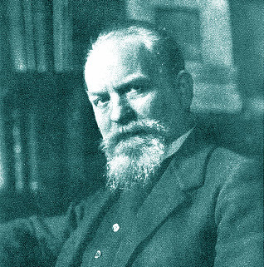
Life & Work..
Into the mentioned grand sweep of European philosophy entered Husserl.
Deeper than the structure of
either reason or sensation,
or Kantian categories of the
understanding, Husserl held,
is the structure of consciousness
itself: what he called intentionality, that is, the way that consciousness is “directed” toward or represent objects of various kinds in the world. For him phenomenology studies just the structure, and thereby provides the proper foundation for knowledge.

Slide 6
Contd…
Husserl's idea of philosophical foundation was different from that of prior thinkers such as Descartes and Kant.
Husserl developed a systematic philosophy in which phenomenology, ontology, epistemology, and logic are interdependent parts, each founded upon elements in the other parts.
For Husserl, all philosophy is founded on the phenomenological theory of intentionality. but phenomenology, logic, ontology, and epistemology in certain ways mutually founding.

Slide 7
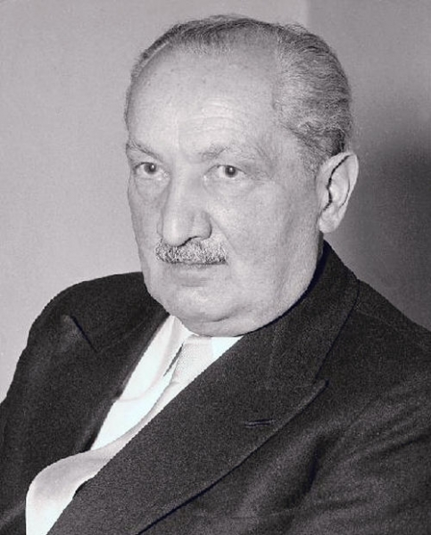
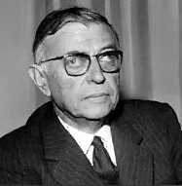
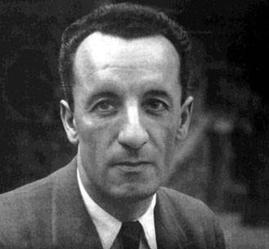
Later thinkers..
As Husserl’s philosophy developed, and as his conception of phenomenology was extended and modified by later thinkers especially Martin Heidegger, Jean-Paul Sartre and Maurice Merleau-Ponty, the concerns of phenomenology spread from the foundations of logic, science. and knowledge to the meaning of human experience and its significance for social reality.
Then, Existentialism and later movements (structuralism and poststruc-turalism) carried phenomenology from mathematics and science to social analysis.

Slide 8
Husserl..
Husserl was a philosophers' philosopher, engaging the large issues raised by Plato. Aristotle, Descartes, Hume, and Kant, along with the issues of logico-mathematical theory emerging in his day in Cantor, Frege. Hilbert. Carnap, Whitehead and Russell.
Accordingly, Husserl's philosophy addressed in a systematic way the classical issues of universal and particular, mind and body. individual and society, fact and value, and especially the emerging issues of how mind and language represent the world.

Slide 9
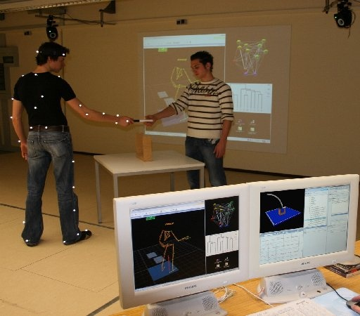
contd…
Today's techniques of' computer science would have been at home in Husserl's model of mental representation.
But still Husserl insisted that the techniques of formal modeling be grounded in bona fide activities of consciousness, as our minds present and engage things in our environment.
From this formal mathematical matrix of ideas emerged Husserl's conception of phenomenology. focused on concrete human experience and the importance of the world of everyday life.

Slide 10
contd…
Husserl's writing was complex and abstract, yet strangely engaging. The more you read, the more you see of his large vision.
His complex prose is holo-graphic: the more you read, the more you see in each part the larger scheme.
The most common thing of his philosophy is his concerns about humanity. His humanistic concern for the life-world, plays smoothly into the concerns of existential philosophy in later decades.
In his later works also we can see the same concerns that launched his earliest work, such as his concern for logical theory as a scheme for representing the world.

Slide 11
Contd
Over the course of his career. Husserl published five books:
Philosophy of Arithmetic (1891)
Logical Investigations (in three volumes, 1900-- 1 )
Ideas toward a Pure Phenomenology and a Phenomenological Philosophy (Book one, 1913)
Formal and Transcendental Logic (1929)
Cartesian Meditations (1931)

Slide 12
contd
Although many years separated the appearance of his key books, Husserl wrote constantly. Posthumous volumes of his writing address the structure of time and space as we experience them, the relation between experience of oneself and empathic experience of others, and much more. Notably, his final phase of writing has been gathered as: The Crisis of the European Science and Transcendental Phenomenology (1935-8).

Slide 13
contd
In his work Husserl addresses the sweep of thought from Galileo's inauguration of the modern sciences the “crisis” of rationality Husserl saw in 1930s Germany. There Husserl developed the theme of the ''life-world,“ in contrast with the "world of nature" as "mathematized" in modern physics.
In the course of his philosophical life, then, Husserl moved from an initial feces on the objectivity of knowledge (in mathematics, logic, and science) to a prominent focus on the subjectivity of our own consciousness (in pure or transcendental phenomenology), and on to a focus on the intersubjectivity of our collective experience of things.

Slide 14
The new science of conscious experience
Husserl set out to establish phenomenology as a new discipline in philosophy and in science generally, a science of consciousness, distinct from psychology, from epistemology, and from other traditional fields of science and philosophy.

Slide 15
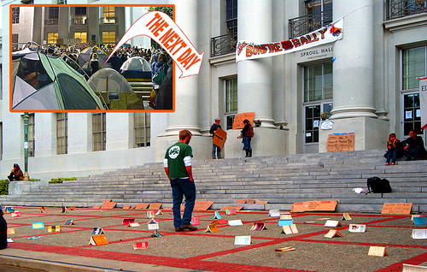
What is phenomenology?
Phenomenology is the study of consciousness as experienced from the first-person point of view. By etymology, phenomenology is the Study of phenomena, in the root
meaning of appearances;
or, better, the ways things
appear to us in our
experience, the ways we
experience things in the
world around us.

Slide 16
contd
We practice phenomenology (with or without the name) whenever we pause in reflection and ask, "what do 1 see?." "1-low co I fee!`." "What am I thinking?." "What do I intend to do?," answering in the first person. specifying the way I experience what I see, feel. think, and so on.

Slide 17
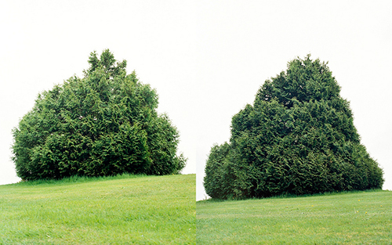
contd
We practice phenomenology (with or without the name) whenever we pause in reflection and ask, "what do 1 see?." “How do I feel?," "What am I thinking?." "What do I intend to do?," answering in the first person, specifying the way I experience what I see, feel, think, and so on.

Slide 18

contd
We produce a phenomenological description of an experience as we declare, attending to our own experience. "I see that fishing boat in the fog," "I feel angry about what was just said," "I think that Husserl read Hume."
Phenomenology thus
characterizes a given
form of consciousness
from the person's own
subjective, first-person
perspective.

Slide 19
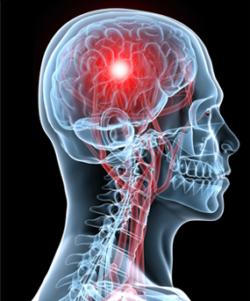
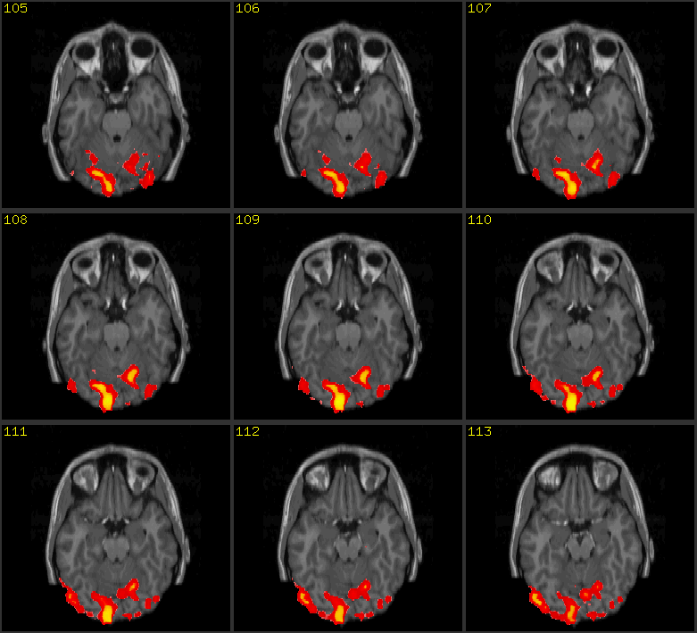
Neuroscience and phenomenology
But by contrast neuroscience studies
how consciousness Is produced in a
person's brain, characterizing his
neural-mental state from an
objective, third-person perspective.
Thus, where a brain scan (an fMRI image)
shows which parts of the brain are most active (burning glucose) but a phenomenological
description characterizes what
the person is experiencing ("I
see a fishing boat" or "I feel a
pain in my left foot").

Slide 20
contd
In a suggestive idiom we may say phenomenology studies what it is like to have a given form of experience. However, we must guide against misunderstanding.
In recent philosophy of mind it has been argued that a physical account of brain activity fails to capture what it is like to feel pain or to see red.
Accordingly, contemporary cognitive scientists and philosophers of mind often think of phenomenology as focused primarily or exclusively on the subjective qualities, or "qualia," of purely sensory experiences such as seeing red.

Slide 21
Husserl and phenomenology..
But the point is that Husserl did not look to sensory experiences and their qualia as the paradigm targets of phenomenological analysis. Indeed, Husserl took our perceptual experiences to have a conceptual content or meaning that presents things around us with a much richer character than mere sensation.
Thus he took phenomenology to be concerned with the meaningful structures of' experience far beyond pure sensation, addressing perception, imagination, desire, thought, and so on, as we engage the world around us.

Slide 22
contd
Husserl insisted that phenomenology is sharply distinguished from the natural science of psychology.
Meaning is central to phenomenology: meaning is the significant content of conscious experience. which we ascribe in saying "what" a person sees or thinks or wishes. It is meaning that distinguishes nearly all of our experiences, and it is meaning that renders experience a consciousness "of" anything at all.
Only through meaning, Husserl held, does consciousness present us with a world, an organized structure of things around us, including ourselves.

Slide 23
contd
But meaning, in abstraction from our lived experience, falls within the domain of study in logic: "pure logic," as Husserl put it. That part of logic that studies meaning has come to be called "semantics" (though this term was not yet established in Husserl's day). So phenomenology must in effect synthesize logic and psychology.

Slide 24
contd
In his middle years Husserl came to champion phenomenology as a new science, distinct from the sciences of nature and indeed of culture, the natural and social sciences (as we call them today). In an essay titled "Philosophy as Strict Science" ("Philosophie als strenge Wissenschaft," 1 910-11 ). Husserl argued at length against "naturalizing" consciousness in psychology or in physics - or, he would have added today, in neuroscience. By contrast, phenomenology was to be a new type of science.

Slide 25
contd
For Husserl,
“With [phenomenological investigation] we meet a science of whose extraordinary extent our contemporaries have as yet no concept; a science. it s true, of consciousness that is still not psychology; a phenomenology of consciousness as opposed to a natural science about consciousness.”
(Husserl 1910-11/ 1965:91)

Slide 26
contd
Phenomenology is different from the natural sciences, however, in that the objects of study conscious experiences - are appraised from the perspective of the experiencer, the first-person or subjective point of view. Here the scientist is both the studier and the studied, the subject and the object of investigation.
In Husserl's own words, phenomenology is the science of the essence of consciousness (ideas I. §34).

Slide 27
The essence of consciousness..
First, every experience, or act of consciousness, is conscious: the subject experiences it, or is aware of performing it.
Second, every act of consciousness is a consciousness of something in perception I see such-and such, in imagination I imagine such-and-such, in judgement I judge that such-and-such is the case, and so on.
This property of consciousness, its being of or about something Husserl called it intentionality.
Thus, we say an experience is intentional, or directed (literally, "aimed") toward some object. We also say a mental state or act represents some object, and so intentionality consists in this representational character.

Slide 28
contd
Husserl allows (correctly) that some experiences are not intentional. When I feel dizzy or nauseous or anxious, my sensation is not of or about anything. But most of our experiences have more structure than that.
Most of our experiences take the form of a consciousness-of-something, and all of our experiences in normal human life take their place in a structured, temporal scream of consciousness (to use William James’ apt phrase).

Slide 29
contd
Thus, in Husserl’s hands, phenomenology- the study of the essence of consciousness as lived - is centrally concerned with structures of intentionality: in perception, imagination, judgment, emotion. evaluation, volition, consciousness of time and space, experience of other people, and so on.
So, phenomenology is largely focused on how perception, thought, emotion, and action are directed toward things in the world. How things are intended in these forms of experience, and thus the meaning things have for us in different forms of experience. Husserl's full theory of intentionality comes into play, accordingly, as the center of the new science of phenomenology.

Slide 30
Phenomenological Description…
We practice phenomenology, most basically, when we give first-person descriptions of various types of conscious experience.
Here are some elementary forms of such descriptions:
*I see that fishing boat on the edge of the fog bank rolling in on the Pacific.
*I hear that helicopter whirling overhead.
*I think that the whales are migrating south along the coast.

Slide 31
Literary description of Phenomenology…
A form of phenomenological description winds its way through Marcel Proust's In Search of Lost Time (published in a series of volumes from 1 913 until after Proust's death in 1922).
The writer's perspective is that of a first-person recollection of his experiences, as if projecting himself in memory back into those experiences, in a reflection on their significance.
The perspective is suggested by the original French title, A La Recherche du temps perdu: literally, if less poetically, "toward research of times lost," that is, a study of experiences lost in time, but here resurrected in a searching form of recollection. We are transported, as it were, through Proust’s recollection into his own first-person perspective on living those experiences in tines past.

Slide 32
Sartre & his Nausea
In the 1930s, Jean-Paul Sartre wrote a novel called Nausea (1938), Written entirely in the first person.
It explores the subject's sense of lost freedom and his recovery of his power over his life. This novel was the overture to his philosophy of existentialism, which took Paris (and the world) by storm as the Second World War ended.
Early in the book the protagonist has from time to time suffered a strangely disorienting sensation he calls Nausea, a sensation lie will later associate with his losing the power to give meaning to things.

Slide 33
Methods…
So we found that, we practice phenomenology in many guises, as we find in Proust and in Sartre and already in everyday life.
Husserl wanted to develop the practice of phenomenology into a proper science. And to that end he developed a methodology intended to ground the new science much as Galileo and Newton had developed the outlines of what we today call the empirical scientific method.

Slide 34
Husserl's Methods…
Husserl's method for phenomenology is a special type of first-person reflection on experience in which we develop phenomenological descriptions of key forms of consciousness.
I am to “bracket” the question of the existence of the object I am currently seeing (or desiring or thinking about), and so I am to turn my attention instead to my consciousness of that object, to the way I am experiencing it, proceeding to a phenomenological description of this form of experience.

Slide 35
contd
In some future time we might have a "virtual reality" machine that produces it, one's brain any specified form of conscious experience. We could call this a phenomenology machine. (The objects of consciousness would be virtual, but the experiences would be real.)
When I don such a headset, it causes appropriate neural activities to unfold in my brain and therewith I have art experience of a given type: I am conscious of this or that. I see various objects, feel various emotions, and experience myself performing various bodily actions as if of my own volition. Such a machine is the sewn of current science fiction, notably in the popular movie The Matrix (1999).

Slide 36
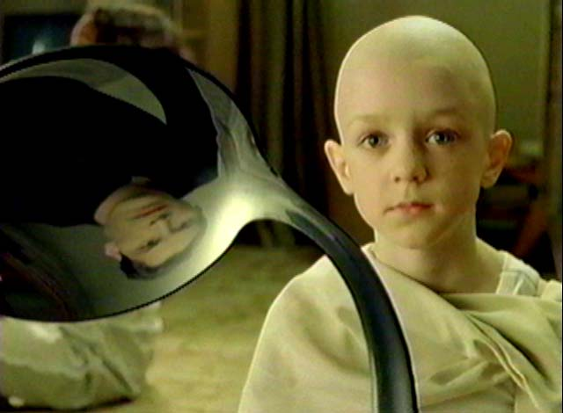
shot from the movie Matrix…

Slide 37
contd
If plugged into such an experience-inducing machine, I could then practice phenomenology in a new way. After experiencing a certain form (if consciousness induced by the machine, I would then reflect on my experience with that form. I would not need to construct phenomenological descriptions in words (like those offered earlier). 1 could instead ask my fellow phenomenologists to don the headset and, at the right time, instruct them to attend to "that" form of experience. We then would proceed to develop theoretical models of the structure of that form of experience, much as a physicist develops theoretical models of an indicated form of physical process such as gravitation.

Slide 38
Contd
To be sure, experience far outruns language. The word "red" can indicate the color of a rose, as we experience the hue, only if we know both the experience and the language.
Given our prior range of experience and command of language, we can develop phenomenological descriptions.

Slide 39
contd
On the formal side, we can study the logic of phenomenological descriptions, looking even to mathematical logic for studies of sentences like "I see that tree" or "I think that Freud suffered."
On the literary or even poetic side, we can study the uses of- language in descriptions of experience by Marcel Proust or jean-Paul Sartre (as earlier).

Slide 40
contd
Even we can follow the quasi poetic analyses of language used by Martin Heidegger in characterizing our everyday activities, or we can pursue the impressionistic accounts of bodily experience we find in Maurice Merleau-Ponty's analyses of perception.
Both forms of language the more formal or mathematical and the more literary or artistic are reflected in Husserl's pursuit of phenomenology, as Husserl turned from mathematics to a philosophical theory of experience in everyday life.

Slide 41
THANK
YOU

