Slide 1
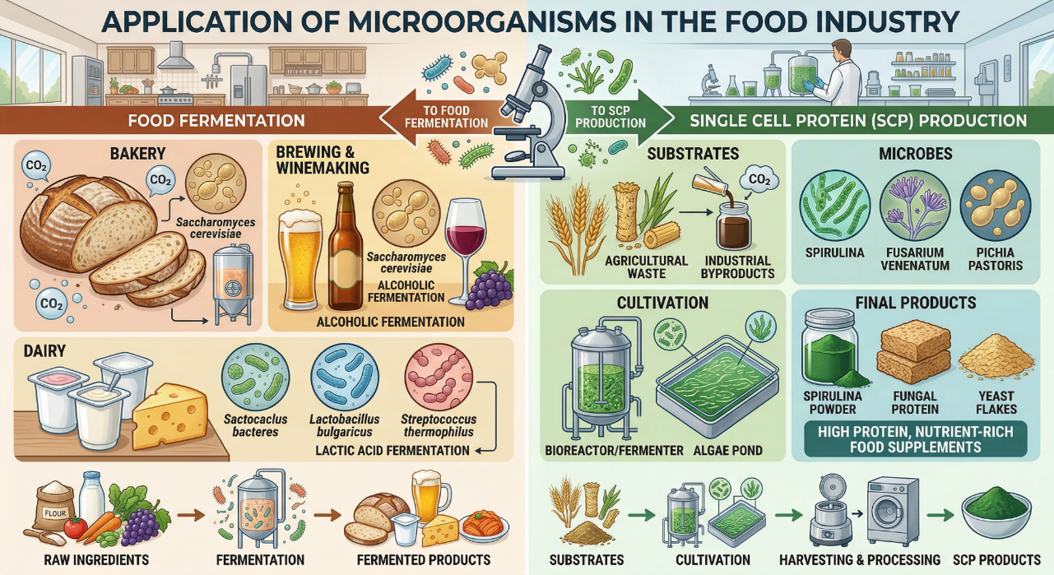

Slide 2
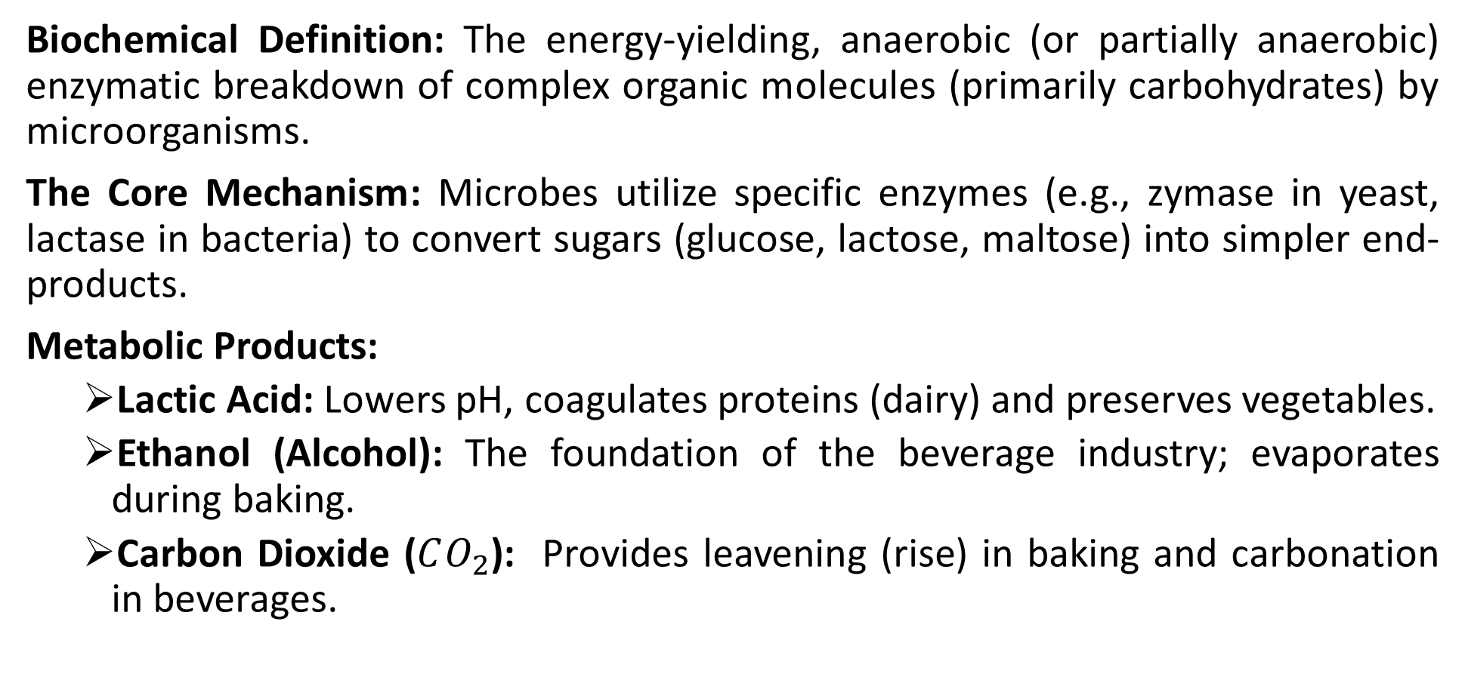
The Science of Food Fermentation
Biochemical Definition: The energy-yielding, anaerobic (or partially anaerobic) enzymatic breakdown of complex organic molecules (primarily carbohydrates) by microorganisms.
The Core Mechanism: Microbes utilize specific enzymes (e.g., zymase in yeast, lactase in bacteria) to convert sugars (glucose, lactose, maltose) into simpler end-products.
Metabolic Products:
  Lactic Acid: Lowers pH, coagulates proteins (dairy) and preserves vegetables.
  Ethanol (Alcohol): The foundation of the beverage industry; evaporates during baking.
  Carbon Dioxide ($CO_{2}$): Provides leavening (rise) in baking and carbonation in beverages.

Slide 3
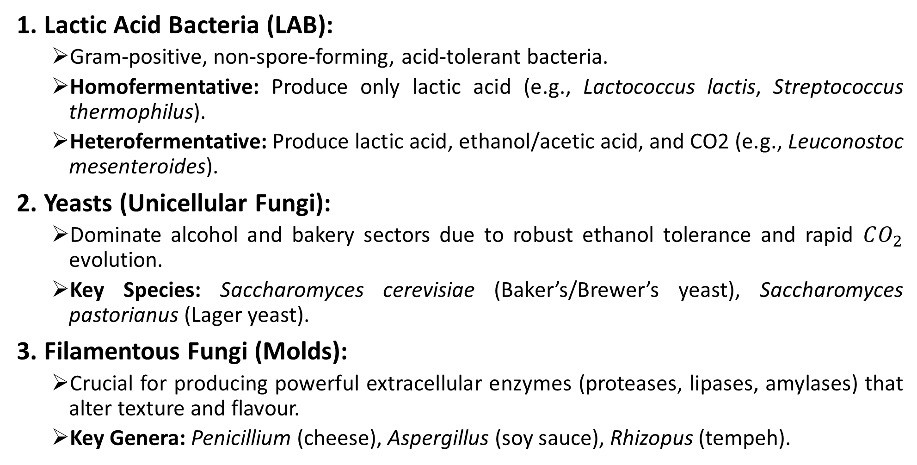
Key Microbial Groups Utilized
1. Lactic Acid Bacteria (LAB):
  Gram-positive, non-spore-forming, acid-tolerant bacteria.
  Homofermentative: Produce only lactic acid (e.g., Lactococcus lactis, Streptococcus thermophilus).
  Heterofermentative: Produce lactic acid, ethanol/acetic acid, and CO2 (e.g., Leuconostoc mesenteroides).
2. Yeasts (Unicellular Fungi):
  Dominate alcohol and bakery sectors due to robust ethanol tolerance and rapid $CO_{2}$ evolution.
  Key Species: Saccharomyces cerevisiae (Baker’s/Brewer’s yeast), Saccharomyces pastorianus (Lager yeast).
3. Filamentous Fungi (Molds):
  Crucial for producing powerful extracellular enzymes (proteases, lipases, amylases) that alter texture and flavour.
  Key Genera: Penicillium (cheese), Aspergillus (soy sauce), Rhizopus (tempeh).

Slide 4
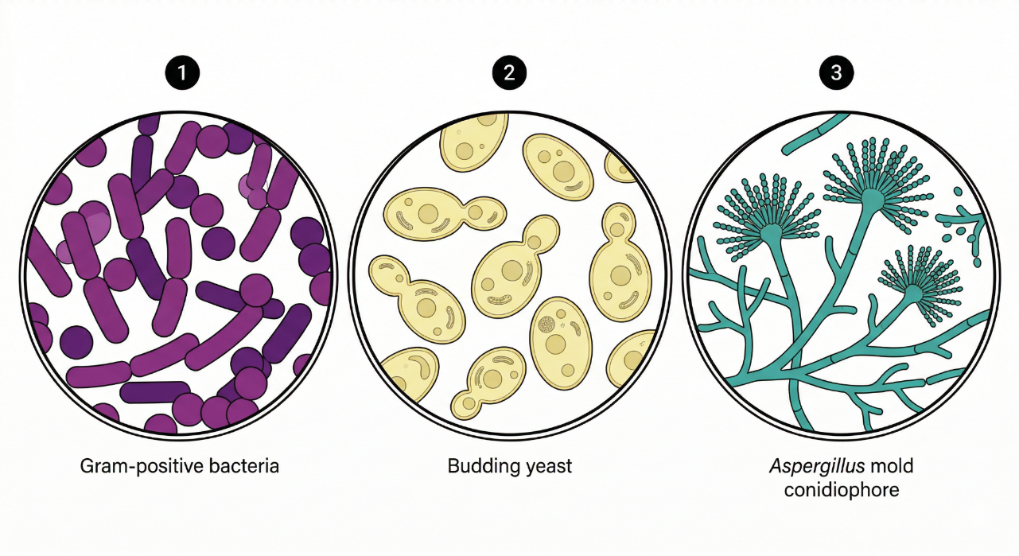

Slide 5
Industrial Applications: The Dairy Sector
The Fundamental Reaction: LAB ferment milk lactose into Lactic Acid. The pH drops below 4.6 (isoelectric point of casein), causing milk proteins to coagulate into a solid curd.
Yogurt Production:
  Utilizes a thermophilic (40-45°C) symbiotic starter culture: Streptococcus thermophilus (rapid acid production) + Lactobacillus delbrueckii subsp. bulgaricus (produces flavour compounds like acetaldehyde and diacetyl).
Cheese Production (A Two-Step Process):
  1. Curdling: Using LAB and the enzyme rennin/chymosin to form curds, separating them from liquid whey.
  2. Ripening (Curing): The curds are aged. Here, molds play a transformative role.
    Surface-Ripened: Penicillium camemberti forms the white rind on Brie/Camembert, degrading surface proteins for a gooey texture.
    Internally-Ripened: Penicillium roqueforti is pierced into Blue Cheese. Its lipases break down milk fats into sharp-tasting free fatty acids and methyl ketones.

Slide 6
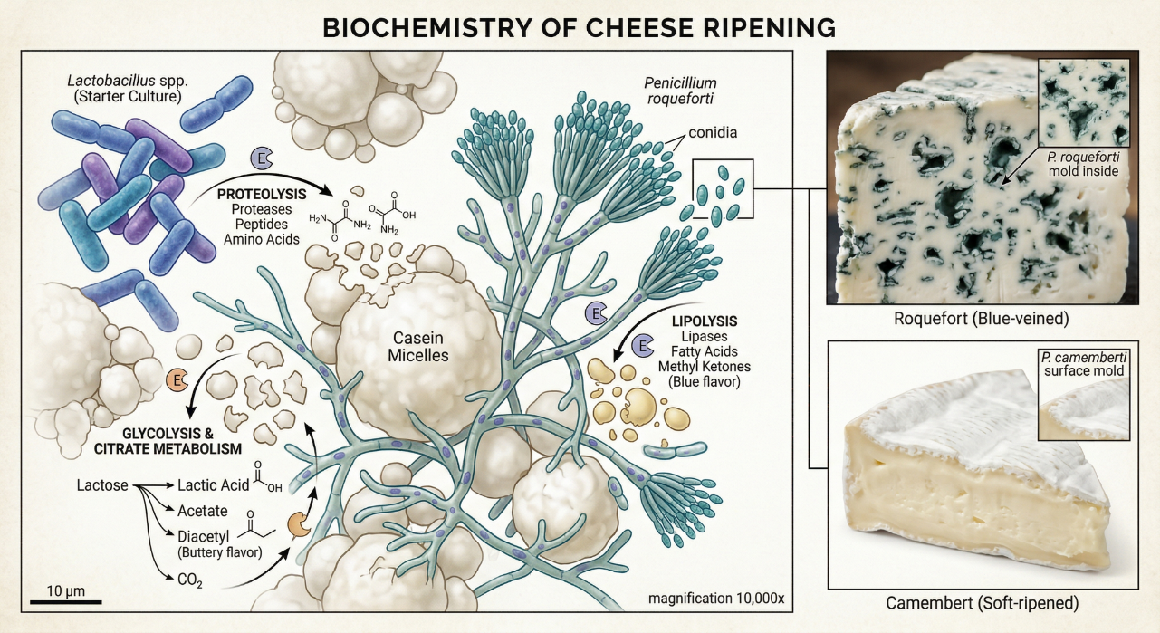

Slide 7
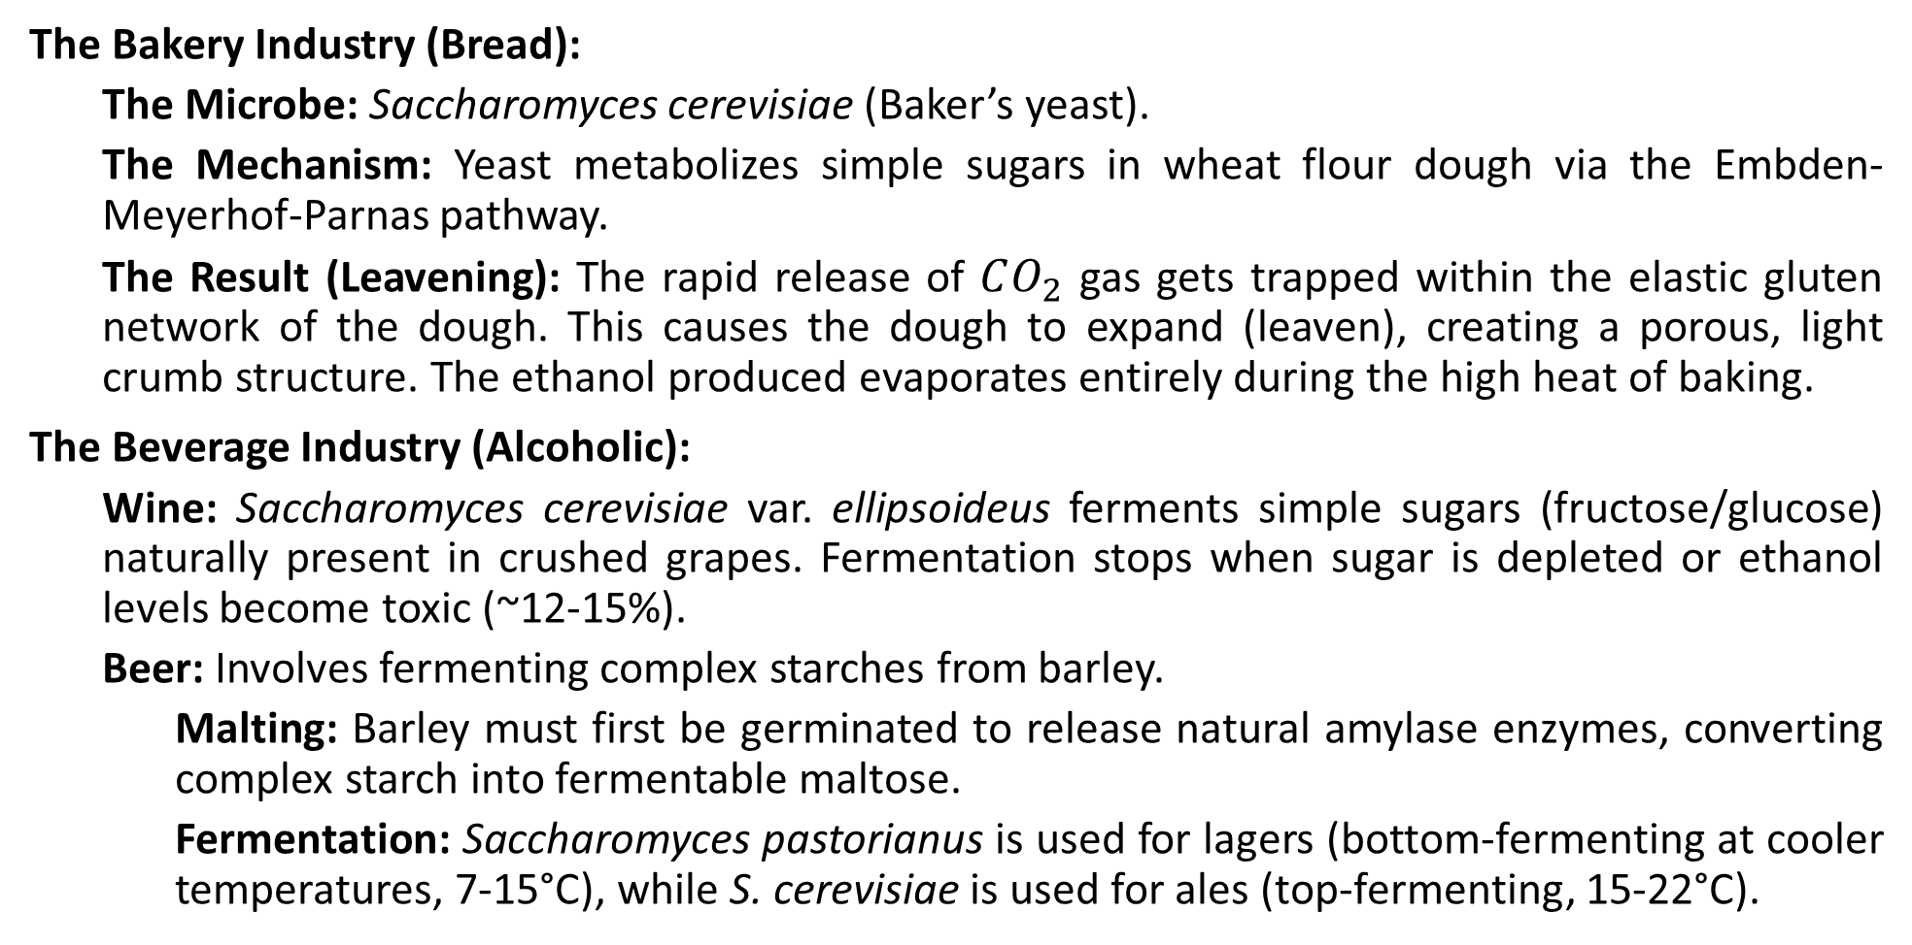
Industrial Applications: Bakery and Beverages
The Bakery Industry (Bread):
  The Microbe: Saccharomyces cerevisiae (Baker’s yeast).
  The Mechanism: Yeast metabolizes simple sugars in wheat flour dough via the Embden-Meyerhof-Parnas pathway.
  The Result (Leavening): The rapid release of $CO_{2}$ gas gets trapped within the elastic gluten network of the dough. This causes the dough to expand (leaven), creating a porous, light crumb structure. The ethanol produced evaporates entirely during the high heat of baking.
The Beverage Industry (Alcoholic):
  Wine: Saccharomyces cerevisiae var. ellipsoideus ferments simple sugars (fructose/glucose) naturally present in crushed grapes. Fermentation stops when sugar is depleted or ethanol levels become toxic (~12-15%).
  Beer: Involves fermenting complex starches from barley.
    Malting: Barley must first be germinated to release natural amylase enzymes, converting complex starch into fermentable maltose.
    Fermentation: Saccharomyces pastorianus is used for lagers (bottom-fermenting at cooler temperatures, 7-15°C), while S. cerevisiae is used for ales (top-fermenting, 15-22°C).

Slide 8
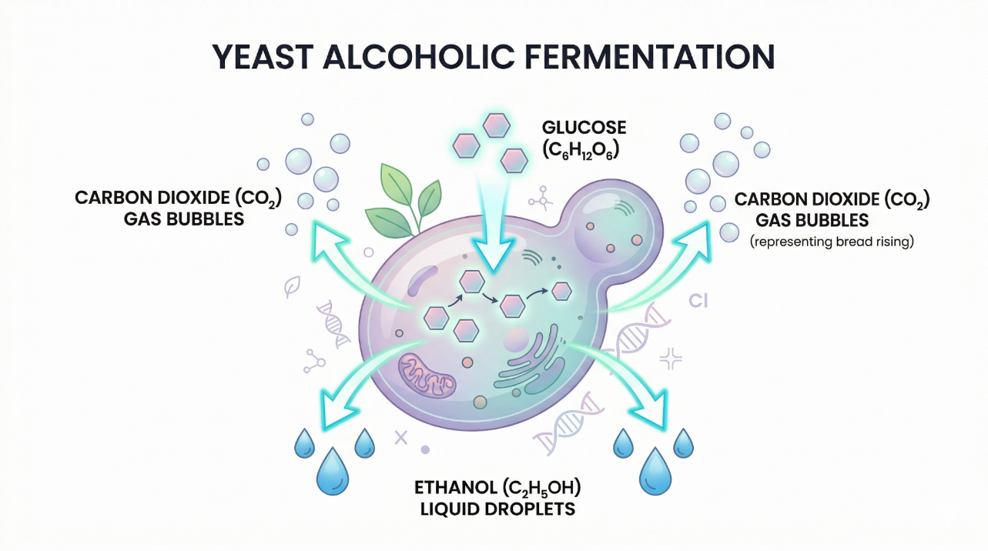

Slide 9
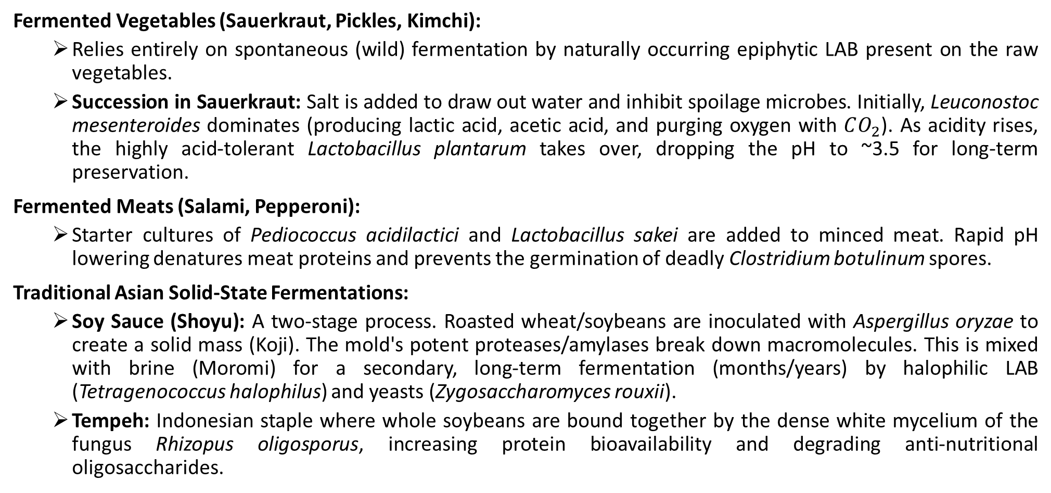
Applications: Vegetables, Meats and Traditional Foods
Fermented Vegetables (Sauerkraut, Pickles, Kimchi):
  Relies entirely on spontaneous (wild) fermentation by naturally occurring epiphytic LAB present on the raw vegetables.
  Succession in Sauerkraut: Salt is added to draw out water and inhibit spoilage microbes. Initially, Leuconostoc mesenteroides dominates (producing lactic acid, acetic acid, and purging oxygen with $CO_{2}$). As acidity rises, the highly acid-tolerant Lactobacillus plantarum takes over, dropping the pH to ~3.5 for long-term preservation.
Fermented Meats (Salami, Pepperoni):
  Starter cultures of Pediococcus acidilactici and Lactobacillus sakei are added to minced meat. Rapid pH lowering denatures meat proteins and prevents the germination of deadly Clostridium botulinum spores.
Traditional Asian Solid-State Fermentations:
  Soy Sauce (Shoyu): A two-stage process. Roasted wheat/soybeans are inoculated with Aspergillus oryzae to create a solid mass (Koji). The mold's potent proteases/amylases break down macromolecules. This is mixed with brine (Moromi) for a secondary, long-term fermentation (months/years) by halophilic LAB (Tetragenococcus halophilus) and yeasts (Zygosaccharomyces rouxii).
  Tempeh: Indonesian staple where whole soybeans are bound together by the dense white mycelium of the fungus Rhizopus oligosporus, increasing protein bioavailability and degrading anti-nutritional oligosaccharides.

Slide 10
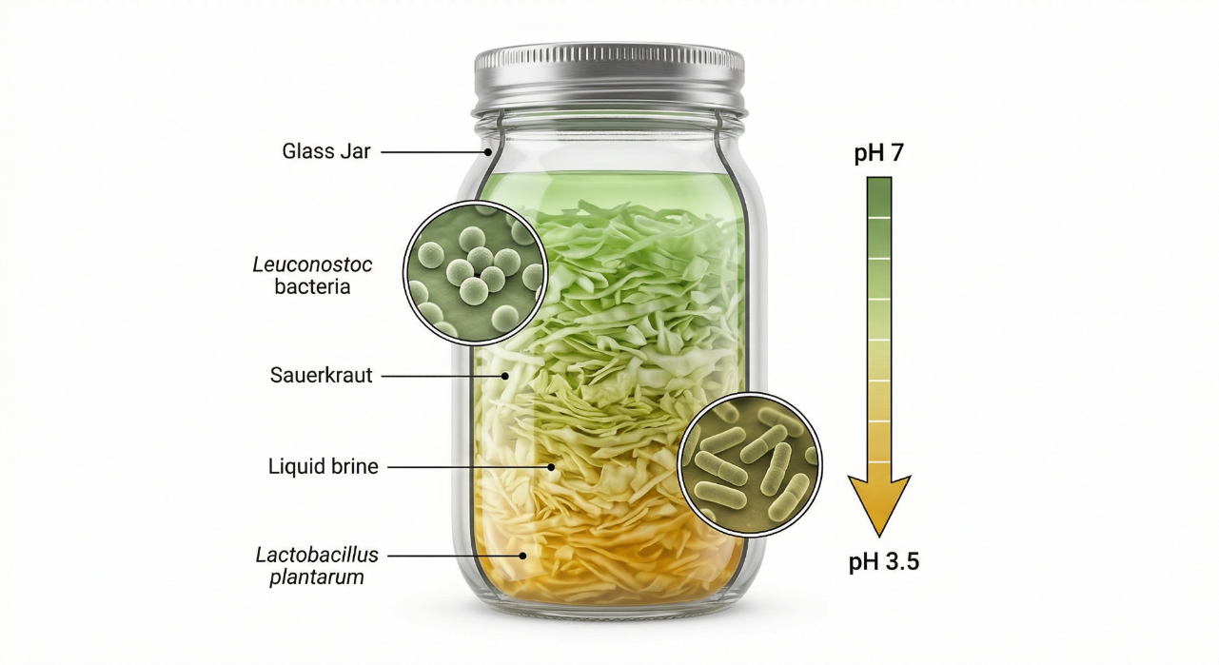

Slide 11
Single Cell Protein (SCP) Production
The Global Challenge: As the population approaches 10 billion by 2050, conventional agriculture (livestock/crops) is severely strained by land degradation, water scarcity, and climate change, leading to a looming "protein gap."
The Solution: Single Cell Protein (SCP).
Definition: SCP refers to the dried, dead cellular biomass of microbial origin (algae, bacteria, fungi, or yeast) cultivated on a massive industrial scale for use as a high-protein supplement in human nutrition or animal feed.
The Goal: To decouple protein production from arable land and traditional weather-dependent agriculture.

Slide 12
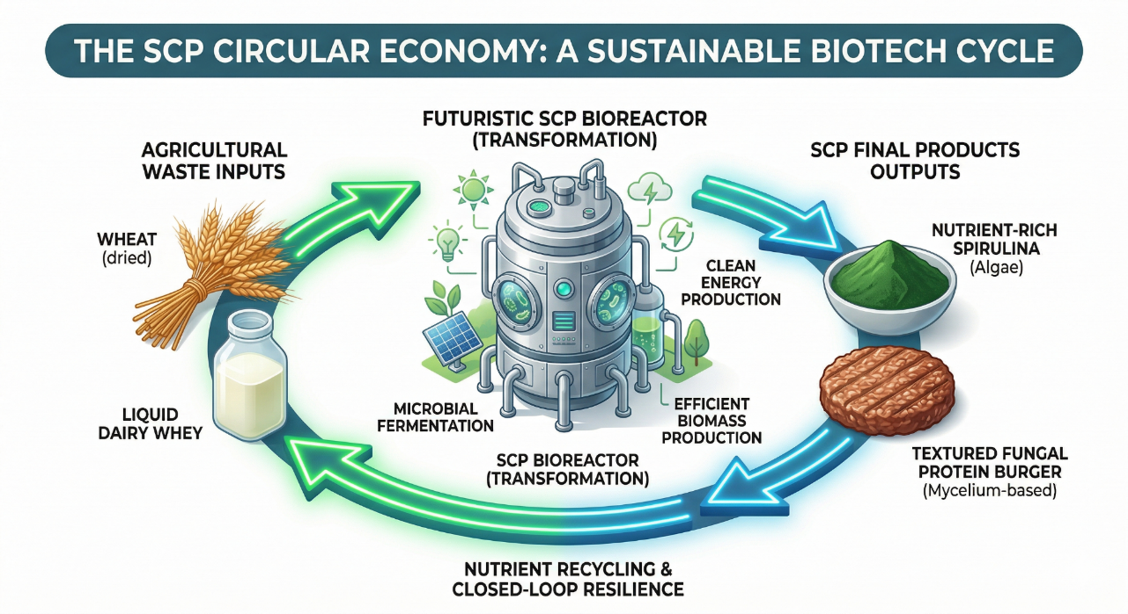

Slide 13
Advantages of SCP over Conventional Agriculture
1. Astronomical Growth Rates: Microbes have incredibly short generation times (doubling in 20-120 minutes).
  The Math: A 250kg cow synthesizes ~200g of protein per day. 250kg of a fast-growing bacterium (Methylophilus methylotrophus) can synthesize 25 tons of protein in the same 24-hour period!
2. High Nutritional Profile: Microbial biomass is exceptionally protein-dense (45% to 85% dry weight), contains a balanced profile of essential amino acids (often lacking in plant proteins like lysine and methionine), and is rich in B-vitamins and lipids.
3. Independence from Climate and Arable Land: SCP production occurs indoors in closed, controlled industrial bioreactors. It requires zero agricultural land, uses significantly less water, and is completely immune to droughts, floods, and seasonal variations.
4. Valorization of Waste (Circular Economy): SCP utilizes cheap, low-value agricultural and industrial waste streams as substrates, effectively converting environmental pollutants into high-value food.

Slide 14
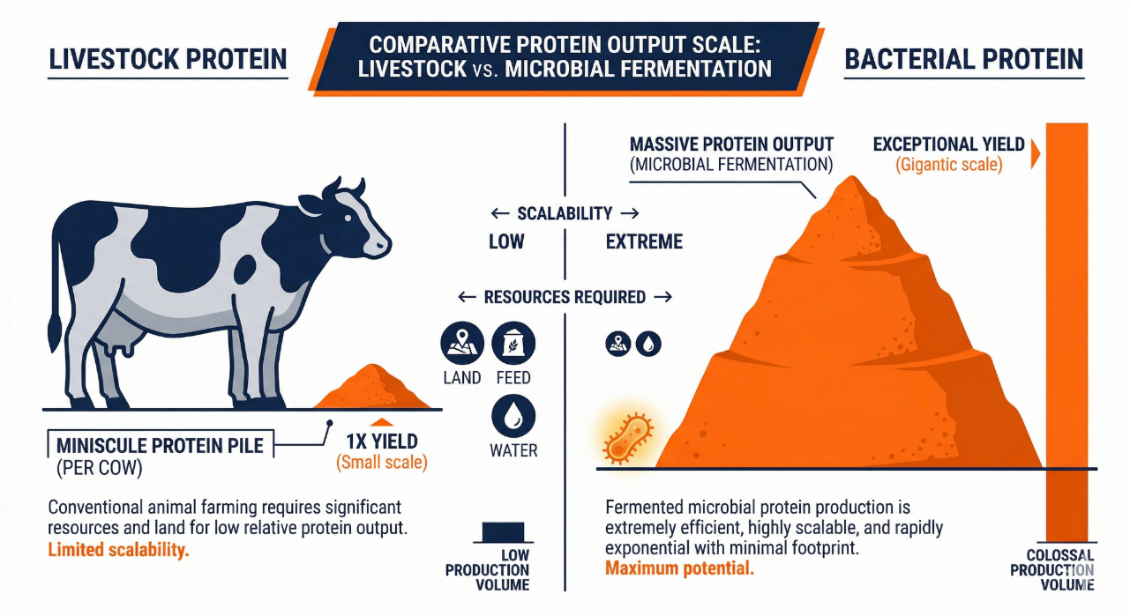

Slide 15
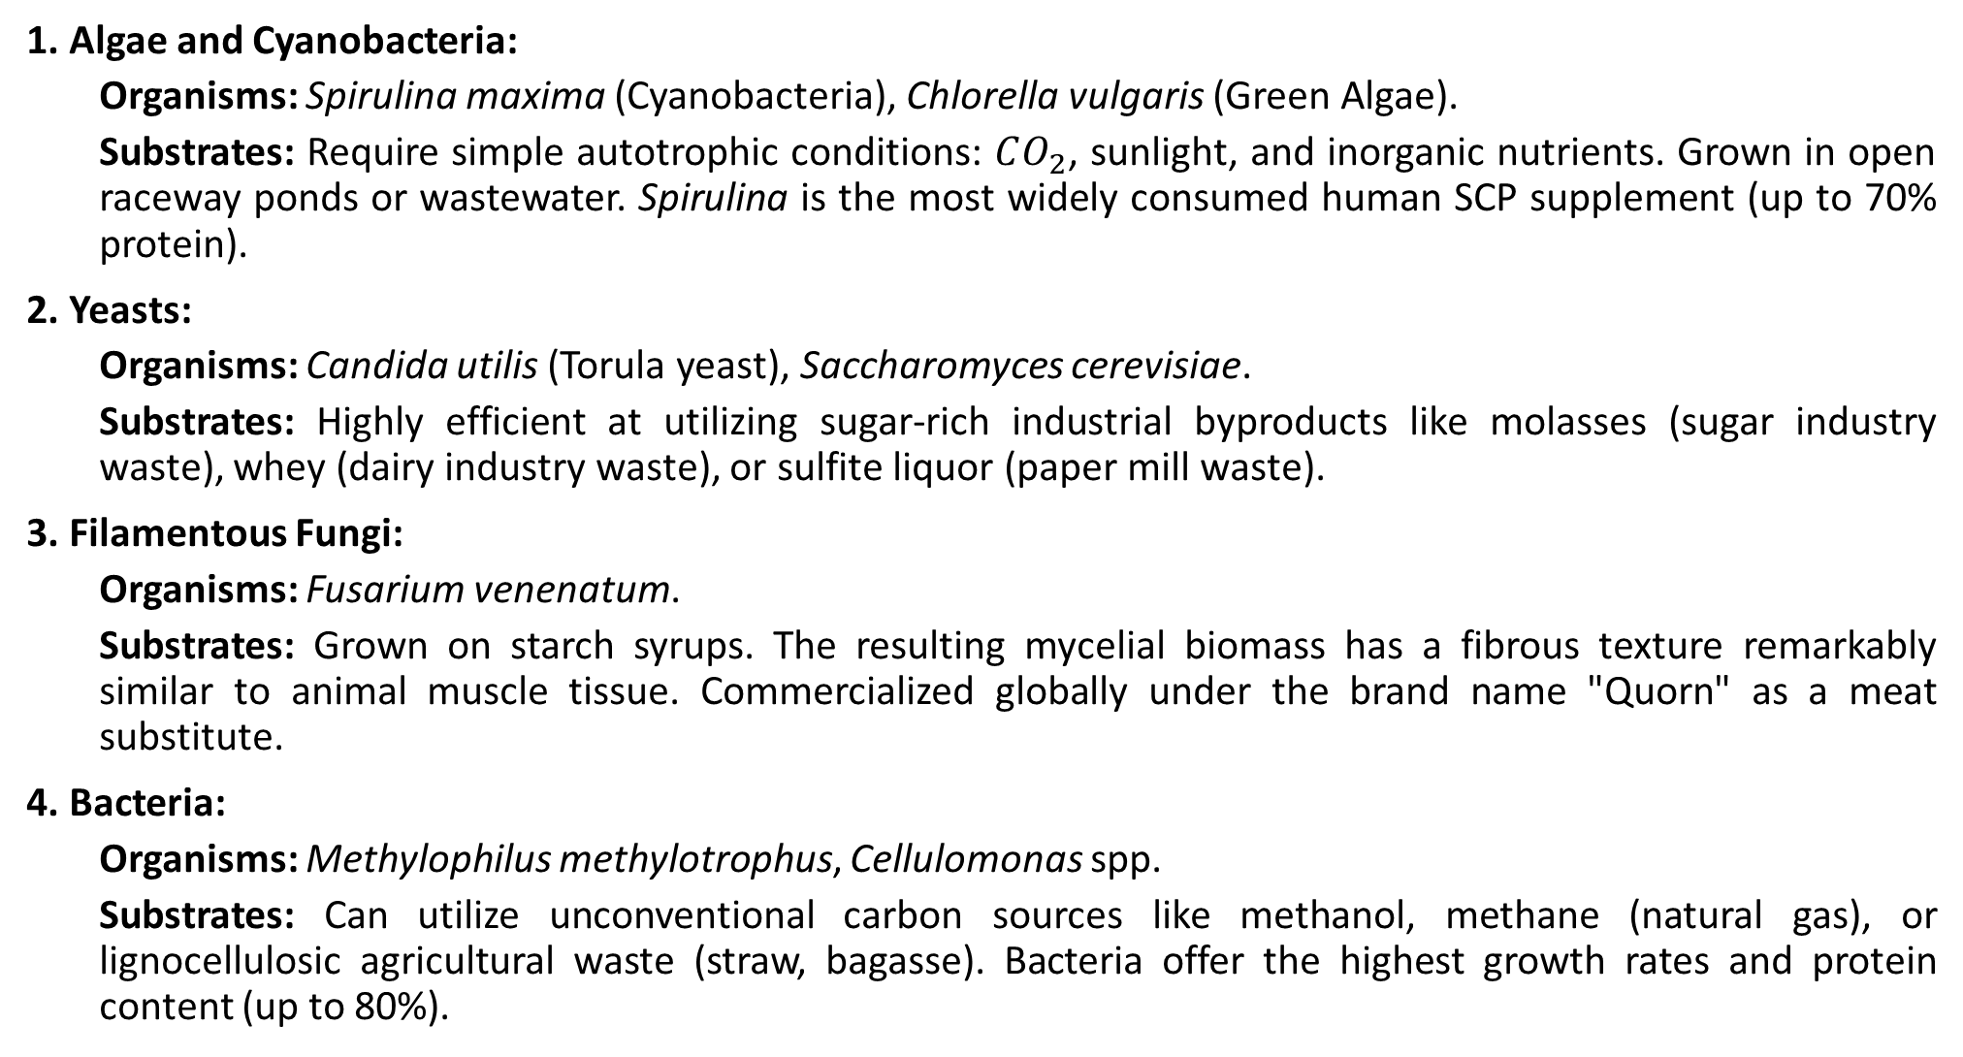
Key Microorganisms and Their Industrial Substrates
1. Algae and Cyanobacteria:
  Organisms: Spirulina maxima (Cyanobacteria), Chlorella vulgaris (Green Algae).
  Substrates: Require simple autotrophic conditions: $CO_{2}$, sunlight, and inorganic nutrients. Grown in open raceway ponds or wastewater. Spirulina is the most widely consumed human SCP supplement (up to 70% protein).
2. Yeasts:
  Organisms: Candida utilis (Torula yeast), Saccharomyces cerevisiae.
  Substrates: Highly efficient at utilizing sugar-rich industrial byproducts like molasses (sugar industry waste), whey (dairy industry waste), or sulfite liquor (paper mill waste).
3. Filamentous Fungi:
  Organisms: Fusarium venenatum.
  Substrates: Grown on starch syrups. The resulting mycelial biomass has a fibrous texture remarkably similar to animal muscle tissue. Commercialized globally under the brand name "Quorn" as a meat substitute.
4. Bacteria:
  Organisms: Methylophilus methylotrophus, Cellulomonas spp.
  Substrates: Can utilize unconventional carbon sources like methanol, methane (natural gas), or lignocellulosic agricultural waste (straw, bagasse). Bacteria offer the highest growth rates and protein content (up to 80%).

Slide 16
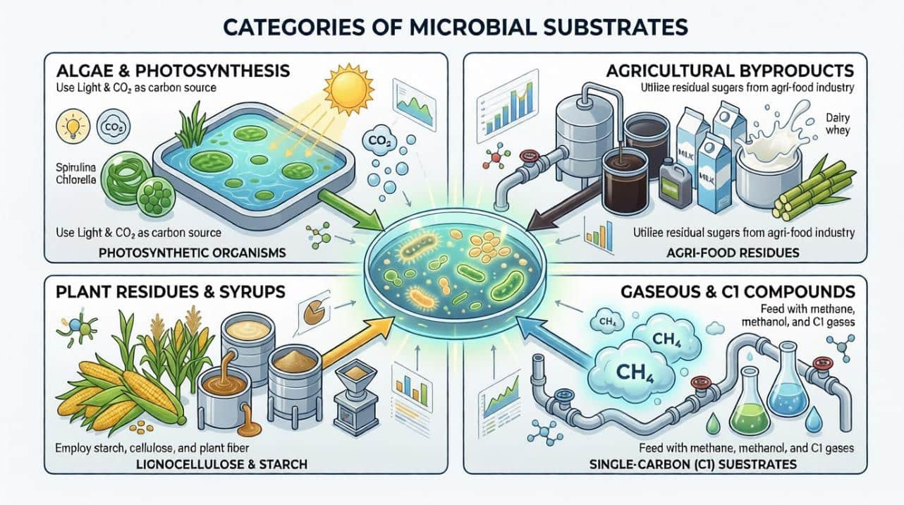

Slide 17
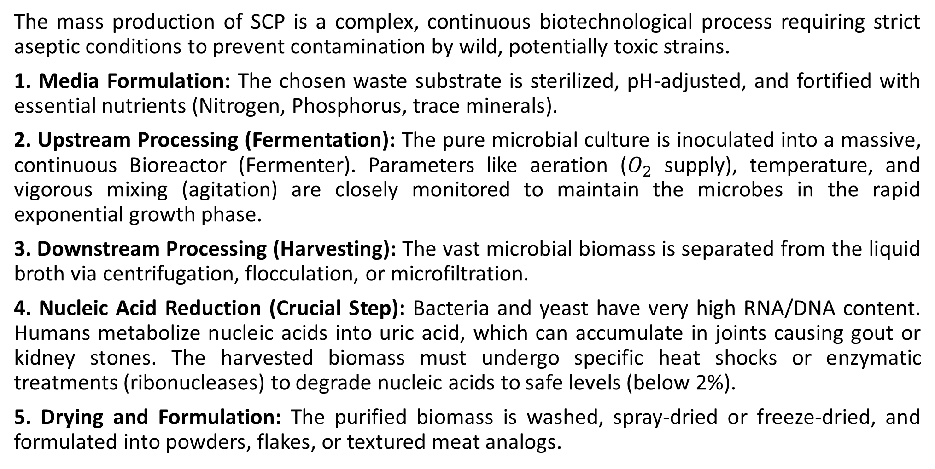
The Industrial SCP Production Process
The mass production of SCP is a complex, continuous biotechnological process requiring strict aseptic conditions to prevent contamination by wild, potentially toxic strains.
1. Media Formulation: The chosen waste substrate is sterilized, pH-adjusted, and fortified with essential nutrients (Nitrogen, Phosphorus, trace minerals).
2. Upstream Processing (Fermentation): The pure microbial culture is inoculated into a massive, continuous Bioreactor (Fermenter). Parameters like aeration ($O_{2}$ supply), temperature, and vigorous mixing (agitation) are closely monitored to maintain the microbes in the rapid exponential growth phase.
3. Downstream Processing (Harvesting): The vast microbial biomass is separated from the liquid broth via centrifugation, flocculation, or microfiltration.
4. Nucleic Acid Reduction (Crucial Step): Bacteria and yeast have very high RNA/DNA content. Humans metabolize nucleic acids into uric acid, which can accumulate in joints causing gout or kidney stones. The harvested biomass must undergo specific heat shocks or enzymatic treatments (ribonucleases) to degrade nucleic acids to safe levels (below 2%).
5. Drying and Formulation: The purified biomass is washed, spray-dried or freeze-dried, and formulated into powders, flakes, or textured meat analogs.

Slide 18
