Slide 1

Cloning Vector
Cloning Vectors

Slide 2
Cloning Vector
The molecular analysis of DNA has been made possible by the cloning of DNA. The two molecules that are required for cloning are the DNA to be cloned and a cloning vector.
A cloning vector is a small piece of DNA taken from a virus, a plasmid or the cell of a higher organism, that can be stably maintained in an organism and into which a foreign DNA fragment can be inserted for cloning purposes.
Most vectors are genetically engineered.
The cloning vector is chosen according to the size and type of DNA to be cloned.
The vector therefore contains features that allow for the convenient insertion or removal of DNA fragment in or out of the vector, for example by treating the vector and the foreign DNA with a restriction enzyme and then ligating the fragments together.
After a DNA fragment has been cloned into a cloning vector, it may be further subcloned into another vector designed for more specific use.

Slide 3

Why Cloning Vector?
Cloning vector is used as a vehicle to artificially carry foreign genetic material into another cell, where it can be replicated and expressed.
It is used to amplify a single molecule of DNA into many copes.
Cloning vectors are DNA molecules that are used to "transport" cloned sequences between biological hosts and the test tube.
Without Cloning Vector, Molecular Gene Cloning is totally impossible.

Slide 4
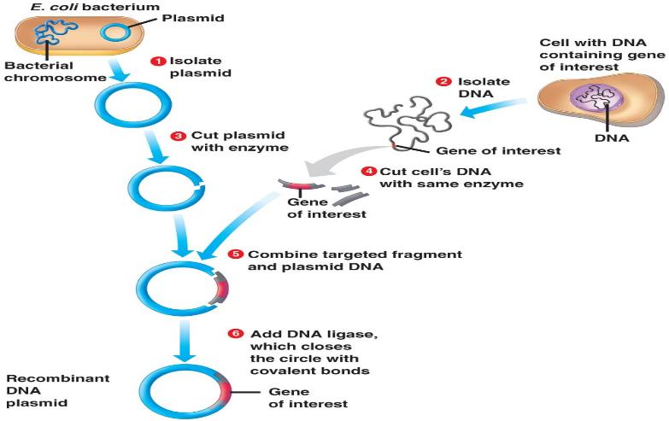
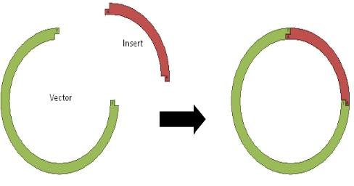
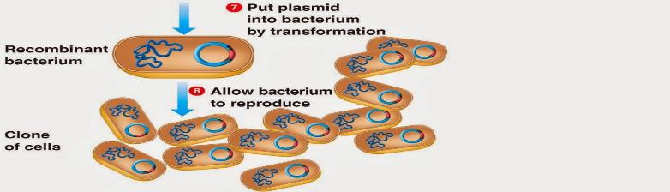
Vector in
Gene Cloning

Slide 5



History
Scientists (Herbert Boyer, Keiichi Itakura and Arthur Riggs) working in Boyer’s lab (University of California) recognized a general cloning vector with unique restriction sites for cloning in foreign DNA and the expression of antibiotic resistance genes for selection of transformed bacteria.
In 1977, they described the first vector designed for cloning purposes, pBR322 – a plasmid.
This vector was small, ~4 kb in size, and had two antibiotic resistance genes for selection.

Slide 6
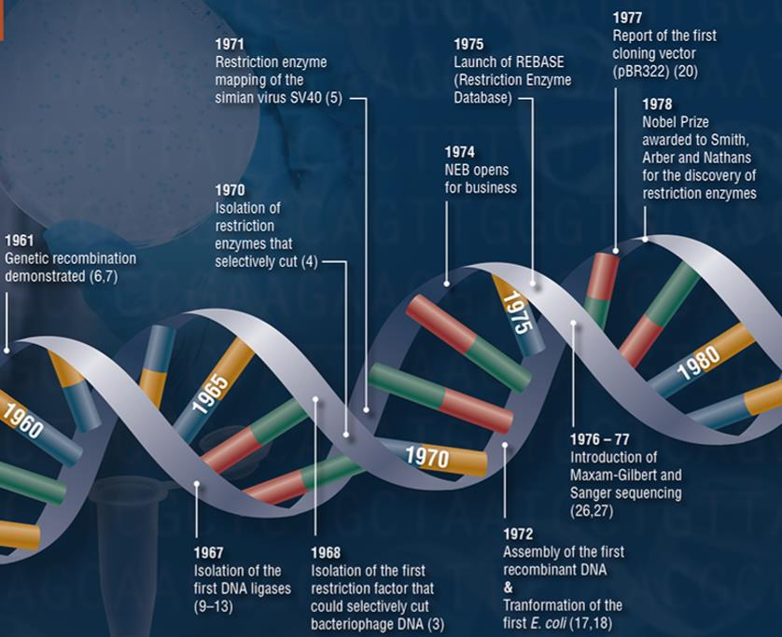

Slide 7
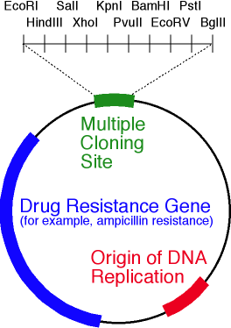
Features of A Cloning Vector
All commonly used cloning vectors have some essential features:
Origin of replication (ori):
  This makes autonomous replication in vector.
  ori is a specific sequence of nucleotide from where replication starts.
  When foreign DNA is linked to the sequence along with vector replication, foreign (desirable) DNA also starts replicating within host cell.
Cloning Site:
  Cloning site is a place where the vector DNA can be digested and desired DNA can be inserted by the same restriction enzyme.
  It is a point of entry or analysis for genetic engineering work.
  Recently recombinant plasmids contain a multiple cloning site (MCS) which have many (up to ~20) restriction sites.

Slide 8
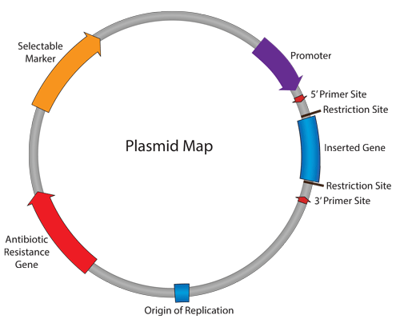
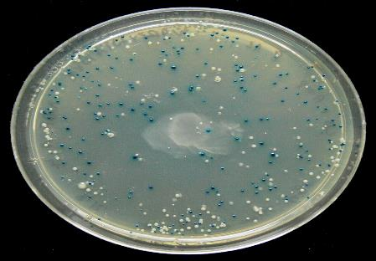
Selectable Marker
  Selectable marker is a gene that confers resistance to particular antibiotics or selective agent that would normally kill the host cell or prevent its growth.
  A cloning vector contains a selectable marker, which confer on the host cell an ability to survive and proliferate in a selective growth medium containing the particular antibiotics.
Reporter Gene or Marker Gene
  Reporter genes are used in cloning vectors to facilitate the screening of successful clones by using features of these genes that allow successful clone to be easily identified.
  Such feature present in cloning vectors is used in blue-white selection.

Slide 9


Additional Properties of Vectors:
It should be short, small.
Compatible with host cell.
Incompatible with other vector.
Should become high in copy number.
It should able to express itself utilizing the host machinery.
It should be able to move under two system (Prokaryote and Eukaryote system).

Slide 10
Types of Cloning Vectors
Plasmid
Bacteriophage
Cosmid
Bacterial Artificial Chromosome (BAC)
Yeast Artificial Chromosome (YAC)
Human Artificial Chromosome (HAC)
Retroviral Vectors

Slide 11
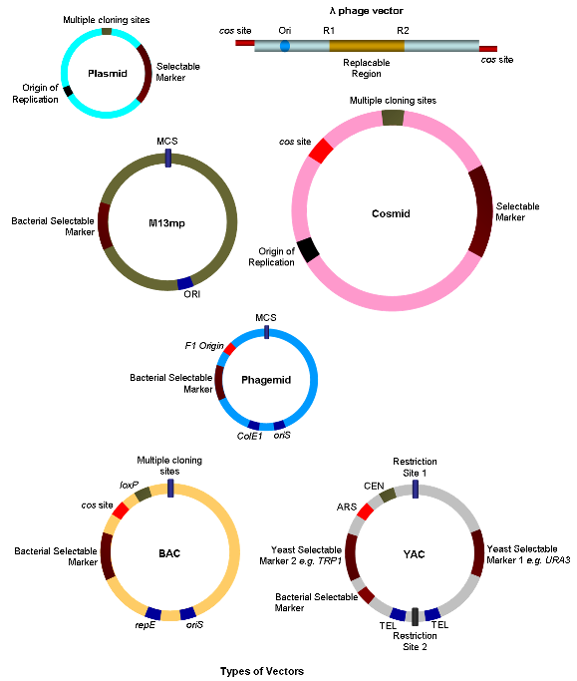

Slide 12
Plasmid
Plasmid is an autonomously replicating circular double stranded extra-chromosomal DNA which is physically separated from a chromosomal DNA and can replicate independently.
They are most commonly found in bacteria, sometimes they are present in archaea and eukaryotic organisms.
The size of the plasmid varies from 1 to over 200 kb.
Most general plasmids may be used to clone DNA insert of up to 10 kb in size.
Many plasmids have high copy number and high copy number is useful as it produces greater yield of recombinant plasmid for subsequent manipulation
However low copy number plasmids may be preferably used in certain circumstances, for example, when the protein from the cloned gene is toxic to the cells.
Example: pBR322, pUC18, F plasmid, Col Plasmid etc.

Slide 13
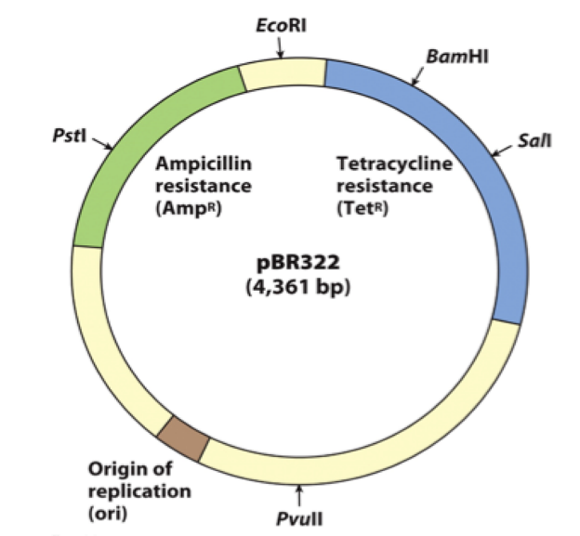
The Nomenclature of Plasmid Cloning Vector
The name ‘pBR322’ conforms with the standard rules for vector nomenclature.
‘p’ indicates that this is indeed a plasmid.
‘BR’ identified the laboratory in which the vector was originally constructed (BR stands for Bolivar and Rodriguez the two researchers who developed pBR322)
‘322’ distinguishes this plasmid from others developed in the same laboratory (there are also plasmid called pBR325, pBR327 etc.)

Slide 14
STRUCTURE OF pBR322
pBR322 DNA is a commonly used plasmid cloning vector.
pBR322 DNA is isolated from E.coli by ion exchange chromatography.
The molecule is a double-stranded circle, 4361 base pairs in length.
pBR322 is 4361 bp in length and contains:
(1) the replicon (rep) responsible for the replication of plasmid.
(2) rop gene coding for the Rop protein, which promotes conversion of the unstable RNA I - RNA II complex to a stable complex and serves to decrease copy number.
(3) bla gene, coding for beta-lactamase that confers resistance to ampicillin
(4) tet gene, encoding tetracycline resistance protein.

Slide 15
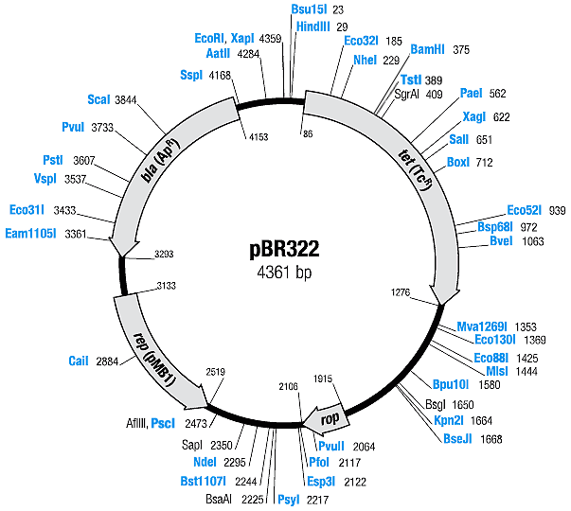

Slide 16
STRUCTURE OF pUC19
pUC19 DNA is a commonly used plasmid cloning vector in E.coli.
Isolated from E.coli by ion exchange chromatography.
The molecule is a double-stranded circle, 2686 base pairs in length.
pUC19 plasmids contain:
(1) the pMB1 replicon (rep) responsible for the replication of plasmid.
(2) bla gene, coding for beta-lactamase that confers resistance to ampicillin. It differs from that of pBR322 by single point mutation, which results in a higher copy number for pUC19 due to disruption of the gene involved in replication control.
(3) It contains region of E.coli operon lac containing CAP protein binding site, promoter, lac repressor binding site and 5'-terminal part of the lacZ gene encoding the N-terminal fragment of beta-galactosidase .

Slide 17
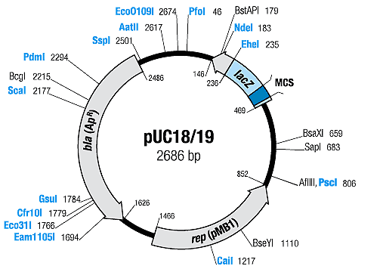

Slide 18
Why Plasmids are Good Cloning Vectors:
Small size (easy to manipulate and isolate).
Circular (more stable).
Replication independent of host cell.
Several copies may be present (facilitates replication).
Frequently have antibiotic resistance (detection easy).
Disadvantages Using Plasmids:
Cannot accept large fragments.
Sizes range from 0 – 10kb.
Standard methods of transformation are inefficient.

Slide 19
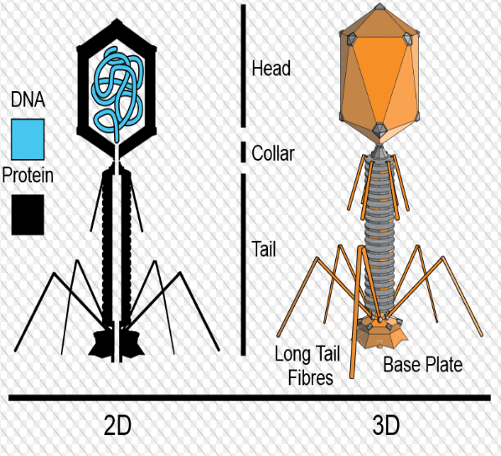
Bacteriophage
The bacteriophages used for cloning are the phage λ and M13 phage.
There is an upper limit on the amount of DNA that can be packed into a phage (a maximum of 53 kb).
There is also a lower size limit for DNA that can be packed into a phage, and vector DNA that is too small cannot be properly packaged into the phage.

Slide 20
Phage Lambda
Phage lambda is a bacteriophage or phage, i.e. bacterial virus, that uses E. coli as host.
Its structure is that of a typical phage: head, tail, tail fibres.
Lambda viral genome: 48.5 kb DNA with a 12 base ssDNA "sticky end" at both ends; these ends are complementary in sequence and can hybridize to each other (this is the cos site: cohesive ends).
Infection: lambda tail fibres adsorb to a cell surface receptor, the tail contracts, and the DNA is injected.
The DNA circularizes and lambda begins its life cycle in the E. coli host.
There are two kinds of λ phage vectors - insertion vector and replacement vector.
  Insertion vectors contain a unique cleavage site whereby foreign DNA with size of 5–11 kb may be inserted.
  In replacement vectors, the cleavage sites flank a region containing genes not essential for the lytic cycle may be deleted and replaced by the DNA insert in the cloning process.

Slide 21
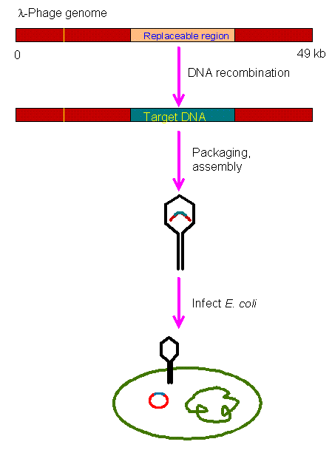
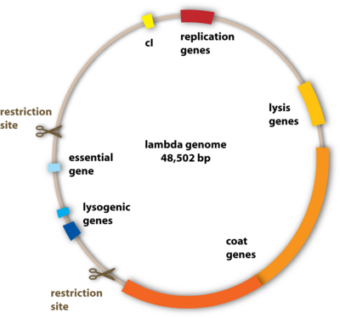

Slide 22
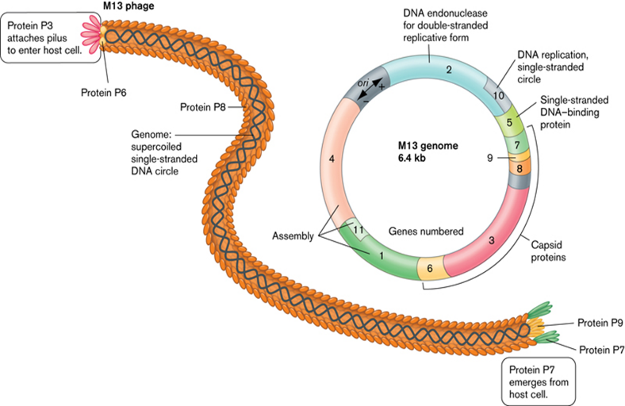
M13 Phage Vector
M13 vectors are used for obtaining ss copies of cloned DNA which are suited for DNA sequencing and in vitro mutagenesis.
They are derived from the 6.4 kb genome of the filamentous bacteriophage M13.
Very large inserts can be cloned.
Pure ss copies of DNA of dsDNA inserts are obtained.

Slide 23
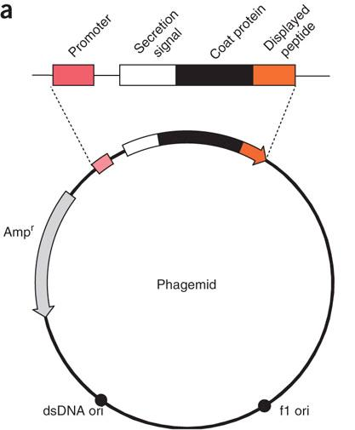
Phagemid
A phagemid or phasmid is a plasmid that contains an f1 origin of replication from an f1 phage.
It can be used as a type of cloning vector in combination with filamentous phage M13.
A phagemid can be replicated as a plasmid, and also be packaged as single stranded DNA in viral particles.

Slide 24
Phage Vectors Present Two Advantages Over Plasmid Vectors-
They are more efficient than plasmids for cloning of large DNA fragments; the largest cloned insert in lambda phage is 24 kb, while for plasmid vector it is less than 15 kb.
It is easier to screen a large number of phage plaques than bacterial colonies for identification of recombinant vectors.

Slide 25
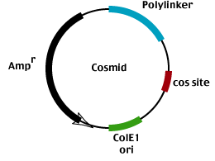
Cosmid
Cosmids are plasmids that incorporate a segment of bacteriophage λ DNA that has the cohesive end site (cos) which contains elements required for packaging DNA into λ particles.
It is normally used to clone large DNA fragments between 25 and 45 Kb.
They can replicate as plasmids if they have a suitable origin of replication.
They can also be packaged in phage capsids, which allows the foreign genes to be transferred into cells by transduction.
Advantages :
High transformation efficiency.
The cosmid vector can carry up to 45 kb whereas plasmid and Lambda phage vectors are limited to 25 kb.

Slide 26
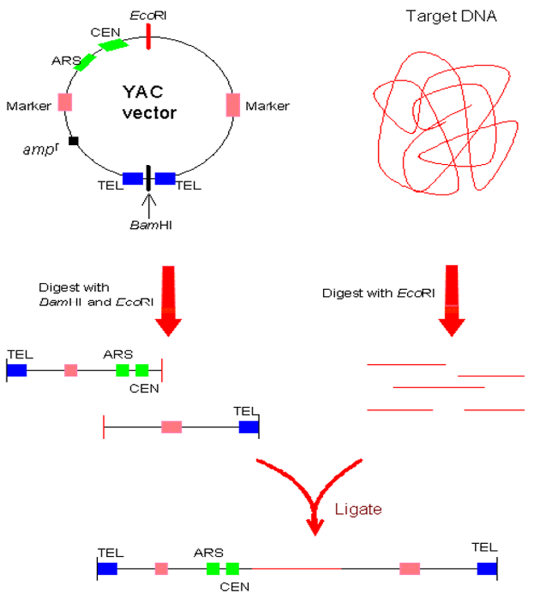
Yeast Artificial Chromosome (YAC)
The yeast artificial chromosome (YAC) vector is capable of carrying a large DNA fragment (up to 200 Kb), but its transformation efficiency is very low.
Cloning vehicles that propogate in eukaryotic cell hosts as eukaryotic chromosomes.
Final chimeric DNA is a linear DNA molecule with telomeric ends: Artificial Chromosome.
YAC cloning vehicles often have a bacterial origin of DNA replication (ori) and a selection marker for propogation of the YAC through bacteria.
The YAC can use both yeast and bacteria as a host.

Slide 27
Bacterial Artificial Chromosome (BAC)
BAC vectors are similar to standard E. coli plasmid vectors.
Contain the origin and genes encoding the ori binding proteins required for plasmid replication.
Derived from a naturally occurring large plasmid, the Fʹ plasmid.
Low copy number (1-2 copies per cell)
The bacterial artificial chromosome's usual insert size is 150-350 kb.
BACs are preferred for different kind of genetic studies of inherited or infectious diseases because they accommodate much larger sequences without the risk of rearrangement, and are therefore more stable than other types of cloning vectors.

Slide 28
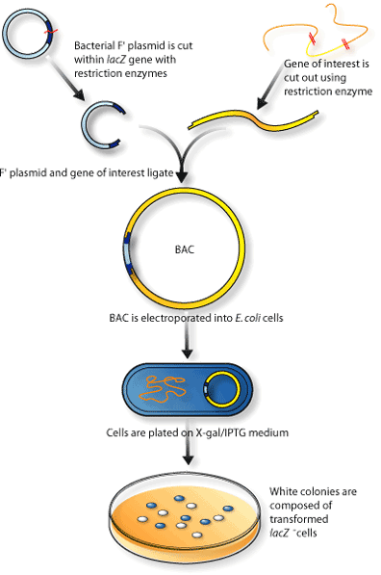
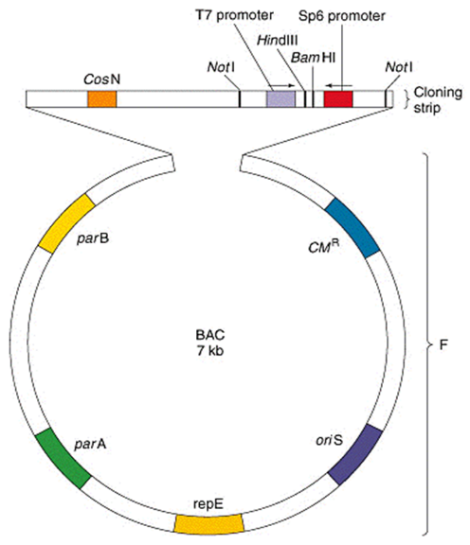

Slide 29
Advantages of BACs compared to YACs
Stable
Ease to transformation
Speed of growth of E. coli host
Simpler to purify
More user friendly
They are helpful in the development of vaccines

Slide 30
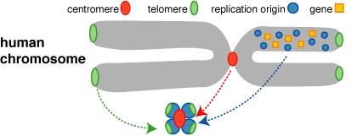
Human Artificial Chromosome (HAC)
Human artificial chromosome may be potentially useful as a gene transfer vectors for gene delivery into human cells.
It is a tool for expression studies and determining human chromosome function.
It can carry very large DNA fragment (there is no upper limit on size for practical purposes), therefore it does not have the problem of limited cloning capacity of other vectors.
It also avoids possible insertional mutagenesis caused by integration into host chromosomes by viral vector.

Slide 31
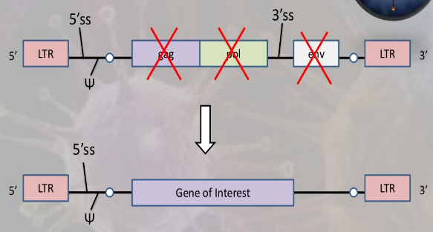
Retroviral Vectors
Retroviral vectors are used to introduce new or altered genes into the genomes of human and animal cells.
Retroviruses are RNA viruses.
The viral RNA is converted into DNA by the viral reverse transcriptase and then is efficiently integrated into the host genome
Any foreign or mutated host gene introduced into the retroviral genome will be integrated into the host chromosome and can reside there practically indefinitely.
Retroviral vectors are widely used to study oncogenes and other human genes.

Slide 32
What Determines Choice of Vector?
Insert size
Vector size
Restriction size
Cloning efficiency
Vector | Insert size (kb)
Plasmid | <10 kb
Bacteriophage | 9 – 15 kb
Cosmids | 23 – 45 kb
BACs | ≤ 300 kb
YACs | 100 – 3000 kb

Slide 33
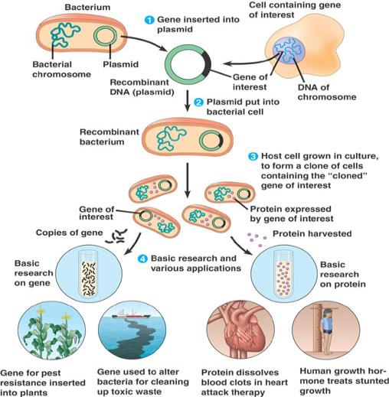
Vector in Molecular Gene Cloning
Prepare the vector and DNA to be cloned by digestion with restriction enzymes to generate complementary ends.
Ligate the foreign DNA into the vector with the enzyme DNA ligase
Introduce the DNA into bacterial cells (or yeast cells for YACs) by transformation
Select cells containing foreign DNA by screening for selectable markers (usually drug resistance).

Slide 34
References
Wikipedia
https://www.neb.com/tools-and-resources/feature-articles/foundations-of-molecular-cloning-past-present-and-future
http://www.slideshare.net/SauravDas4/cloning-vector
http://slideplayer.com/slide/6856299/
http://shomusbiology.weebly.com/cloning_vector/
www.aun.edu.eg/molecular_biology/.../2%20Cloning%20vectors.pdf
www.uenf.br/cbb/lbt/files/.../Cloning-vectors.pdf
http://yoanx7.blogspot.com/2013/05/dna-cloning-and-its-applications-preview.html
https://www.emaze.com/@AOFQRWCO/BioTechnology
https://www.ndsu.edu/pubweb/~mcclean/plsc431/cloning/clone3.htm
http://www.chemistrylearning.com/cloning-vector/

Slide 35


Slide 36



