Slide 1
Ti Plasmid

Slide 2
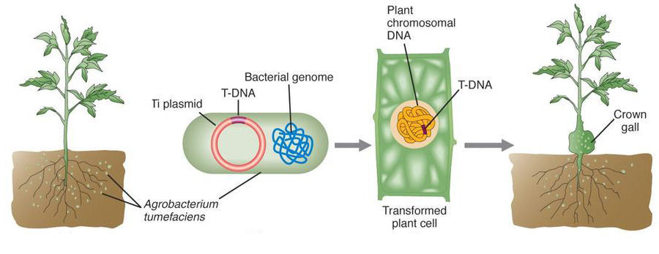
Definition
Ti-plasmid, short for tumour-inducing plasmid, is an extrachromosomal molecule of DNA found commonly in the plant pathogen Agrobacterium tumefaciens.
2
Notes:
SAY:
Before we wrap up the course, let’s review what we have learned today.
During this course, we have
<READ the bullets from the slide.>
GO to next slide.

Slide 3
Introduction
The Ti-plasmid in the bacteria is known to induce crown gall disease in plants by transferring crucial regions from the plasmid.
These crucial regions were seen to modify the plant cells into a tumour to produce synthetic plant hormones and cause crown gall.
Thus, crown gall disease is a naturally evolved genetic engineering process.
This led the scientists to believe that there is a scope for bioengineering techniques to modify the plants using Ti-plasmid for beneficial use.
3
Notes:
SAY:
Before we wrap up the course, let’s review what we have learned today.
During this course, we have
<READ the bullets from the slide.>
GO to next slide.

Slide 4
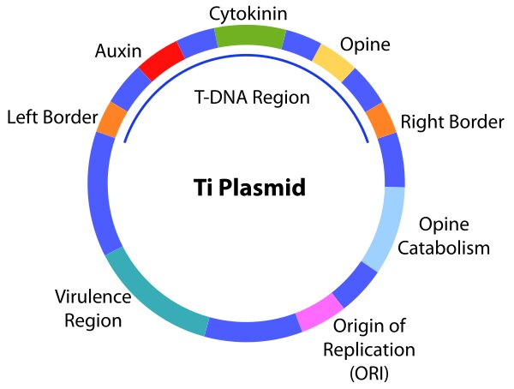
4
Notes:
SAY:
The purpose of epidemiology in public health practice is to
discover the agent, host, and environmental factors that affect health;
determine the relative importance of causes of illness, disability, and death;
identify those segments of the population that have the greatest risk from specific causes of ill health; and
evaluate the effectiveness of health programs and services in improving population health.
GO to next slide.

Slide 5
Features of Ti Plasmid
Virulence Region:
The virulence region codes for virulence genes that are responsible for the transfer of T-DNA to the plant cells and also recruiting various effector proteins for infecting the plant cells.
T-DNA:
The T-DNA region is the crucial region that gets transferred to the plant cell for infection. It is approximately 15-20kb in length and is transferred to the plant cell via means of genetic recombination.
Origin of Replication:
The origin of replication is the region where replication of the plasmid is initiated.
Opine Catabolism:
The opine catabolism region is the region from where the bacteria sources its nutrients for the whole process. Opines are derivatives of amino acid or sugar phosphates that can be catabolized to use in the form of nutrients.
The types of opines found in Ti-plasmid are nopaline and octopine types.
5
Notes:
SAY:
The purpose of epidemiology in public health practice is to
discover the agent, host, and environmental factors that affect health;
determine the relative importance of causes of illness, disability, and death;
identify those segments of the population that have the greatest risk from specific causes of ill health; and
evaluate the effectiveness of health programs and services in improving population health.
GO to next slide.

Slide 6
Uses of Ti Plasmid
They are being used to transfer genes of interest into the plant and produce plants with better quality and quantity.
It is used for the development of stress-tolerant plant varieties.
The ability of the Ti-plasmid to modify the plant cells has been taken advantage of for the production of transgenic plants.
It is therefore known as ‘nature’s genetic engineer’.
Ti plasmids are also responsible for inducing amino acids and sugar-phosphate derivatives known as opines.
6
Notes:
SAY:
The purpose of epidemiology in public health practice is to
discover the agent, host, and environmental factors that affect health;
determine the relative importance of causes of illness, disability, and death;
identify those segments of the population that have the greatest risk from specific causes of ill health; and
evaluate the effectiveness of health programs and services in improving population health.
GO to next slide.

Slide 7
Limitations of Ti Plasmid
Ti plasmid is relatively a larger plasmid (200-800 kb), and smaller plasmid vectors may be preferred in some cases.
Ti plasmid usually works only in plants that can be infected by Agrobacterium tumefaciens.
Absence of unique restriction enzyme sites on Ti plasmids.
It cannot be used for monocot plants.
7
Notes:
SAY:
The purpose of epidemiology in public health practice is to
discover the agent, host, and environmental factors that affect health;
determine the relative importance of causes of illness, disability, and death;
identify those segments of the population that have the greatest risk from specific causes of ill health; and
evaluate the effectiveness of health programs and services in improving population health.
GO to next slide.

