Slide 1
Ascomycotina
By Prabhali Doley

Slide 2
Ascomycotina
Diagonostic features:
Thallus wel developed, branched, septate mycelium (except yeast).
Complete absence of motile phase.
Sexual reproduction generally occurs by non-motile conidia and conidiophores.
Production of sac-like structure called ascus (Asci) with definite number of ascospores.
Plasmogamy is not immediately followed by karyogamy.
Production of definite fruiting bodies, the ascocarps, in most of the species.

Slide 3
General characters of Ascomycotina
Occurrence:
It includes about 2500-3500 species. Most of them are terrestrial and occur as saprophyte or as parasite. Majority of them are coprophilous fungi.
Vegetative Structure:
The mycelium is well developed and branched (except in Yeast). The hyphae are septate and multiellular. Septa are characterised by presence of a minute central pore through which protoplasmic strands pass from one cell to another. The nuclei also migrate from one cell to another through septal pores. Each cell is uninucleate or multinucleate. The nuclei may be homokaryotic or heterokayotic. The cell walls of hyphae are made up of chitin.
The Mycelium of parasitic species usually grows intercellularly but produces intracellular haustoria. The mycelium in fruiting bodies is well organised to form prosenchyma or pseudoparenchyma in some cases the hyphal masses aggregate to form sclerotium or stromata or stroma.

Slide 4
Asexual Reproduction:
It occurs by-
Fragmentation
Fission
Budding
Oidia
Chlamydospores
Conidia formation
Conidia formation is the common method of asexual reproduction. The conidia are non-motile exogenous spores produced singly or in chains from the terminal and of special hyphae called conidiophores. The conidiophores may be unicellular or multicellular, unbranched or branched. If born successively in chains the conidia may arise acrogenously (youngest on the top) or basigenously (oldest on the top).
The conidiophores may arise singly scattered over the general surface of mycelium or arise on special fruiting bodies. There are four main types of fruiting bodies which enclose conidiophores and conidia-
Synnema (Synemata): The conidiophores arise in very close packets in such a way that their greater part is fused in length, e.g., Ceratocystis ulmi
Acervuls (Acervuli): The conidiophores remain clustered in a saucer or barrel shaped stromatic mass of fructification. These are usually found in parasitic fungi.

Slide 5
3. Sporodochium (pl. sporodochia): It is a hemisperical or barrel shaped fruiting body with the lower portion of cushioned stroma like mass of hyphae. The conidiophores arise from the floor surface.
4. Pycnidum (pl. pycnidia): it is a flask-shaped body with an opening called ostiole. The conidiophores arise from the inner lining of pycnidium. The conidia are called pycnidiospores. The conidia are disseminated by air of any other means and germinate by giving out germ tubes.

Slide 6
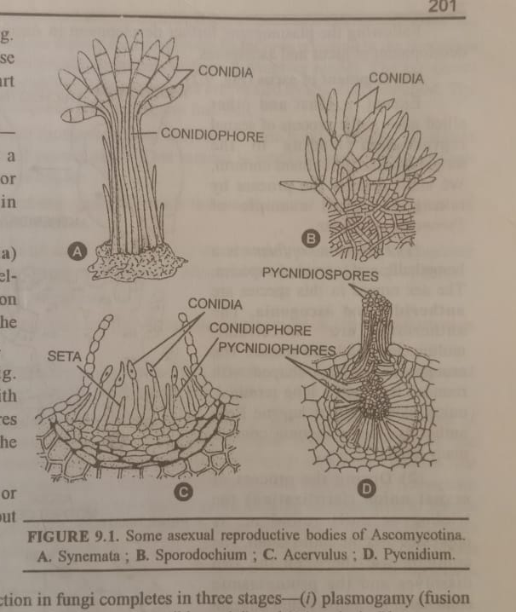

Slide 7
Sexual reproduction in Ascomycotina (Development of ascus and ascospores):
Phases:
Plasmogamy: it is the fusion of two protoplasts which brings the two compatible nuclei close together in a single cell. The resulting cell becomes dikaryon. The phenomenon is termed as dikaryotization.
Karyogamy: it is the fusion of two compatible nuclei brought together as a result of plasmogamy. The resulting diploid nucleus is called synkaryon.
Meiosis: The diploid nucleus divides by meiosis resulting in the formation of haploid nucleus. Usually meiosis occurs immediately after karyogamy.

Slide 8
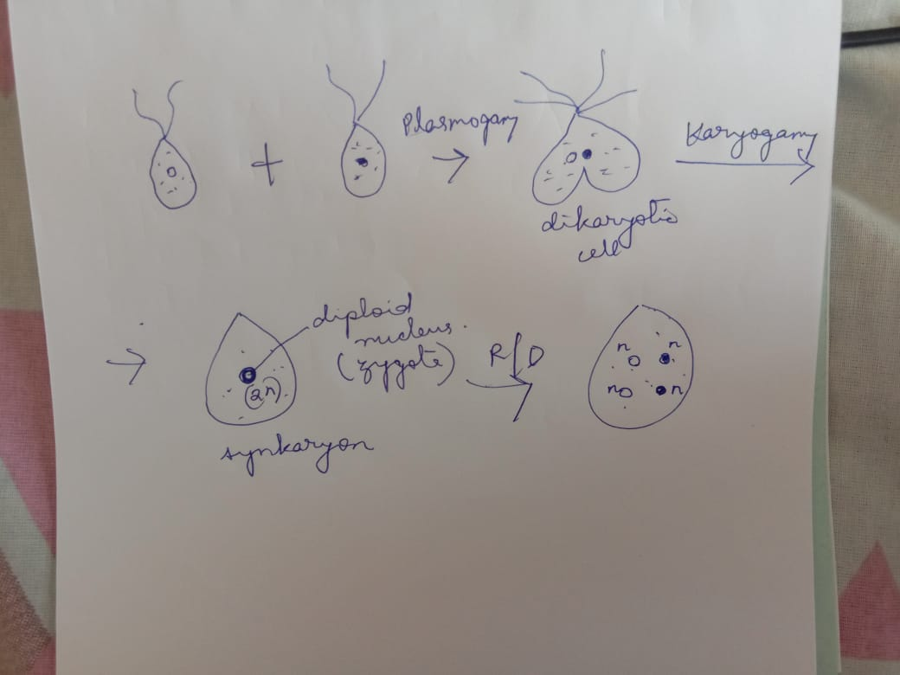

Slide 9
Modes of sexual reproduction in Ascomycotina
Gametic copulation: in this type, the male and female gametes are morphologically indistinguishable. The two identical gametes fuse with each other and the fusion cell directly transfers into single ascus. In this type of sexual reproduction the plasmogamy is immediately followed by karyogamy. Example Yeast.
Gametangial contact: In this type, the male and female reproductive organs are differentiated. The male sex organs are called antheridia and female sex organs are called ascogonia. The antheridia are usually curved to clavate and uninucleate. The ascogonium consists of cylindrical to globose body with an upper tubular neck portion called trichogyne. The trichogyne may be septate or non-septate. Sexual union occurs by migration of antheridial contents into ascogonium either through lateral pore or through dissolved tip trichogyne. The two nuclei come close together but the nuclear fusion (karyogamy) is delayed. Example: Pyronema.

Slide 10
Spermatization: In this case the antheridia are not formed. Instead, the male sex cells called spermatia are produced inside the flask shaped bodies called spermogonia. The spermatia are minute, spherical, uninucleate male sex cells which get attached to receptive hyphae or trichogyne. Example: Ascobolus.
Somatogamy: The sexual fusion occurs between the two somatic cells belonging to two compatible mycelia. Sometimes fusion occurs between two branches of the same mycelium.
Following the plasmogamy further development in ascomycotina is almost uniform. It leads to the formation or development of Ascus and Ascospores.

Slide 11
Development of ascus and ascospores:
Pyronema confluens is a homothallic and saprophytic species. The sex organs in this species are antheridia and ascogonia. The antheridia are unicellular, multinucleate and club-shaped. The ascogonium is flask shaped with rounded base and a long terminal, unicellular, curved trichogyne.
During the process of the sexual union (fertilization) the trichogyne coils round or is oppressed over the anthridium. The common wall between the two dissolved and the protoplasmic contents of the antheridium migrate into the ascogonium through the trichogyne. The male and female nuclei form pairs in ascogonium.
The plasmogamy and pairing of nuclei is followed by conjugate nuclear division resulting a large number of nuclear pairs.

Slide 12
The ascogonium gives rise a number of branched or unbranched hyphal outgrowths, known as ascogenous hypae. The nuclear pair migrates to the tip of each ascogenous hypha. The nuclear pairs continue to divide by conjugate divisions and septa are laid down with the result the ascogenous hyphae become multicellular septate.
The terminal cell of the ascogenous hyphae always possesses two nuclei of opposite strains. It bends and forms a hook-like crozier.
The two nuclei of crozier divide by mitosis in such a way that one goes to the apical portion of crozier, two remain in the middle and one goes to the basal part. Now two septa are laid down forming uninucleate terminal cell (apical cell), binucleate crook cell (penultimate cell) and uninucleate basal cell (antipenultimate cell).

Slide 13
The two nucei of crook cell fuse to form a diploid nucleus. This stage is called karyogamy. This cell with diploid nucleus and apical position becomes ascus mother cell.
The ascus mother cell elongates and the diploid nucleus divides by meiosis resulting in the formation of 4 haploid daughter nuclei. These four nuclei divide by mitosis to form 8 daughter nuclei. The cytoplasm collects around each nucleus and thin walled uninucleate ascospores are formed by free cell formation.
Usually 8 ascospores are produced endogenously inside the sac-like ascus. These ascospores are liberated and germinate to produce haploid mycelium.
It has been observed that segregation of sex i.e. (+) and (-) strains takes place in the first meiotic division of zygote nucleus. Thus out of 8 ascospores produced, 4 belong to (+) strain and 4 to (-) strain.

Slide 14
