Slide 1
Fungi
By
Prabhali Doley
Deptt of Botany
Handique Girls’ College

Slide 2
Syllabus
Unit 3 : Fungi
Introduction- General characteristics, ecology and significance, range of thallus organization, cell wall composition, nutrition, reproduction and classification; True Fungi- General characteristics, ecology and significance, life cycle of Rhizopus (Zygomycota) Penicillium,Alternaria (Ascomycota), Puccinia, Agaricus (Basidiomycota); Symbiotic Associations-Lichens: General account, reproduction and significance; Mycorrhiza: ectomycorrhiza and endomycorrhiza and their significance

Slide 3
General Characters of Fungi
Mycology (mykos=mushroom; logos=discourse): Branch of science that deals with the study of fungi is called mycology.
Definition of fungi: “a group of those plants whose form is a thallus, build up of single cell or cells that possess definite cell wall and nucleus but lack of chlorophyll”.
Fungi is a large group that includes more than 1,00,000 species distributed the world. They are ubiquitous.
They lack chlorophyll and cannot synthesize their foods.
The most usual habitat of fungi is wet soil rich in humus. A few forms are aquatic.

Slide 4
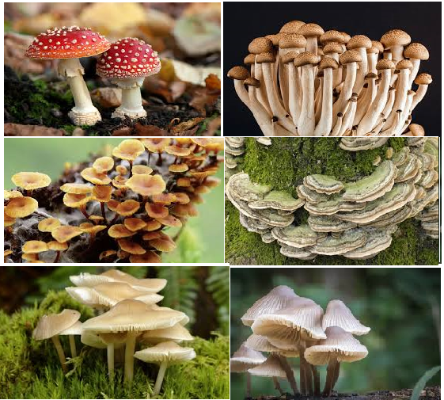

Slide 5
4. Fungi exhibit heterotrophic mode of nutrition.
5. They either parasites or saprophytes.
6. The parasites may be ectoparasites or endoparasites.
7. Some fungi are symbiosis. Eg. Lichen and Mycorrhiza
8. Parasitic fungi produces haustoria to absorb their nutrient from living protoplast.
9. The plant body is thalloid . The thallus may be unicellular or multicellular.
10. In most of the cases, thallus consists of long, tubular, branched filaments called hyphae, the mass of hyphae is called mycelium.
11. Fungal hypae made up of definite cell wall. The cell wall composed of fungal cellulose, chitin, pectose or any related materials.

Slide 6
12. The cell wall encloses protoplast which is differentiated into plasma membrane, cytoplasm, nucleus and vacuoles. Besides, there are other cytoplasmic inclusions such as mitochondria, endoplasmic reticulum, golgi apparatus and ribosomes.
13. The reserve food material is glycogen or oil droplets.
14. In some fungi, the cytoplsm is continuous in the entire mycelium and the cross wall (septa) are not formed. Such condition is called aseptate. The aseptate mycelium is usually multinucleate and this condition is called coenocytic. If the cytoplasm of mycelium is divided by cross walls, the condition is called septate and multicellular.
15. The septa possess pores, simple pore and dolipore.
16. Each cell of the multicellur mycelium may be uninucleate, binucleate (dikaryotic) or multinucleate.
17. Presence of flagella in motile bodies is the characteristic feature of some lower fungi. Uniflagellate or biflagellate. Tisel and whiplash flagella.

Slide 7
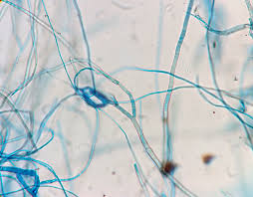
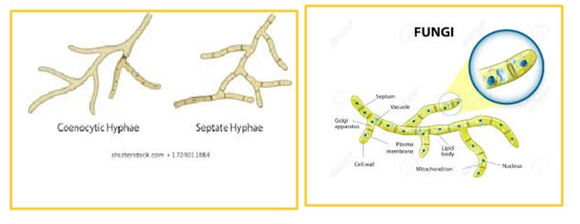

Slide 8
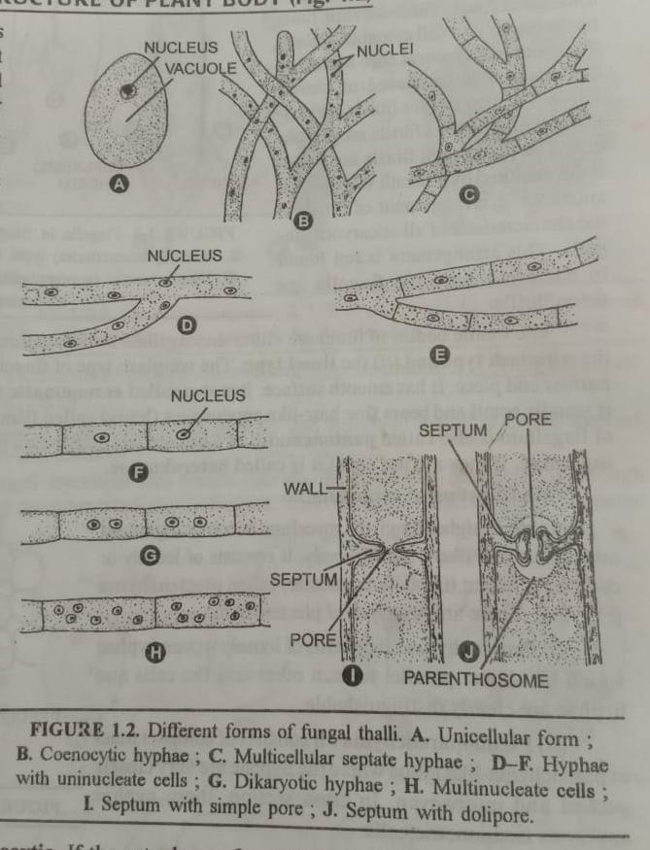

Slide 9
Reproduction
Fungi reproduce by asexual and sexual methods:
If the plant body is unicellular, the complete vegetative body transformed into reproductive boby it is called holocarpic. If a portion of vegetative thallus is transformed into reproductive structure, the condition is called eucarpic.
A. Asexual reproduction:
Fragmentation:
Budding:
Fission:
Oidia:
Chlamydospores:
Spores: Fungi reproduces most commonly by production of spores. These are minute propagating units which serve in the production of new individuals. They vary in size, shape and colour in different individuals. The asexual sopres are of two types: (a) Sporangiospores and (b) conidia.

Slide 10
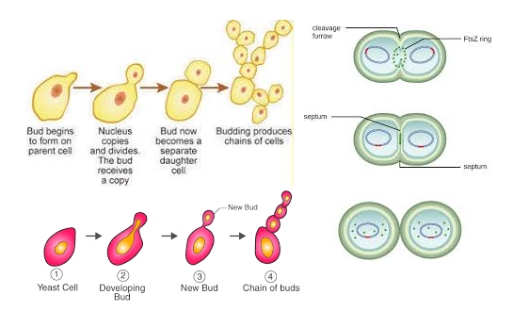
Fig: Budding and Fission

Slide 11
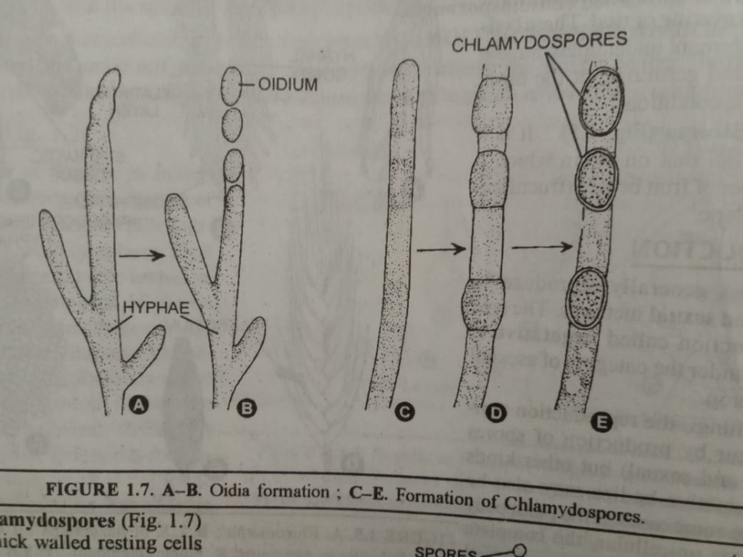
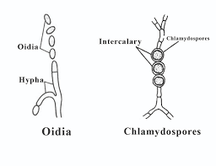
Fig: Oidia and chlamydospore

Slide 12
Sporangiospores: These spores are produced inside the sac-like structures called sporangia. Sometimes these spores are also called endospores. If the sporangiospores are non-motile, they are called aplanospores (Mucor, Rhizopus). If sporangiospores are motile, they are called zoospores.
Conidia: These are non motile spores produced singly or in chains by constrictions at the tip or lateral side of special hyphal branches, called conidiophores. They are produced exogenously. The conidia germinate directly by giving germ tube.

Slide 13
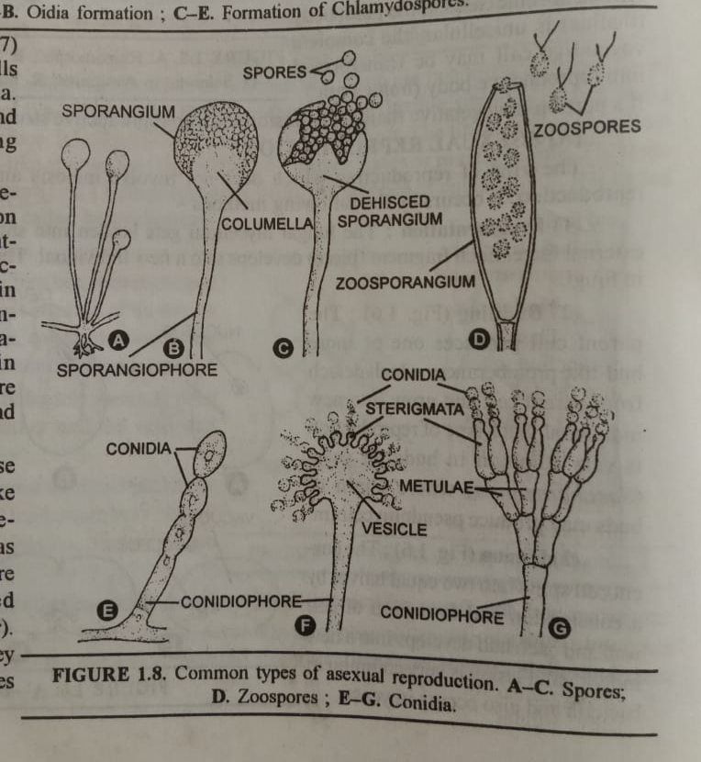

Slide 14
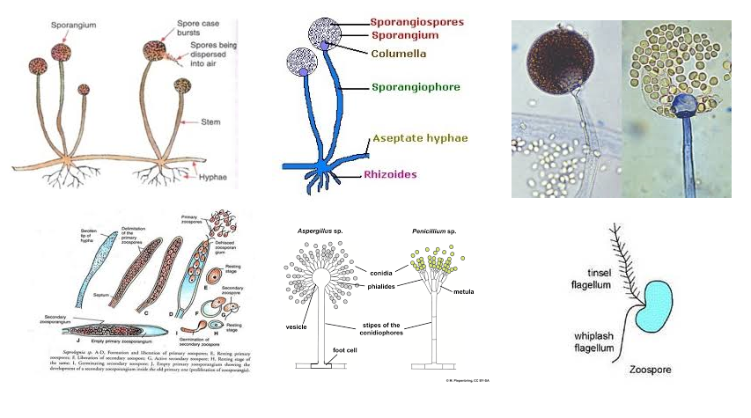
Fig: Asexual spores of Fungi

Slide 15
Thank You

