Slide 1
The Tissue System
By
Dr. Prabhali Doley
Deptt of Botany
Handique Girls’ College
Guwahati-1

Slide 2
The Tissue System
All the tissues of a plant which perform the same general function, regardless of position or continuity in the body, constitute the tissue system. The tissues of a plant are organized into three tissue systems:
A. Epidermal tissue system
B. Ground or fundamental tissue system
C. Vascular tissue system

Slide 3
A. Epidermal tissue system
Epidermal tissue system is the outermost covering of plants. It consists of (a) epidermis, (b) stomata and (c) epidermal outgrowths.
Epidermis is generally composed of single layer of parenchymatous cells compactly arranged without intercellular spaces. But it is interrupted by stomata. In leaves some specialized cells which surround the stomata are called the guard cells. Chloroplasts are present only in the guard cells of the epidermis. Other epidermal cells usually do not have chloroplasts. The outer wall of epidermis is usually covered by cuticle.

Slide 4
Stoma is a minute pore surrounded by two guard cells. The stomata occur mainly in the epidermis of leaves. In some plants such as sugarcane, the guard cells are bounded by some special cells. They are distinct from other epidermal cells. These cells are called subsidiary or accessory cells.
Trichomes and root hairs are some epidermal outgrowths. The unicellular or multicellular appendages that originate from the epidermal cells are called trichomes. Trichomes may be branched or unbranched. Rhizodermis has two types of epidermal cells - long cells and short cells. The short cells are called trichoblasts. Root hairs are produced from these trichoblasts.

Slide 5
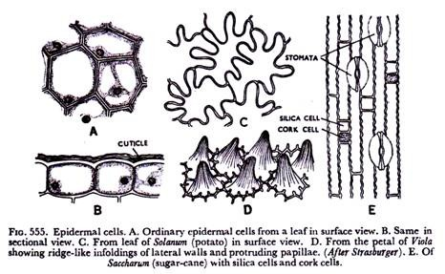
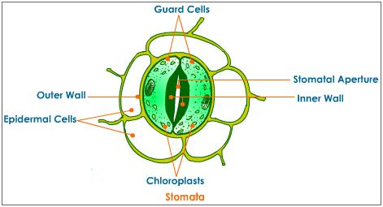

Slide 6
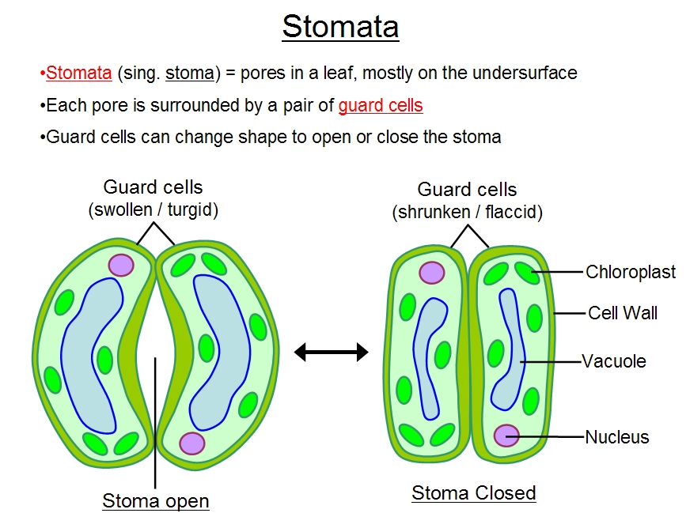

Slide 7
Types of stomata
In dicot
1. Anomocytic or irregular-celled type :
Stoma remains surrounded by a limited number of cells which cannot be distinguished from other epidermal cells. Thus the subsidiary cells are absent. This is also called Ranunculous type, common in the families Ranunculaceae, Capparidaceae and others.
2. Anisocytic or unequal-celled type :
Here the stoma remains surrounded by three subsidiary cells of which one is distinctly smaller than the other two. It is otherwise known as cruciferous type common in Cruciferae.

Slide 8
3. Diacytic or cross-celled type :
Here the stoma remain enclosed by a pair of subsidiary cells whose common wall is at right angles to the guard cells. This is also called caryophyllaceous type, common in Caryophyllaceae, Acanthaceae and others.
4. Paracytic or parallel- celled type :
The stoma is accompanied on either side by one or more subsidiary cells which lie parallel to the long axis of the pore of guard cells. This is also referred to as Rubiaceous type common in Rubiaceae, Magnoliaceae and others.

Slide 9
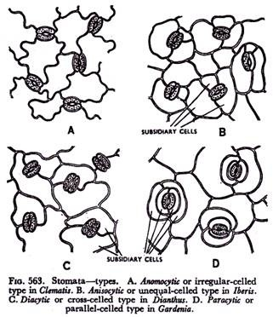

Slide 10
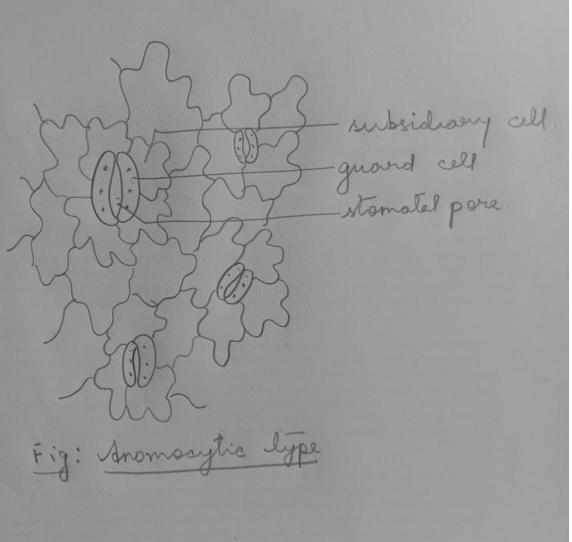

Slide 11
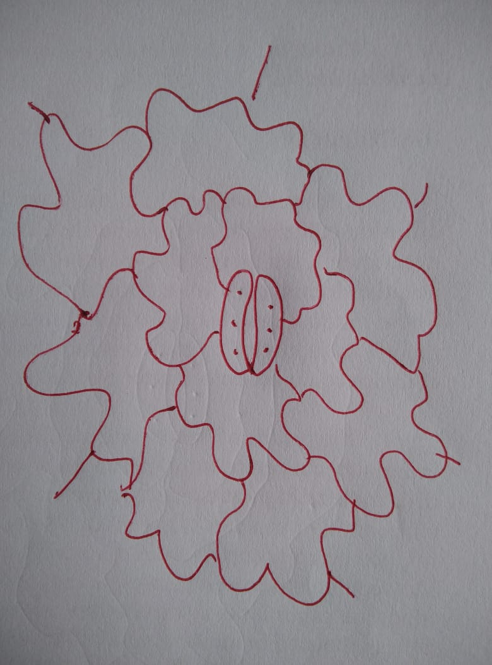

Slide 12
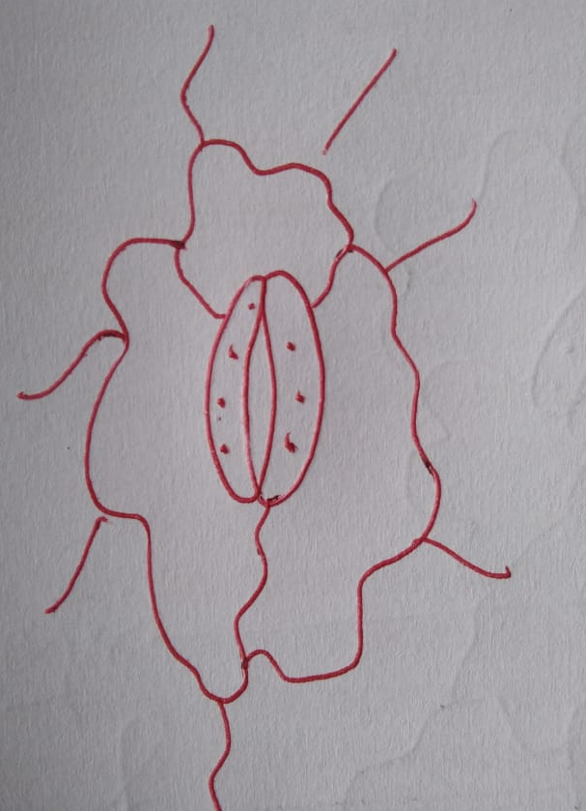

Slide 13
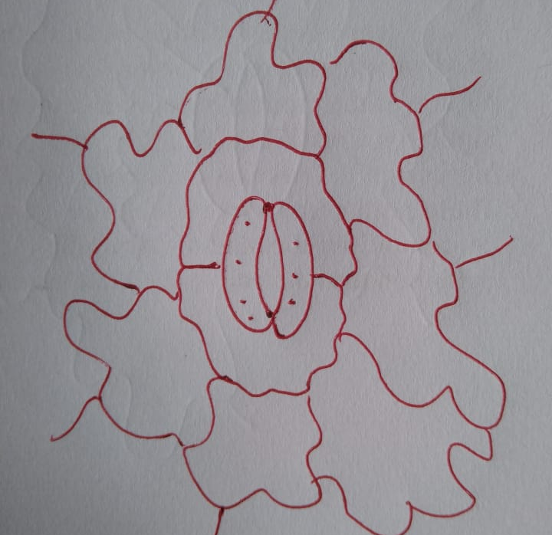

Slide 14
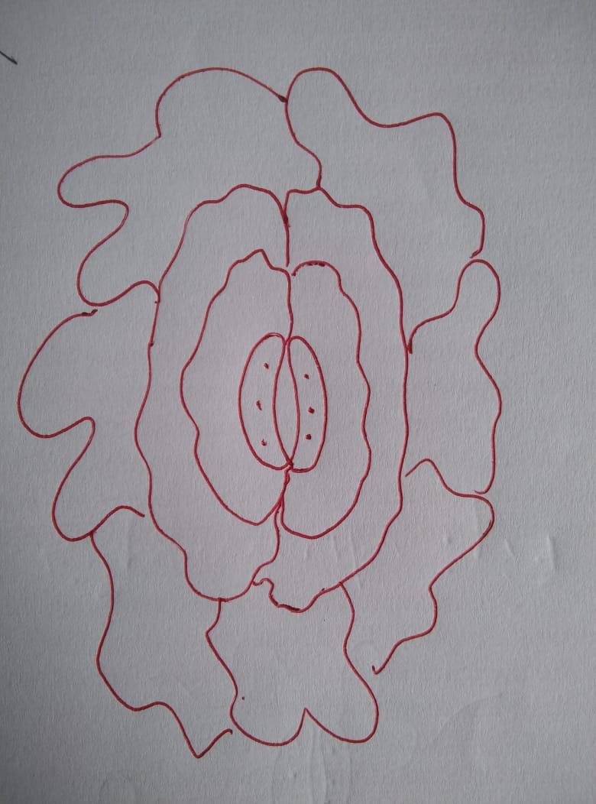

Slide 15
In monocot
Graminaceous type: Stomata of monocot plants are the tiny pores in the upper and the lower epidermis of the leaves, which are surrounded by a pair of dumbbell-shaped guard cells. Since the stomata of monocots are equally distributed in both upper and the lower epidermis, the stomata distribution of monocots is known as an amphistomatic distribution. Due to the amphistomatic distribution of stomata in monocots, the frequency of transpiration can be high than that of a dicot leaf. Therefore in the presence of excess sunlight, monocot leaves are rolled to reduce the surface area of the leaf, preventing the water loss.

Slide 16
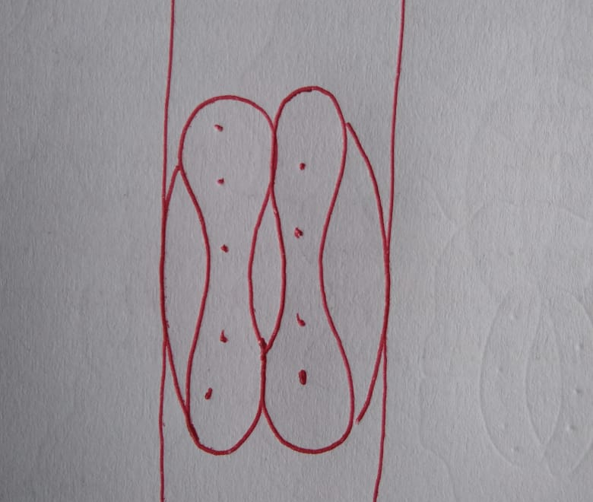

Slide 17
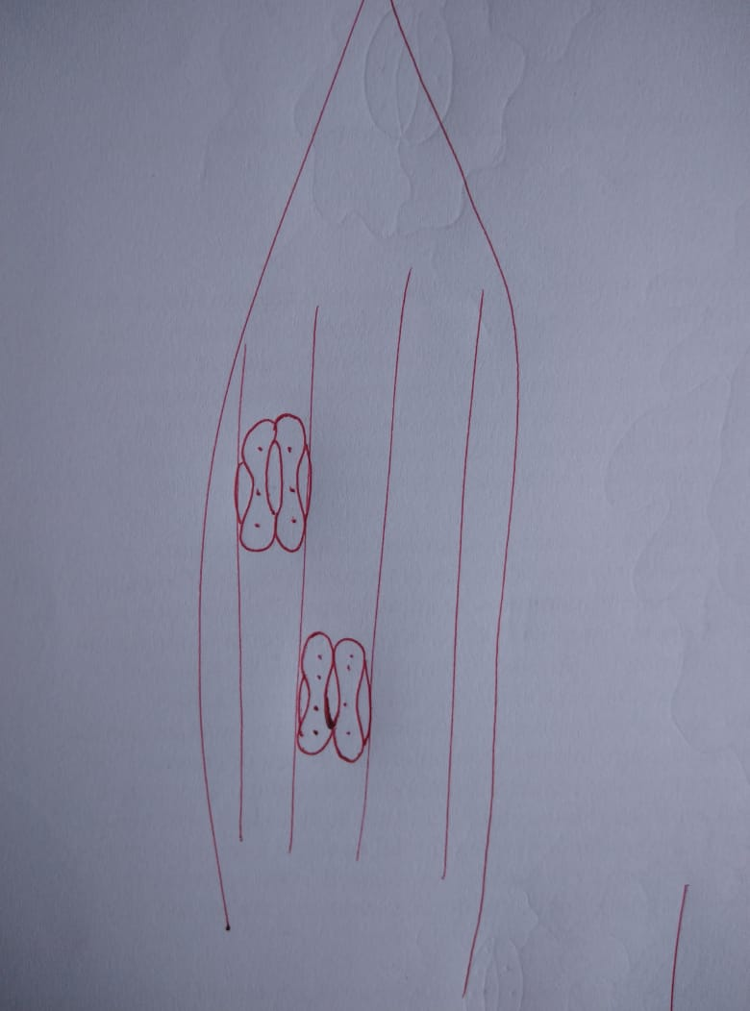

Slide 18
Functions of stomata
Stomata are very important structures from physiological point of view.
Physiological functions like photosynthesis, respiration and transpiration take place with the help of stomata, as these phenomenon are exchange of gases between the intercellular spaces of the internal cells and the outer atmosphere.

Slide 19
Functions of epidermal tissue system
This tissue system in the shoot checks excessive loss of water due to the presence of cuticle.
2. Epidermis protects the underlying tissues.
3. Stomata involve in transpiration and gaseous exchange.
4. Trichomes are also helpful in the dispersal of seeds and fruits.
5. Root hairs absorb water and mineral salts from the soil.

Slide 20
B. Ground or fundamental tissue system
It includes all the tissues of the plant body except epidermal and vascular tissues.
(i) Hypodermis: It is situated below the epidermis. It is multilayered and made up of parenchymatous and sclerenchymatous cells.
(ii) General Cortex: This consists of parenchymatous cells with or without chloroplasts.
(iii) Endodermis: Endodermis is single layered made up of parenchymatous cells. The radial and internal walls of endodermal cell are thickened; a band of lignin or suberin knows as casparian strip is sometimes found on the radial and transverse wall of every cell.

Slide 21
(iv) Pericycle: It is single or multilayered and is situated in between endodermis and vascular bundles. It is made up of sclerenchymatous and parechymatous cells.
(v) Pith: The central portion in stems and roots is called pith or medulla. It is made up of parenchymatous cells with intercellular spaces. In dicot stem the pith is large and well developed; in dicot roots the pith is either absent or small; in monocot roots large pith is present; in monocot stem the vascular bundles are scattered and the ground tissue is not marked into different parts.

Slide 22
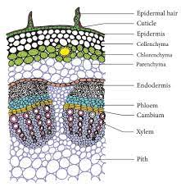
Fig: T.S. of Dicot stem

Slide 23
C. Vascular tissue system
It consists of xylem and phloem tissues which are found as strands termed as vascular bundles. The main function of xylem is to conduct water, materials to different parts of the plant body. The main function of phloem is transportation of food materials in different parts of the plant.
(i) Radial Bundles: Xylem and phloem strands are located on alternate radii in radial vascular bundles. These are mainly found in roots.
(ii) Conjoint bundles: Xylem and phloem combine together into one bundles, Xylem lies towards the centre and phloem towards the periphery. There are two types of conjoint bundles.

Slide 24
a. Collateral: Xylem and phloem lie on the same radius, xylem towards the centre and phloem towards the periphery. When cambium is present in collateral bundles, such bundle is called open, e.g. in dicot stems and collateral bundle without cambium is called closed, e.g. in monocot stems.
b. Bicollateral: In this type of bundle, the phloem strands are present on both outer and inner side of xylem.

Slide 25
(iii) Concentric Bundles:
In this type of vascular bundle, one tissue is completely surrounded by the other. These are of two types Amphivasal and Amphicribral.
Amphivasal: In this type of vascular bundle xylem surrounds the phloem, e.g. Dracaena.
Amphicribral: In this type, phloem surrounds the xylem, e.g. in Ferns.

Slide 26
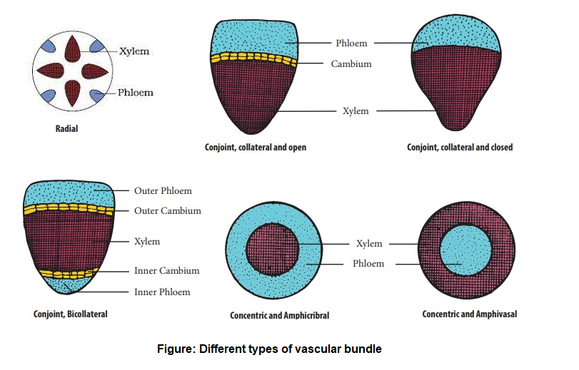

Slide 27
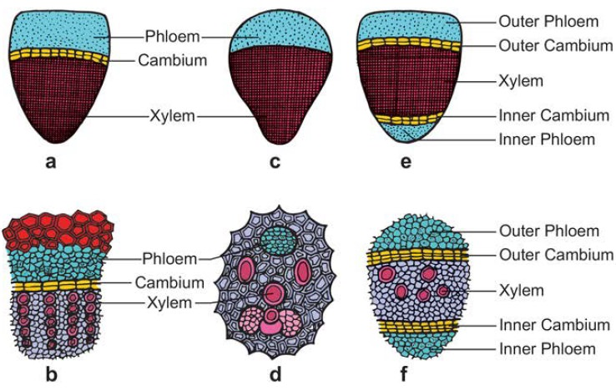

Slide 28
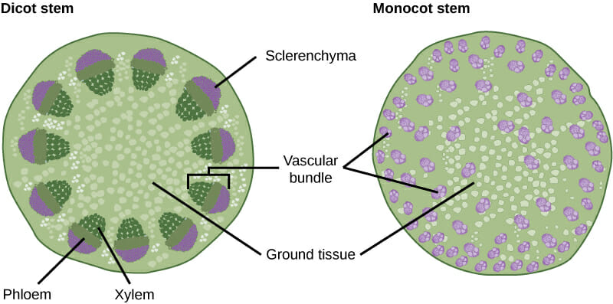

Slide 29
Tissue system | Components | Functions
Epidermal tissue system | Epidermis, periderm (older stems and roots) | Protection 2. Prevention of water loss
Ground tissue system | Parenchyma tissue Collenchyma tissue Sclerenchyma tissue | Photsynthesis Food storage Regeneration Support protection
Vascular tissue system | Vascular bundles: Xylem tissue Phloem tissue | Transport of water and minerals Transport of organic foods

Slide 30
Thank You

