Slide 1
GENE SILENCING

Slide 2
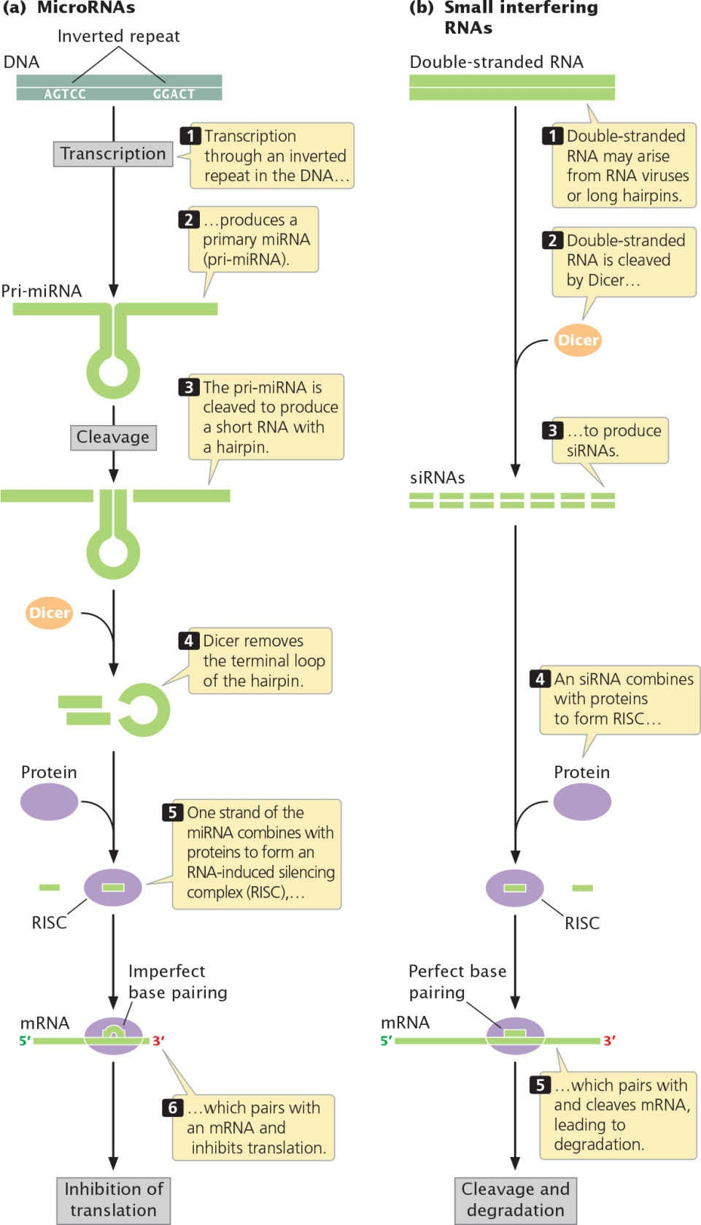
transcription.

Slide 3
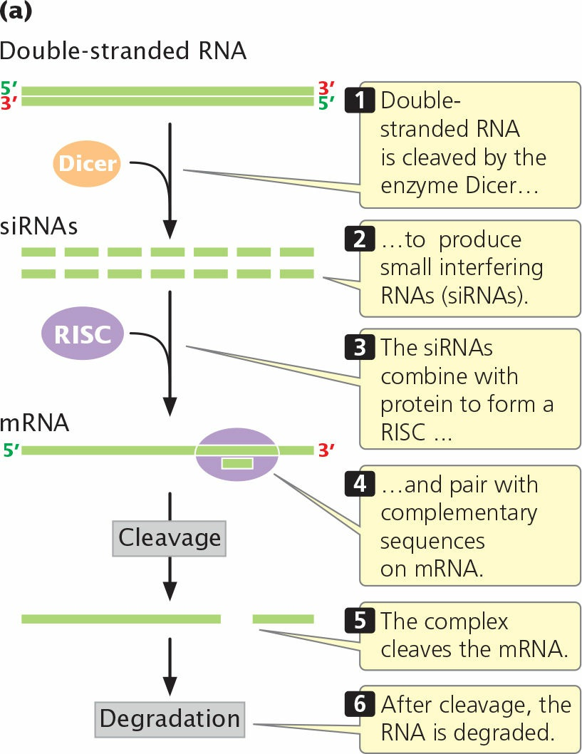
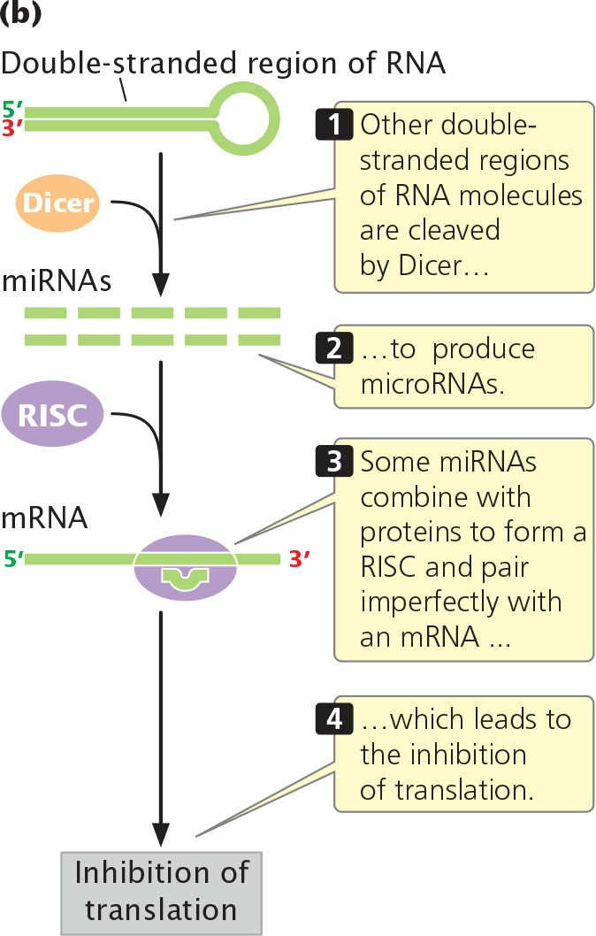
Source: Genetics- A conceptual approach (by Benjamin A. Pierce; 8th edition)

Slide 4
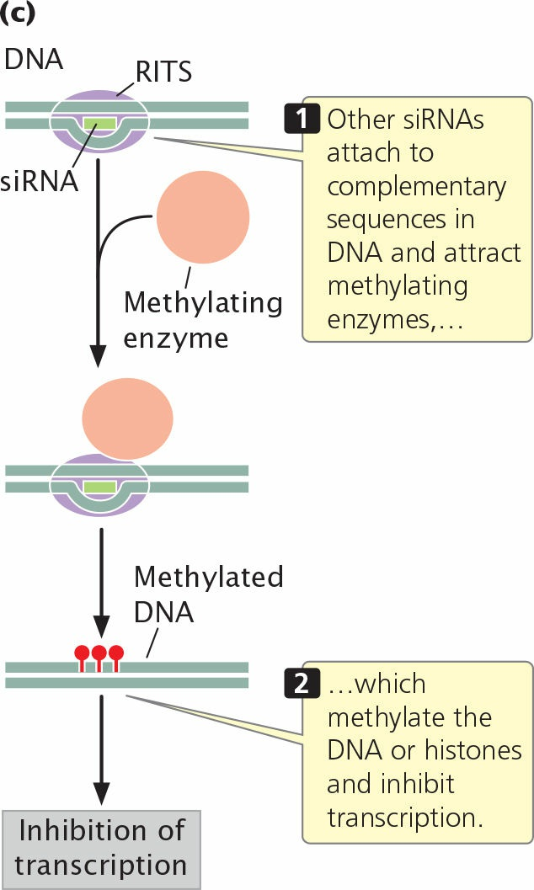
Source: Genetics- A conceptual approach (by Benjamin A. Pierce; 8th edition)

