Slide 1
The trp operon
Dr. Kuntala S. Bordoloi
Assistant Professor
Department of Botany
Handique Girls’ College

Slide 2
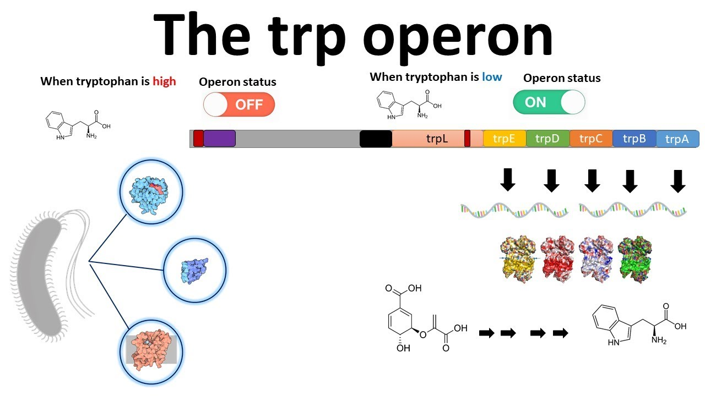

Slide 3
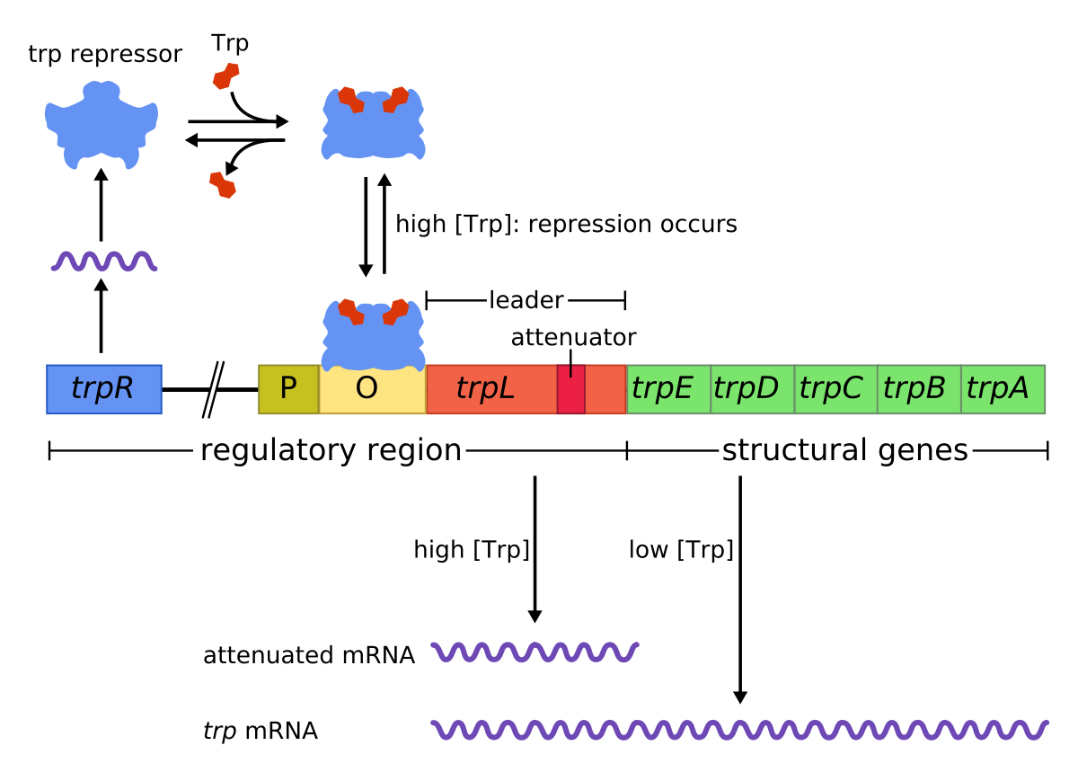

Slide 4
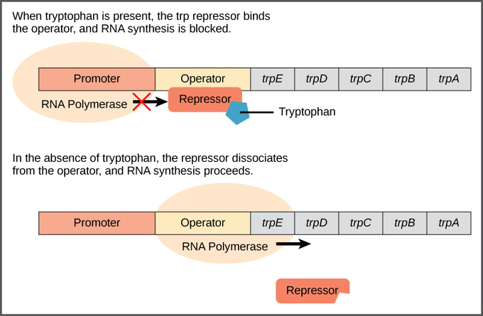

Slide 5
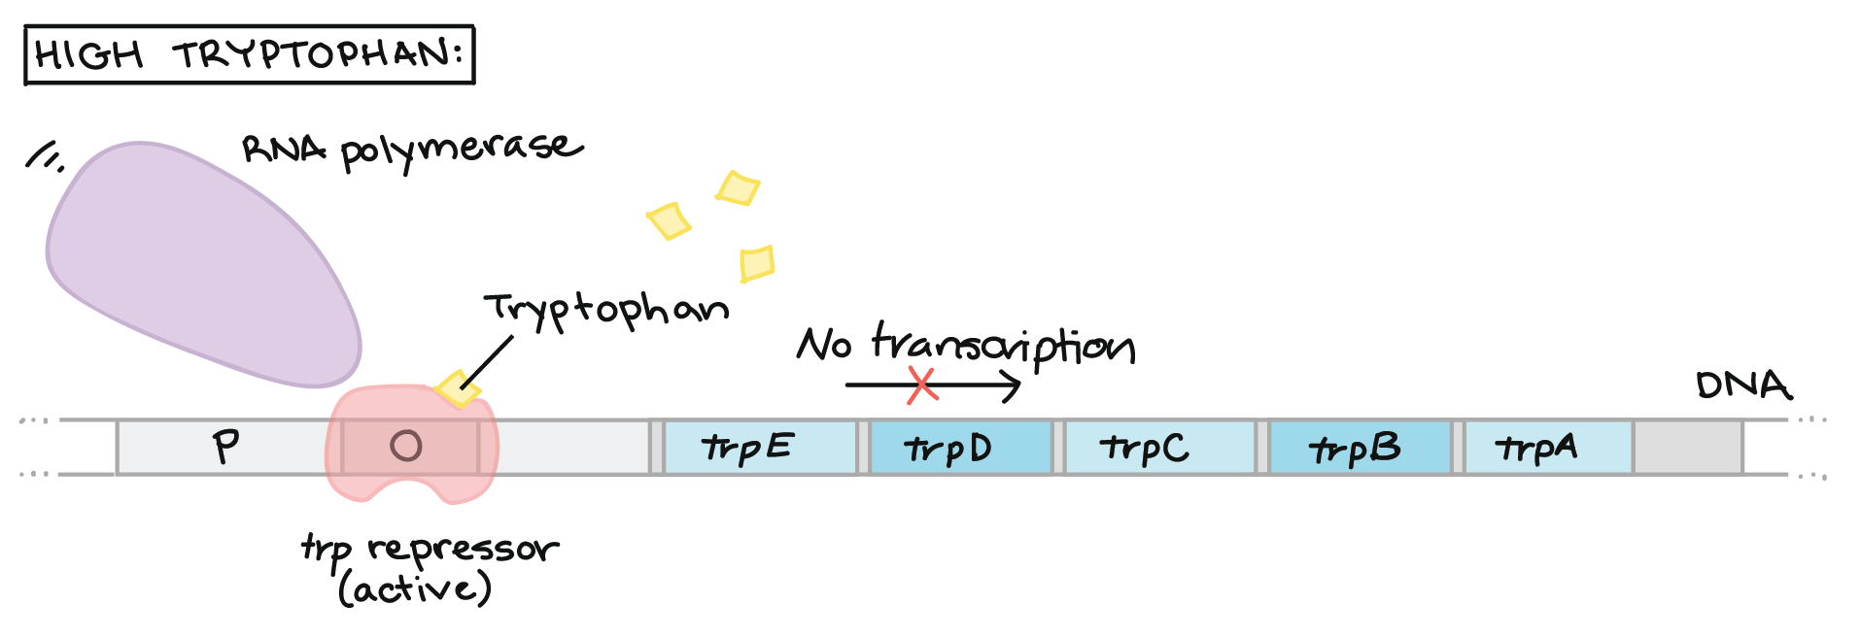

Slide 6


Slide 7
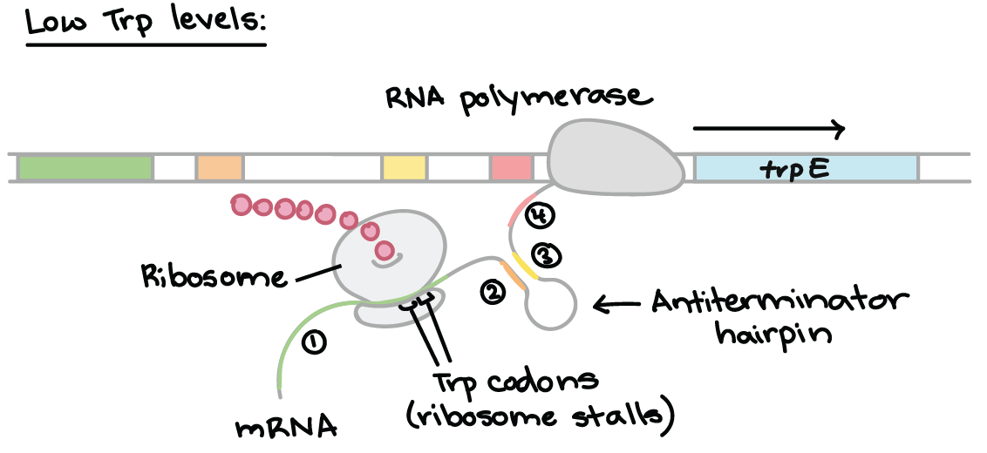

Slide 8
