Slide 1
The lac operon
Dr. Kuntala S. Bordoloi
Assistant Professor
Department of Botany
Handique Girls’ College

Slide 2
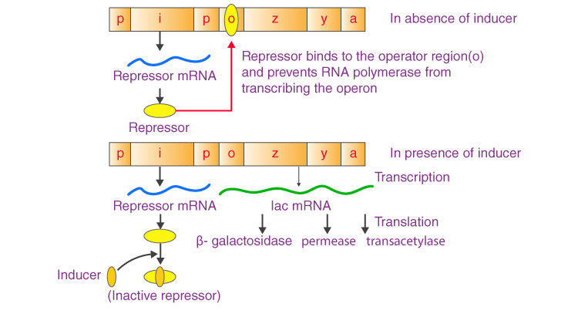

Slide 3
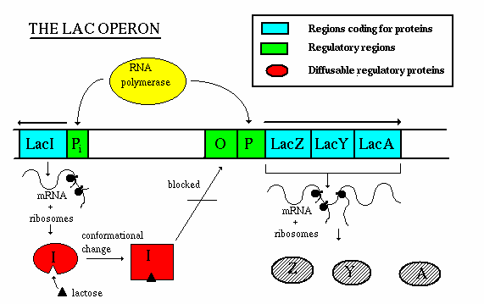

Slide 4
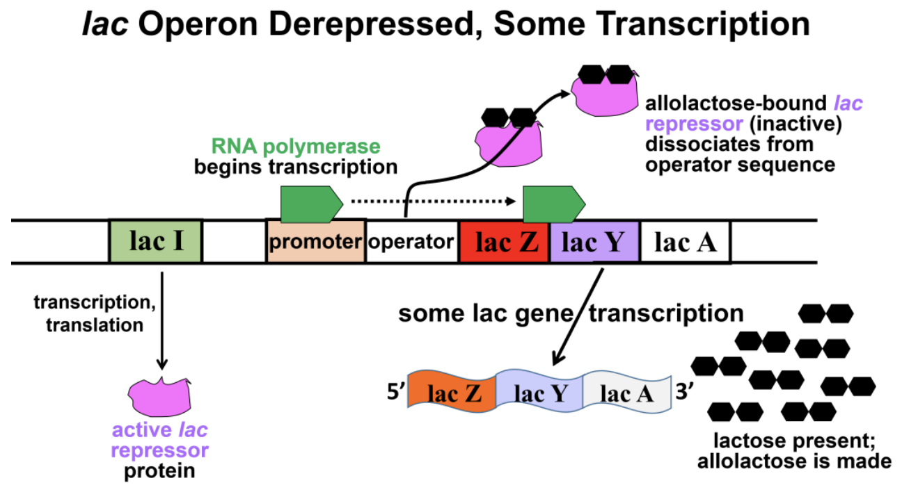

Slide 5
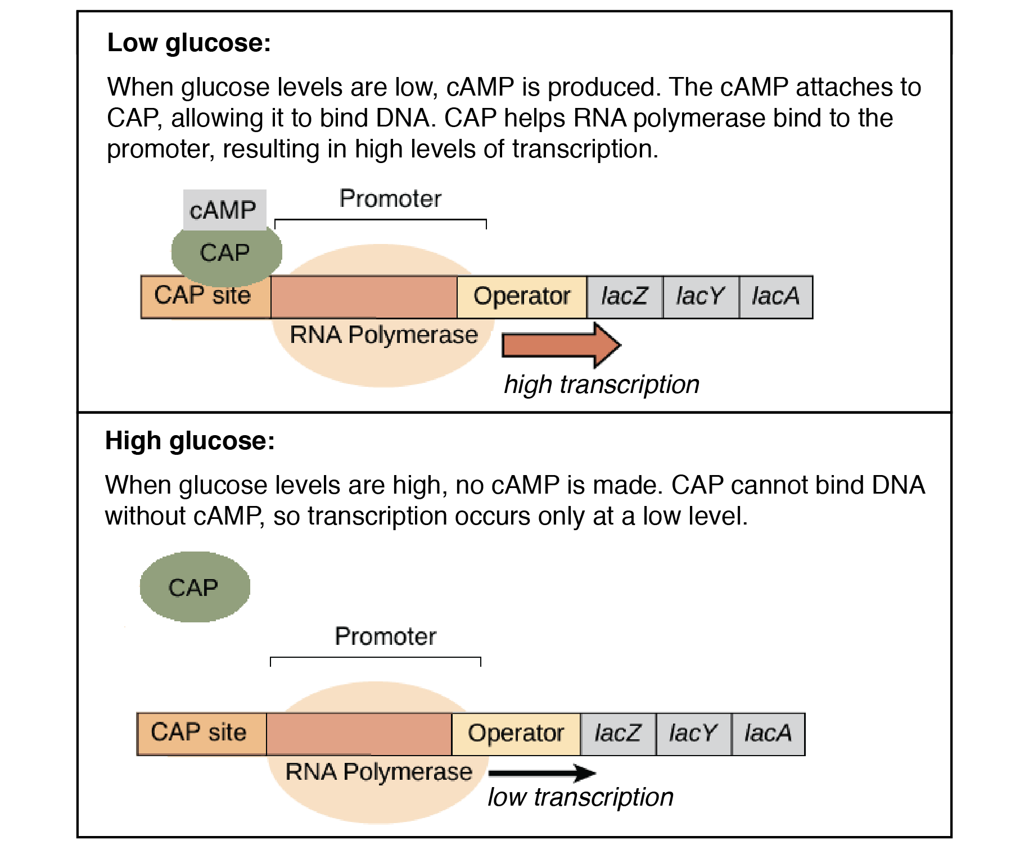

Slide 6
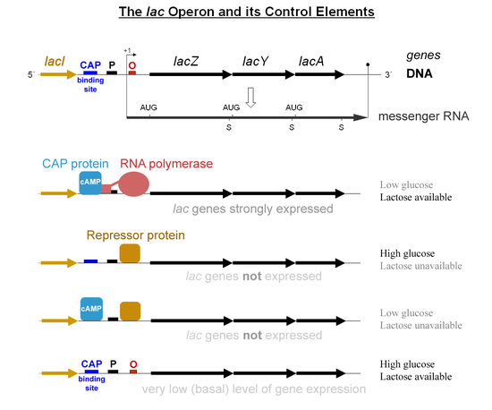

Slide 7
