Slide 1
NUCLEUS

Slide 2
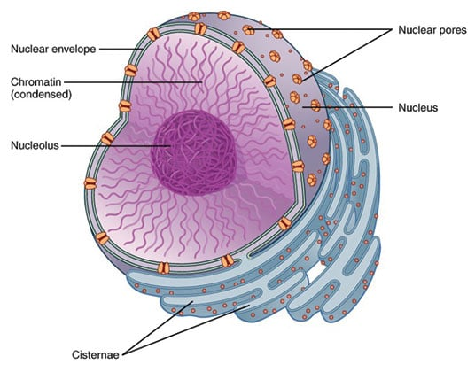
INTRODUCTION
Nucleus is a double-membrane bound organelle which contains all the genetic informations necessary for cellular processes. It controls and regulates the activities of cell such as metabolism, growth and differentiation of the cell.
Uninucleate/mononucleate/monokaryotic: Most eukaryotic cells
Binucleate/dikaryotic: Cells of Paramecium caudatum, cartilage cells, liver cells.
Trinucleate: Paramecium, Aurelia.
Multinucleate: Several fungi (Mucor, Rhizopus), Algae(Vaucheria).
Multinucleate condition in plant cells is called coenocytic,
While in animal cells and Plasmodium it is called syncytium.
ROBERT BROWN, 1831

Slide 3
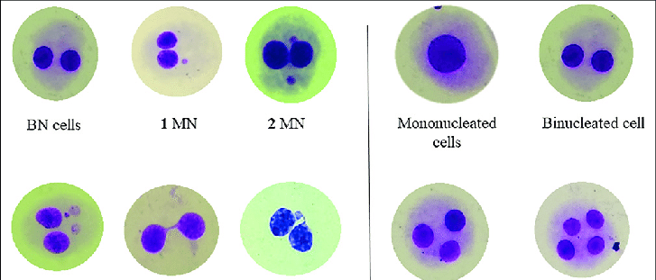
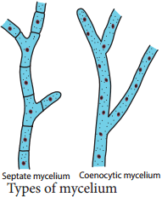

Slide 4
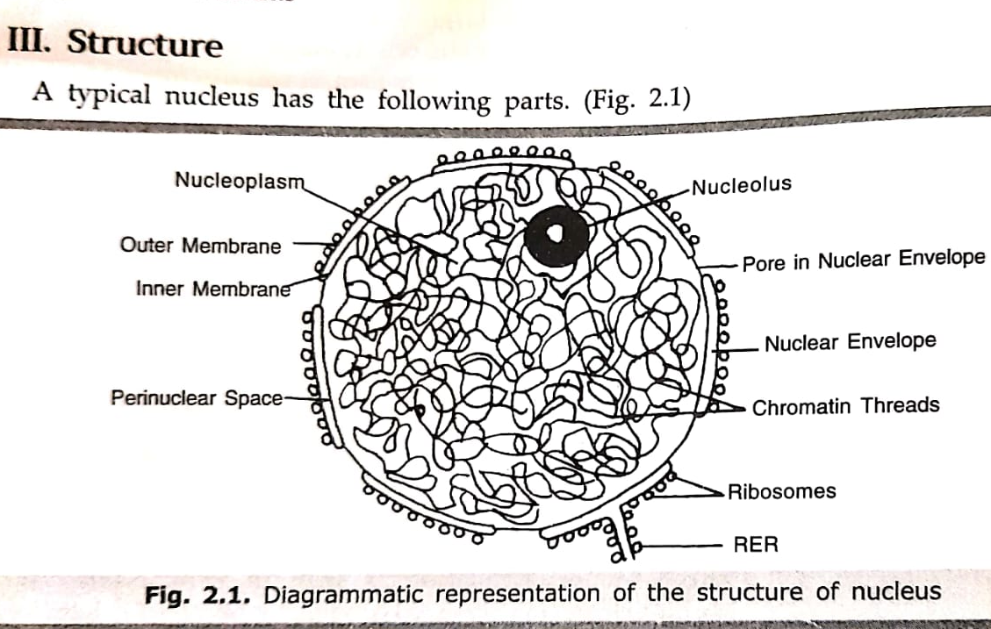
Structure of nucleus
3-D structure of nucleus

Slide 5
A typical nucleus has the following parts:
Nuclear envelope/Karyotheca: Outer membrane and inner membrane which is separated by perinuclear space. Ribosomes present on its outer side.
Nuclear lamina: It is lined on the inner surface of inner nuclear membrane. It is a protein fibrous network of 15-30nm thick and it connects the Inner membrane with the chromatin. Three extrinsic membrane proteins Lamin A, B and C present
Nuclear pores: Present in nuclear envelope. It possess annulus.

Slide 6
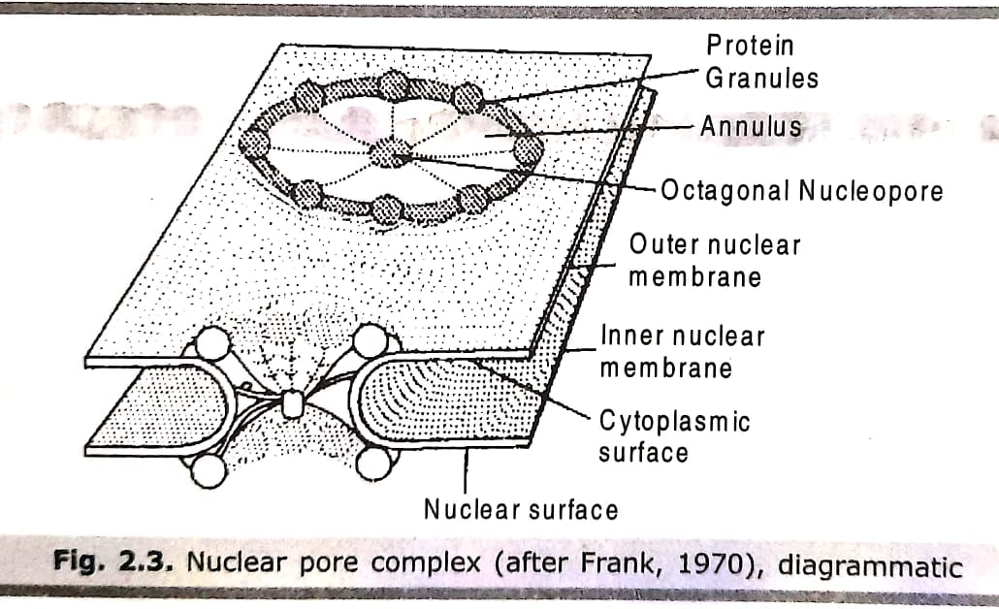
4. Nuclear pore complex:
Large complex structure (120 nm in diameter and 50nm in thickness). It has a 8 fold symmetry. It consists of annuli (sin. annulus), a set of large protein grannules arranged in octagonal pattern, and a large central grannule plugging the pore. 8 radial spokes extend from plug to rings.
Each nuclear pore complex transports about 100 histone molecules/min. during DNA synthesis. During active growth, each nuclear pore complex transport about 6 newly assembled large and small ribosomal subunits/min. from nucleus to cytosol to be utilized in protein synthesis.

Slide 7
5. Nuclear matrix: It maintains shape of the nucleus. Nuclear lamina is included under matrix.
6. Nucleoplasm/nuclear sap: Transparent, semi-solid, granular substance of nucleus. Nuclear components such as chromatin, nucleolus remain suspended in nucleoplasm. Proteins, enzymes, minerals, ribonucleoprotein particles are also present. It is the store house of all raw materials and enzymes required for synthesis of DNA, RNA and ribosome subunits.

Slide 8
7. Chromatin/nuclear reticulum:
Euchromatin: light stained region which is metabolically and genetically active. Crossing over of mesiosis occurs.
Heterochromatin: darkly stained condense region which is metabolically and genetically inert.

Slide 9
Differences between Euchromatin and Heterochromatin
Euchromatin | Heterochromatin
It contains active genes. | It contains inactive or inert genes.
It is light stained region of the chromatin with a thickness of 30-80 Å. | It is dark stained region of the chromatin with a thickness of 250 Å.
It is metabolically active. | It is metabolically inert.
Crossing over of meiosis occurs in euchromatin at a higher frequency. | Crossing over frequency is very less in this part.
It is fibrous. | It is granular.
Euchromatin appears diffused. | It is condensed.
It involves less coiling of nucleosome strand. | It involves more solenoid type of coiling of nucleosome strand.
Euchromatin is influenced by changes in temperature, pH, hormones, poisons etc. | It is very little influenced by these factors.
It takes part in transcription to form RNA. | It does not take part in this process.
Replicates early in S-phase of interphase of cell cycle. | Replicates late towards the end of S-phase which continues upto G2 phase.
It does not show heteropycnosis. | Shows heteropycnosis.

Slide 10
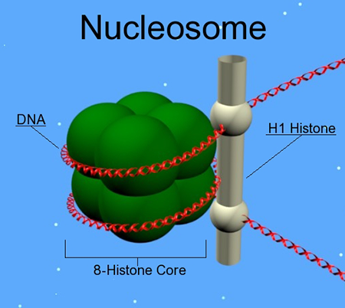
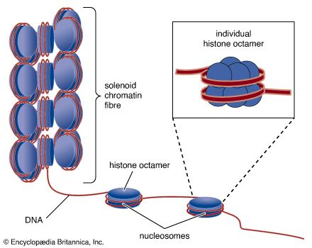
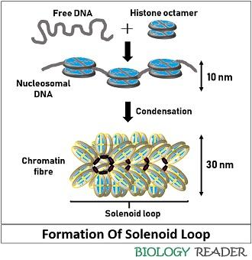
Molecular organization of Chromatin
Formation of nucleosome
Formation of solenoid of 30nm fibre
Formation of metaphase chromosome

Slide 11
Nucleosome
It is the basic structural unit of chromatin.
It consists of 200bp of DNA organized by an octamer of small histone proteins into a beaded structure.
Histone proteins are of 5 types (H1, H2A, H2B, H3 and H4.
Chromatosome(200bp):
Nucleosome core particle+ H1 histone+ linker DNA

Slide 12
Formation of 30nm chromatin fibre (Solenoid model):
The nucleosome (10nm) chain is coiled, about 6 nucleosomes per turn, to produce a 30nm diameter helical structure known as 30 nm fibre or filament also known as solenoid structure.
The solenoid model was first proposed by Aaron Klug.

Slide 13
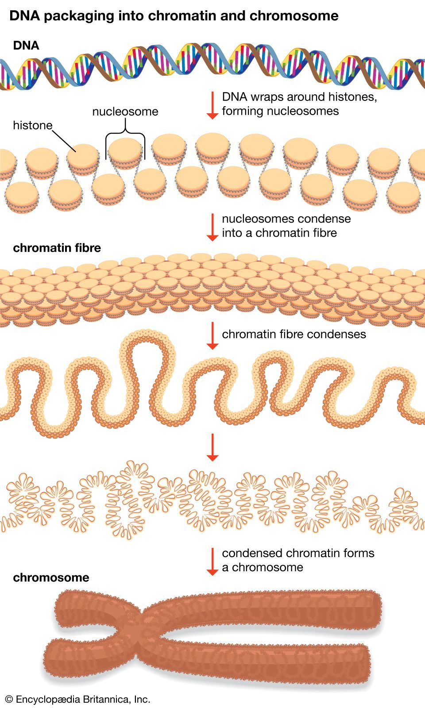
Formation of metaphase chromosome
A chromatin is an organized structure of DNA and protein that is found in the nucleus of eukaryotic cells.
It contains a single dsDNA in coiled and condensed form.
The difference between chromatin and chromosome is that chromatin is less condensed and extended DNA while chromosomes are highly condensed DNA.
The formation of chromosome begins in prophase, where chromatin (a complex of DNA and proteins) undergoes supercoiling with the help of histone proteins.
DNA wraps around histone proteins to form nucleosomes, which further coil into chromatin fibers (solenoid).
These fibers undergo further compaction into distinct sister chromatids, joined at a central centromere.

Slide 14
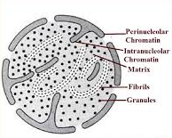
NUCLEOLUS
It is a non-membrane bound dynamic body which disappears in the late prophase and reappears in the telophase stage of cell division.
It is a principle site for synthesis of rRna and assembly of ribosome.
Nucleolus structure consists of the following:
Amorphous matrix
Nucleolar chromatin: Perinucleolar and intranucleolar chromatin
Fibrils: Contain RNA and small amount of proteins. Precursors of granules.
Granules: Contains protein and RNA in the ratio 2:1. Precursors of ribosomes.

Slide 15
Functions of nucleus
Storehouse of genetic information
Transmission of genetic information
Cell division
Growth of new cells
Cell differentiation
Formation of ribosomes
Replication
Transcription
Cellular metabolism
Genetic variation

Slide 16
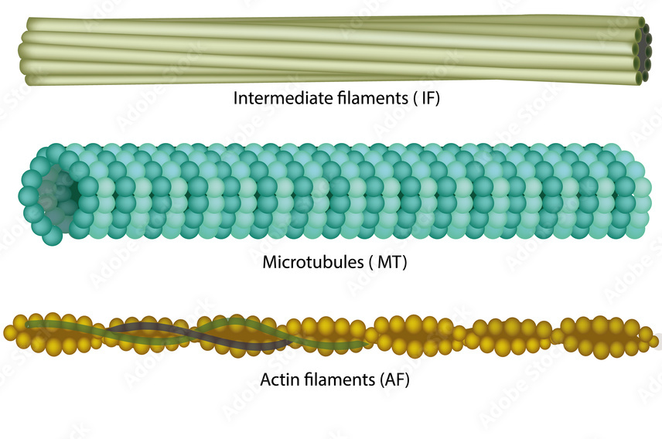
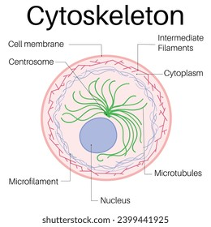
CYTOSKELETON
A three dimensional, intracellular network of protein filaments present in the cytoplasm is known as cytoskeleton.
There are 3 types of cytoskeletal fibers:
Microtubules
Microfilaments
Intermediate filaments

Slide 17
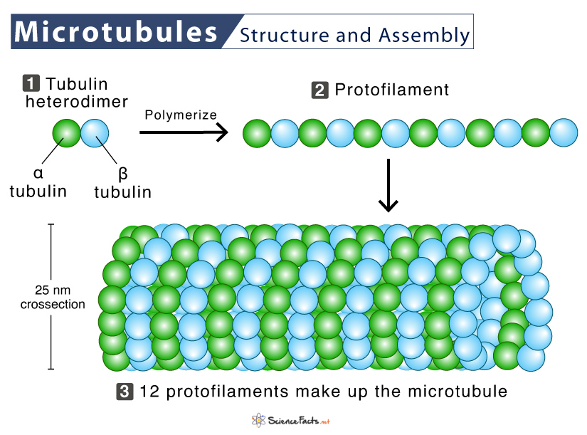
Microtubules
Microtubules are hollow, cylindrical structure, approximately 25nm in diameter
They are present in all eukaryotic cells and play crucial roles in the determination of cell shape and cellular motility.
The basic building block of microtubule is αβ-tubulin heterodimer, composed of two 50 kDa subunits known as α-tubulin and β-tubulin.
Each linear array of tubulin heterodimers is called a protofilament.
In cells generally 13 protofilaments are arranged into a tube structure called microtubules.

Slide 18
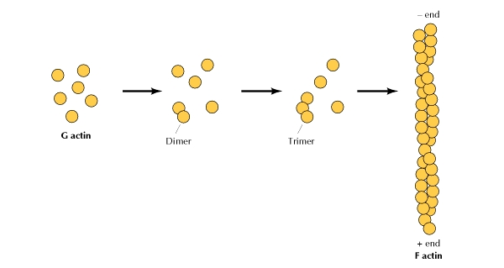
Microfilaments/ Actin filaments (Edward David Korn, 1968)
Long solid fiber of 7nm in diameter, actin filament is made up of G-actins.
The globular G-actin is a 43kDa ATPase and like tubulin, it has a binding site for a nucleotide, but the nucleotide is ATP (or ADP) rather than GTP (or GDP).
Each G-actin contains a Mg²⁺ ion complexed with either ATP or ADP.
It is the most abundant intracellular protein in most eukaryotic cells.
The G-actin subunits assemble to generate filamentous F-actin with distinct structural polarity.
Two parallel F-actins twist around each other in a right handed helix to form an actin filament.
Actin filaments are thinner and more flexible, and usually much shorter than microtubules.

Slide 19
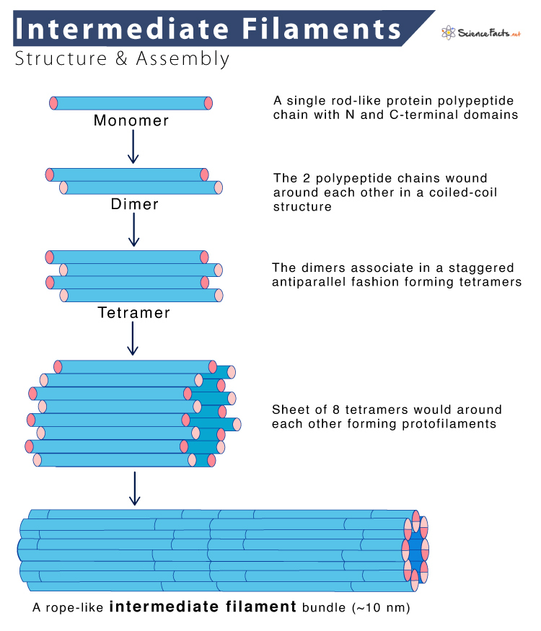
Intermediate filaments (Howard Holtzer et al., in 1968
Intermediate filaments are ropelike cytoplasmic filaments of about 10 nm diameter.
These filaments are found in vertebrates, nematodes and molluscs but not in plants and fungi.
Intermediate filament proteins are chemically heterogenous and show species-specific variations in molecular weight.
More than 50 different intermediate filament proteins have been identified and classified into six major groups- acidic keratins, neutral or basic keratins, vimentin, neurofilament proteins, nuclear lamins and nestin.
They do not participate in cell motility.

