Slide 1
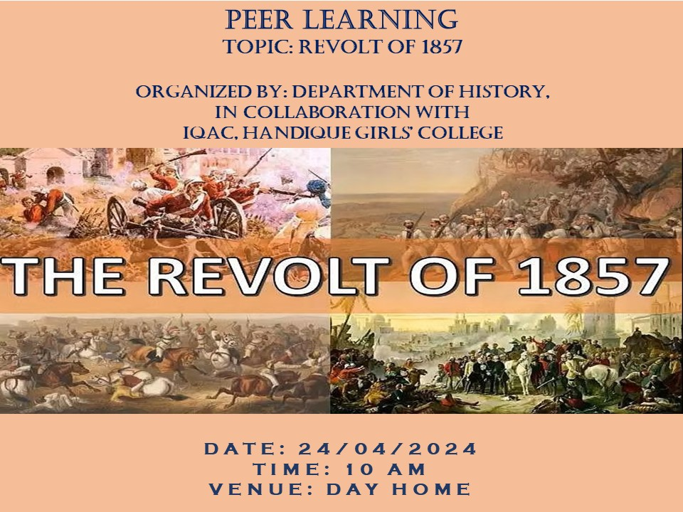
Speaker:
Dr. Dimpy Das

Slide 2
Nature of the Revolt
Was it a Sepoy Mutiny?
Was it the First War of Independence?
Was it aimed at liberating India from the British rule?

Slide 3
Causes of the Revolt
Political Causes
Economic Causes
Socio-religious Causes
Military Causes
Immediate Cause

Slide 4
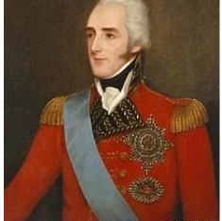
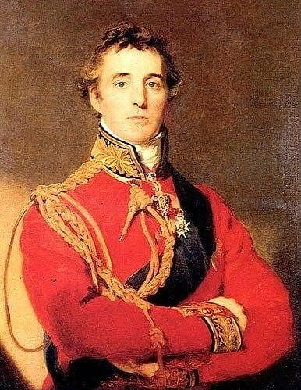
Political Causes
Lord Dalhousie
Doctrine of Lapse
Lord Wellesley
Subsidiary Alliance System

Slide 5
Economic Causes
Drain of Wealth
Decline of cottage industries
Introduction of cash crops
British land revenue policy

Slide 6
Socio-religious Causes
British laws : i) Abolition of Sati in 1829
ii) Widow Remarriage Act 1856
iii) Religious Disabilities Act 1856
iv) Female Infanticide Act 1829
The Theory of White Man’s Burden
Activities of Christian Missionaries
Introduction of English Education

Slide 7
Military Causes
Ill-treatment towards the soldiers
Deprivation of Indian soldiers( lower pay grade and promotion )
General Service Enlistment Act 1856
Conversion of soldiers

Slide 8
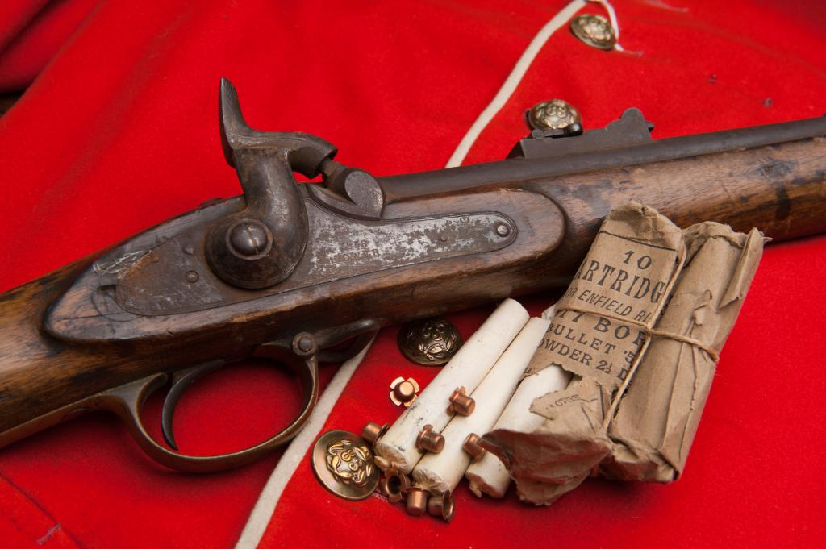
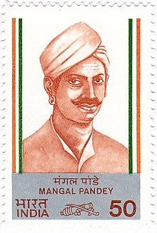
Immediate Cause
Introduction of the Enfield Rifle
Rumor of mixing bone-dust of cows and pigs in flour

Slide 9
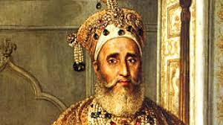
Course of the Revolt
Began on 10th May, 1857 at Meerut
Bahadur Shah Zafar II was declared as the Emperor of India by the rebel soldiers.

Slide 10
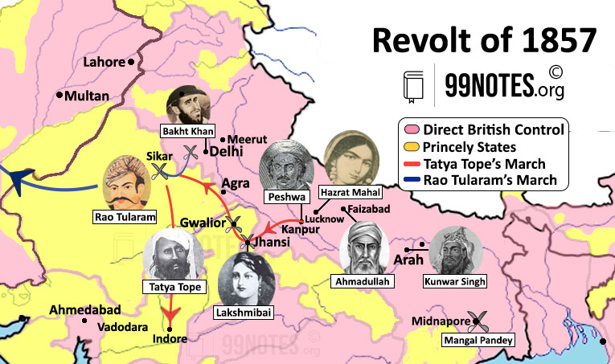
Importance Centers of the Revolt

Slide 11
Outcome of the Revolt
The Revolt failed
Bahadur Shah Zafar II was exiled to Rangoon
Most of the leaders were either killed or captured
Lord Canning announced the end of the Revolt on 8th July, 1858

Slide 12
Causes of failure
Lack of unity
Lack of planning and organization
Lack of resources
No unanimous aims
Superior military strength of the British
Non involvement of many Indians

Slide 13
Consequences of the Revolt
Transfer of power (Government of India Act, 1858)
Reformation & reorganization of the Army
Administrative changes
Policy of divide and rule
New era of economic exploitation
Instilling the feeling of national consciousness among the Indians

Slide 14
The Revolt was so impactful that it inspired several artworks in contemporary British media

Slide 15
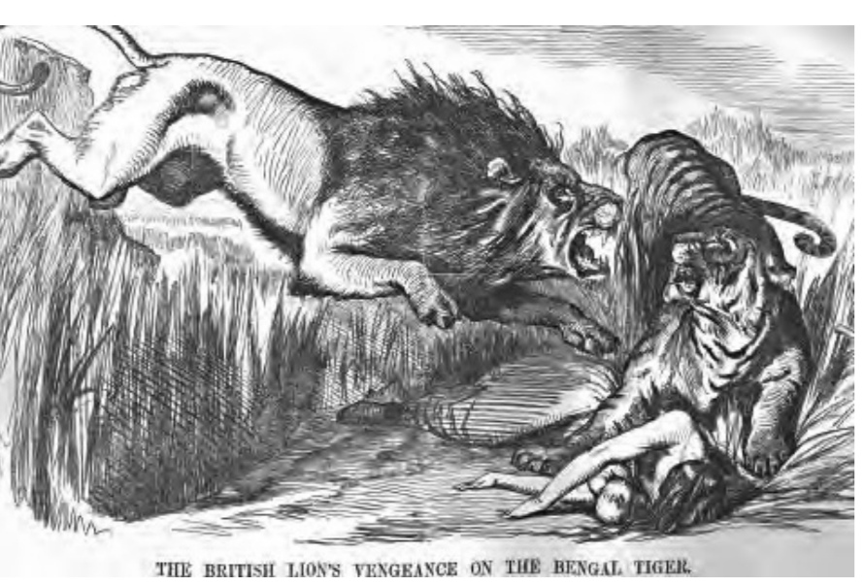

Slide 16
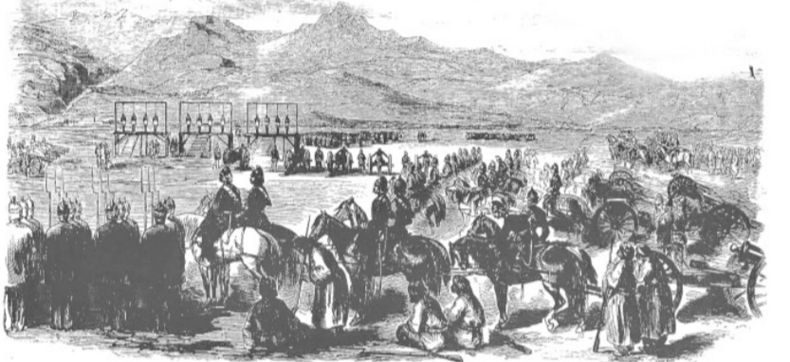
Mass Execution of sepoys in Peshawar
In London News

Slide 17
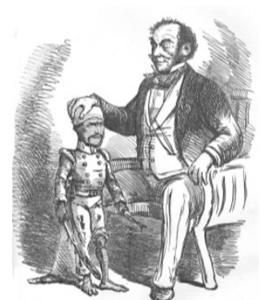
Lord Canning was mocked for granting pardon to the rebels
in the Punch (Magazine)

Slide 18
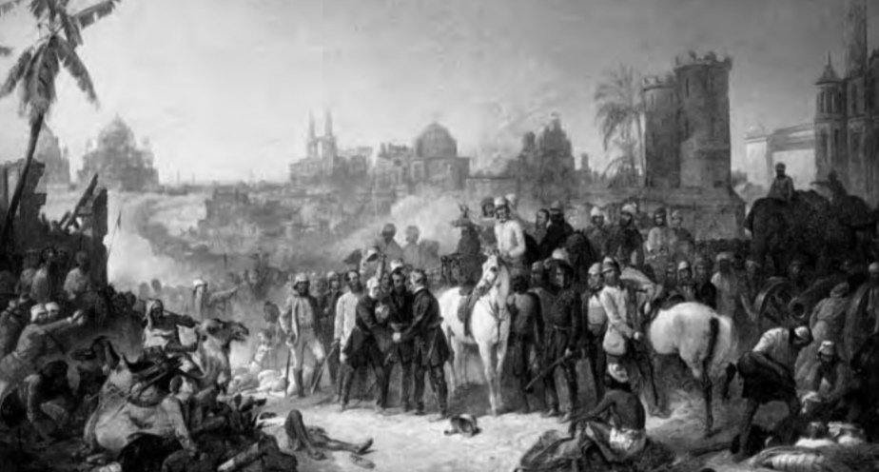
Relief of Lucknow
A Painting by Thomas Jones Baker n 1859

Slide 19
Thank You!

