Slide 1
TOPIC – ANCIENT INDIAN LITERATURE
SEMESTER – 2ND SEM
SPEAKER – DR. DIMPY DAS

Slide 2
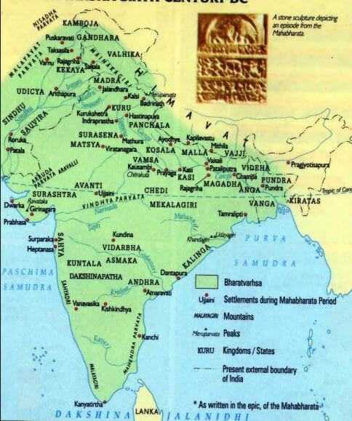
Indian Classical Literature as a Source for Reconstructing Ancient Indian History

Slide 3
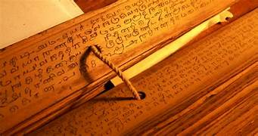
Introduction
Indian classical literature as an indigenous historical source
Texts in Sanskrit, Pali and Prakrit
Reveal political, social and religious structures
Require critical historical interpretation
Insert Image / Map / Manuscript

Slide 4
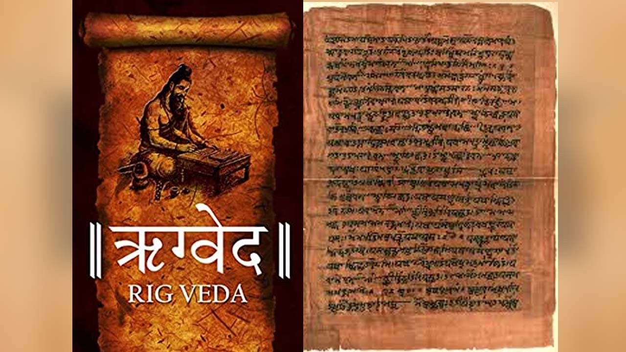
Categories of Sources
Vedic literature
Epics (Itihasa tradition)
Puranas
Buddhist and Jain texts
Classical Sanskrit works
Insert Image / Map / Manuscript

Slide 5
Vedic and Epic Traditions

Slide 6
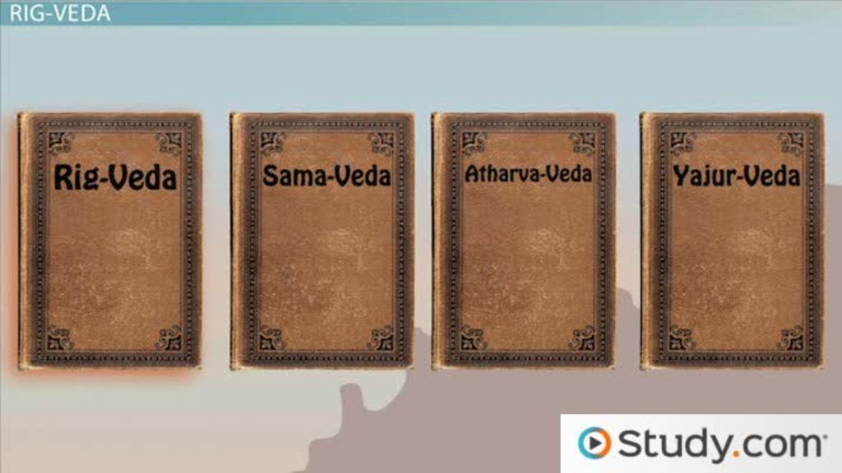
Vedic Literature
Rigveda,
Samaveda,
Yajurveda, Atharvaveda
Earliest textual corpus of ancient India
Tribal polity and pastoral economy
Religious rituals and cosmology

Slide 7
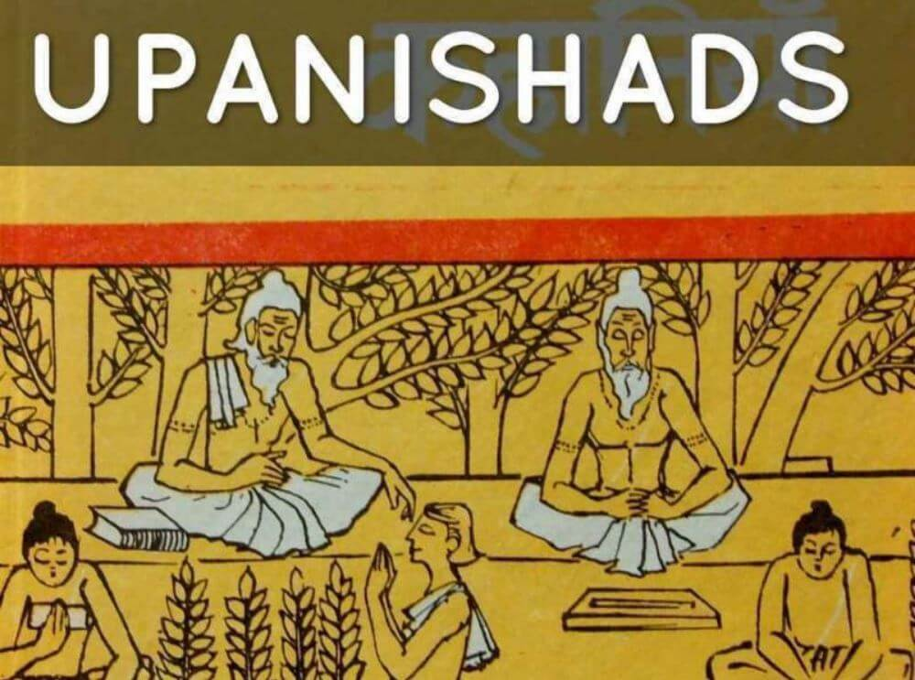
Later Vedic Texts
Brahmanas
Aranyakas
Upanishads
Shift toward agrarian society
Growth of monarchy
Emergence of philosophical speculation
Insert Image / Map / Manuscript

Slide 8
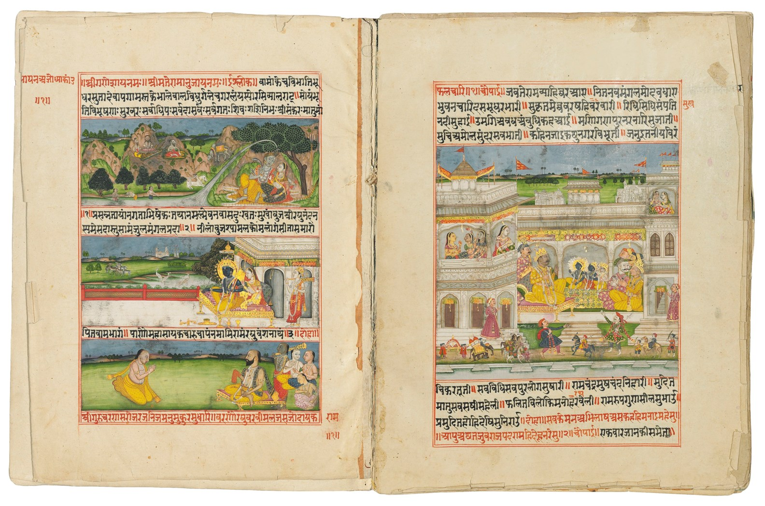
The Epics
Ramayana and Mahabharata
Blend mythology and social memory
Political ideals of kingship
Descriptions of warfare and diplomacy
Insert Image / Map / Manuscript

Slide 9
Insights from Epic Literature
Court life and governance
Social hierarchy and dharma
Military organization
Geographical imagination of ancient India

Slide 10
Religious Literary Traditions

Slide 11
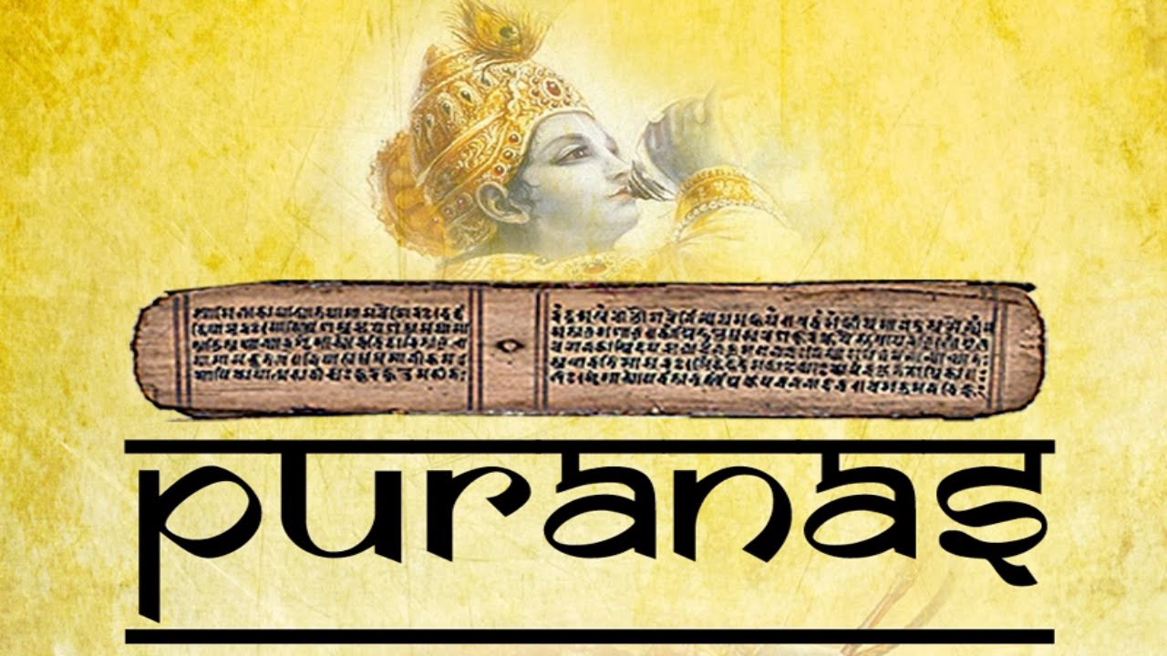
Puranic Literature
Genealogies of kings
Dynastic lists including Mauryas and Guptas
Mythology combined with historical memory
Useful for dynastic chronology
Insert Image / Map / Manuscript

Slide 12
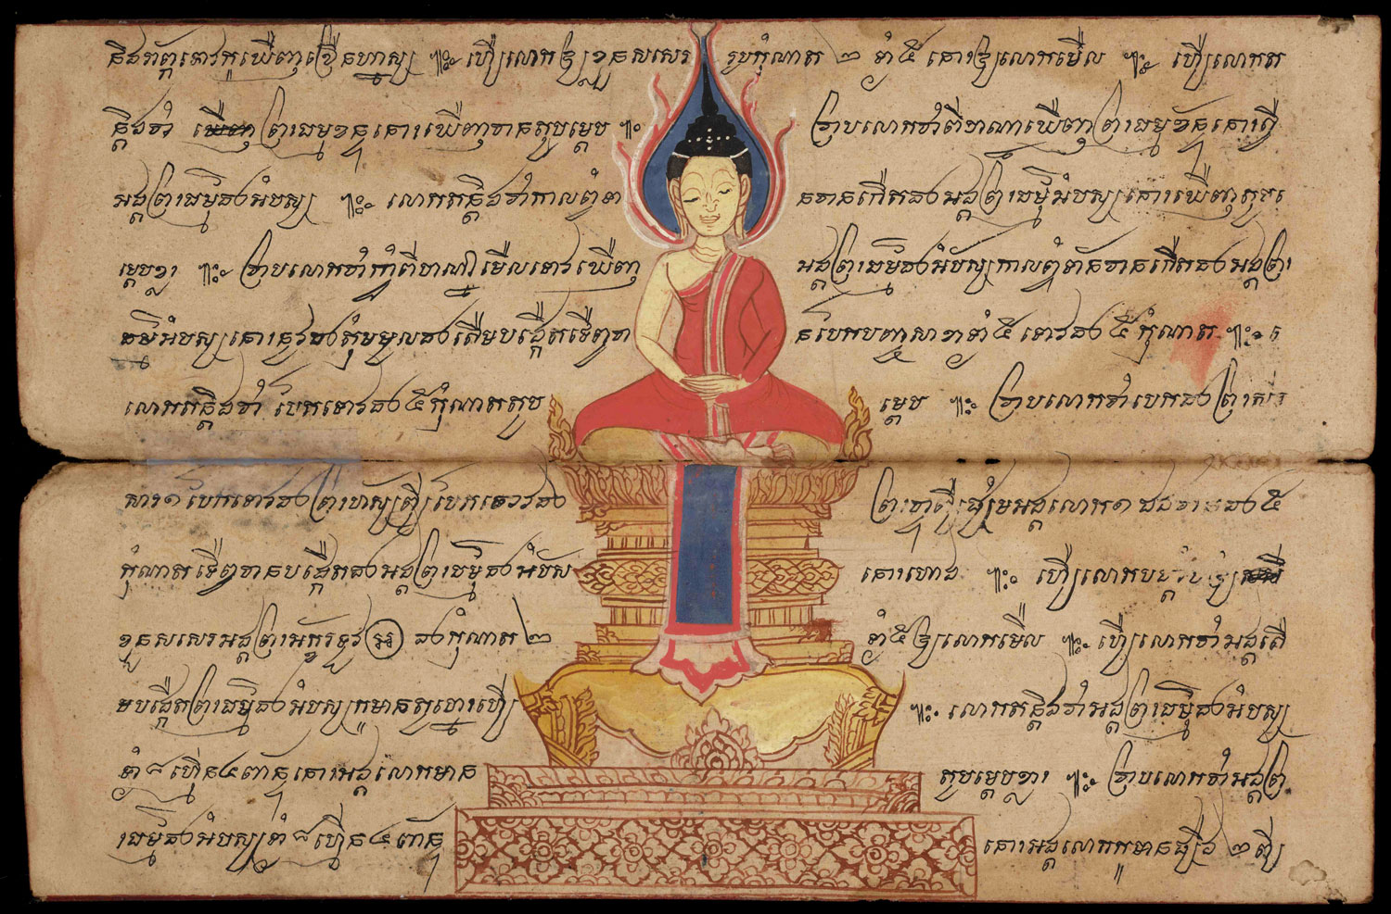
Buddhist Literature
Tripitaka and Jataka stories
Urban life and trade routes
Information on Mahajanapadas
Details of everyday society
Insert Image / Map / Manuscript

Slide 13
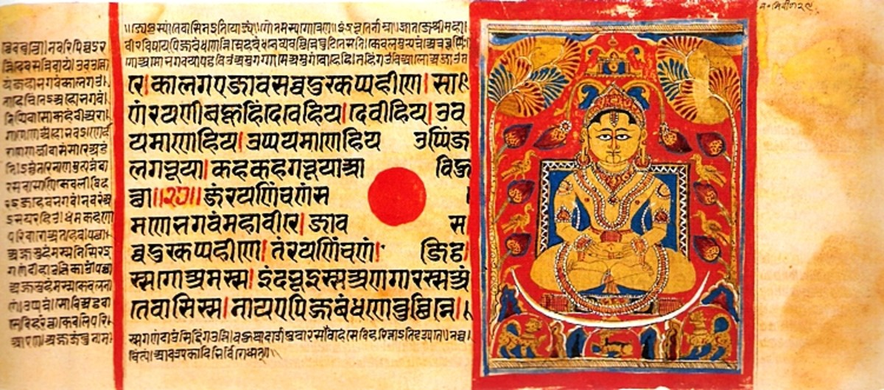
Jain Literature
Kalpa Sutra and Acharanga Sutra
Accounts of Mahavira
Merchant communities and urban centres
Political geography of northern India
Insert Image / Map / Manuscript

Slide 14
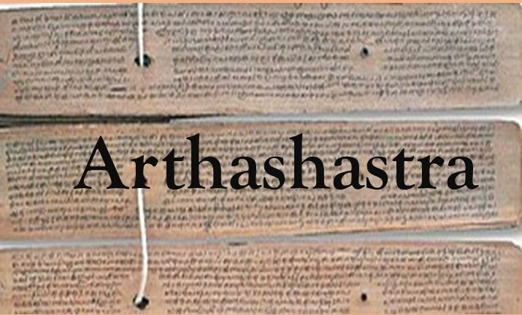
Classical Sanskrit Works
Arthashastra – statecraft and administration
Mudrarakshasa – political drama
Harshacharita – court biography
Insights into governance and diplomacy
Insert Image / Map / Manuscript

Slide 15
Limitations
Mythological narratives
Chronological uncertainty
Religious and ideological bias
Need for corroboration

Slide 16
Conclusion
Literary texts remain crucial historical sources
Provide insight into ancient worldviews
Must be used alongside material evidence

Slide 17
Selected Scholarly References
R.S. Sharma – India's Ancient Past
Romila Thapar – Early India
Upinder Singh – A History of Ancient and Early Medieval India
D.D. Kosambi – An Introduction to the Study of Indian History
A.L. Basham – The Wonder That Was India

