Slide 1
SYMBOLISM
DR.TASRINA IQBAL

Slide 2
As a school of literature, Symbolism refers to three phases of a vital part of the development of literary modernism: first to an artistic movement in France and Belgium during the last decade and a half of the nineteenth century; then, retrospectively and most importantly, to its immediate sources in French poetry beginning in the 1850s; and finally to the influence that both of these had on European and American literatures throughout the first half of the twentieth century.
In its primary context, then, Symbolism refers to the four poets who preceded the Symbolist movement: Charles Baudelaire (1821–67), Stéphane Mallarmé (1842–98), Paul Verlaine (1844–96), and Arthur Rimbaud (1854–91). They are also the principal sources of influence on many of the writers outside of France who were drawn to the new aesthetic tendency they helped define. Each in his own way was responsible for powerful innovation, having gathered up the principal threads of the French poetic tradition since the sixteenth century along with German, British, and American contributions to Romanticism. Beyond the simple designation of an aesthetic tendency, Symbolism is a useful term as applied to the works of these poets in that it refers at once to an important feature of poetic content and to an attitude toward the figurative operation of literary language.

Slide 3
From its beginnings, Symbolism had an international character. Among its major sources were Poe, Swinburne, Wagner, and later, Whitman. Early projects looked beyond national borders, as with Mallarmé’s attempt in the early 1870s to create an international confraternity of poets
Symbolism is considered today to have become a fully European literary movement, from Hungary (Endry Ady, 1877–1919) to Portugal (Eugenio de Castro, 1869–1944). Among the most import ant figures associated with Symbolism were the Russian poet Aleksandr Blok (1880–1921), the Norwegian playwright Henrik Ibsen (1828– 1906), and the German poets Stefan Georg (1868–1933) and Rainer Maria Rilke (1875–1926).
In the Americas, Nicaraguan poet Rubén Darìo (1867–1916) employed Verlainian musicality to liberate Spanish verse from its prosodic traditions. Throughout much of the twentieth century, Symbolism, along with Surrealism, had a pervasive influence on Latin American literature. A major instance is that of Mexican poet and novelist, Octavio Paz (1914–98) whose work establishes ties between Mallarméan influences and mysticism.
In Britain and the United States, the role of Symbolism has been significant in the development of modernist prose and poetry. The Symbolist Movement in Literature (1899), by British poet and critic Arthur Symons, had widespread influence, bringing the younger French poets to the attention of William Butler Yeats (1865–1939) and James Joyce (1882–1941), both of whom would be further marked by Mallarmé’s late poems and essays. The British novel of the early twentieth century saw the use of images and symbols supplanting realist narrative devices, not only in the work of Joyce but also in that of Joseph Conrad (1857–1924), D. H. Lawrence (1885–1930) and Virginia Woolf (1882–1941). T. S. Eliot (1888–1965) adapted Symbolist aesthetics to his own very individual poetic style and to his critical writing (his notion of the objective correlative, especially). Eliot’s deep appreciation of Symbolism’s hermetic nature and formal complexities in turn influenced, in the period between the world wars, the analytical criticism of the Cambridge Critics in England and the New Criticism in the United States, as well as American poets Ezra Pound (1885–1972), John Crowe Ransom (1888–1974), and Wallace Stevens (1879–1955).

Slide 4
Modernist literature, emerging in the early 20th century, witnessed a departure from traditional literary techniques and embraced innovative approaches to storytelling. Symbolism, as a prominent feature of modernist literature, allows authors to transcend literal meanings and delve into deeper thematic explorations. Symbolic elements such as objects, settings, characters, and events serve as vehicles for expressing complex ideas and emotions (Waham 2023)
Interpreting symbolism in modernist literature poses several challenges due to its subjective nature and the multiple possible interpretations that symbols may carry. Recent research has focused on the contextual influences that shape the interpretation of symbols in modernist works. For example, the socio-political climate, cultural movements, and personal experiences of the authors can significantly impact the symbolism within their works (Garcia, 2022). Understanding these contextual factors allows for a more nuanced analysis of the symbols employed in modernist literature. Symbolism in modernist literature, as exemplified by the works of T.S. Eliot and Roland Barthes, remains a rich area of exploration. Recent scholarship has highlighted the multifaceted nature of symbolism, its various cultural and historical dimensions, and its interpretive challenges. The examination of symbols in modernist literature offers readers a deeper understanding of the intricate layers of meaning and enhances our appreciation of these complex literary works. Further research in this field is necessary to uncover new perspectives and enrich our comprehension of the symbolic tapestries woven by modernist authors Carter, (2022).
Barthes and Semiotics: Decoding Symbolic Structures Roland Barthes, a prominent literary theorist, contributed extensively to the understanding of symbolism in literature through his semiotic approach. His work "Mythologies" (1957) delves into the analysis of everyday objects and cultural phenomena as symbolic structures. Barthes argues that these symbols hold hidden meanings and reinforce dominant ideologies. In a recent study by Garcia and Lopez (2022), they explore Barthes' semiotic theory in the context of modernist literature. They emphasize Barthes' concept of the "myth," which reveals the symbolic nature of cultural representations and how they shape collective consciousness.
Symbolism in T.S. Eliot's "The Waste Land": T.S. Eliot's magnum opus, "The Waste Land," published in 1922, is often regarded as a quintessential modernist poem. This complex and fragmented work showcases Eliot's mastery of symbolism, which serves as a key tool for unraveling the multiple layers of meaning within the poem. The use of symbolic imagery, such as the barren wasteland, the Fisher King, and the mythical figures from various cultures, enables Eliot to explore themes of disillusionment, spiritual decay, and the fragmented nature of modern society .

Slide 5
Symbolism in Roland Barthes' "The Death of the Author": Roland Barthes, a prominent literary theorist and philosopher, made significant contributions to the understanding of symbolism and its role in literature. In his influential essay "The Death of the Author," published in 1967, Barthes challenges the traditional notion of authorship and argues for a reader-centric interpretation of texts. While not directly focusing on symbolism, Barthes' ideas have important implications for understanding the function of symbols in modernist literature Brown, (2022). According to Barthes, symbols in a text are not fixed or determined by the author's intended meaning. Instead, they are open to multiple interpretations, shaped by the reader's individual experiences and cultural context.
Symbolism has played a significant role in shaping modernist literature, providing writers with a powerful tool to convey complex ideas and emotions. In the realm of literary criticism, unraveling the layers of symbolism in modernist literature has emerged as an intriguing and fruitful endeavour.
What does it do?
Beyond Literal Meaning: Symbols in literature represent something more than their basic definition.
Multi-layered Meaning: They can carry multiple interpretations, adding complexity to the text.
Contextual Dependence: The meaning of a symbol is often shaped by the specific context of the literary work.
Emotional Resonance: Symbols can evoke strong emotions and feelings in the reader.
Universal vs. Particular: Some symbols are widely recognized (e.g., light for hope, darkness for despair), while others are unique to a specific work or author.
Connection to Themes: Symbolism helps authors explore and develop central themes within their narratives.
Character Development: Symbols can be used to reveal character traits, motivations, or inner conflicts.
Enhancing Narrative: Symbolism adds layers of meaning, making the story richer and more engaging for the reader.

Slide 6
Eg. "The Second Coming" is a response to a world wracked by violence. Yeats wrote the poem 1919, right after the end of World War I, in which 16 million people were killed in a horrifying display of the power of modern technological war and of the continuing conflicts that wracked the supposedly modern, civilized world. The poem voices a sense of shock, dismay, and pessimism about the future that many felt after the war. Prophecy "The Second Coming" is a deeply ominous poem, full of foreshadowing. It is full of dramatic premonitions that do not necessarily make the future much clearer: al all it is sure of is that something is going to happen, and the world will never be the same. Christianity In this poem, Yeats uses Christianity as a stand-in for all order, ethics, and tradition. He borrows this poem's title from the Book of Revelations, which describes Christ's return to earth after the end times as a "second coming". In the Bible, Christ's return always occurs after a death—of himself, or of the world, in the case of the Book of Revelations. The world is spinning towards a kind of death, Yeats predicts in this poem, but what rises out of the ashes will not be Christ—it will be a mysterious "rough beast.“
Meaninglessness - "The Second Coming" is about loss, about change, and about traditional meanings and values coming apart at the seams. The line "the center cannot hold" basically fixated on the idea that much of life is meaningless, hollow, without defined order and certainly without the comforting linearity and order that religion and tradition provide. The center cannot hold—there is no more core meaning or logic to be found, and only time will tell what will rise out of the ashes. The main symbols The widening gyre The gyre in “The Second Coming” symbolizes the growing world. It is one of the most iconic images of twentieth-century poetry. A gyre is a conical spiral motion or form, often referring to an oceanic surface current. The gyre in Yeats‟s poem represents the increasing chaos and instability of the human world as history progresses. Rather than the world being a stable structure, it is perpetually in motion and growing outward. The falcon Yeats places the falcon at the center which represents humanity's control over the world. The fact that the falcon "cannot hear" its master thus symbolizes a loss of that control. The falcon, separated from the falconer, is lost: without reason, without ruler. It is a symbol for a lost humanity, at the mercy of uncontrollable forces. The falcon, in short, is all of us, wandering around the earth, trying to find meaning.

Slide 7
The falconer The falconer represents God or the traditional values, ethical responsibility and order that was once controlled the falcon.
The Beast - In "The Second Coming." the great beast emerges from the Spiritus Mundi, or soul of the universe, to function as the primary image of destruction in the poem. The speaker predicts the arrival of the Second Coming, and this prediction summons a "vast image" of a frightening monster pulled from the collective consciousness of the world. The speaker has a vision of a beast. The beast has a "lion body" and the "head of a man." This makes it similar to a sphinx which was a mythical creatures said to be greedy towards humans. With its animal body and human head, perhaps this beast says something about the "nightmare" to come. Though humans have tried to civilize themselves and improve their world, perhaps their more beastly animal nature has only been hidden not defeated. The beast might symbolize that civilization itself is a kind of illusion. The human head has a "gaze" that lacks empathy, suggesting that the beast is ready to kill. This strange image seems to gesture towards humankind's ever-improving capacity for self-destruction.
THE END

Slide 8
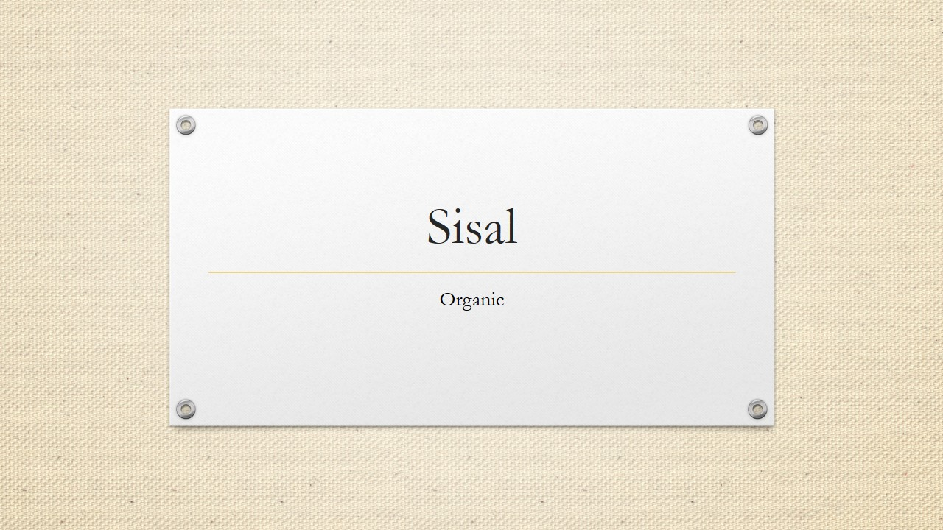
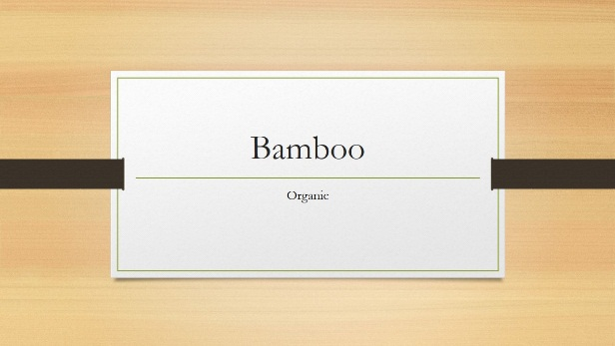

Design
Right from the start, you’ll have access to beautiful, widescreen themes that you can easily change to match your style. Every theme comes with a variety of color variants that you can mix and match.
New features like Merge Shapes and a color-matching Eyedropper open up new possibilities for your designs.
Line up your layouts, photos, and diagrams perfectly in seconds with alignment guides and smart guides.

Slide 9
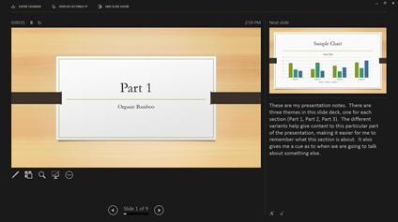

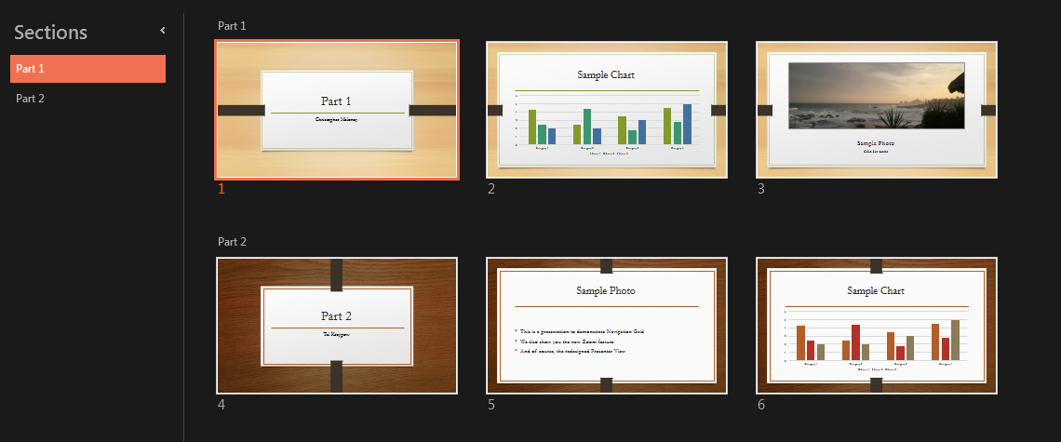

Impress
The improved Presenter View has new tools to keep you in control. The new Auto-Extend instantly applies the right settings for you, so you can focus on speaking instead of your display.
  Slide zoom – Help focus your audience on your ideas. Just click to zoom in and out on a specific diagram, chart or graphic.
  Slide Navigator – A feature that enables the user to visually browse for and navigate to other slides without leaving Slide Show view. Your audience only sees the slide you’re presenting.

Slide 10

Work Together
Edit with others from different PCs at the same time and have conversations with improved commenting.
Sharing online is simple. Even if your audience doesn’t have PowerPoint, simply project to their browser with Present Online.
Work together with others at the same time from different locations, whether you are using PowerPoint on your desktop or PowerPoint Online.

Slide 11
PowerPoint 2013
Intuitively design beautiful presentations, easily share and work together with others and give a professional performance with advanced presenting tools.
Find out more at the PowerPoint Getting Started Center
(Click the arrow when in Slide Show mode)
Notes:
In Slide Show mode, click the arrow to enter the PowerPoint Getting Started Center.

