Slide 1
The Lodi Dynasty (1451–1526) and the First Battle of Panipat
The Lodi Dynasty was the fifth and final ruling family of the Delhi Sultanate, of Afghan (Pashtun) origin, ruling northern India from 1451 to 1526.
Key Characteristics: Replaced the Sayyid Dynasty; marked by territorial expansion, administrative reforms, and internal conflicts leading to decline.
Historical Context: Emerged amid the fragmentation of the Delhi Sultanate post-Timur's invasion; represented a shift to Afghan nobility dominance.
Significance: Bridge between Sultanate era and Mughal Empire; introduced Afghan cultural elements into Indian governance.

Slide 2
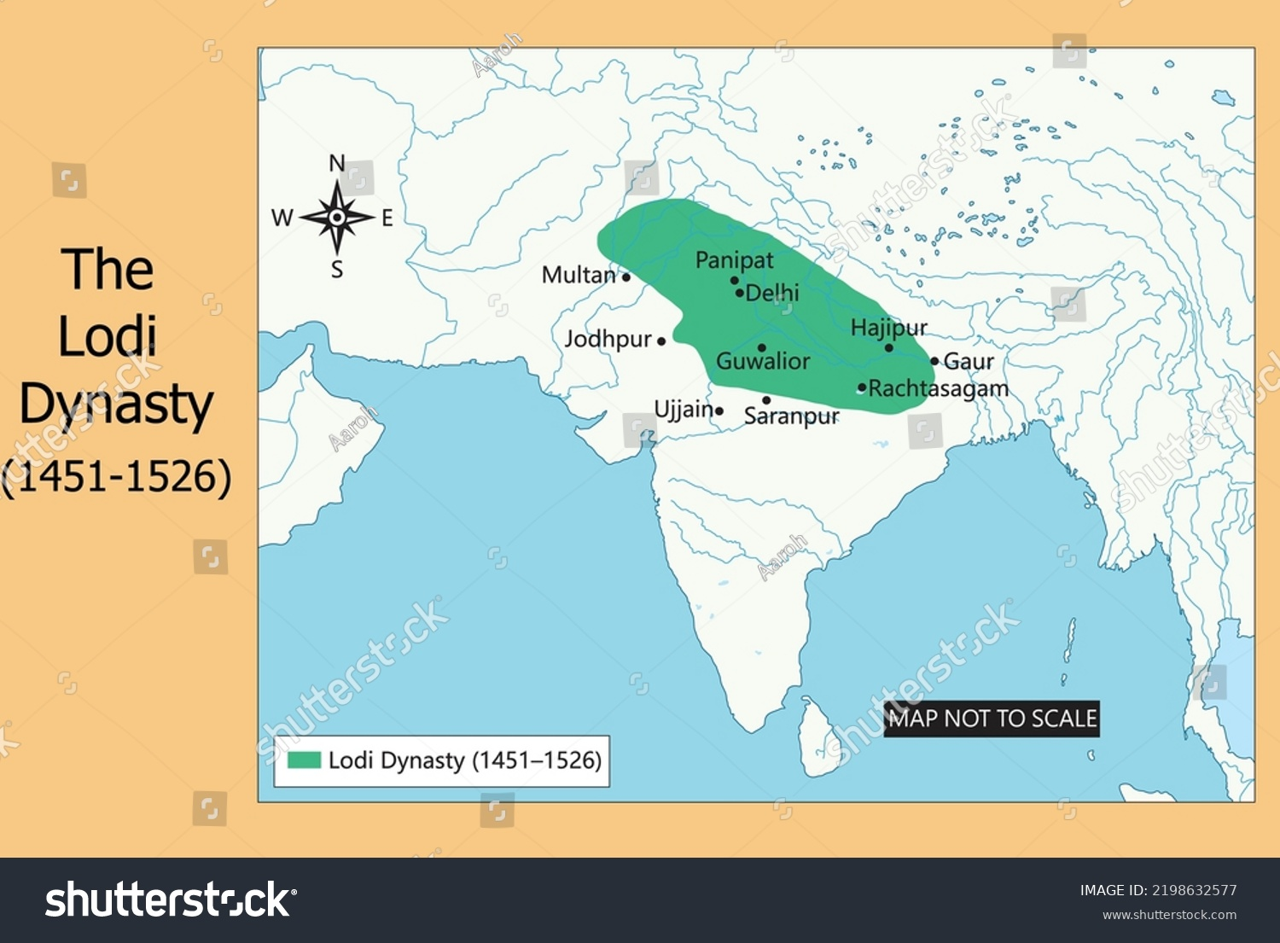

Slide 3
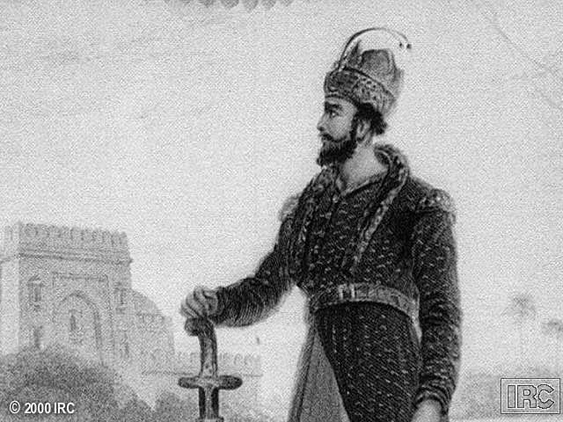
Bahlul Lodi (r. 1451–1489) – Founder and Consolidator
Background: Nephew and son-in-law of Malik Sultan Shah Lodi; governor of Sirhind; ascended throne after Alam Shah's abdication.
Achievements: Expanded sultanate to Punjab, Bihar, and Bengal borders; conquered Jaunpur (1479) and Malwa; maintained loose confederacy of Afghan and Turkish chiefs.
Policies: Pragmatic ruler; focused on military vigor and noble alliances; founded Sultanpur Lodhi as a trade center.
Analysis: His strong personality prevented fragmentation; set foundation for Lodi stability but relied on personal charisma.

Slide 4
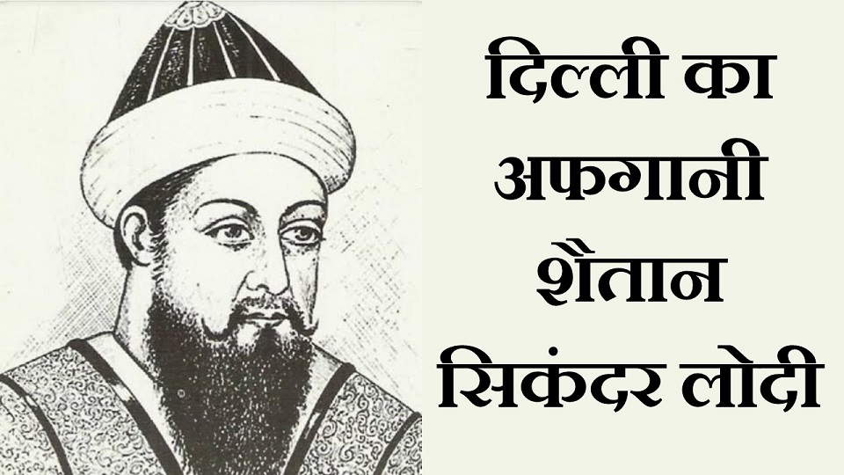
Sikandar Lodi (r. 1489–1517) – Expansion and Reforms
Background: Second son of Bahlul; ascended after succession disputes.
Achievements: Conquered Bihar; founded Agra (Sikandarabad) as a strategic city; promoted trade and agriculture through measurement reforms (gaz-i-sikandari).
Policies: Centralized administration; patronized Persian literature and music; known for religious intolerance toward Hindus (e.g., temple destructions).
Analysis: Enhanced royal authority but alienated non-Muslims; his bigotry foreshadowed communal tensions; economic policies strengthened the sultanate temporarily.

Slide 5
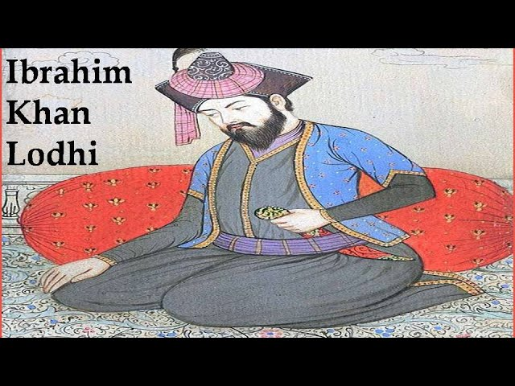
Ibrahim Lodi (r. 1517–1526) – Decline and Fal
Background: Eldest son of Sikandar; faced noble rebellions due to harsh centralization efforts.
Challenges: Internal dissent from Afghan nobles; invitations to external invaders (e.g., Daulat Khan Lodi invited Babur).
Policies: Attempted to curb noble power, leading to alienation; military focus but outdated tactics.
Analysis: His tyranny accelerated the dynasty's collapse; represented the failure of feudal Afghan governance in a diversifying India.

Slide 6
Administration, Economy, and Culture under the Lodis
Administration: Feudal system with Afghan nobles as iqta holders; emphasis on military loyalty over bureaucracy.
Economy: Agricultural reforms (e.g., land measurement); trade hubs like Sultanpur and Agra; coinage in copper and silver.
Culture: Patronage of Persian poetry and Sufism; architecture (e.g., Moth ki Masjid, tombs in Lodi Gardens); blend of Afghan and Indian styles.
Analysis: Shift toward Indianization (e.g., use of Hindi in administration); cultural syncretism amid religious orthodoxy.

Slide 7
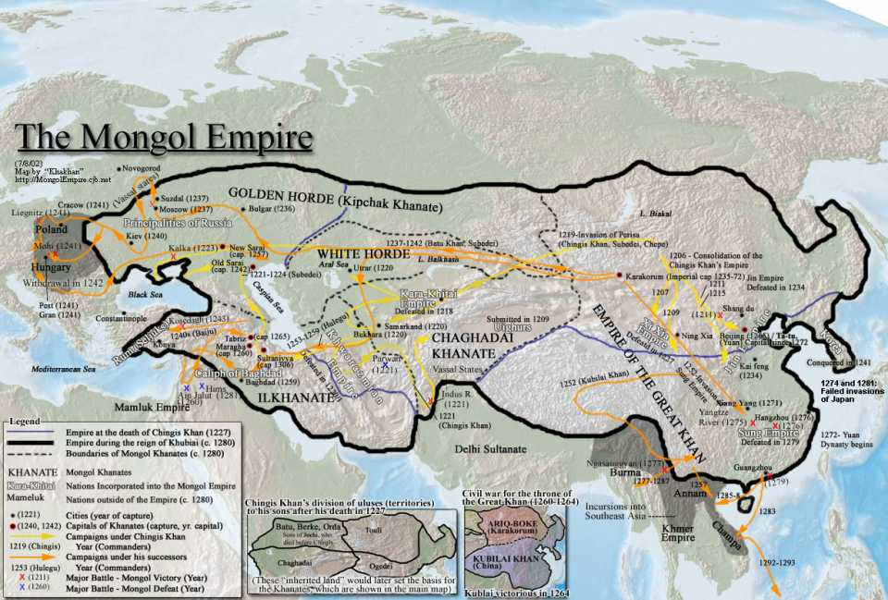

Slide 8
Background to the First Battle of Panipat
Context: Lodi internal weaknesses (noble revolts); Babur's ambitions from Kabul; invitations by disaffected Lodis (1524–1525).
Prelude: Babur's earlier raids on Punjab; captured Lahore (1524); advanced to Delhi in 1526.
Forces: Babur ~12,000–15,000 (cavalry, artillery); Ibrahim ~50,000–100,000 (infantry, 1,000 elephants).
Analysis: Technological disparity (Babur's gunpowder) vs. numerical superiority; marked transition from medieval to early modern warfare in India.

Slide 9
Origins: Timurid prince, descendant of Timur and Chingiz Khan; inherited Fergana post-Timurid breakup.
Struggles: Squeezed by Safavids (Iran) and Uzbeks (Central Asia); gained/lost Samarkand thrice; moved to Kabul 1504 for power base.
Early Raids: Touched India 1504–1524; raided Northwest frontier 4 times; crushed Yusufzais in Afghanistan.
Aspirations: Gave up Samarkand 1512; dreamed of Indus empire as Timur's birthright; Baburnama quotes resolve to conquer.
Analysis: Survival battles hardened army; opportunity from Afghan chiefs' invitation.

Slide 10
North India Powers: Delhi Sultanate under Lodis; Rajputs under Rana Sanga.
South India: Deccan Sultanates and Vijayanagar dominance.
Invasion Route: From Kabul to Lahore, Dipalpur, Sialkot, Ambala, Yamuna, Panipat.
Analysis: Fragmented powers allowed Babur's entry; strategic chokepoints like Panipat.

Slide 11
Babur’s Invasion Details
1524: Started for Lahore; found Daulat driven out; routed Lodi forces, burned Lahore; installed Alam Khan at Dipalpur; returned to Kabul.
Setbacks: Alam overthrown; joined Daulat to besiege Delhi but defeated; Babur realized need for direct control.
1525: Crossed Indus with 12,000 core force (grew to 20,000 at Panipat); unopposed at Sialkot; defeated Hamid Khan at Hisar Firoza.
Prelude Battles: Raiding force crossed Yamuna April 1; defeated Daud/Hatim Khan April 2; executed prisoners as warning.
Arrival: Reached Panipat April 12; defensive measures against Lodi's larger army.
Analysis: Intelligence and reinforcements key; Babur's veterans vs. Lodi's feudal levies.

Slide 12
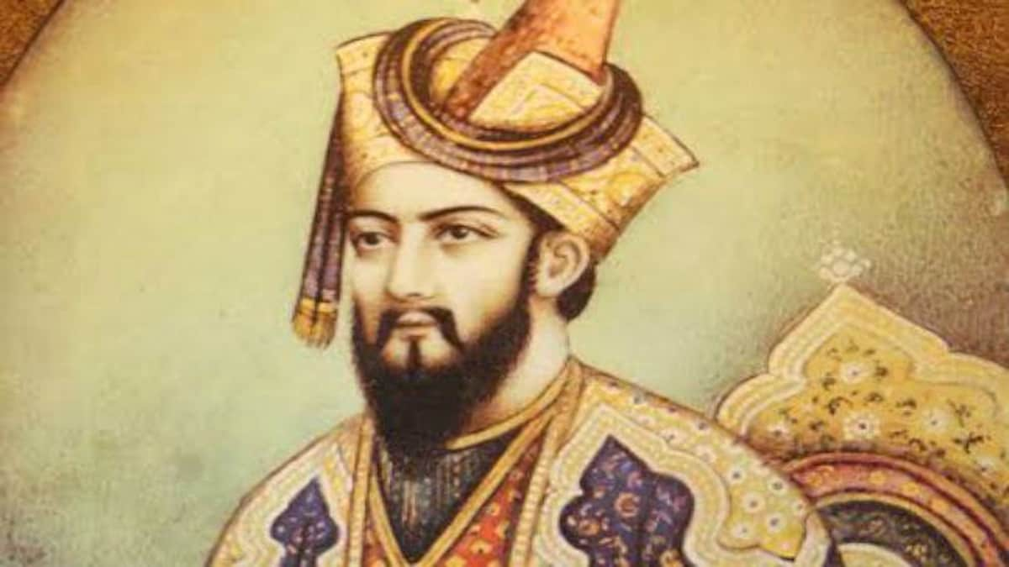
Key Figures in the Battle
Babur (1483–1530): Timurid descendant; innovative tactician; used Ottoman-inspired methods; authored Baburnama.
Ibrahim Lodi: Autocratic ruler; relied on traditional elephant charges; underestimated gunpowder.
Other Players: Ustad Ali Quli (Babur's artillery expert); Daulat Khan (Lodi defector).
Analysis: Babur's adaptability vs. Ibrahim's rigidity; personal leadership decided the outcome.

Slide 13
The First Battle of Panipat (April 21, 1526)
Location: Plains near Panipat, Haryana; strategic chokepoint for Delhi.
Babur's Tactics: Tulughma (flanking maneuvers); wagon fortifications (laager) for cannons; matchlocks and artillery.
Lodi's Approach: Frontal assault with elephants; panicked by gunfire, causing stampede on own troops.
Phases: Initial standoff; Lodi charge repelled; Mughal counterattack and encirclement.

Slide 14
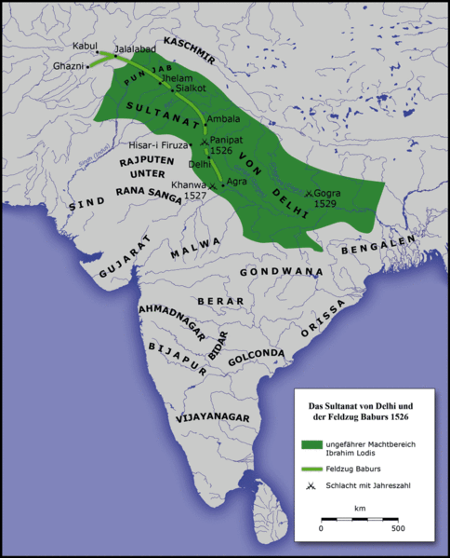
Babur’s route to India
India 1525 & Babur’s Invasion route — The delhi sultanate and rajputs under Rana sanga were the 2 major powers in north india. South india being dominated by the deccan sultanates and Vijaynagar)​

Slide 15
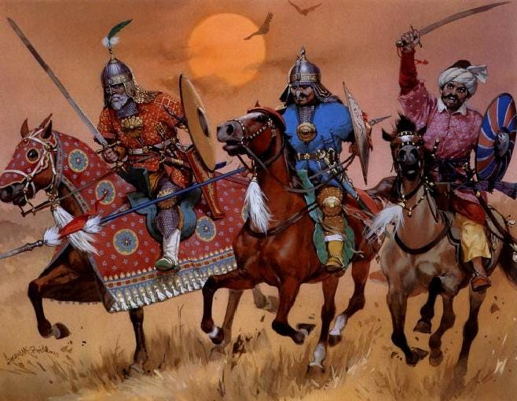
The Afghan Sultanate Army – Overview
Composition: Cavalry-based with war elephants; quasi-feudal: central force + chief contingents + Turkish jagirdars + Indian levies/mercenaries.
Afghan Heavy Cavalry: Basis of military power; shock charges without horse archery. Equipment: Mailed lancers; plate-chainmail hybrid or iron lamellar armor; lance, mace, scimitar.

Slide 16
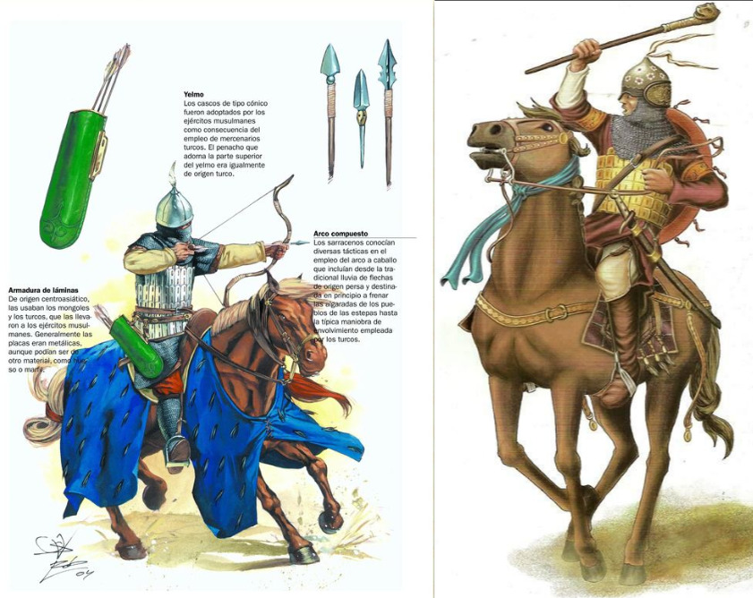
Ghulams, Armored Cavalry, and Elephants
Ghulams: Standard melee cavalry since Ghurids; shield, lance, mace, scimitar; little change in armor.
Elephants: 400+ armored; terrifying shock/mobile fortresses; mahout + 2-3 infantry with spears/bows.

Slide 17
.
Infantry:
Cannon fodder due to climate/archery/elephants; no heavy armor or pikes.
Types: 1. Pashtun tribal foot (axes, swords, spears; variable armor). 2. Muslim foot archers (composite bow, sword). 3. Bumi levies/mercenaries (bamboo longbow, broadsword; minimal armor).
Tactics:
Formation: Five-fold (vanguard, right/left, center, rear); Sultan at center with picked cavalry.
Key Elements: Skirmishing, night raids; shock from elephants/heavy cavalry; massed frontal assaults on plains.
Analysis: Brute force; lacked maneuverability; no understanding of Tulughma; feudal contingents uncoordinated

Slide 18
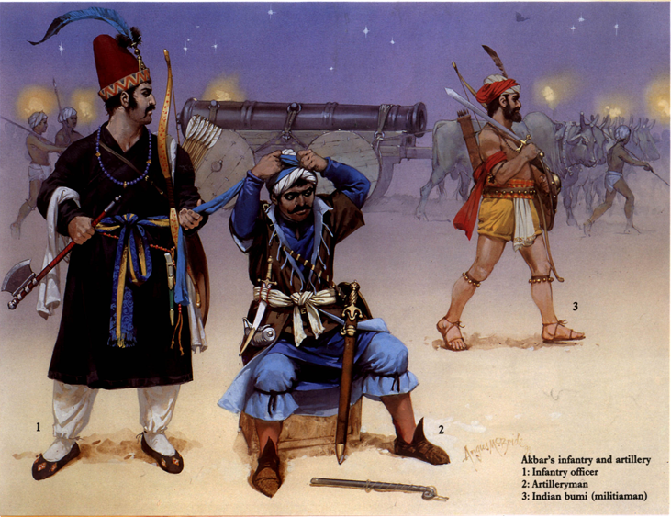

Slide 19
The Mughal Army – Overview
Composition: Turks, Mongols, Iranians, Afghans; veteran core campaigned with Babur for decade; equality in ranks.
Size: 15,000–20,000 at Panipat; organized in Timurid units (10-1000).
Morale: High; battle-hardened, loyal; dining with Babur; no retreat option.
Cavalry
Centerpiece: Horse archers (Mongols from Moghulistan) + heavy melee (Turks); all armored (lamellar/chainmail-plate hybrids).
Equipment: Lances, swords, bows; capable of shock or archery.
Analysis: Steppe warfare masters; ambushes, feints; superior to Afghan shock cavalry.

Slide 20
Mughal Horse Archers
Role: Primary superiority; Turco-Mongol composite bow (3x faster than matchlock; accurate 70-100 yds, dangerous 200 yds).
Equipment: Full armor; 6 shots in 20 seconds for veterans.
Mughal Infantry
Types: Foot archers (composite bows + secondary weapon); matchlock musketeers (tufang/bunduqchi; Turkish origin).
Ratio: 4:1 archers to matchlocks; range ~100 yds; matchlocks lethal vs. horses/elephants; used mantlets.
Acquisition: From Ottomans via Safavids.
Mughal Artillery
Introduction: Field artillery new to India; models: zarb-zan (light), kazan (heavy); 20 at Panipat; stone shot.

Slide 21
Mughal Tactics
Ottoman Influences
Tabur Cengi: Wagon defenses (araba); pioneered by Hussites, adopted by Ottomans (e.g., Chaldiran 1514, Mohacs 1526).
Formation: Infantry/artillery center behind wagons; cavalry wings; Akinci screen; reserves.
Analysis: Pivot for flanks; artificial defenses; Babur learned via Turkish gunners.
Tulughma and Timurid Array
Tulughma: Encircling maneuver; divide forces for flexibility; flanking parties (horse archers) surround enemy.
Yasal Array: Vanguard (harawal), center (kol), flanks (jaranghar/baranghar), rear (chadavul); illtimish reserves.
Analysis: From Uzbeks/Timur; drilling enabled synchronization; fusion with Ottoman tactics at Panipat.

Slide 22
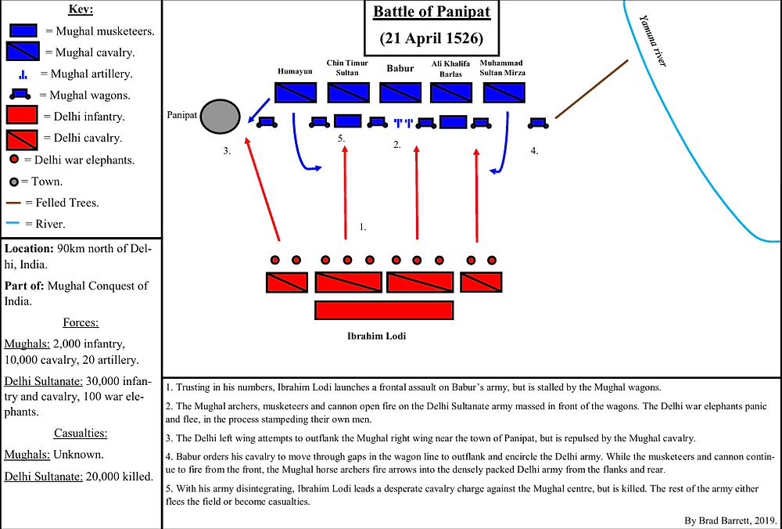

Slide 23
Outcome
Losses: Afghans ~15,000 killed/wounded; Mughals ~4,000.
Results: Babur captures Delhi/Agra; end of Lodi Dynasty; Mughal foundation.
Analysis: Discipline/innovation won; gunpowder revolutionized warfare.
Immediate: Babur deals with Rajputs at Khanua, Afghans at Gogra; dies before consolidation.
Long-Term: Humayun faces Sher Shah; Akbar consolidates Mughal Empire.
Military Shift: End of Sultanate; gunpowder age begins; elephants decline.
Analysis: Epoch in medieval India; Persianate influence grows.

Slide 24
Causes of Mughal Success
  Intelligence: Intercepted reinforcements; probed defenses.
  Discipline: Flawless maneuvers vs. Afghan disorder.
  Morale: Equality/no retreat vs. Lodi discontent.
  Technology: Cannons/matchlocks rendered elephants useless.
  Firepower: Bows/artillery barrage; psychological impact.
  Surprise: Cart-line/Tulughma new to India.
  Elephant Failure: Reverse rout ruined cohesion.
  Ibrahim's Death: Premature; reserves unused.
  Security: Balanced defense/counterattack
  To Napoleon is credited the saying — ‘’The whole art of war consists of a well-thought out and extremely circumspect defensive, followed by a rapid and audacious counterattack’’. Babur’s tactics at Panipat were a perfect balance between caution and aggression.

