Slide 1
Greek Religion
Nature, Beliefs and Practices in Ancient Greece

Slide 2
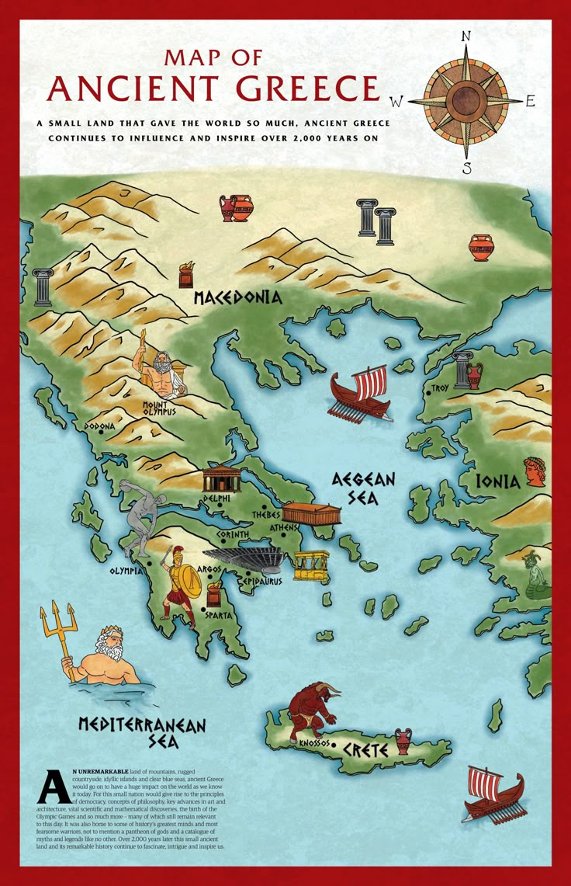

Slide 3
Phases
Minoan Civilization (c. 3000–1450 BCE)
Early Aegean culture with distinctive religious practices and monumental architecture
Mycenaean Civilization (c. 1600–1100 BCE)
Warrior society with palatial centers and early Greek religious traditions
Greek Dark Age (c. 1100–800 BCE)
Period of decline during which Homer's Iliad and Odyssey were composed orally
Archaic Period (c. 800–500 BCE)
Cultural revival with development of city-states and formalized religious institutions
Classical Period (c. 500–323 BCE)
Golden age of Greek civilization with flourishing philosophy and religious practices
Hellenistic Period (323–31 BCE)
Spread of Greek culture across Mediterranean with syncretic religious developments

Slide 4
Sources of Greek Religion
Greek mythology
Epic literature (Iliad and Odyssey)
Works of Hesiod – Theogony
Archaeological remains
Inscriptions and monuments

Slide 5
Unity in Greek Religion
Despite political divisions among city‑states, Greeks shared:
Common gods and myths
Pan‑Hellenic festivals
Sanctuaries such as Delphi and Olympia
Shared rituals and cultural traditions

Slide 6
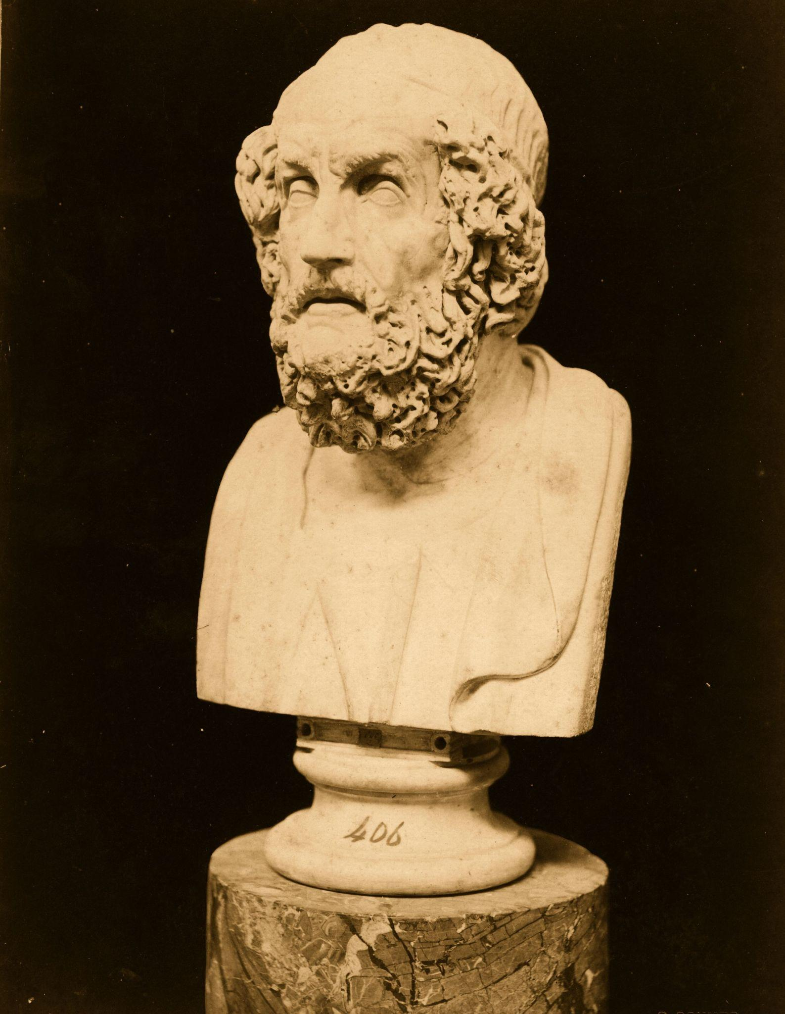
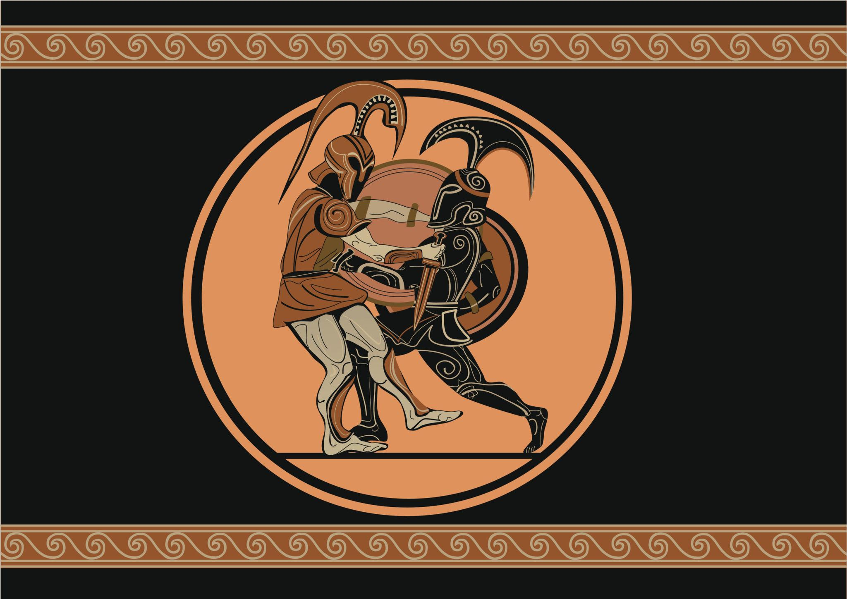
Homer
Bust Of Homer
Achilles kills Hector

Slide 7
Homeric Tradition
The Iliad and the Odyssey attributed to Homer
Describe the gods, heroes and beliefs
Reflect aristocratic warrior culture
Influenced religion during Archaic and Classical periods

Slide 8
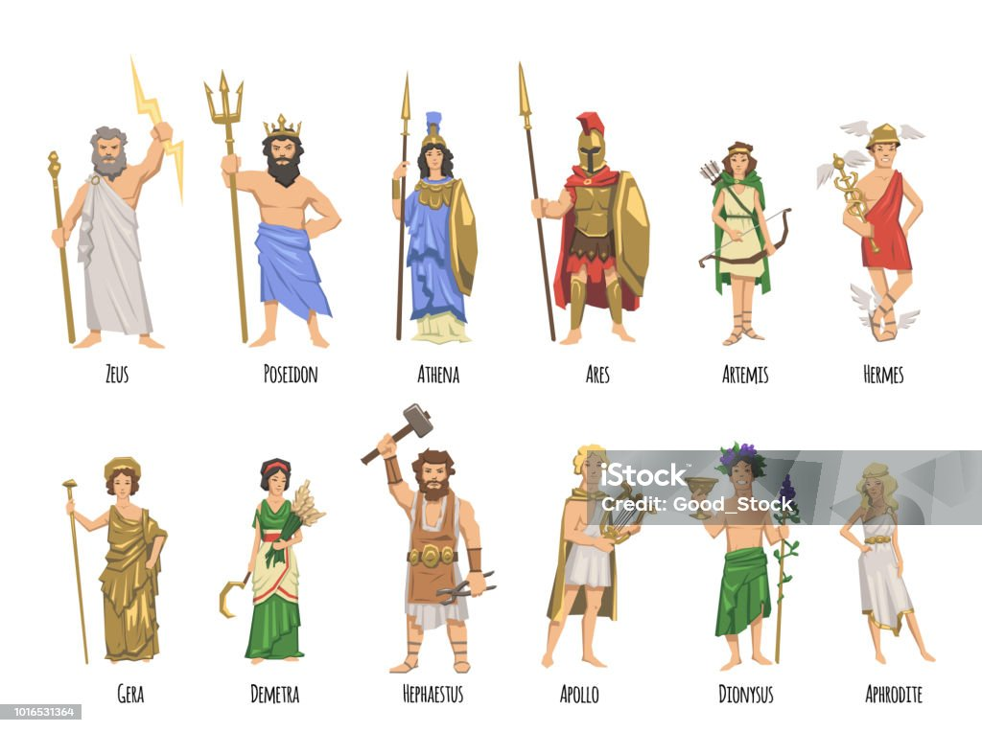
Greek religion was polytheistic, with twelve major deities residing on Mount Olympus. Zeus, ruler of the divine world, was protector of law and order. Gods possessed human-like qualities but were immortal.
Gods
Zeus
King of gods, protector of law and order
Athena
Wisdom, warfare, protector of cities
Apollo
Music, prophecy, healing, light
Poseidon
Ruler of seas and earthquakes
Demeter
Grain, fertility, agriculture
Aphrodite
Love, beauty, fertility

Slide 9
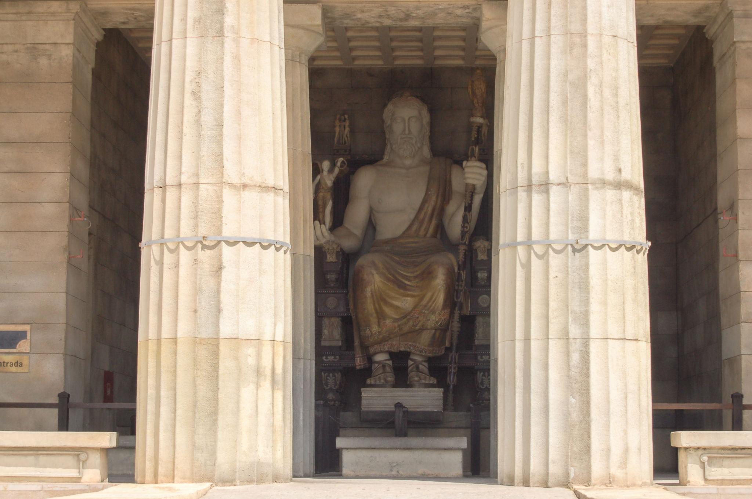
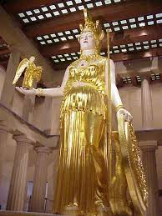
Statue of Zeus at Olympia, Greece
Athena Parthenos by Phidias - World History Encyclopedia

Slide 10
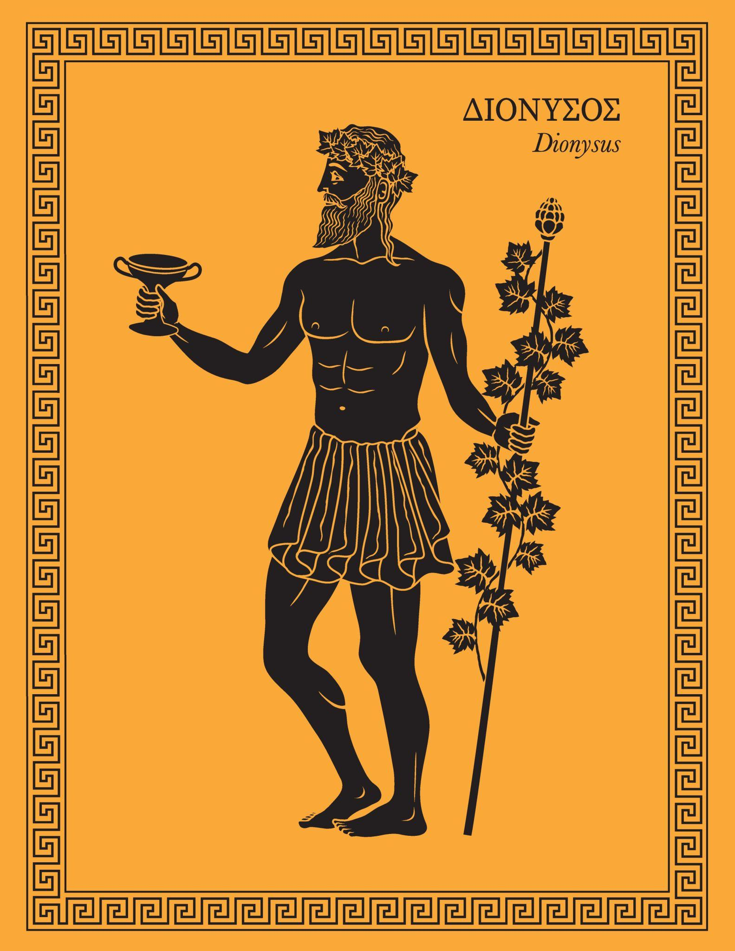
God of wine, fertility and ecstatic celebrations
Originated in Thrace
Associated with theatre and dramatic festivals
Symbolised emotion and instinct in human life
Dionysus

Slide 11
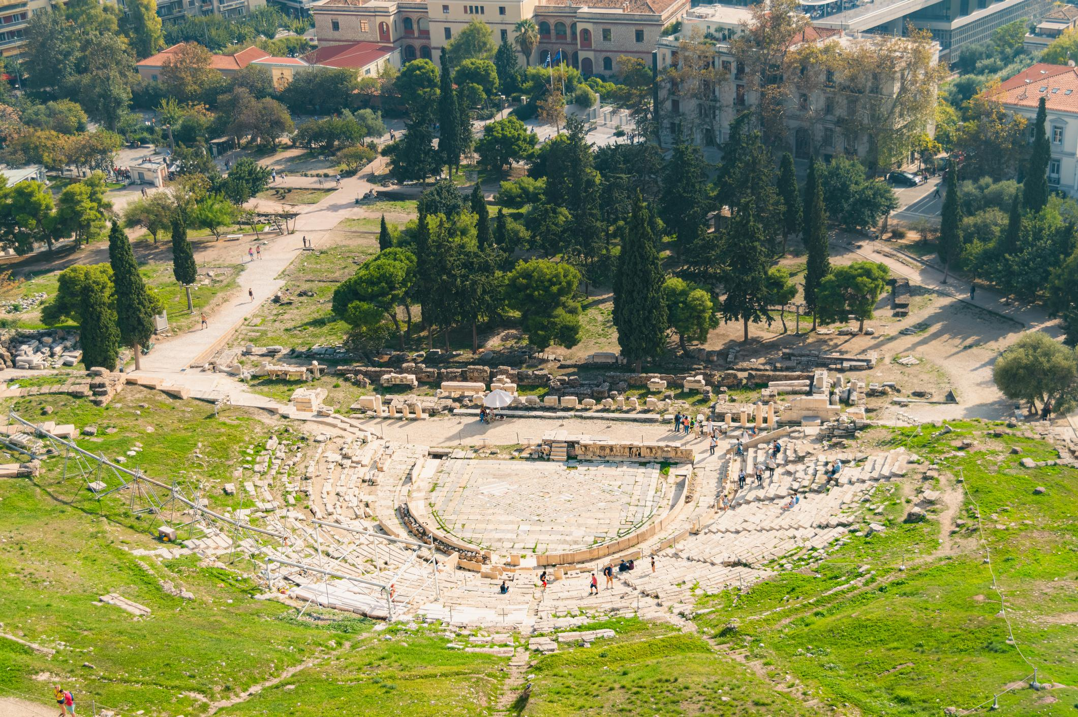
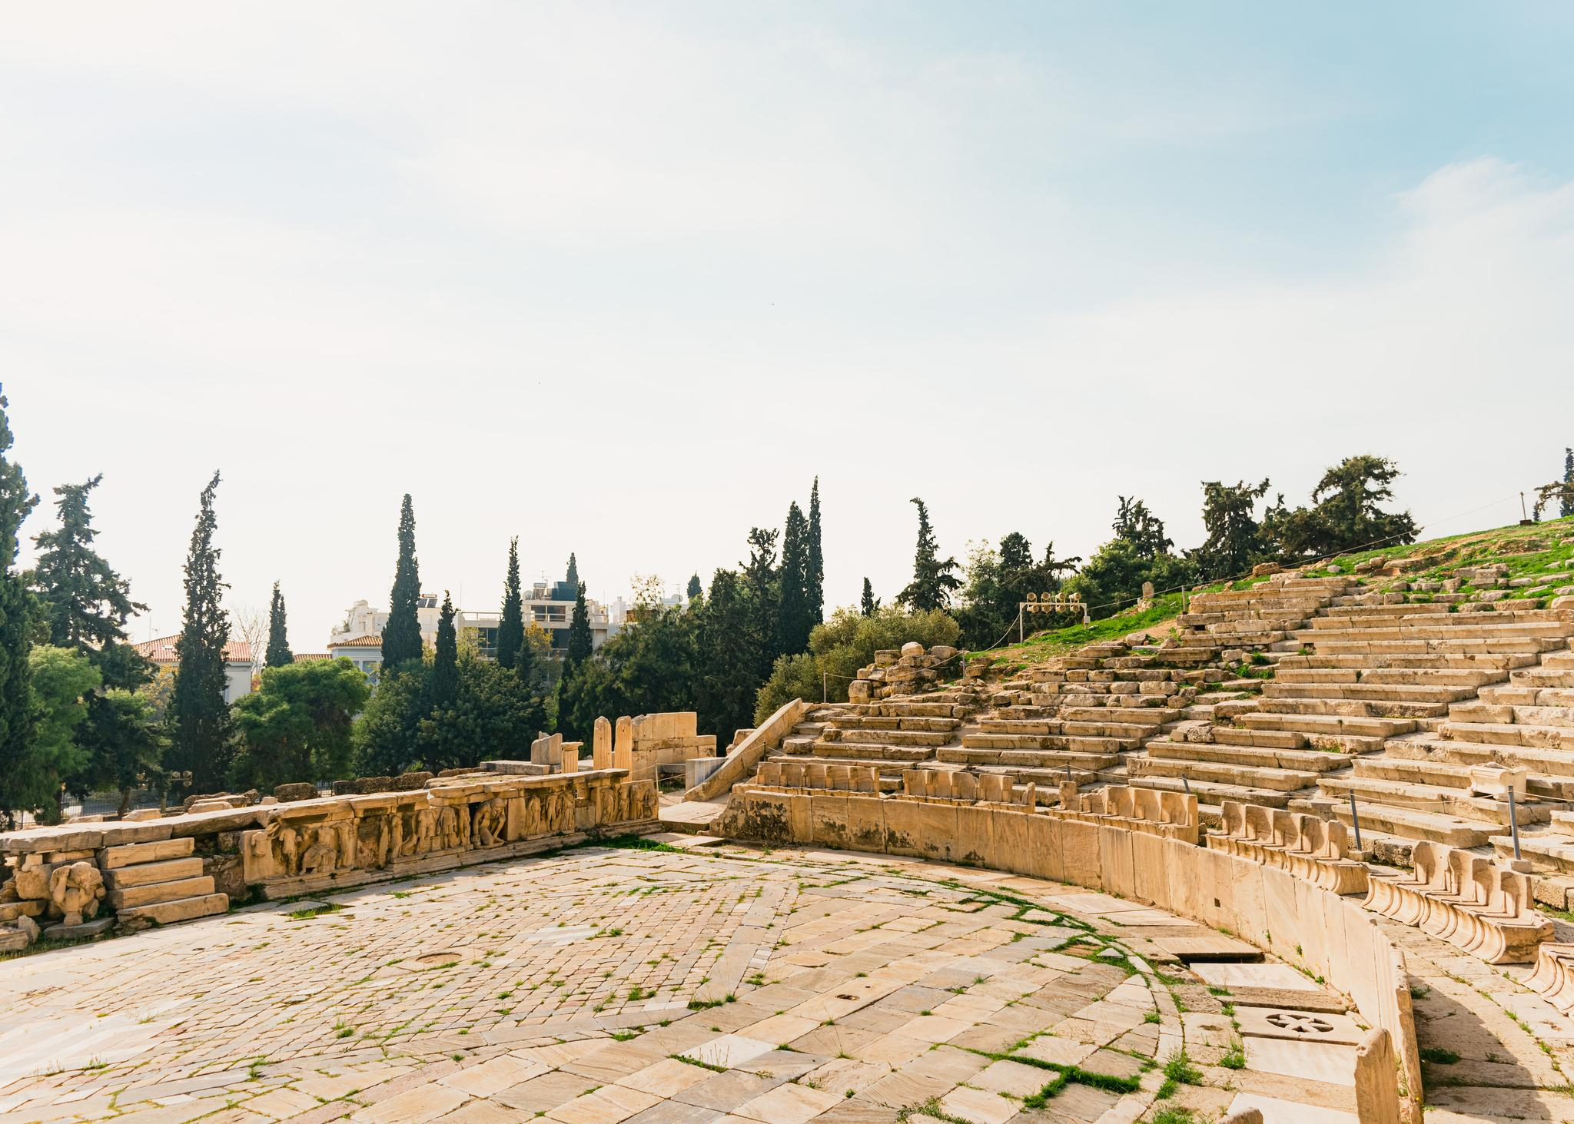
Dionysus
Ancient Theatre of Dionysus: Birthplace of Greek Tragedy on Acropolis
Ruined Theatre of Dionysus, Birthplace of Western Drama on Acropolis

Slide 12
Rituals and Religious Practices
Sacrifices and offerings to gods
Household rituals for birth, marriage and death
Public ceremonies connected with civic life
Religious oaths taken by magistrates

Slide 13
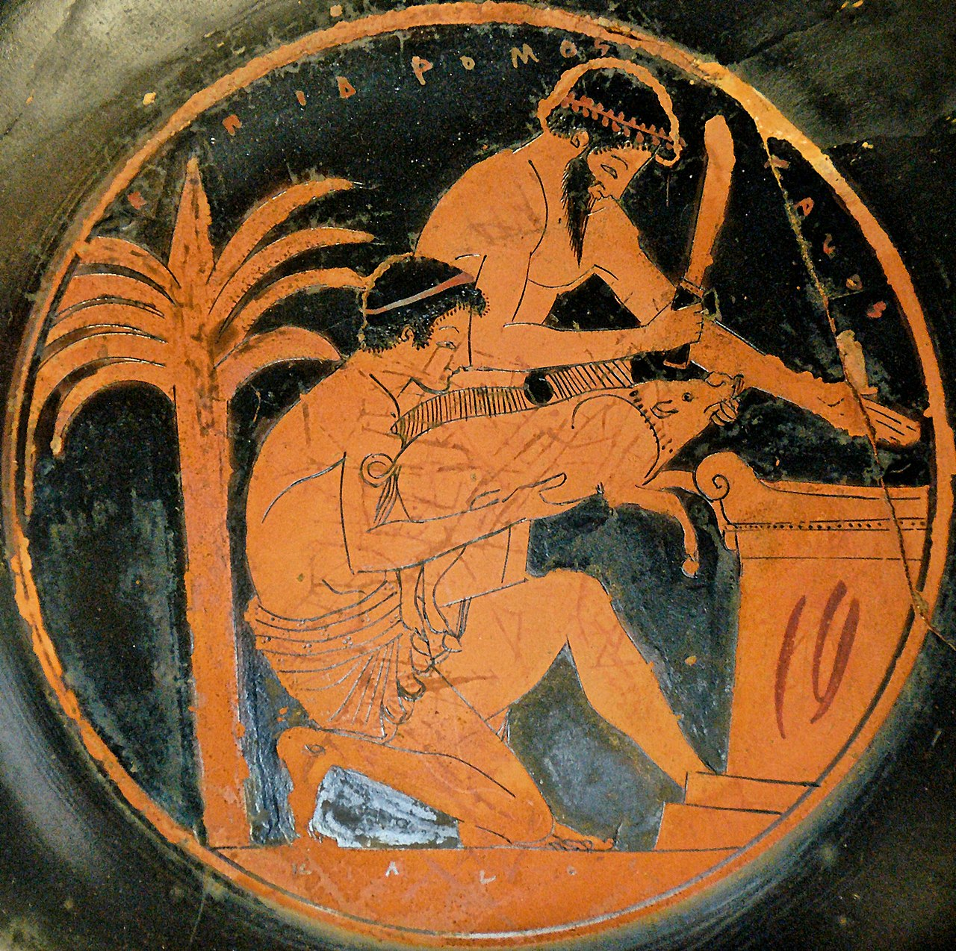
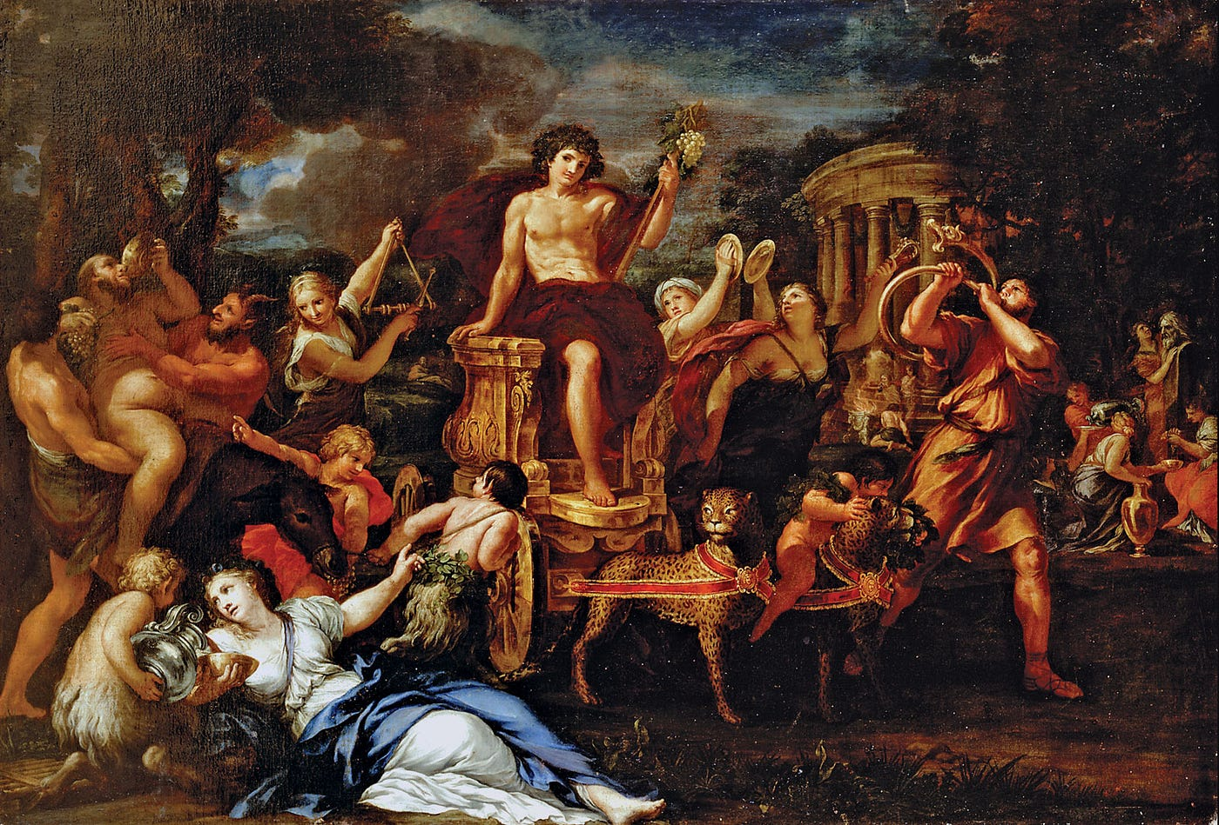
Animal sacrifice - Wikipedia
Cult and Festivals of Dionysus in Ancient Greece | by Selin Öztürk | Medium

Slide 14
Festivals and Games
Great Dionysia – dramatic performances
Panathenaea – festival of Athena
Olympic Games at Olympia (from 776 BCE)
Athletic contests with religious significance

Slide 15
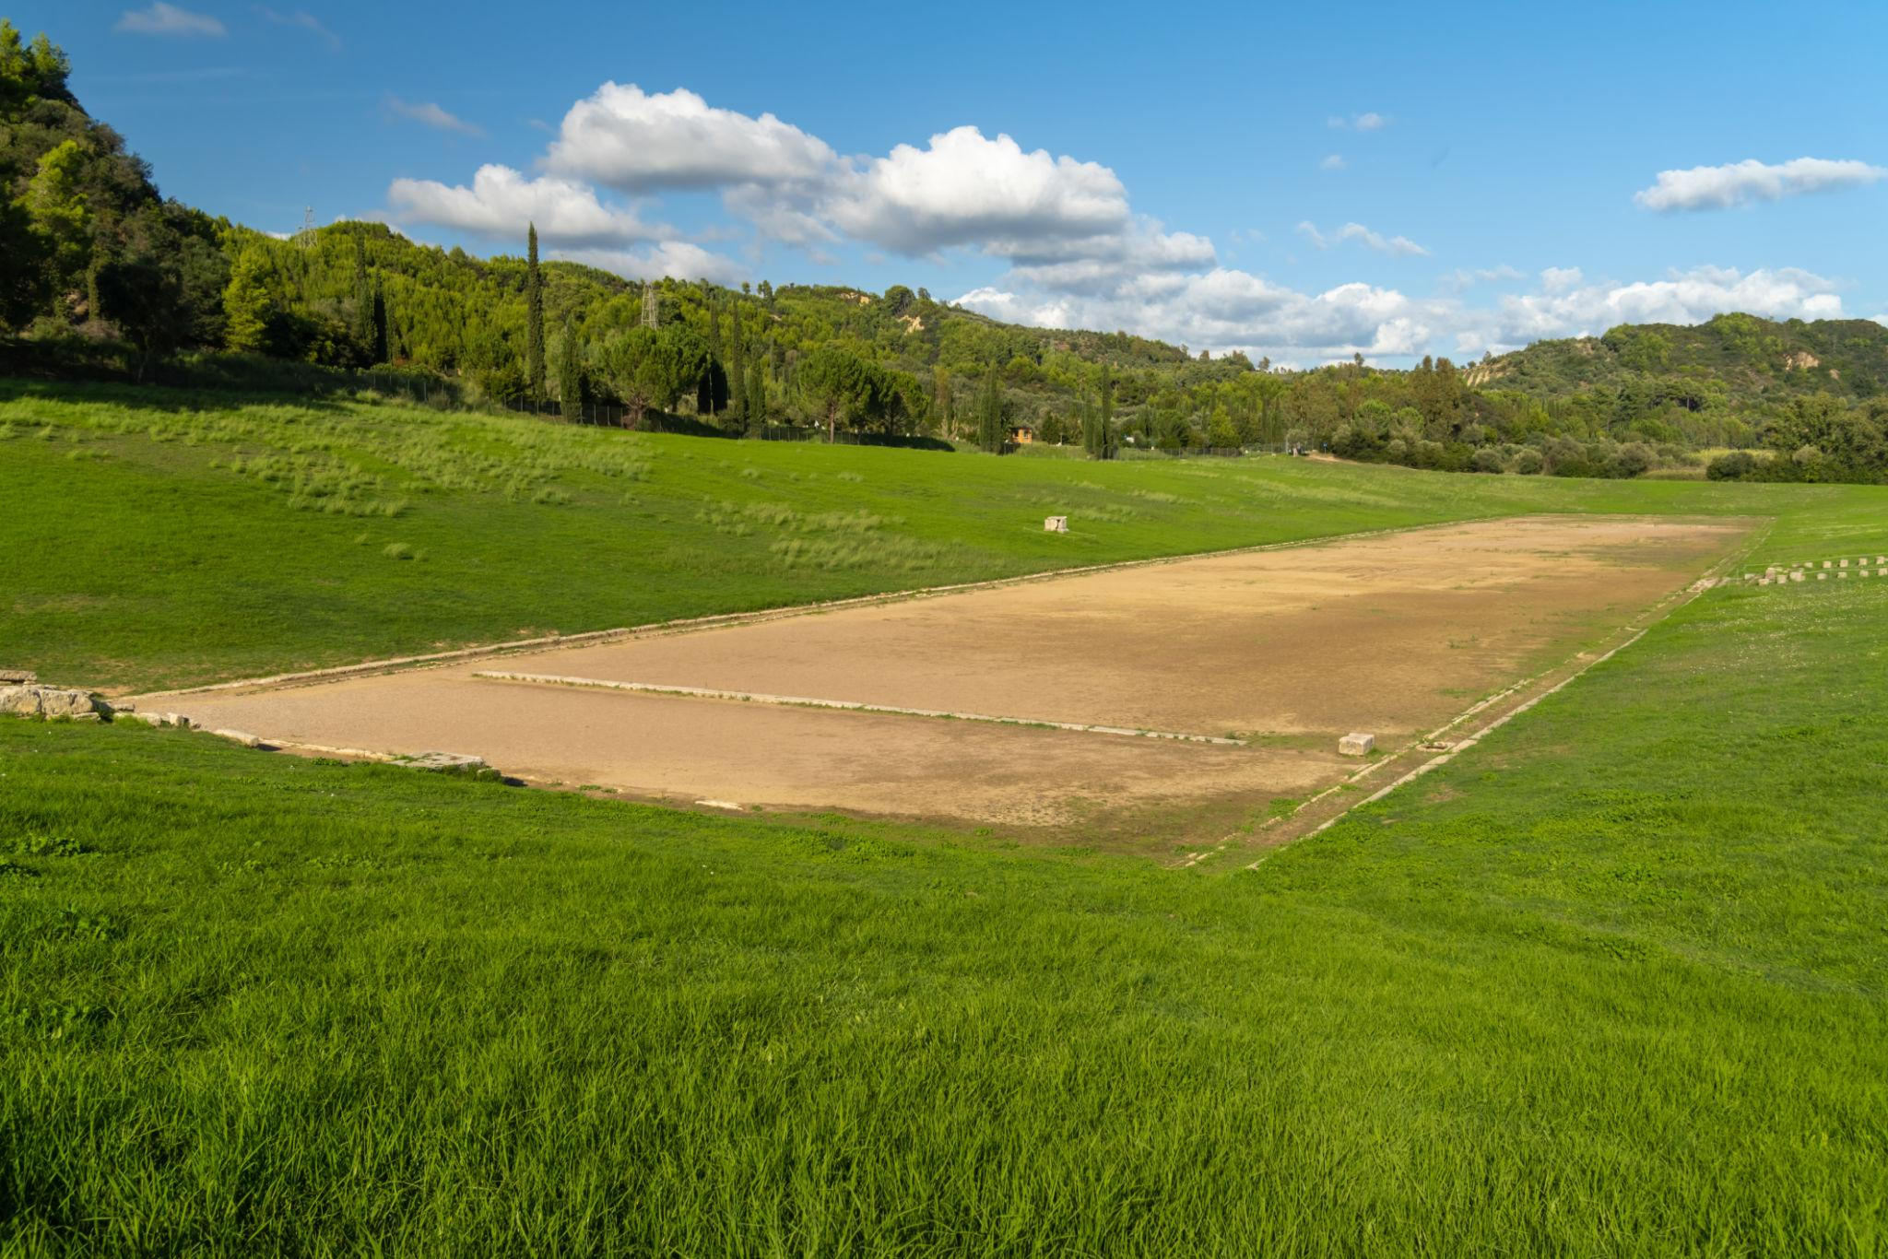
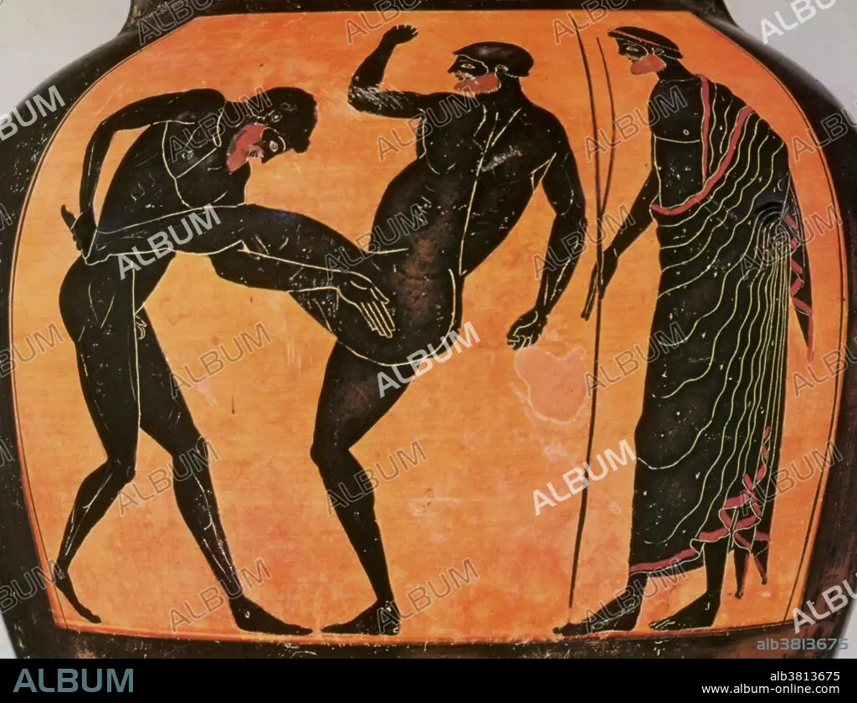
Ruins of the Olympic Stadium in the archeological site of Olympia, Greece, a major Panhellenic religious sanctuary of ancient Greece, where the ancient Olympic Games were held.
Olympic Games, Pankration, Black-Figure Pottery - Album alb3813675

Slide 16
Temples and Sanctuaries
Temples built to house statues of gods
Rituals performed in sacred areas (temenos)
Important centres: Delphi, Delos, Olympia, Athens
Parthenon built during the time of Pericles

Slide 17
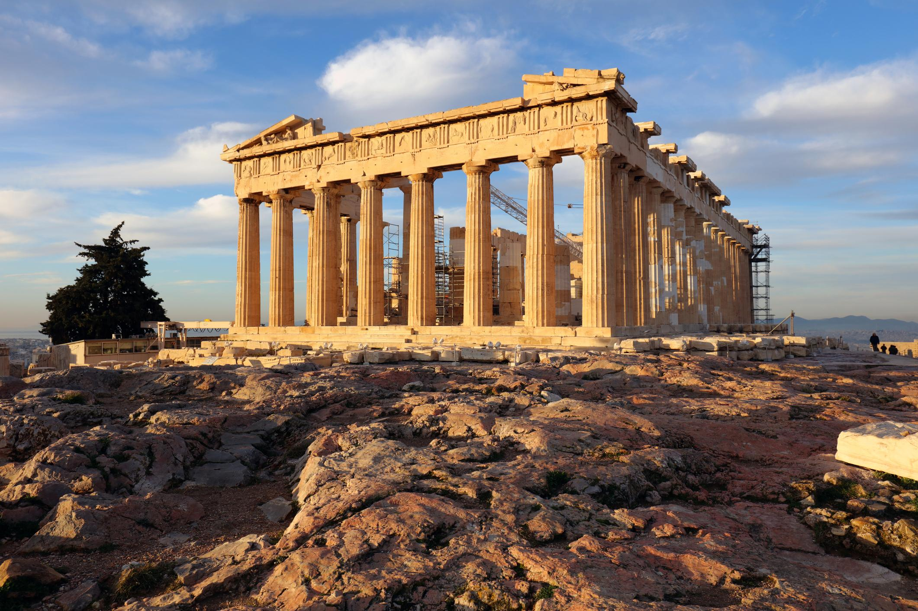
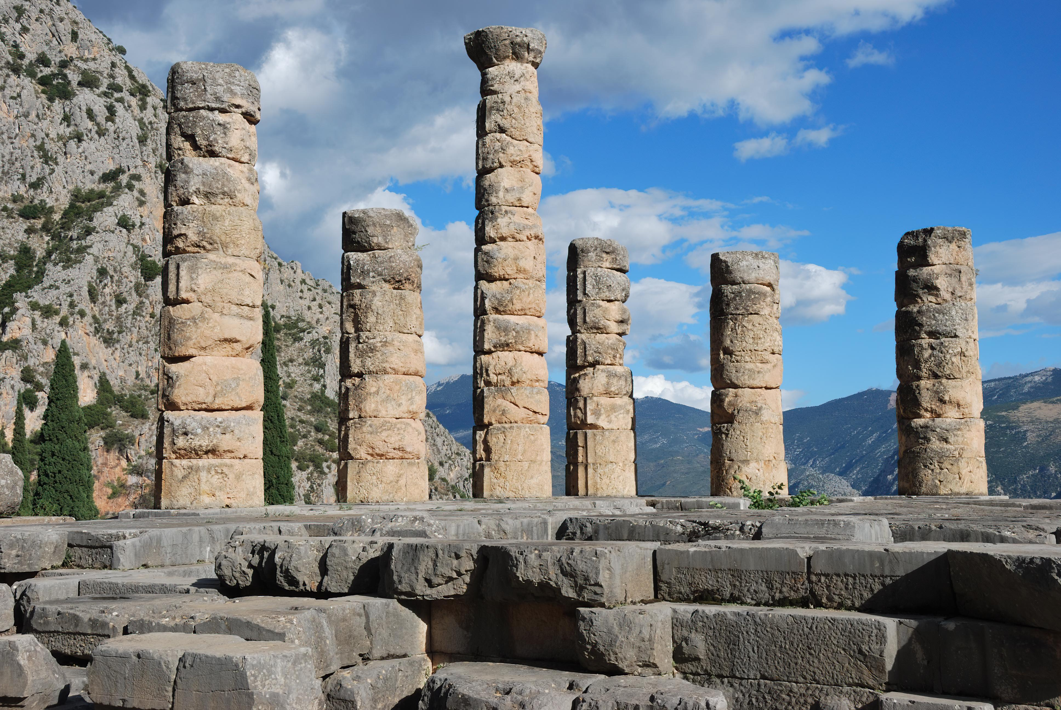
Temples
Athens - Parthenon on the Acropolis at sunrise in Greece
Apollo Temple in Delphi, Greece

Slide 18
Oracles and Mysticism
Oracle of Delphi – divine guidance
Eleusinian Mysteries – hope of life after death
Orphism – ascetic practices
Pythagoreanism – philosophical religious movement

Slide 19
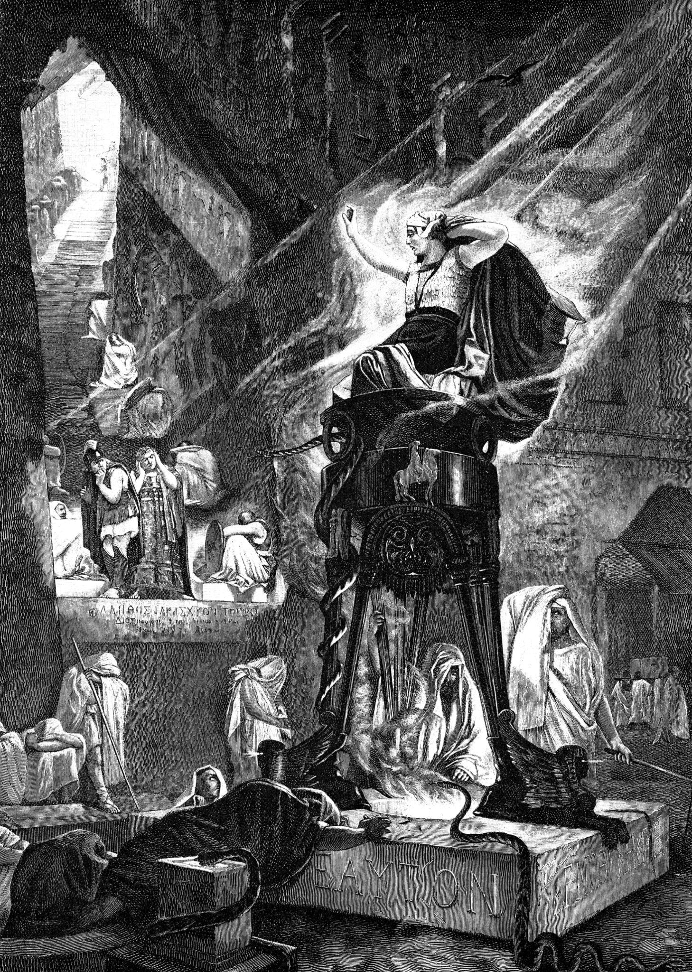
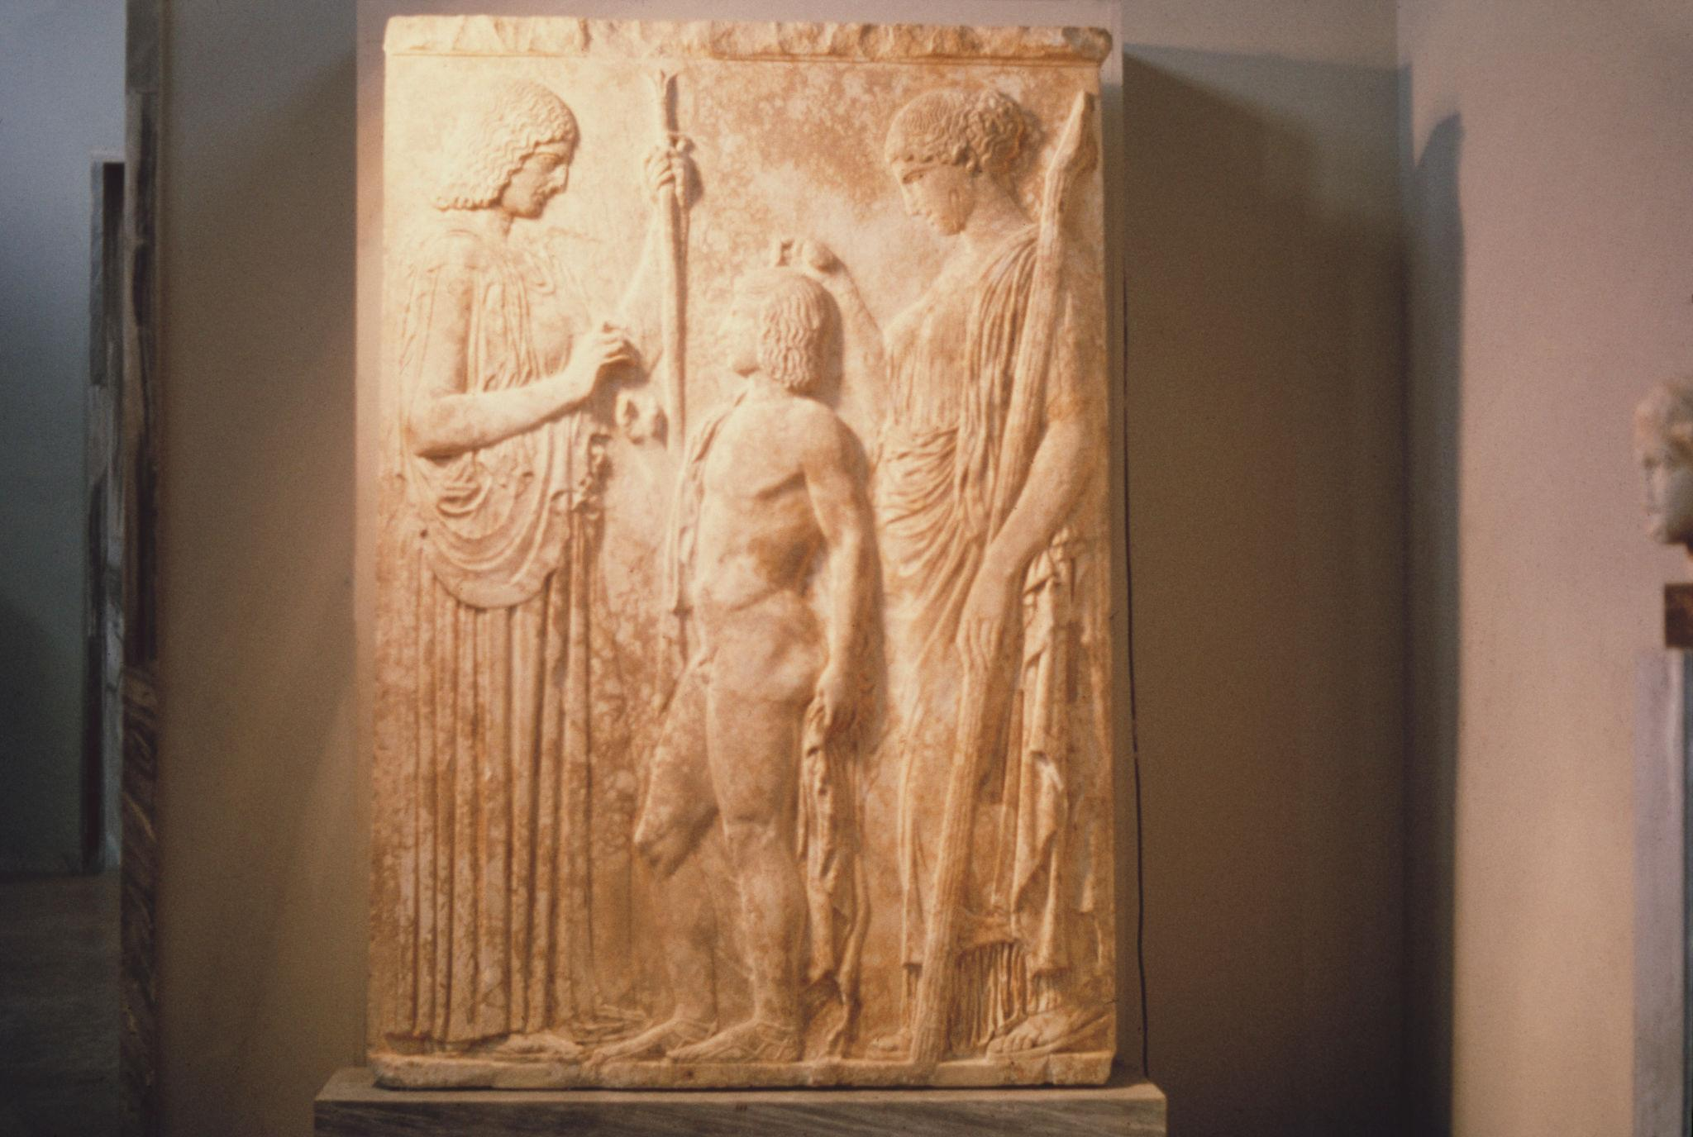
Oracles and Mysticism
The Priestess of Delphi
Eleusenian Relief

Slide 20
Decline and Transformation
Intellectual Challenge
After Peloponnesian War (late 5th century BCE), Sophists questioned conventional religious beliefs
Foreign Cults
Spread of cults from Anatolia and Thrace. Worship of Thracian goddess Bendis became popular in Athens
Inclusive Appeal
Foreign religions open to women, foreigners, and slaves. Promised personal salvation unlike civic religion

Slide 21
Conclusion
Greek religion shaped social and cultural life
Created unity among city‑states
Influenced philosophy, art, literature and Western culture

