Slide 1
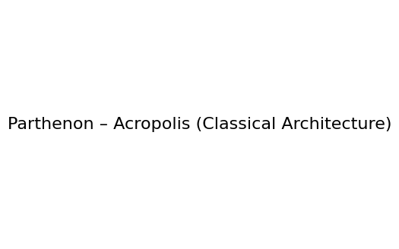
Greek Art and Architecture – Archaic and Classical Periods

Slide 2
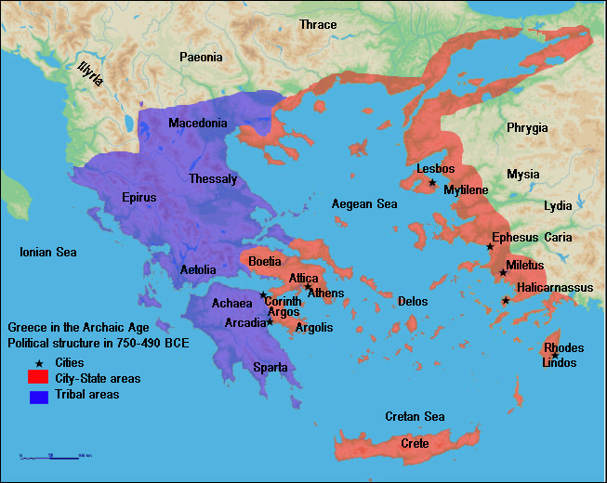
Introduction to Ancient Greece
Independent poleis with shared culture.
Classical efflorescence: prosperity and innovation.
Focus on Archaic and Classical periods.

Slide 3

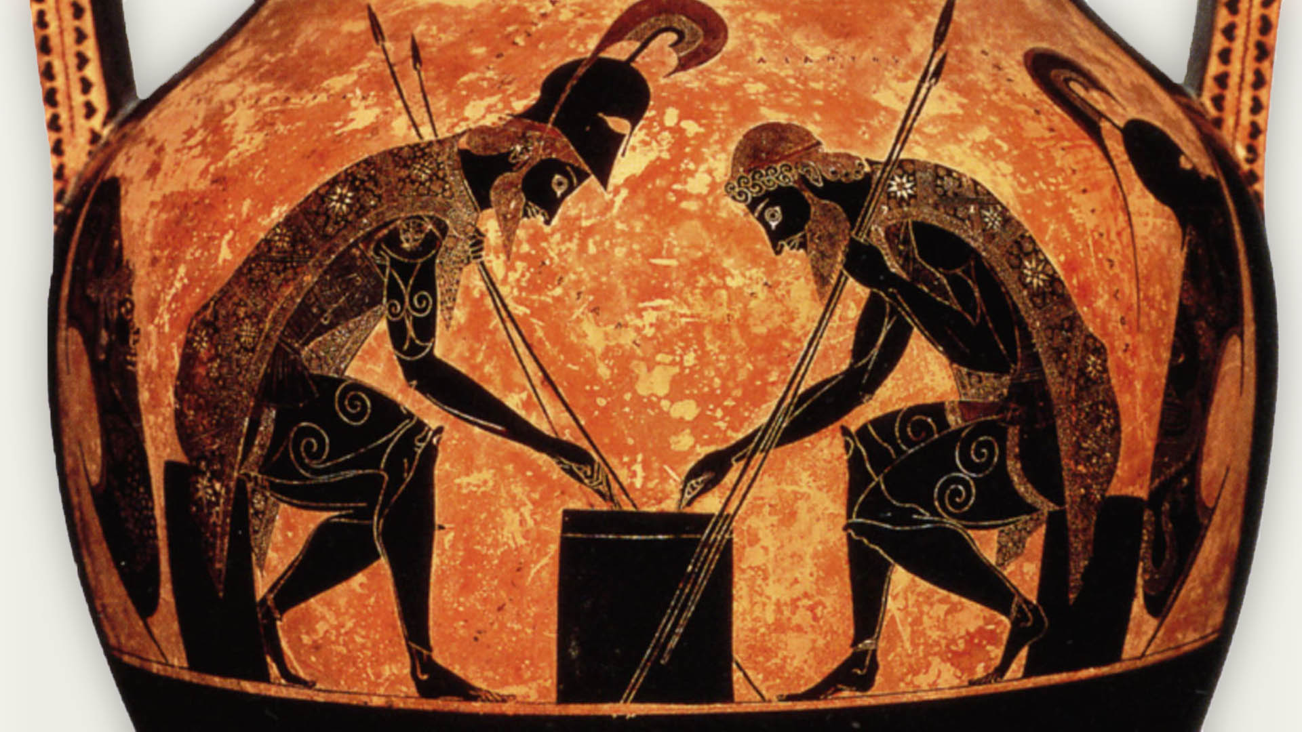
Pottery & Vase Painting – Overview
Key evidence of mythology and daily life.
Shift: Black‑figure → Red‑figure innovation.
                Black figure amphora by Axekias, Achilles and Ajax engaged in game(540-530BCE)

Slide 4
Corinthian Black‑Figure Technique
Corinth dominated early trade.
Black silhouettes with incised detail.
Mythology, athletics and symposia themes.

Slide 5
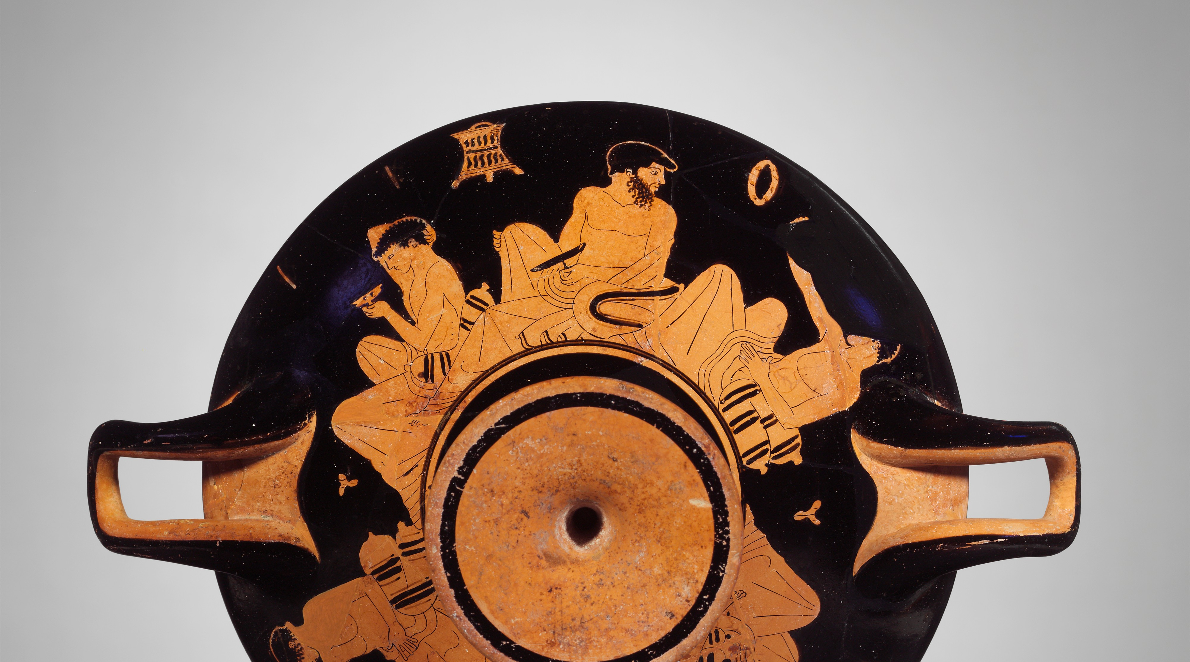
Athenian Red‑Figure Technique
c.530 BCE innovation.
Painted detail allowed realism and emotion.
Expanded subjects including theatre.

Slide 6
Classical Vase Painting
Peak narrative drama and expression.
Inspired by theatre culture.

Slide 7
Greek Sculpture – Overview
Human ideal beauty and proportion.
Archaic rigidity → Classical naturalism.

Slide 8
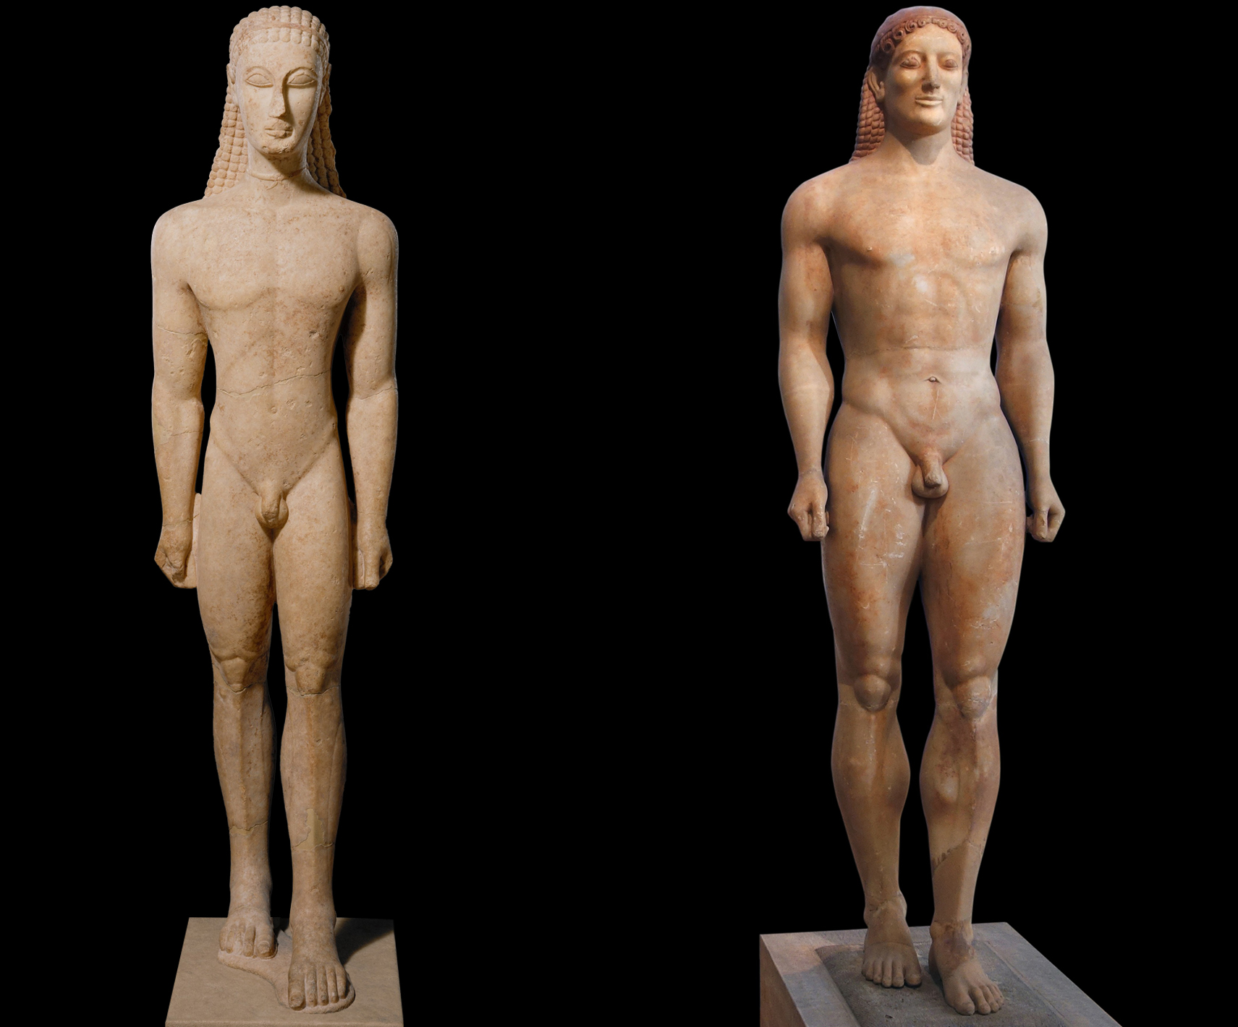
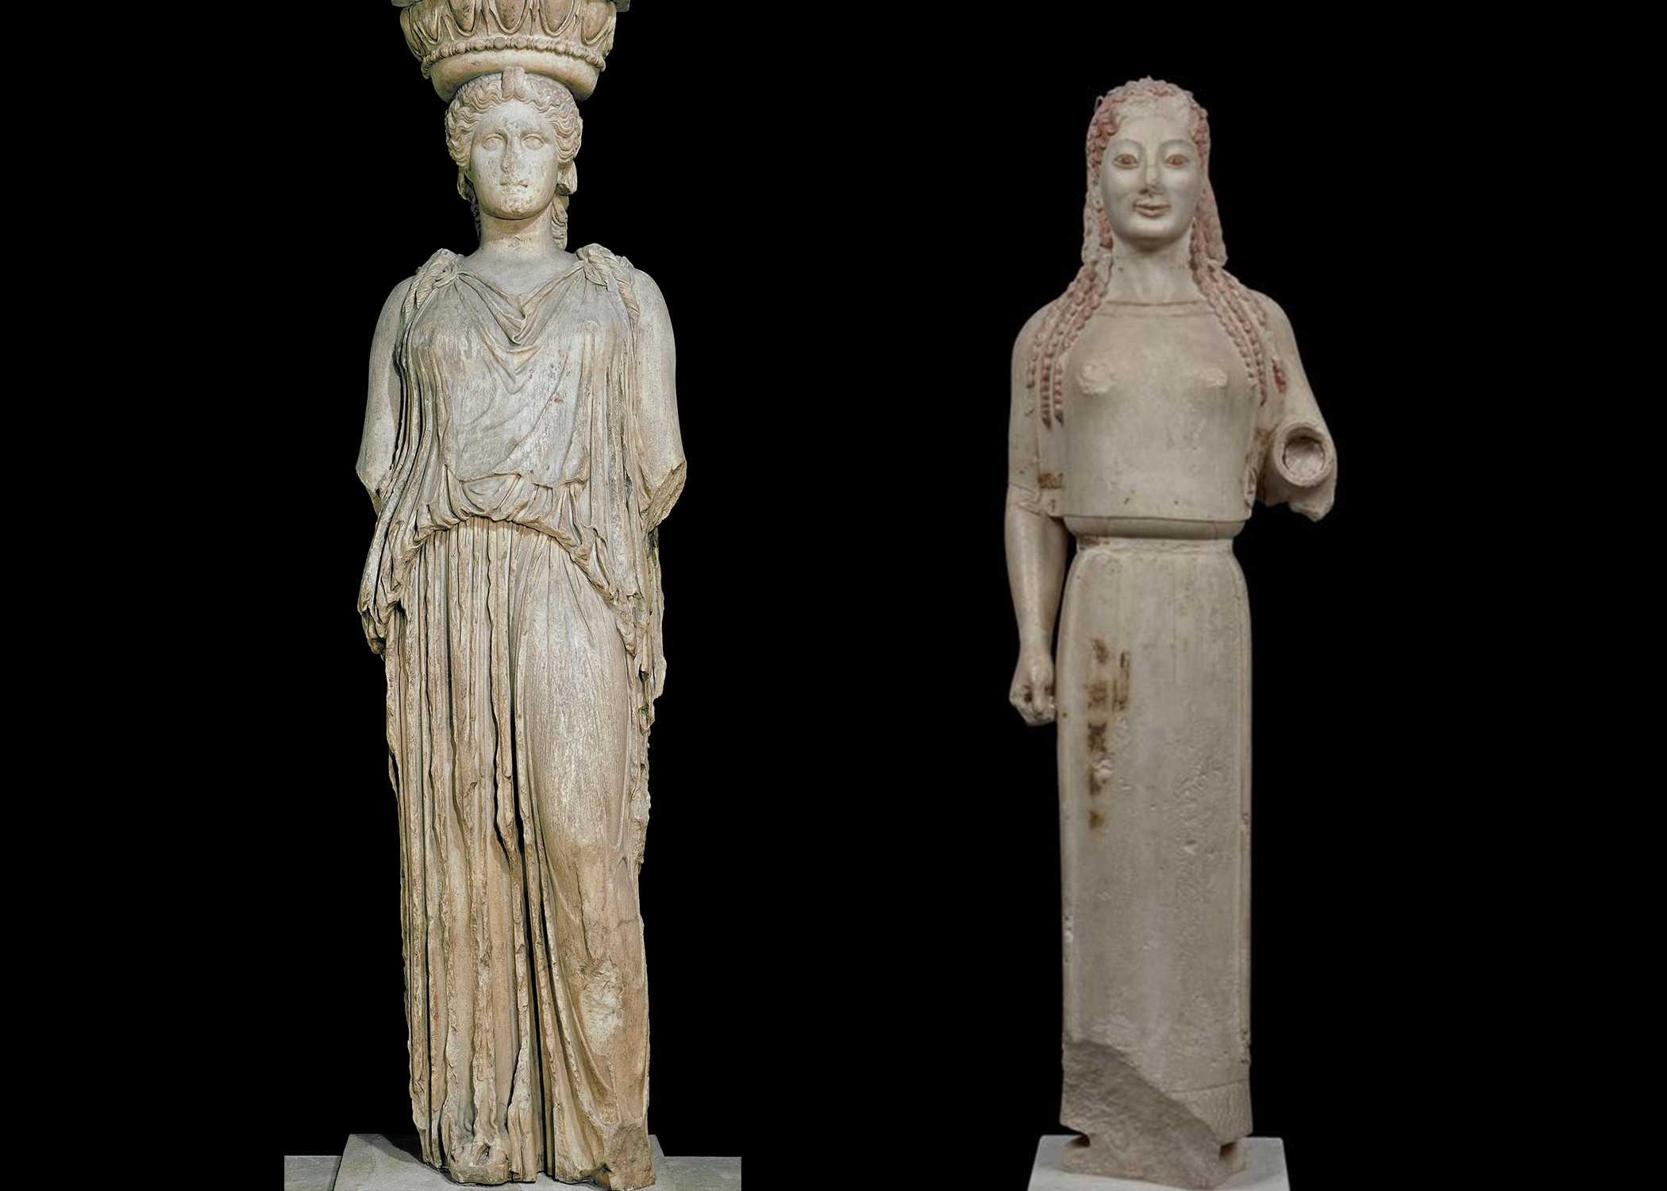
Archaic Sculpture
Kouros and Kore forms.
Egyptian influence and Archaic smile.

Slide 9
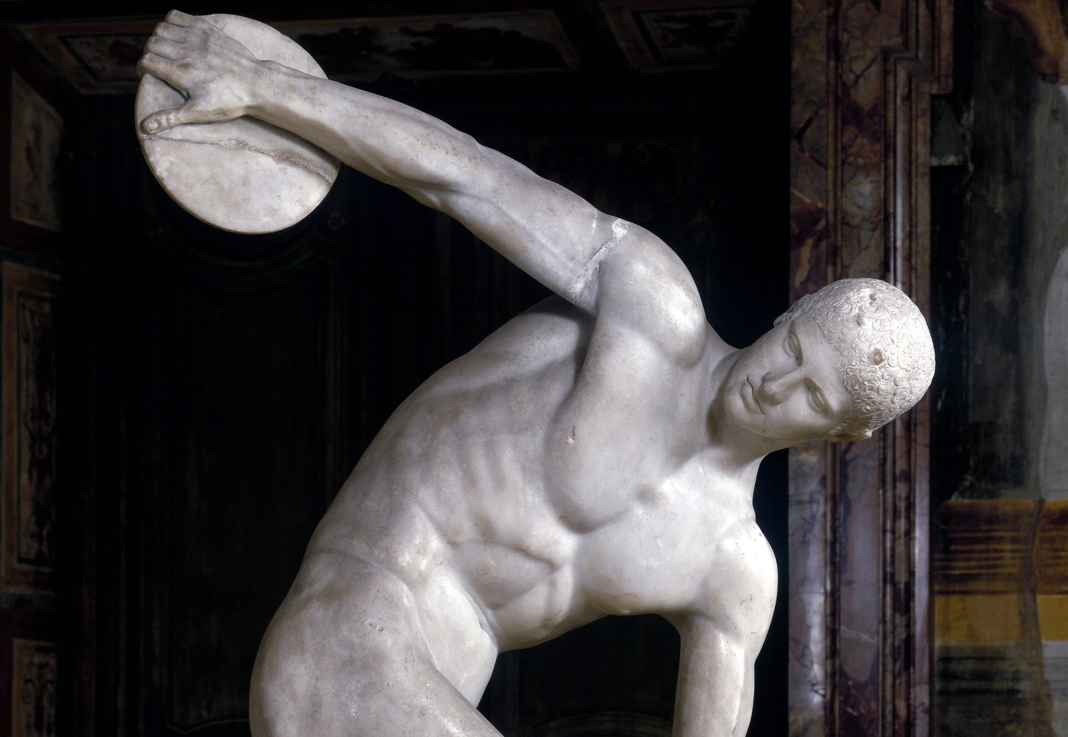
Classical Sculpture
Contrapposto stance.
Myron’s Discobolus captured motion.

Slide 10

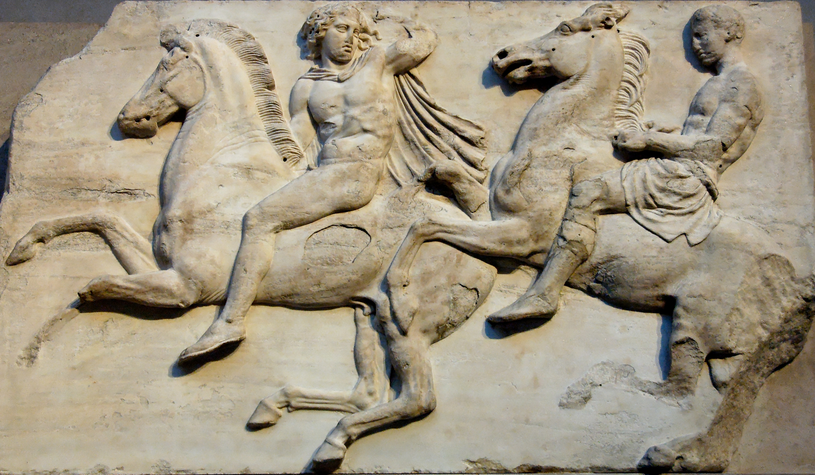
Major Classical Sculptors
Phidias – Parthenon.
Polykleitos – Canon.
Praxiteles – Emotional realism.

Slide 11
Greek Architecture – Overview
Temples expressed religion and civic pride.
Agora as urban centre.

Slide 12
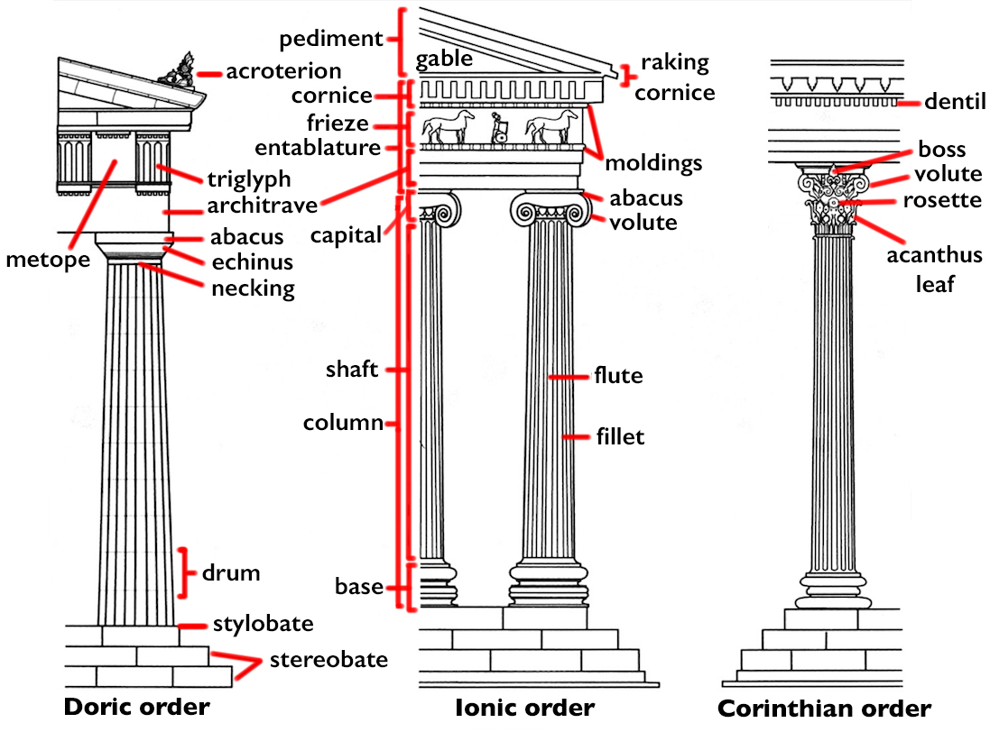
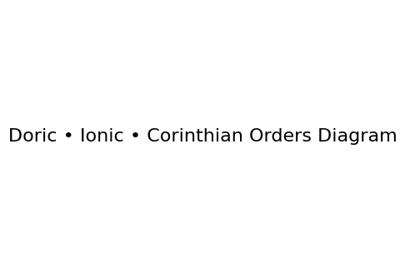
Architectural Orders
Doric – strength.
Ionic – elegance.
Corinthian – ornate decoration.

Slide 13
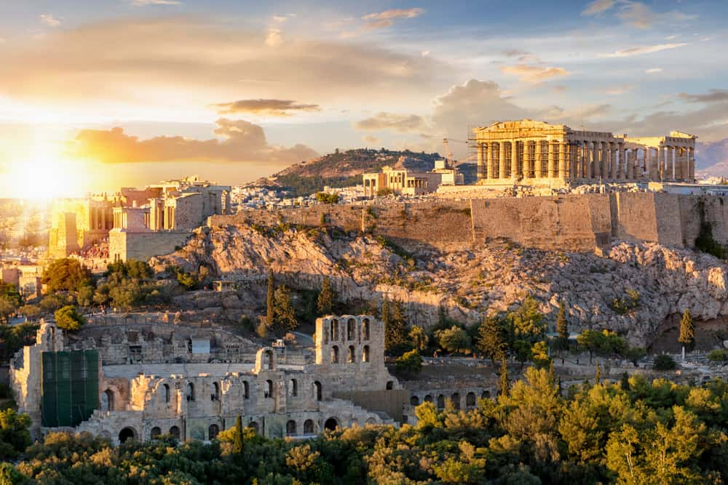
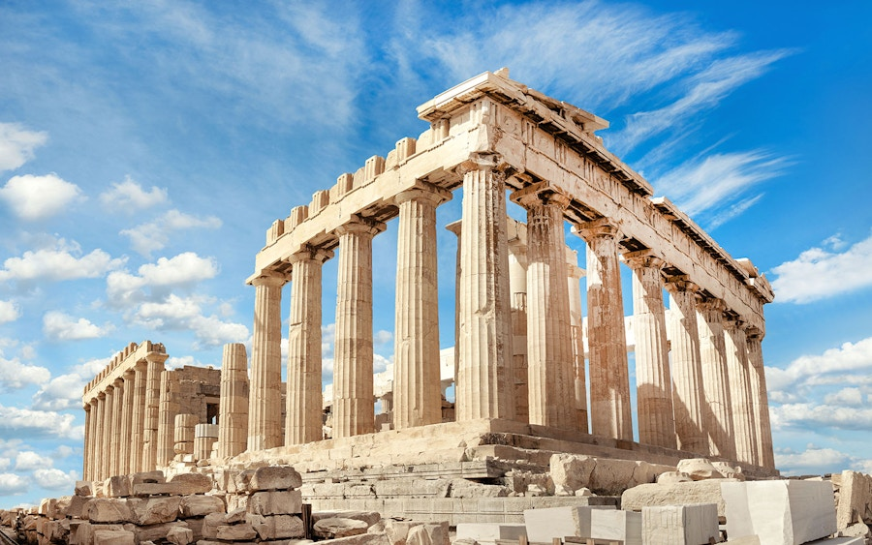
Classical Architecture – Golden Age
Parthenon (447–438 BCE).
Optical refinements and harmony.

Slide 14
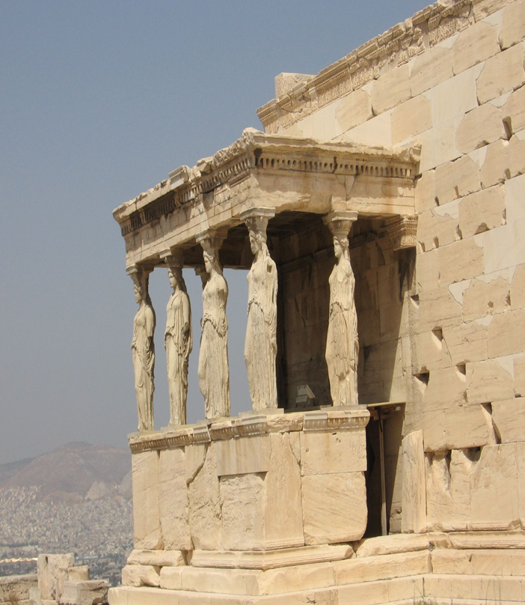
5th c .temple on Athens Acropolis dedicated to Athena and Poseidon

Slide 15
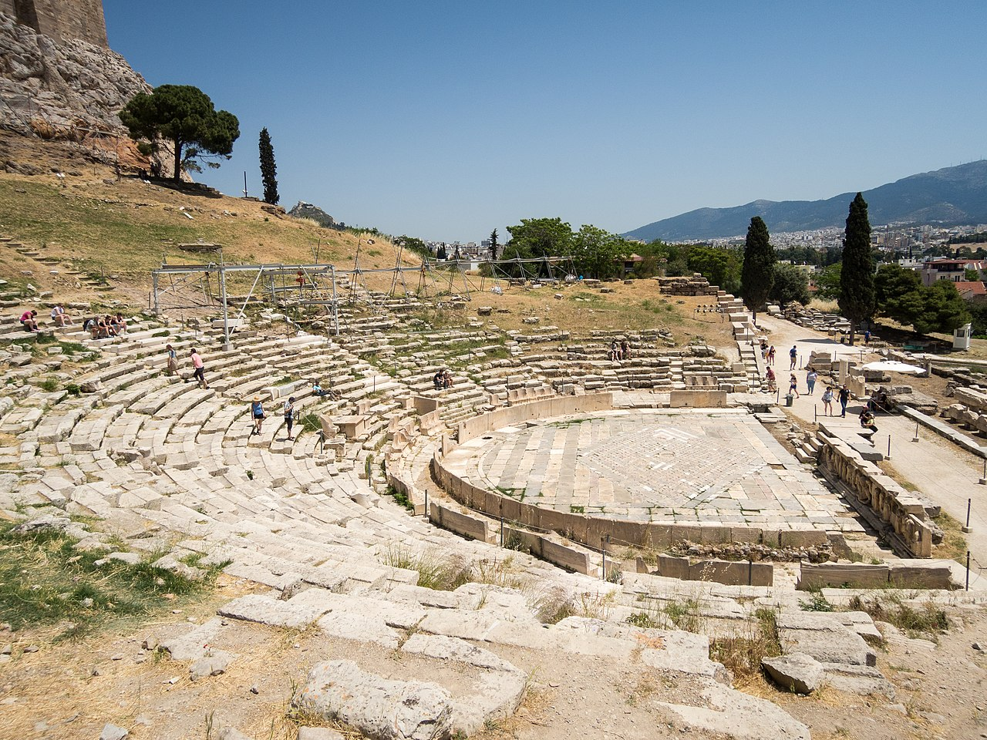
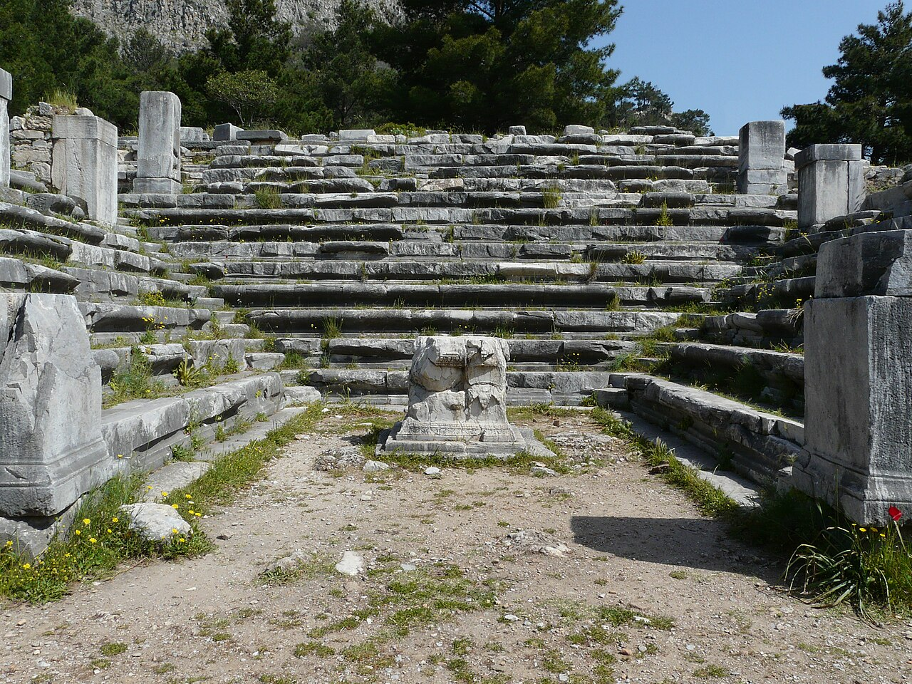
Civic Architecture
Theatre of Dionysus and Long Walls, Statues reinforced democracy(Court House).

