Slide 1
Greek
Philosophy
♦ ♦
From Cosmic Inquiry to the Science of Human Existence
Origins • Schools • Legacy

Slide 2
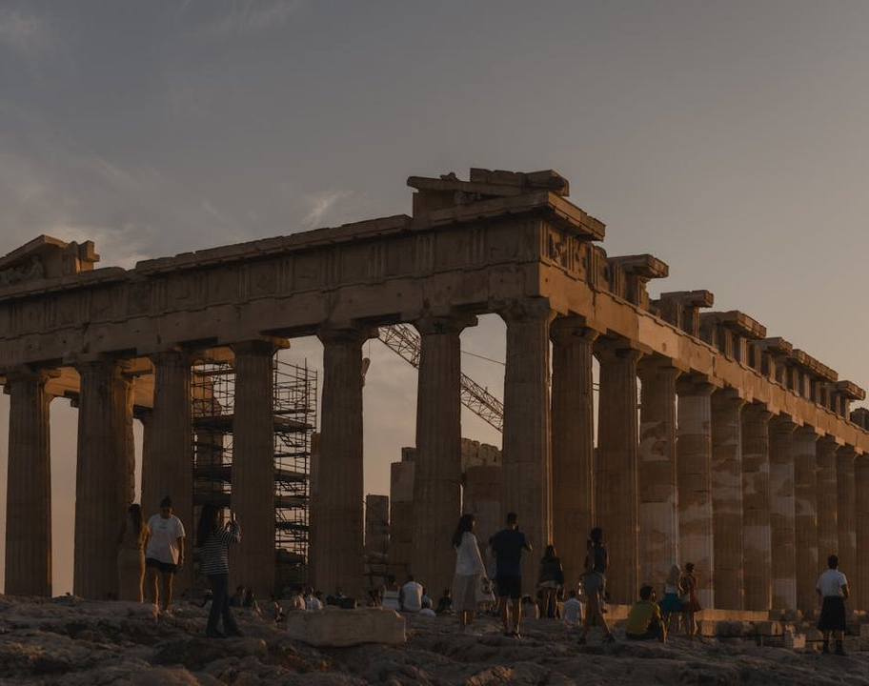
The 6th Century BCE
The Greek Miracle:
Origins of Philosophy
Intellectual Awakening: A decisive shift from mythological explanations (like those of Homer and Hesiod) to rational inquiry and observation.
Triumph of Reason: The "Greek Miracle" symbolized the victory of logic (Logos) over superstition and divine intervention.
The Polis Context: Social and political crises in city-states like Miletus fostered an environment of debate, rule of law, and free inquiry.
From Mythos to Logos: Thinkers began to explain the universe through natural elements rather than the whims of gods.

Slide 3
The First Philosophers
The Milesian School
Emerging in the Ionian city of Miletus (Asia Minor), these thinkers sought the Archê (fundamental principle) of the cosmos, replacing myth with natural law.
Anaximenes
c. 585 – c. 528 BCE
Proposed a mechanism for change, attempting to explain how the primary substance transforms into other elements.
Principle: Air
Through rarefaction (becoming fire) and condensation (becoming wind, cloud, water, earth), air forms the cosmos.
Thales
c. 624 – c. 546 BCE
Often regarded as the first Greek philosopher. He broke away from mythological explanations to propose natural causes.
Principle: Water
He believed water or moisture was the primary substance from which all things originated and to which they return.
Anaximander
c. 610 – c. 546 BCE
A student of Thales who argued that the origin could not be a specific material like water, as it limits the potential for opposites.
Principle: The Apeiron
The "Boundless" or "Indefinite" — an eternal, ageless substance from which opposites (hot/cold, wet/dry) emerge.

Slide 4
"Geometry has two great treasures: one is the theorem of Pythagoras; the other, the division of a line into extreme and mean ratio."
Pythagoras
of Samos
c. 570 – c. 495 BCE
Born on the island of Samos, Pythagoras migrated to Croton in southern Italy where he founded a secretive religious-philosophical brotherhood. His school combined mysticism with mathematics, influencing Plato and Western thought profoundly.
Metempsychosis (Transmigration)
Influenced by Orphism, he taught that the soul is immortal and passes into other bodies (human or animal) after death until purified.
Harmonia & Numbers
Believed that "all things are number." Discovered that musical intervals correspond to simple whole-number ratios, suggesting a cosmic order.
Ethics & The Mean
Taught a way of life based on moderation, dietary restrictions (vegetarianism), and the pursuit of harmony in the soul.

Slide 5
th Century BCE • Athens
The Sophists
Teachers of Rhetoric & Practical Wisdom
Man is the measure of all things.
”
Protagoras
First & Most Prominent Sophist
Asserting that truth is subjective and relative to the individual, challenging absolute divine authority.
The Intellectual Revolution
Rise of Democracy: Flourished in democratic Athens where public speaking and persuasion were keys to power.
Professional Educators: Unlike earlier philosophers, they charged fees to teach rhetoric (the art of persuasion) to young citizens.
Skepticism & Relativism: Questioned traditional religious beliefs and absolute moral truths.
Focus on Human Affairs: Shifted inquiry from the cosmos (nature) to human society, politics, and language.
Key Concepts:
Rhetoric Relativism Skepticism Civic Virtue Individualism

Slide 6
Before Socrates
Pre-Socratic Thinkers
The Turn from Myth to Mechanism
Anaxagoras
Clazomenae • Brought Philosophy to Athens
"Everything is in everything."
Key ContributionsConservation of Matter: Matter cannot be created or destroyed, only rearranged.
Nous (Mind): Introduced the concept of a cosmic Mind that orders and separates the chaotic mixture of ingredients.
Cosmology: The universe consists of infinite mixtures of
Democritus
Abdera • The Laughing Philosopher
"Nothing exists except atoms and empty space."
Key ContributionsAtomism: All matter consists of tiny, indivisible, indestructible particles called atomos.
The Void: Atoms move constantly through empty space, colliding and combining.

Slide 7
Socrates
The Moral Philosopher c. 470 – 399 BCE
A pivotal figure who shifted philosophy from the study of the cosmos to human existence. He wrote nothing himself; his life and methods are known primarily through the dialogues of his student, Plato.
The Socratic Method
A form of cooperative argumentative dialogue (elenchus) based on asking and answering questions to stimulate critical thinking and expose contradictions in beliefs.
Ethics & Knowledge
Believed that "virtue is knowledge"—if one truly knows what is right, one will act rightly. He sought objective definitions of virtues like justice and courage.
Trial & Execution
Accused of impiety and corrupting the youth. He chose death by drinking hemlock rather than exile, affirming his loyalty to the laws of Athens.

Slide 8
Plato
Student of Socrates, Teacher of Aristotle c. 427 – 347 BCE
Founder of the Academy in Athens, the first institution of higher learning in the West. Plato's dialogues laid the foundations of Western philosophy, moving from Socratic ethics to a comprehensive system of metaphysics and politics.
Theory of Forms (Ideas)
The material world is a shadow of true reality. Perfect, eternal "Forms" exist beyond sensory experience and can only be grasped by the intellect.
The Ideal State (The Republic)
Proposed a tripartite society of Producers, Guardians, and Rulers. Justice is achieved when each class performs its function in harmony.
Philosopher-Kings
"Until philosophers represent kings, or kings philosophize... cities will have no rest from their evils." Wisdom justifies authority.

Slide 9
Aristotle
The Systematizer
384 – 322 BCE
A student of Plato who founded the Lyceum. Unlike his teacher, Aristotle grounded his philosophy in the observable world, laying the foundations for logic, biology, and scientific inquiry.
Empirical Observation
Rejected independent Forms. Believed knowledge begins with sensory experience and the study of the natural world (the Lyceum).
Teleology
The concept that everything in nature has a purpose or final cause toward which it moves to fulfill its potential.
Politics & Ethics
Defined humans as "political animals." Advocated for a mixed constitution combining monarchy, aristocracy, and democracy for stability.

Slide 10
The Great Divergence
Plato vs. Aristotle
Idealism vs. Empiricism in Ancient Thought
Plato | Aristotle
School | The Academy Focus on mathematics & abstract reasoning | The Lyceum Focus on natural science & observation
Reality | World of Forms True reality is abstract, eternal, and non-material (Ideas). | Material World Reality is found in substance (matter + form) within nature.
Knowledge | Reason & Intellect Knowledge is "recollection" of Forms; senses are deceptive. | Empiricism Knowledge begins with sensory experience processed by reason.
Politics | Philosopher-Kings Ideal utopian state with strict class hierarchy (Republic). | Balanced Constitution Mixed government (Polity) ruled by law and middle class.
Method | Dialectic Dialogue and logical argumentation to reach truth. | Syllogism & Observation Deductive logic combined with biological classification.

Slide 11
The Enduring Impact
Legacy of Greek Philosophy
Foundations of Western Thought
From Cosmos to Ethics
Shifted the focus of inquiry from the mechanical structure of the universe (Pre-Socratics) to the profound questions of human behavior, virtue, and political organization (Socrates, Plato, Aristotle).
Athens as Intellectual Crucible
Established the model of the academy and free inquiry. The democratic environment of Athens fostered debate, logic, and the systematic examination of ideas that became the hallmark of Western education.
Foundations of Western philosophy, science, political theory -
Enduring triad: Socrates, Plato, Aristotle

Slide 12
The Chronology of Thought
Timeline of Greek Philosophers
From the Milesian School to the Lyceum
Thales c. 624 BCE
The First Philosopher
Water as Archê
Pythagoras c. 570 BCE
Mathematics & Mysticism
Theorem a²+b²=c²
Anaxagoras c. 500 BCE
Brought philosophy to Athens
Mind (Nous)
Socrates c. 470 BCE
Birth of the Moral Philosopher
Democritus c. 460 BCE
Atomic Theory
The Laughing Philosopher
Plato c. 427 BCE
Founder of the Academy
Theory of Forms
Death of Socrates
399 BCE
Trial and Execution
Turning Point
Aristotle
384 BCE
The Lyceum
Logic & Biology

