Slide 1
Characteristics of Zygomycotina &
Life Cycle of Mucor

Slide 2
General Characteristics of zygomycota
1-Somatic phase consist of hypha as coenocyte, only in some species we can see septa in the end of reproductive part or old part of the hypha.
2-Sexual reproduction by spore with thick wall called zygospore find in zygosporangium after conjugation of gametes.

Slide 3
3-Asexual reproduction by non-motile sporangiospore inside sporangium or as conidia or chlamydospore.
4-Not forming zoospore.
5-Cell wall contain chitin, chitosan.
6-Sporangium big size and in the end contain columella.

Slide 4
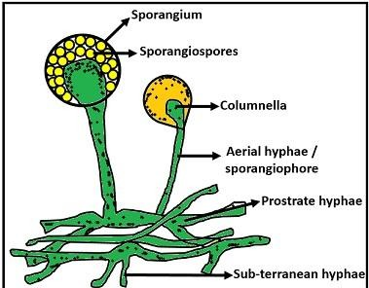
Life Cycle of Mucor

Slide 5
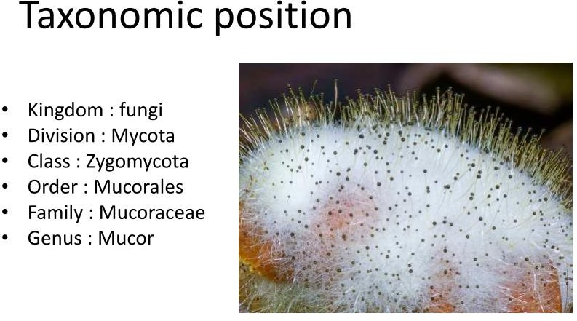

Slide 6
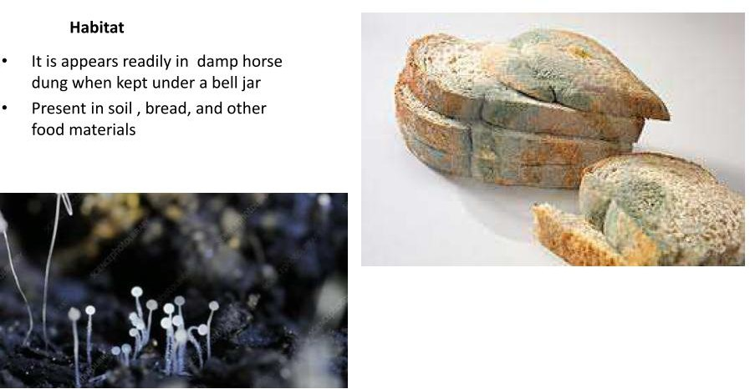

Slide 7
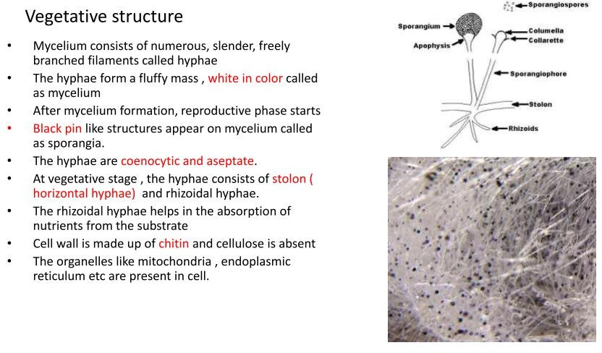

Slide 8
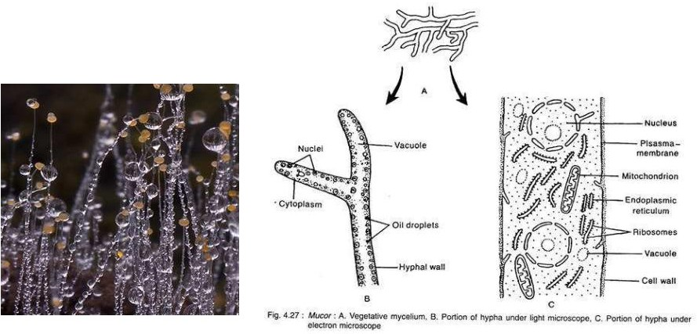

Slide 9
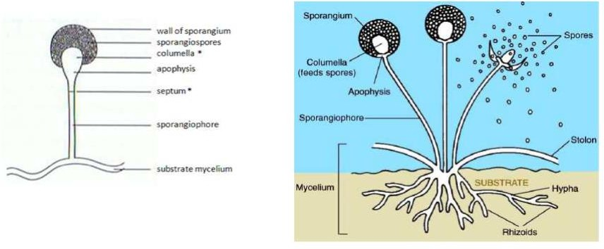

Slide 10
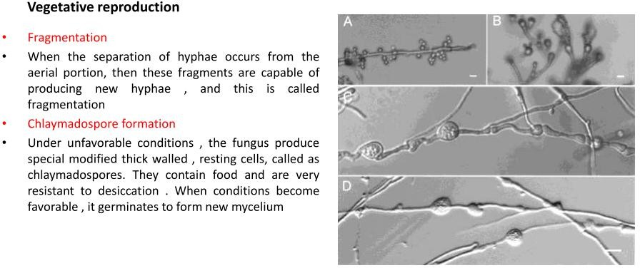

Slide 11
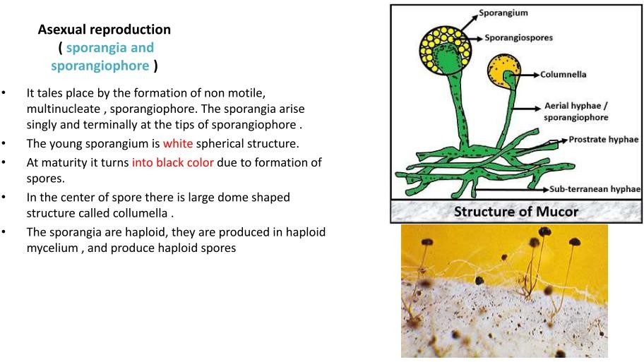

Slide 12
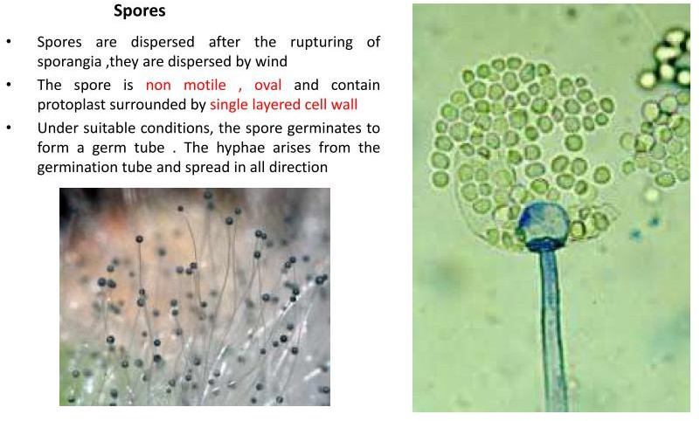

Slide 13
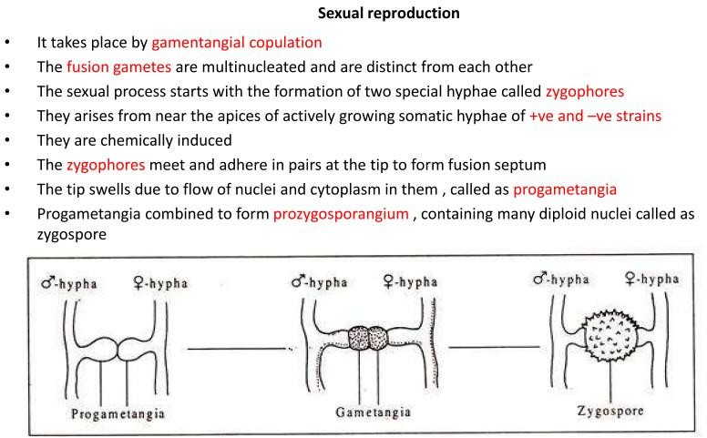

Slide 14
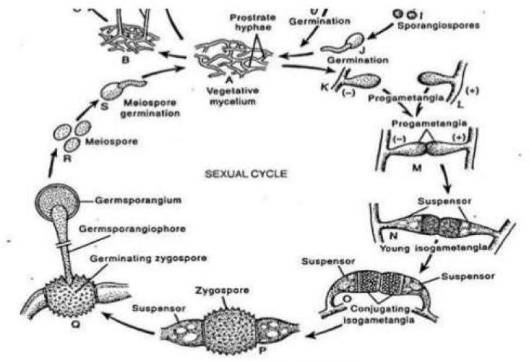

Slide 15
Thank you

