Slide 1
Phytopthora
( Characteristic features, Reproduction and Life cycle )

Slide 2
PHYTOPTHORA
Systematic position
Division : Eumycota
Subdivision: Mastigomycotina
Class: Oomycetes
Order: Perenosporales
Family: Pythiaceae
Genus: Phytopthora

Slide 3
Occurance and Habit
The genus includes about 75 species, out of which about 15 reported from India
Most of the species are facultative saprophytes ( is an organism that generally obtains nourishment from the living matter, but can obtain nourishment even from dead organic matter too)
A few are facultative parasite ( which can act as a parasite but does not rely on its host to continue its life cycle )

Slide 4
The genus is most destructive
The name itself indicates ( Phyta= plant ; opthora= destroyer )
This genus cause serious diseases on flowering plants
One of the most common species is P. infestans, causes late blight disease of potato, is most destructive

Slide 5
Late Blight of Potato
Description:
This disease caused by fungus called Phytophthora infestans.
The disease may attack almost any time after the crop has
put up a fairly good foliage.
Initially the lower leaves infected.

Slide 6
Late Blight of Potato
During winter season, western disturbances cause cloudiness, rains, dew and fog over North India. Under such conditions, late blight of potato appears
During summer season, incidence of late blight of potato is common in hilly regions.

Slide 7
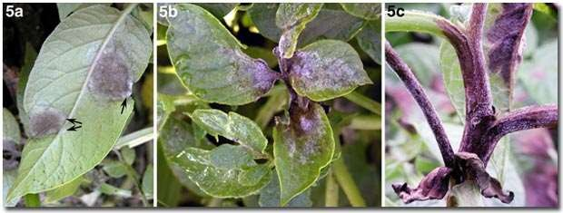
Late blight of Potato
Phytophthora infestans
Irish famine - 1845-46 Symptoms
Leaves, stems and tubers are infected
Water soaked spots appear on leaves, turn purple brown & finally black colour
White growth develops on under surface
Stem breaks at these points and the plant topples

Slide 8
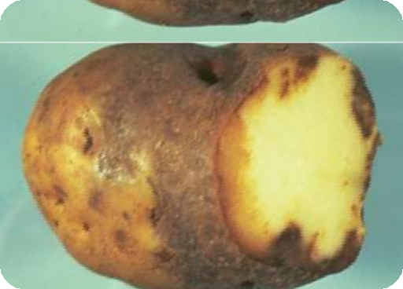
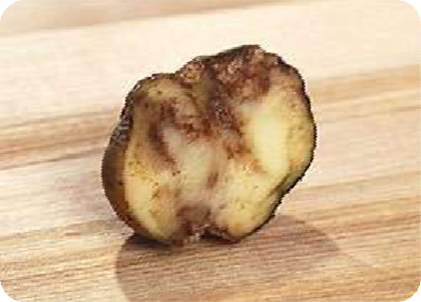


In tubers - purplish brown spots & spread to entire surface
Tuber show rusty brown necrosis (death of body tissue) spreading from surface to the center

Slide 9
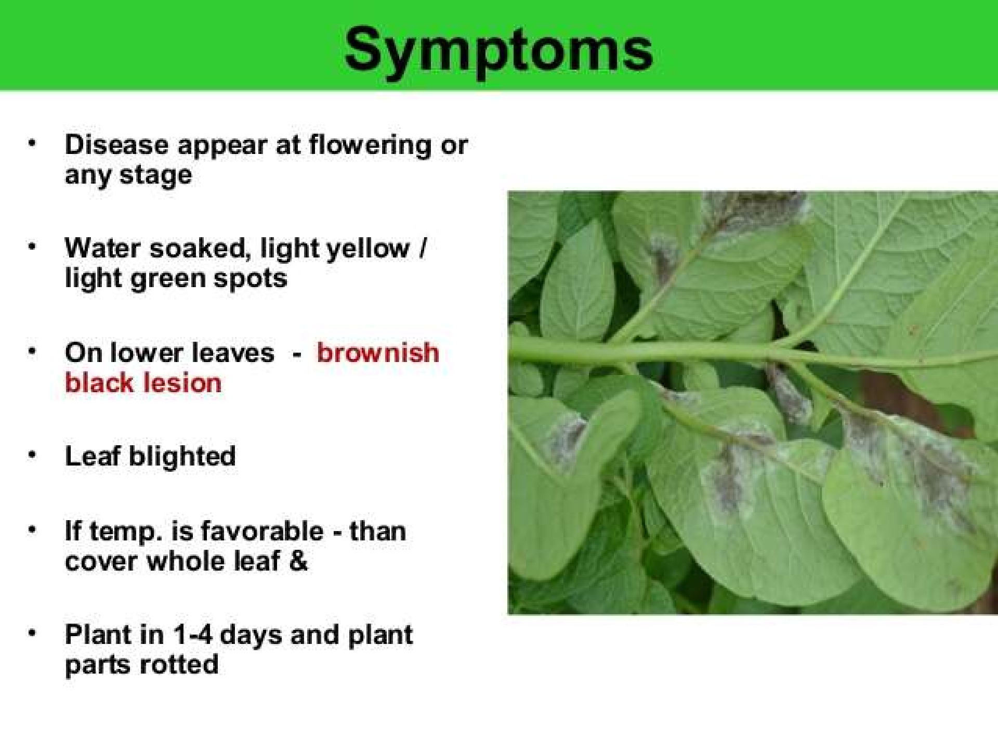

Slide 10
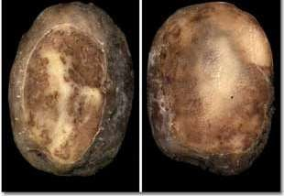
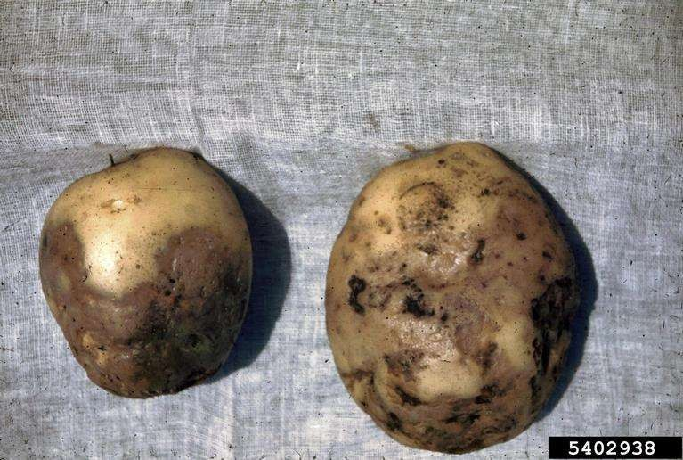
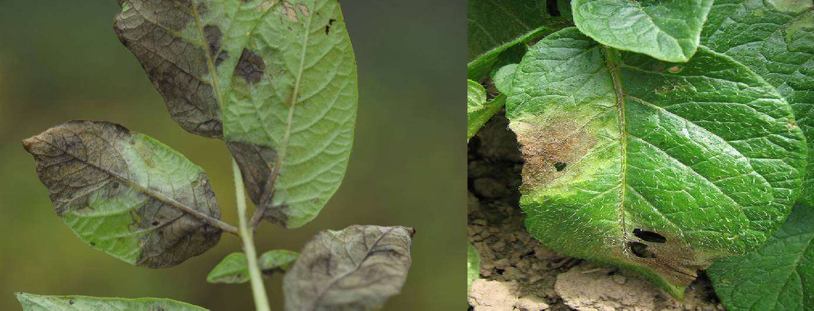

Slide 11
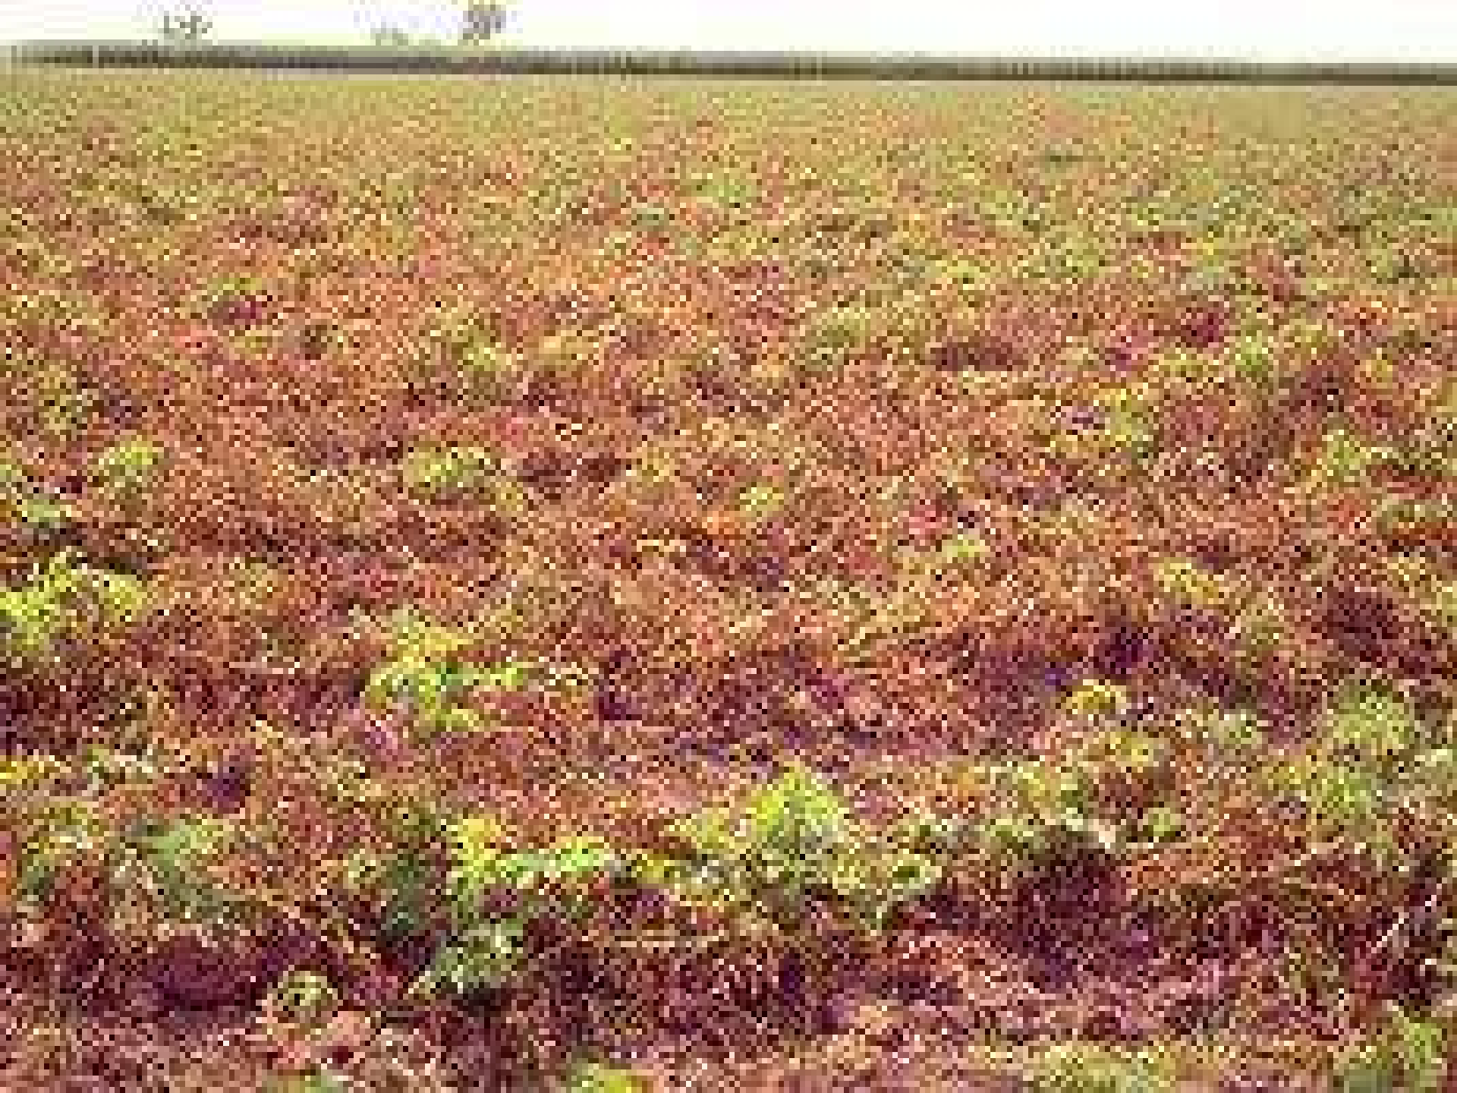

Slide 12
Mode of spread and survival
Infected tubers and infected soil - source of primary infection
Survival of fungus in fruiting stage or as dormant mycelium in the soil
Persisting of perennial mycelium in affected tubers from the
field, stored and used as seed in next season
Epidemiology
Cool (12 to 15ºC) and humid ( above 90 %) weather with rains alternating with warm (20º C) moist period

Slide 13
Vegetative Structure
The vegetative plant body consists of long, filamentous, branched, aseptate and multinucleate hyphae
Aseptate condition is called acellular coenocytic
The mycelium is hyaline and irregularly branched
Septa appear during differentiation of sex organs or in older hyphae

Slide 14
The mycelium is both intercellular and intracellular
It produces intracellular, short, curved and cylindrical haustoria
Haustoria absorb nourishment from the host cells
Internal structure of hyphae shows the presence of a large number of nuclei distributed in the cytoplasm
The cytoplasm posses mitochondria, endoplasmic reticulum, ribosomes and oil drops

Slide 15
Reproduction
Reproduction occurs by
[A]Vegetative,
[B] Asexual and
[C] Sexual methods

Slide 16
[A] Vegetative Reproduction
By the formation of terminal or intercalary chlamydospores
These spores are thick walled and store reserve food materials
The chlamydospores germinate by giving out 3 – 11 germ tubes which usually develop sporangia at their tips

Slide 17
[B ] Asexual Reproduction
Asexual reproduction occurs by means of sporangia produced on special hyphal branches called sporangiophores
Each mature sporangium is hyaline, ovoid or lemon shaped structure provided with a small stalk towards the base and a thin papilla at the terminal end
It encloses 5-8 or more nuclei distributed in dense cytoplasm

Slide 18
The sporangia are deciduous and desiminated by water or blown by the wind
At the place of detachment of sporangia, the sporangiophores bear nodular swellings which are typical characteristic of this fungus
On falling upon a suitable host, the sporangia germinate
Germination of sporangium is governed by two factors i.e moisture and temperature

Slide 19
The protoplasm of the sporangium is cut off into many uninucleate polyhedral pieces
Each polyhedral piece later rounds up and metaphorphoses into zoospore
Zoospores are kidney shaped, biflagellate and possess flagella on lateral side
Of the two flagella one is whiplash type and the other of tinsel type

Slide 20
The zoospores are liberated by bursting of the sporangial wall
After swimming for sometime they come to rest, encyst and germinate by a germ tube
The germ tube adheres on the epidermis of the host and produces a flattened pressing organ i.e appresorium, at the tip
From the appresorium a fine tubular, peg like outgrowth arises. This is the infection hypha
It penetrates the host tissue through stomata or epidermal cells

Slide 21
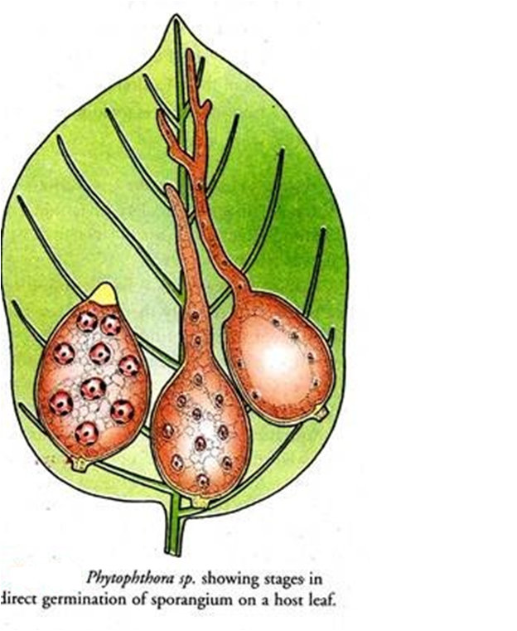
Phythophthora sp. Stages of direct Germination of sporangium on a host leaf

Slide 22
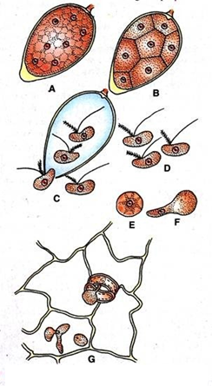
Phytophthora infestans stages in indirect germination of sporangium and germination of a zoospore

Slide 23
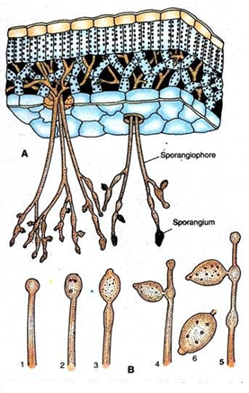
Phytophthora infestans
A. V.S infected potato leaf showing the intercellular mycelium and the emerging sporangiophores
B. the stages of development of sporangia

Slide 24
[C] Sexual Reproduction
Sexual reproduction is oogamous type
Mode of sexual reproduction is gametangial contact type
The male sex organs are antheridia and female sex organs are oogonia
Various species of Phytopthora may be homothallic or heterothallic

Slide 25
Categories of Antheridium
Depending upon the position of antheridium in relation to oogonium, there are two categories of antheridium ---
I ) Paragynous antheridium – The position of antheridium is lateral to oogonium, e.g P. cactorum, P. nicotianae.
ii ) Amphigynous antheridium – The anthridium lies at the base of oogonium forming a funnel shaped collar, e.g P. infestans, P. himalayensis, P. parasitica etc.

Slide 26
Mature oogonium is globose structure, internally differentiated into central dense ooplasm and peripheral vacuolated periplasm. Single large egg nucleus lies in the centre of ooplasm
The antheridium is irregular, collar- shaped found at the base of oogonium. It has 2-3 long papillae. Single functional male nucleus lies in the antheridium

Slide 27
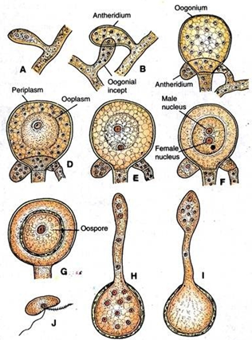
Phytophthora infestans showing the stages of development of sex organs and fertilisation (A-G) Germination of oospores (H-I), liberated zoospre (J)

Slide 28
Fertilization
At the time of fertilization one of the antheridial papilla elongates and grows towards oogonium
The tip of papilla adheres closely to the side of oogonium
The common wall between the two dissolves and the protoplasm of antheridium along with its nucleus migrates into oogonium

Slide 29
Stages of fertilization
The first stage of fertilization is plasmogamy which is followed by karyogamy
The resultant structure becomes oospore and undergoes a period of rest
The oospore secretes its own cell wall which is smooth and comes to lie freely inside the oogonial wall ( aplerotic )
In some species the oospore completely fills the cavity of oogonium ( plerotic )

Slide 30
Germination of oospore
After passing a period of rest the oospore starts germinating. It absorbs water and becomes activated.
The nucleus divides by meiosis just before germination
Further nuclear divisions are mitotic
The outer wall of oospore cracks and the inner wall comes out in the form of a tube which develops a terminal zoosporangium
The zoosporangium germinates by giving out zoospores in the same manner as in case of asexual reproduction
Under unfavourable conditions the sporangium may germinate directly by giving out germ tube

Slide 31
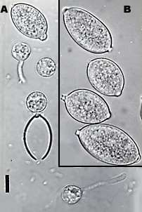
Fungus
 Mycelium - endophytic, coenocytic and hyaline
Sporangiophores – arise from internal mycelium through stomata on the tubers
Sporangia - multinucleate, thin walled, hyaline, oval shaped
Zoospores - biflagellate
Phytophthora infestans
A, zoospores produced within the lemon-shaped sporangia (B).

Slide 32
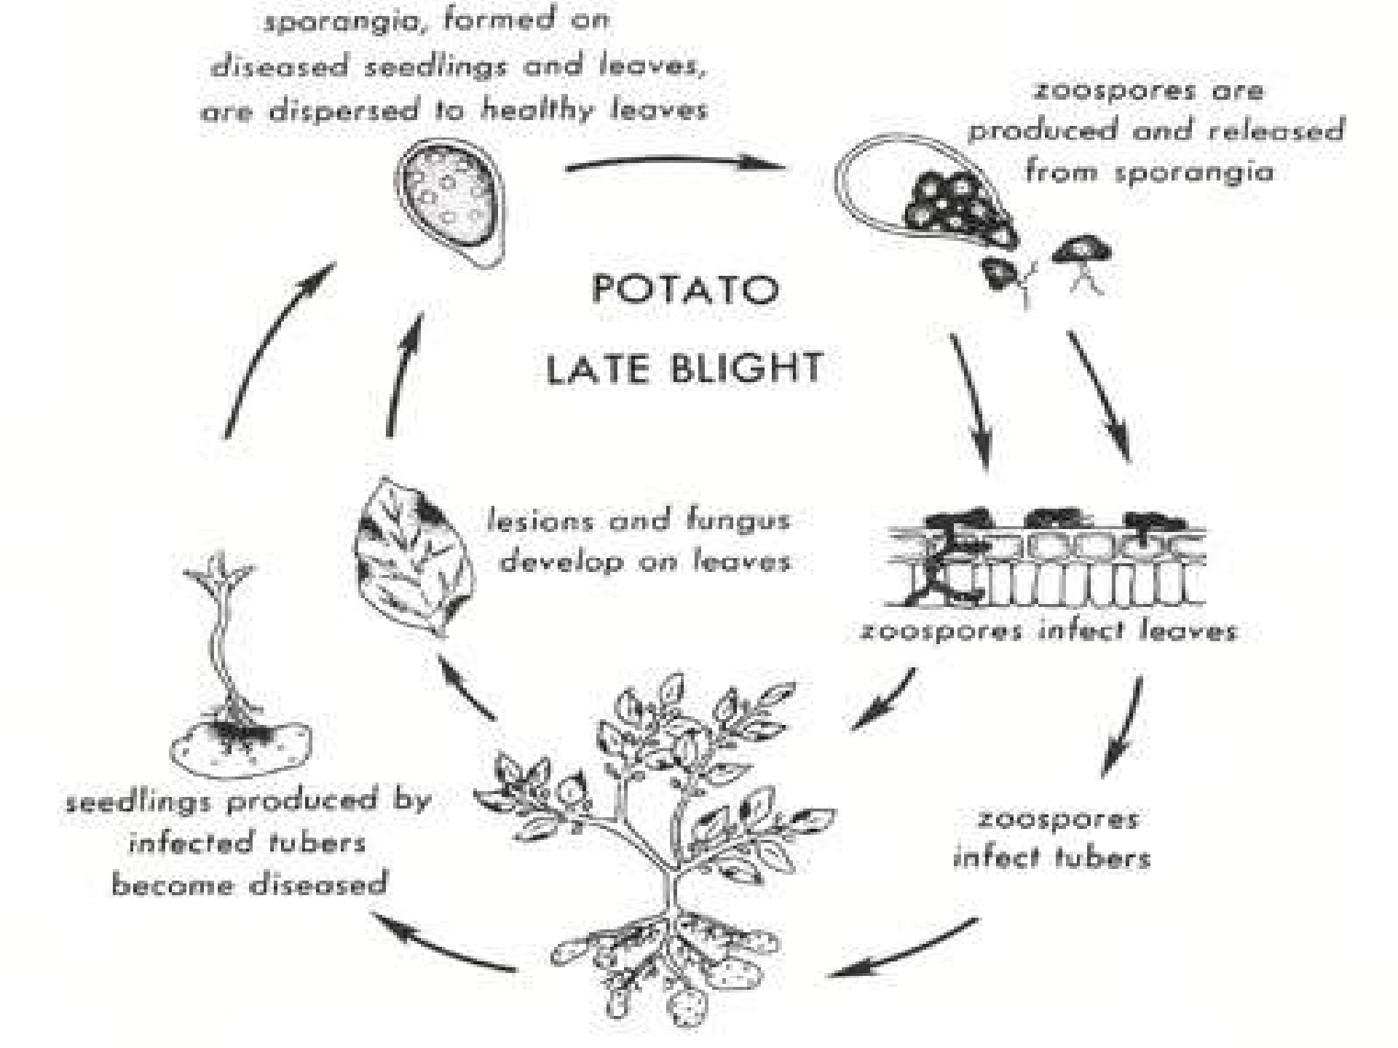

Slide 33
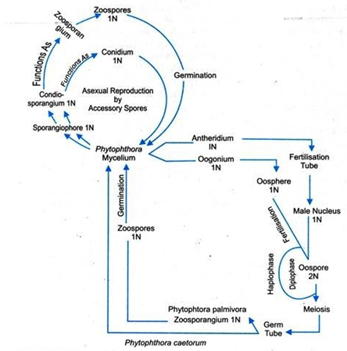
Life Cycle of Phytophthora with Zygotic meiosis

Slide 34
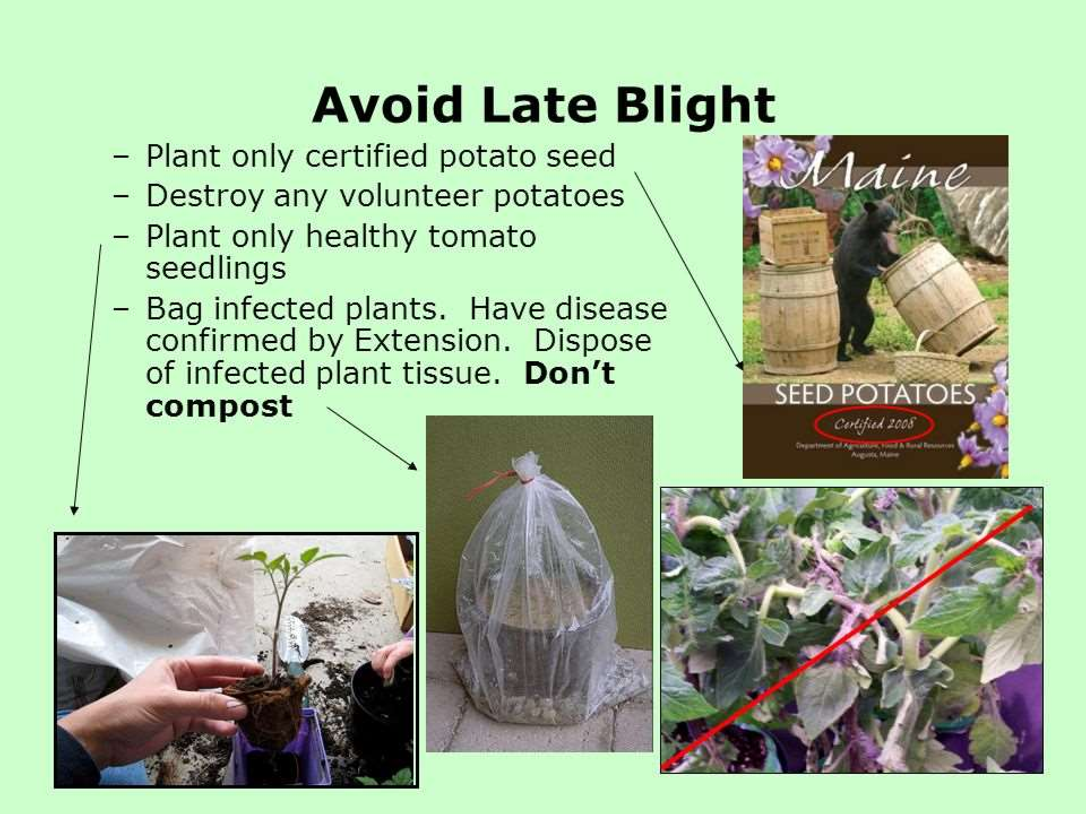

Slide 35
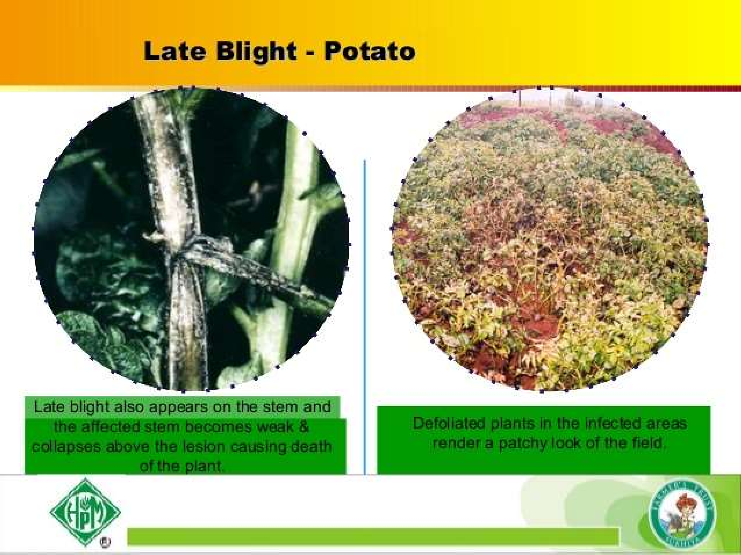

Slide 36
Control Measures
S. demissum and S. phureja - used for breeding for disease
resistant varieties
Varieties - Kufri Naveen, Kufri Jeevan, Kufri Alenkar, Kufri Moti
Bruising of tubers at harvest should be avoided
Regular spraying during growing season gives effective control- 10 to 15 days interval
  Brestan 600g/ha
  Zineb 0.2 %
  Bordeaux mixture 1.0%
  Mancozeb (2 kg/ha)

Slide 37
Thank You

