Slide 1
Proteins
(Structure and classification of proteins)
Dr. Manashi Kalita

Slide 2
Proteins
(Structure and classification of proteins)
Proteins are regarded as the most important constituents of all living organisms as they play important role in their life
The important functions of proteins are :
a) they form the structural framework of the cell
b) maintain osmotic balance

Slide 3
c) catalyse biochemical reactions
d) regulate metabolism
e) help in storage of some elements
f) act as oxygen carriers
g) form the colloidal system in protoplasm
h) transport lipids as lipoproteins and
i) act as storage proteins (proteinoplast)

Slide 4
Characteristic features of Proteins
1. Proteins are colloidal, optically active, highly complex, naturally occuring organic compounds of definite melting point. They have very high molecular weights.
2. They are essentially made up of C,H,O,N and S, but may also contain Fe and phosphorus
3. Each protein molecule is made up of several amino acids bound together by ‘amide bonds’between the α-amino group of one molecule and the carboxyl group of another. These bonds are called peptide bonds.

Slide 5
4. They may contain disulphide linkages, hydrogen bonds and Vander Waal forces
5. Proteins are mostly insoluble in water, alcohols and ethers, but are soluble in dilute salt solutions
6. On heating they get coagulated, while on hydrolysis (acid,alkaline or enzyme) they yield a mixture of amino acids
7. It is mainly found in seeds and leaves
8. Roots contain very small amount of protein

Slide 6
Protein content of the plant
1. Seed Proteins : The seeds like ground nut, soybean maize,wheat,barley,rice, cotton seeds,peas and beans etc. contain maximum amount of protein which remain stored as reserve form of nitrogen in aleurone grains or protein bodies. The protein bodies are single membraned structures of about 1-20μm in diameter

Slide 7
2. Leaf Protein : Leaf protein is mainly present in chloroplasts but in small amounts it is also present in other cell organelles and cytoplasm. In chloroplasts, the pigments exists as chromoproteins.
3. Root protein : The protein content of roots is quite low, ranging from 1-15 per cent on fresh weight basis. The protein content gradually decreases till the roots mature.

Slide 8
Classification Of Proteins
Proteins are polymers that are made up of some 22 monomers, the amino acids
Proteins have been classified into three major classes on the basis of their solubility, chemical properties and composition
The three major classes are :
1. Simple Proteins
2. Conjugated proteins
3. Derived proteins

Slide 9
1. Simple proteins
Simple proteins are those which on hydrolysis yield a mixture of α-amino acids only
Albumins, histones,protamines etc. are some examples of simple proteins
Simple proteins have been further divided into seven groups on the basis of their solubility
The seven groups are Albumins, Globulins, Glutelins, prolamines, Protamines,Histones and Scleroproteins

Slide 10
2. Conjugated Proteins
Conjugated proteins are those which on hydrolysis yield some substance or substances ( carbohydrates, nucleic acids, phosphoric acid or lipids) in addition to α-amino acids, e.g, casein from milk, mucin from saliva, vitellin from egg yolk etc.
The additional non amino acids are referred to as prosthetic groups

Slide 11
Conjugated proteins are further classified in accordance with their prosthetic group into the following seven major types
1. Nucleoproteins : They are characterized by the possession of prosthetic groups known as nucleic acids. They are weakly acidic in nature and are soluble in water. They are found in the nucleus of the cell. Other examples of the nucleoprotein are viruses and ribosomes.

Slide 12
2. Glycoproteins : They are characterized by the possession of prosthetic group known as polysaccharides. Thus they are the complexes of amino acids and carbohydrates. They are soluble in alkalies and are acidic in nature. They are found in egg white, jelly fish, cell membranes and saliva.
3. Lipoproteins : They are complexes of lipids and proteins. The prosthetic groups are lecithin and cephalin. They are insoluble in water and are found in the membranes, nucleus and lamellae of the chloroplast. The egg yolk contains the lipoprotein, lipovitellin

Slide 13
4. Chromoproteins : It contain pigments as prosthetic groups. The pigments also contain metals like Fe,Cu,Co, Mg etc.The chlorophyll proteins are known as chlorophylloproteins and iron porphyrin containing proteins are known as haemoproteins. The chromoproteins include hemoglobins, myoglobins, carotenoid proteins etc.

Slide 14
5. Metalloproteins : They contain no special non – protein substances other than the metallic atoms themselves. Among them are ferredoxin and ferretin (iron containing proteins), copper- binding and iron- binding plasma proteins , carbonic anhydrase (a zinc protein enzyme), insulin (a zinc containing hormone) and certain metal activated peptidase enzymes.

Slide 15
6. Lecithoproteins : They contain phosphorylated fats, i.e lecithin as the prosthetic group
7. Phosphoproteins : They possess phosphoric acid as prosthetic group. They are insoluble in water and soluble in alkalies

Slide 16
3. Derived Proteins
They are produced from natural proteins by the action of enzymes, acids or alkalies
The derived proteins may be the size of parental protein or smaller than that
If it is of the parental size, it is known as primary derived protein
The small sized proteins are known as secondary derived proteins

Slide 17
Primary derived proteins are of two types :
i) Metaproteins
ii) Coagulated proteins
i) Metaproteins are insoluble in water and dilute salt solutions, but soluble in acids and alkalies
ii) Coagulated proteins are formed by heating the natural proteins. They are insoluble in water and are produced by the action of alcohol or heat, e.g coagulated egg white

Slide 18
Types of Secondary Derived Proteins
i) Proteoses : They are soluble in water and do not coagulate by heat. They can be easily precipitate with ammonium sulphate. They show toxic effects when injected in animals, e.g Albuminose from albumin.
ii) Peptones : They are produced by the action of dilute acids like HCl and H₂SO₄ or enzymes on natural proteins. They are soluble in water and do not coagulate by heat.
iii) Peptides : They are produced by the graded hydrolysis with HCl or H₂SO₄. They are soluble in water and are not coagulated by heat.

Slide 19
Levels of Protein structure
Primary
Secondary
Tertiary and
Quarternary

Slide 20
Primary Structure
The simplest level of protein structure, primary structure, is simply the sequence of amino acids in a polypeptide chain. For example, the hormone insulin has two polypeptide chains, A and B, shown in diagram below. (The insulin molecule shown here is cow insulin, although its structure is similar to that of human insulin.) Each chain has its own set of amino acids, assembled in a particular order. For instance, the sequence of the A chain starts with glycine at the N-terminus and ends with asparagine at the C-terminus, and is different from the sequence of the B chain.

Slide 21
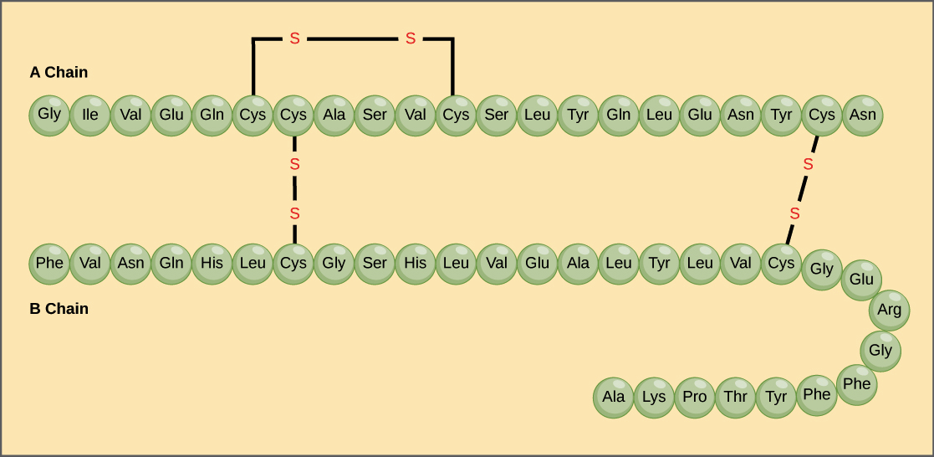
Primary Structure

Slide 22
The sequence of a protein is determined by the DNA of the gene that encodes the protein (or that encodes a portion of the protein, for multi-subunit proteins). A change in the gene's DNA sequence may lead to a change in the amino acid sequence of the protein. Even changing just one amino acid in a protein’s sequence can affect the protein’s overall structure and function.

Slide 23
Secondary Structure
The next level of protein structure, secondary structure, refers to local folded structures that form within a polypeptide due to interactions between atoms of the backbone. (The backbone just refers to the polypeptide chain apart from the R groups – so all we mean here is that secondary structure does not involve R group atoms.) The most common types of secondary structures are the α helix and the β pleated sheet. Both structures are held in shape by hydrogen bonds, which form between the carbonyl O of one amino acid and the amino H of another.

Slide 24
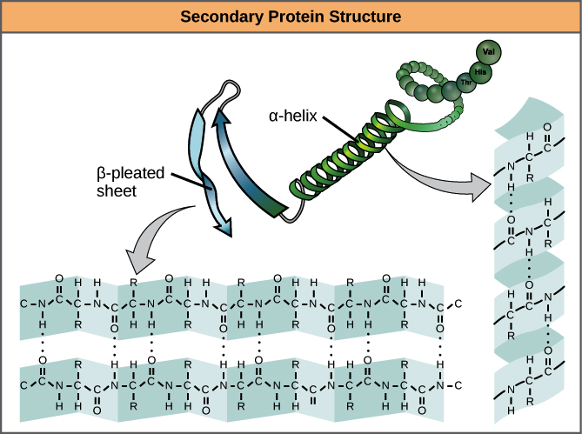

Slide 25
In an α helix, the carbonyl (C=O) of one amino acid is hydrogen bonded to the amino H (N-H) of an amino acid that is four down the chain. (E.g., the carbonyl of amino acid 1 would form a hydrogen bond to the N-H of amino acid 5.) This pattern of bonding pulls the polypeptide chain into a helical structure that resembles a curled ribbon, with each turn of the helix containing 3.6 amino acids. The R groups of the amino acids stick outward from the α helix, where they are free to interact.

Slide 26
In a β pleated sheet, two or more segments of a polypeptide chain line up next to each other, forming a sheet-like structure held together by hydrogen bonds. The hydrogen bonds form between carbonyl and amino groups of backbone, while the R groups extend above and below the plane of the sheet. The strands of a β pleated sheet may be parallel, pointing in the same direction (meaning that their N- and C-termini match up), or antiparallel, pointing in opposite directions (meaning that the N-terminus of one strand is positioned next to the C-terminus of the other).

Slide 27
Tertiary Structure
The overall three-dimensional structure of a polypeptide is called its tertiary structure. The tertiary structure is primarily due to interactions between the R groups of the amino acids that make up the protein.

Slide 28
R group interactions that contribute to tertiary structure include hydrogen bonding, ionic bonding, dipole-dipole interactions, and London dispersion forces – basically, the whole gamut (the complete range or scope of something) of non-covalent bonds. For example, R groups with like charges repel one another, while those with opposite charges can form an ionic bond. Similarly, polar R groups can form hydrogen bonds and other dipole-dipole interactions. Also important to tertiary structure are hydrophobic interactions, in which amino acids with non polar, hydrophobic R groups cluster together on the inside of the protein, leaving hydrophilic amino acids on the outside to interact with surrounding water molecules.

Slide 29
Finally, there is one special type of covalent bond that can contribute to tertiary structure: the disulfide bond. Disulfide bonds, covalent linkages between the sulfur-containing side chains of cysteine, are much stronger than the other types of bonds that contribute to tertiary structure. They act like molecular "safety pins," keeping parts of the polypeptide firmly attached to one another.

Slide 30
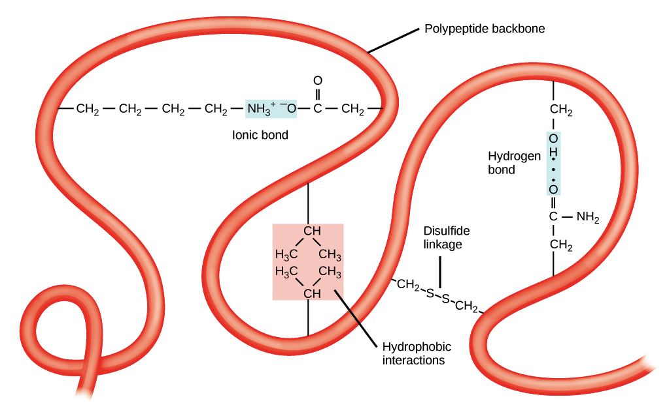
Tertiary Structure

Slide 31
Quaternary Structure
Many proteins are made up of a single polypeptide chain and have only three levels of structure . However, some proteins are made up of multiple polypeptide chains, also known as subunits. When these subunits come together, they give the protein its quaternary structure.

Slide 32
In general, the same types of interactions that contribute to tertiary structure (mostly weak interactions, such as hydrogen bonding and London dispersion forces) also hold the subunits together to give quaternary structure.

Slide 33
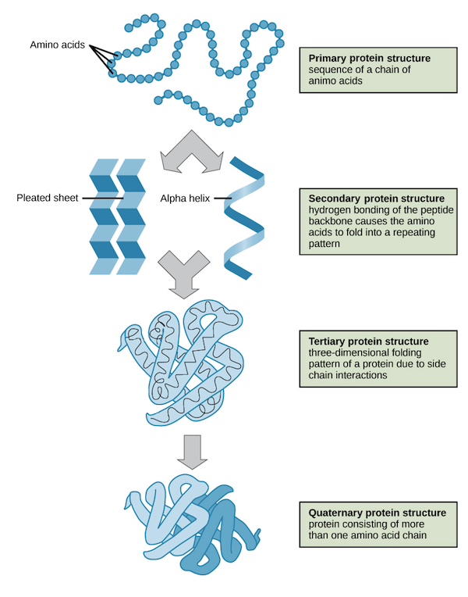

Slide 34
Protein Denaturation and protein folding
Each protein has its own unique shape. If the temperature or pH of a protein's environment is changed, or if it is exposed to chemicals, these interactions may be disrupted, causing the protein to lose its three-dimensional structure and turn back into an unstructured string of amino acids. When a protein loses its higher-order structure, but not its primary sequence, it is said to be denatured. Denatured proteins are usually non-functional.

Slide 35
For some proteins, denaturation can be reversed. Since the primary structure of the polypeptide is still intact (the amino acids haven’t split up), it may be able to re-fold into its functional form if it's returned to its normal environment. Other times, however, denaturation is permanent. One example of irreversible protein denaturation is when an egg is fried. The albumin protein in the liquid egg white becomes opaque and solid as it is denatured by the heat of the stove, and will not return to its original, raw-egg state even when cooled down.

Slide 36
Researchers have found that some proteins can re-fold after de naturation even when they are alone in a test tube. Since these proteins can go from unstructured to folded all by themselves, their amino acid sequences must contain all the information needed for folding. However, not all proteins are able to pull off this trick, and how proteins normally fold in a cell appears to be more complicated. Many proteins don’t fold by themselves, but instead get assistance from chaperone proteins (chaperonins).

Slide 37
1. Denaturation at Different Levels of Protein Structure
Denaturation of proteins at different levels occurs as follows :
In quarternary structure denaturation, of protein sub-units are dissociated and /or the spatial arrangement of protein sub-units is disrupted
Tertiary structure denaturation involves the disruption of ( i) covalent interactions between amino acid side chain (ii) Non-covalent dipole-dipole interactions between polar amino acid side chains

Slide 38
c) In secondary structure denaturation , proteins lose all regular repeating patterns such as alpha-helices and beta pleated sheets, and adopt a random coil configuration
d) Primary structure, such as the sequence of amino acids held together by covalent peptide bonds, is not disrupted by denaturation

Slide 39
2. Loss of Function Due to Denaturation
Most biological substrates lose their biological function when denatured
For example, enzymes lose their activity, because the substrates can no longer bind to the active site
The denaturing process and the associated loss of activity can be measured using techniques such as dual polarization interferometry, CD, QCM-D and MP-SPR

Slide 40
3. Denaturation is Irreversible
In very few cases, denaturation is reversible
This process can be called renaturation
All the information needed for proteins to assume their native state was encoded in the primary structure of the protein, and hence in the DNA that codes for the protein, the so called “ Anfinsen’s thermodynamic hypothesis”

Slide 41
Biological Role Of Proteins
Proteins play a central role in biological processes
There are many different types of proteins in our body
Proteins catalyse reactions in our bodies, transport molecules such as oxygen and transmit messages from cell to cell
They serve important roles in growth, development and everyday functioning

Slide 42
Examples of biological roles of proteins
i) Enzymes are proteins that facilitate biochemical reactions, for example pepsin is a digestive enzyme in the stomach and helps to break down proteins in food
ii) Antibodies are proteins produced by the immune system to help remove foreign substances and fight infections

Slide 43
iii) DNA-associated proteins regulate chromosome structure during cell division and / or play a role in regulating gene expression for example, histones and cohesion proteins
iv) Contractile proteins are involved in muscle contraction and movement (e.g, actin and myosin)
v) Structural proteins provide support in our bodies, for example, proteins in our connective tissues, such as collagen and elastin

Slide 44
vi) Hormone proteins co-ordinate bodily functions, for example, insulin controls our blood sugar concentration by regulating the uptake of glucose into cells
vii) Transport proteins move molecules around our bodies, for example haemoglobin transports oxygen through blood

Slide 45
THANK YOU

