Slide 1
The Triple Alliance (1882): A Defensive Pact in a Divided Europe

Slide 2
Overview of European Politics Post-1870
Ongoing Franco-German hostility after the Franco-Prussian War (1870-1871) and Treaty of Frankfurt (1871), where France ceded Alsace-Lorraine to Germany.
This rivalry split Europe into two blocs: Triple Alliance vs. Triple Entente (France, Russia, Britain by 1907).
Bismarck's goal: Isolate France to prevent revanchism (revenge for lost territories).
Additional info: The "Scramble for Africa" influenced alliances, as colonial rivalries (e.g., France's Tunis conquest in 1881) pushed Italy toward Germany.

Slide 3
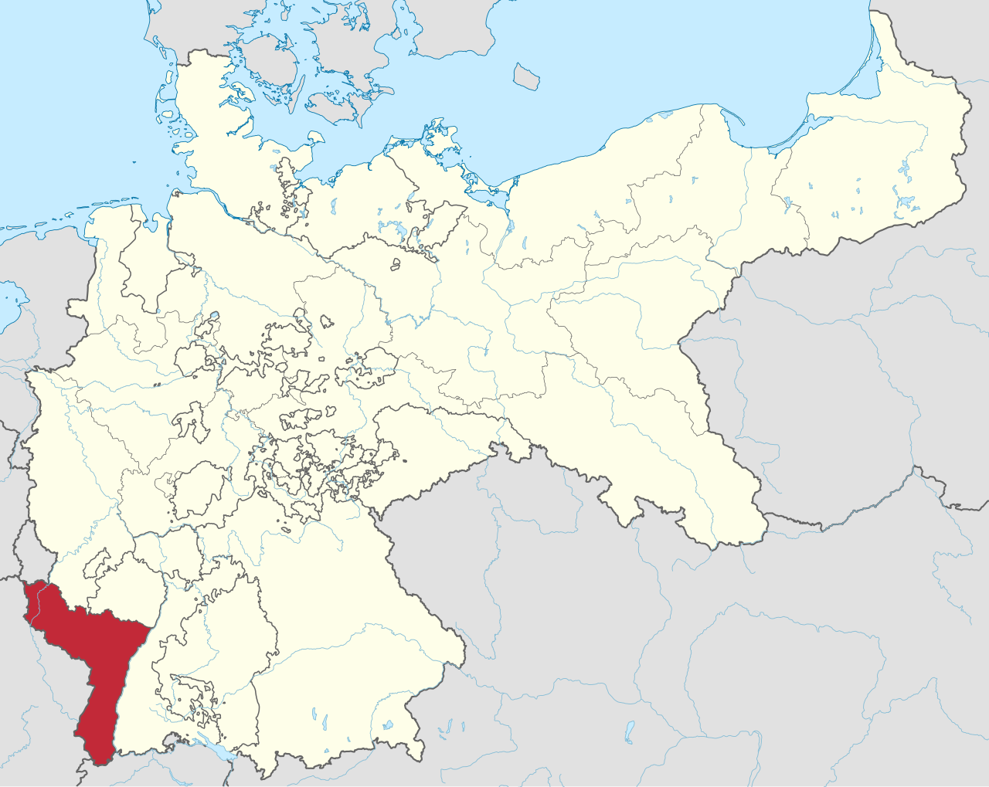
File:Alsace-Lorraine in the German Reich (1871).svg - Wikimedia Commons (Bismarck's strategy was short-term success but long-term failure?)

Slide 4
Bismarck's Foreign Policy Objectives
Primary aim: Protect Germany's unification gains and maintain European peace.
Tactics: Encourage French colonial expansion (e.g., supporting Tunis takeover) to distract from Alsace-Lorraine; form alliances to encircle potential threats.
Initial reluctance toward Italy: Viewed as "selfish and unreliable," but fears of Franco-Italian alliance and Austria's vulnerabilities changed his mind.
Bismarck orchestrated the Dual Alliance (Germany-Austria, 1879) as a precursor, aiming for a "League of Peace" to counter Russian Balkan ambitions.

Slide 5

•

Slide 6
Formation of the Triple Alliance
Built on Dual Alliance (Germany-Austria, 1879); Italy joined on May 20, 1882, after "Slap of Tunis" (France's 1881 conquest alienated Italy).
Reasons for Italy's inclusion: Counter Franco-Italian alliance; relieve Austria's encirclement (tensions with Russia and Italy).
Member states: German Empire (led by Wilhelm I, Bismarck as Chancellor), Austria-Hungary (Emperor Franz Joseph I), Kingdom of Italy (King Umberto I).
Romania secretly joined in 1883 due to Hohenzollern ties and anti-Russian fears, making it a "Quadruple Alliance" in practice.

Slide 7

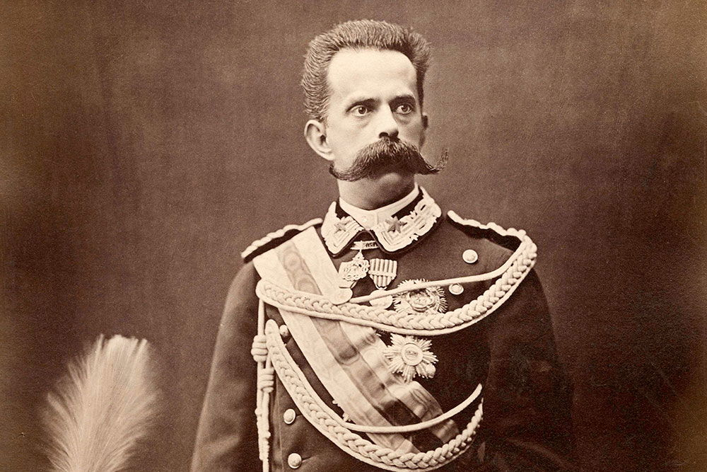
Emperor Franz Joseph of Austria and Empress Elizabeth
Umberto I of Italy

Slide 8
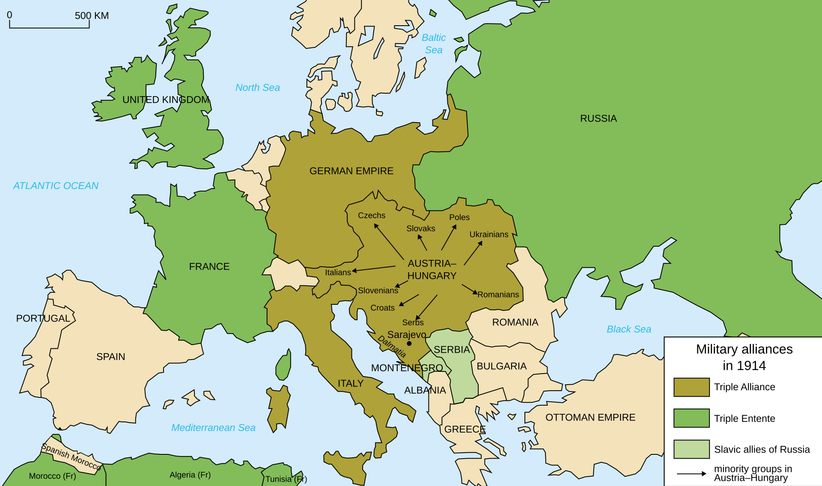
Map of Triple Alliance
•

Slide 9
Geospatial analysis
Geographical context: Alliance controlled Central Europe, from the Baltic to the Mediterranean.
Highlighted regions: Germany (unified core), Austria-Hungary (multi-ethnic empire in Balkans), Italy (peninsular power with African aspirations).
Contrasted with emerging Triple Entente; alliance aimed to maintain Balkan status quo but failed amid Slavic nationalism.

Slide 10
Chief Provisions of the Treaty
Mutual Defense vs. France: If Italy attacked by France Germany/Austria aid Italy; Italy aids Germany vs. France.
Neutrality vs. Russia: Italy remains neutral if Russia attacks Germany/Austria alone.
Aid if Russia + France Attack: Italy assists if Russia attacks with French help.
Duration and Secrecy: Signed for 5 years (renewed multiple times: 1887, 1891, 1902, 1912); kept secret.
Exclusions: Not to be used against Britain; focused on defensive scenarios.
Additional info: 1887 renewal added German support for Italian North African claims; 1902 included Balkan consultation clauses.

Slide 11
Renewals and Evolutions
1887: Italy gains colonial promises; Austria agrees to Balkan consultations.
1891: Failed attempt to include Britain.
1902: Italy secretly guarantees neutrality to France, weakening the pact.
1912: Compensation clauses for Balkan changes (post-Balkan Wars).
By 1912, alliance attended the Conference of Ambassadors, but internal distrust grew (e.g., Austria's preemptive plans against Italy by 1911).

Slide 12
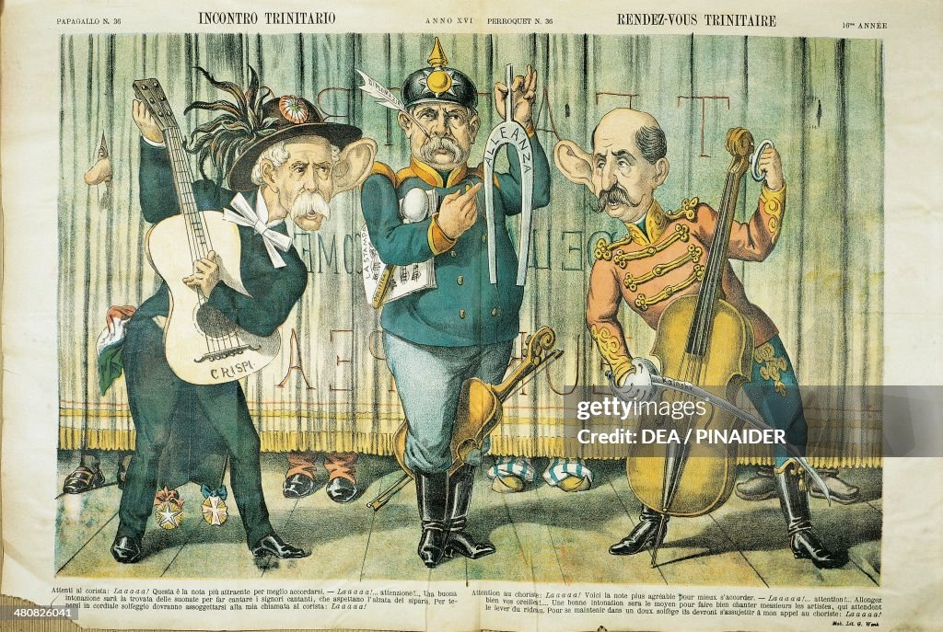
Caricature illustrating alliance tensions.

Slide 13
Strains Within the Alliance
Italy-Austria tensions: Competing claims over Albania, "unredeemed Italy" (Trentino, Istria—Italian-speaking areas under Austria).
Germany-Italy issues: Germany's Turkish ties clashed with Italy's 1911-1912 Italo-Turkish War (seizure of Tripoli/Libya).
Broader distrust: Bismarck's skepticism of Italy proved prescient; mutual suspicions led to fortified borders.
Austria's Chief of Staff Franz Conrad von Hötzendorf advocated war against Italy from 1903, highlighting ideological rifts (monarchies vs. Italy's liberal leanings).

Slide 14
Italy's Role and "Betrayal"
Initial enthusiasm: Italy sought security against France.
WWI outbreak (1914): Italy declares neutrality, citing Austria's aggression (no consultation on Sarajevo crisis).
Defection: Signs Treaty of London (1915) with Entente; joins Allies, declaring war on Austria-Hungary.
Additional info: Romania follows suit in 1916; alliance dissolves, succeeded by Central Powers (Germany, Austria-Hungary, Ottoman Empire, Bulgaria).

Slide 15
Impact on European Politics and WWI
Divided Europe into blocs, escalating tensions (e.g., arms races, Moroccan Crises 1905-1911).
Successes: Isolated France temporarily; prevented major wars until 1914.
Failures: Failed to contain Balkan nationalism; Italy/Romania's defection weakened Central Powers.
Additional info: Contributed to "balance of power" collapse; alliance system turned local conflicts (e.g., Archduke assassination) global.

Slide 16
Conclusion
The Triple Alliance was a Bismarckian masterpiece of diplomacy but unraveled due to internal contradictions and shifting national priorities.
Legacy: Exemplifies how alliances can deter yet provoke wars; key precursor to WWI's alliance entanglements.
Discussion question: Could stronger provisions have prevented Italy's defection?

Slide 17
Bismarck's isolation of France effective, or did it accelerate arms races?
How did geography influence alliance dynamics (e.g., Austria's Balkan exposure)?
Emphasize the defensive nature, but note how ambiguities (e.g., no clear aggression definition) led to Italy's 1914 neutrality.
Analyze renewals as signs of fragility—Italy's dual dealings with France foreshadowed defection.
Discuss how national interests overrode alliance loyalty, a key theme in realist IR theory.
Was Italy's switch opportunistic or justified by treaty loopholes? Link to Versailles Treaty outcomes (Italy's "mutilated victory").

