Slide 1
The Balkan Wars (1912–1913):
Treaty shattered Greater Bulgaria from San Stefano; created autonomous Bulgaria & Eastern Rumelia
Ottoman losses fueled nationalist aspirations among Serbs, Greeks, Bulgarians
Great Powers (Russia, Austria-Hungary, Britain, Germany) redrew map to balance influence
Set stage for irredentism & ethnic tensions in multi-ethnic Ottoman Europe

Slide 2
Background – Decline of the Ottoman Empire
Mid-19th century: Ottoman Empire called the "Sick Man of Europe"
Multi-ethnic, multi-lingual empire in serious decline
European powers planned to divide the weakened empire
Turks unhappy with the Sultan due to foreign influence & corruption

Slide 3
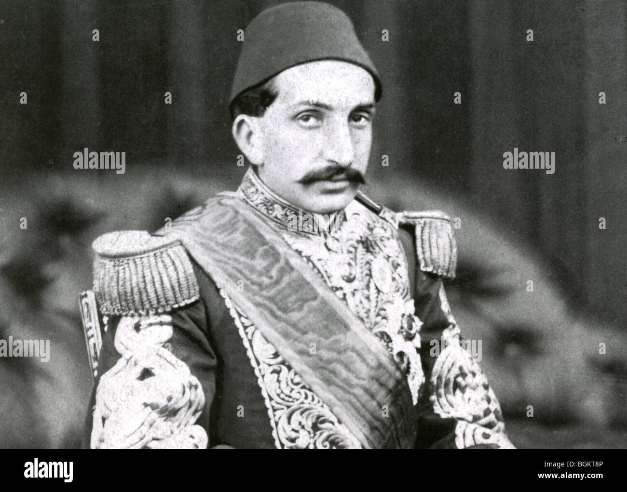
Portrait of Sultan Abdul Hamid II (autocratic ruler).

Slide 4
Causes of the Movement
Sultan Abdul Hamid II (r. 1876): Autocratic rule; briefly introduced 1876 Constitution but suspended it
Treaty of Berlin (1878): Major territorial losses → increased foreign influence & chaos
Growing Balkan nationalism: Bulgarians, Serbians, Romanians, Greeks demanded freedom

Slide 5
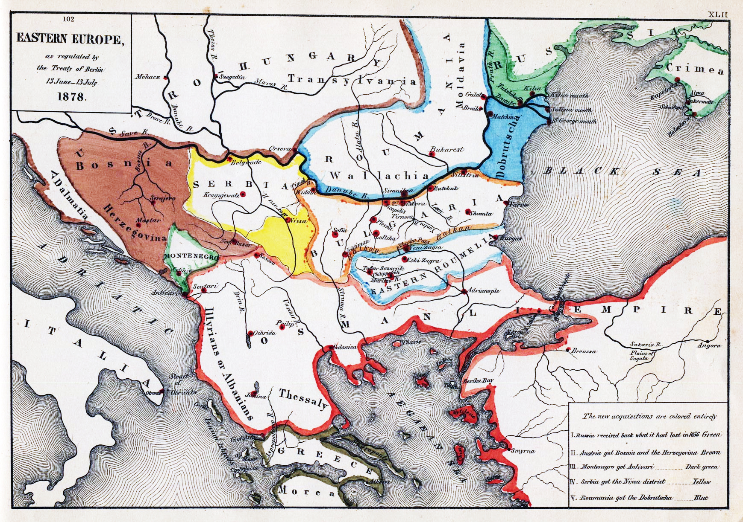
Treaty of Berlin (1878) – shows lost territories & new autonomous/independent states.

Slide 6
Formation of the Young Turks
Began in 1891 in Geneva (exiled reformers)
Blamed decline on Abdul Hamid’s corrupt & oppressive rule
Demanded constitutional government; inspired by liberty, equality, fraternity
Operated secretly → formed Committee of Union and Progress (CUP)
Key leaders: Niyazi Bey, Enver Bey

Slide 7

Niyazi Bey with companions (1908 revolutionary group)

Slide 8
The Revolution of 1908
July 3, 1908: Niyazi Bey uprising in Macedonia demands restoration of 1876 Constitution
July 23–24, 1908: Abdul Hamid yields → Constitution reinstated
April 1909: Counter-revolution by Sultan → crushed by CUP troops from Salonica & Adrianople
Abdul Hamid deposed; brother Mehmet V becomes Sultan
Young Turks (CUP) rule effectively 1908–1918

Slide 9
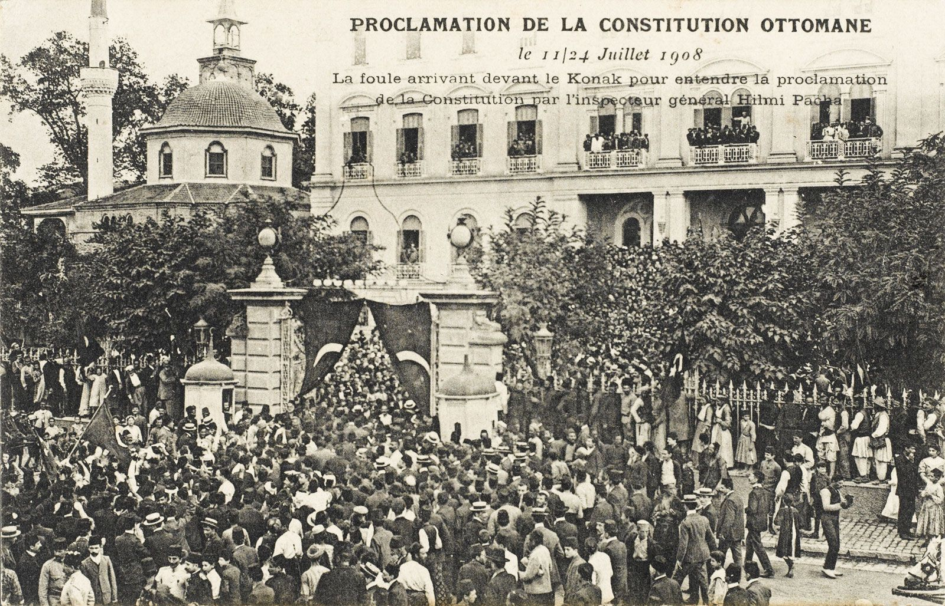
Crowd celebrating the proclamation of the Constitution in Constantinople (July 1908).

Slide 10
Immediate Impact of the Movement
Turkification: Promoted Turkish language & culture to unify empire → alarmed non-Turkish groups
Inspired Balkan independence movements
Bulgaria declared full independence (1908)
Austria annexed Bosnia and Herzegovina (1908)
Centralization & minority suppression → revolts in Macedonia & Albania by 1910

Slide 11
Opposition to San Stefano
Britain
Feared Russian control of Constantinople.
Threat to Mediterranean routes.
Austria-Hungary
Opposed large Bulgaria.
Feared Slavic nationalism within its empire.
Germany
Otto von Bismarck feared Austro-Russian war.
Wanted to preserve League of Three Emperors.
Others
Greece, Serbia, Romania dissatisfied.

Slide 12
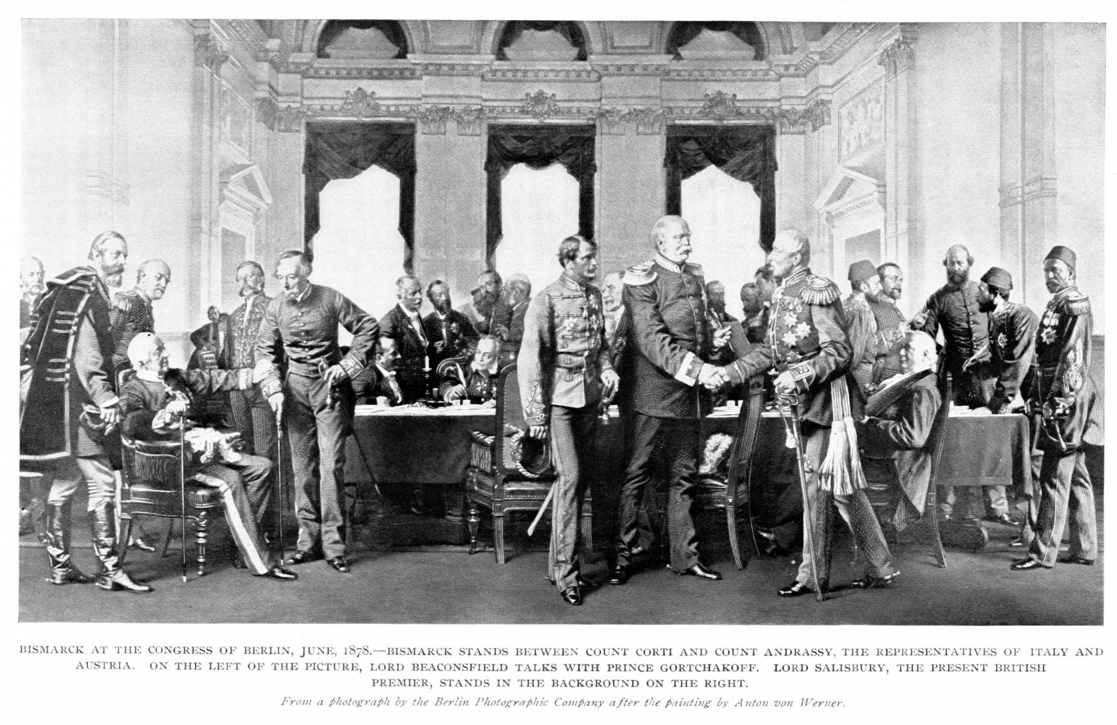
Congress of Berlin

Slide 13
Congress of Berlin (1878)
Held in Berlin, July 1878.
President: Otto von Bismarck (“Honest Broker”).
Participants: Britain, France, Germany, Austria-Hungary, Russia, Italy, Turkey.
Result: Treaty of Berlin (13 July 1878).
Treaty of Berlin
Greater Bulgaria divided into three parts.
Macedonia returned to Turkey.
Serbia, Montenegro, Romania independent.
Austria administered Bosnia & Herzegovina.
Britain acquired Cyprus.
Russia retained Bessarabia, Batoum, Kars.

Slide 14
Long-Term Consequences
Compromise, not permanent settlement.
Ignored nationalist aspirations.
Created dissatisfaction in:
  Bulgaria
  Serbia
  Greece
  Macedonia
Macedonia left under Turkish rule.
Bosnia issue led to Austro-Serbian rivalry.

