Slide 1
Historical Context – Congress of Berlin (1878)
Treaty shattered Greater Bulgaria from San Stefano; created autonomous Bulgaria & Eastern Rumelia
Ottoman losses fueled nationalist aspirations among Serbs, Greeks, Bulgarians
Great Powers (Russia, Austria-Hungary, Britain, Germany) redrew map to balance influence
Set stage for irredentism & ethnic tensions in multi-ethnic Ottoman Europe

Slide 2
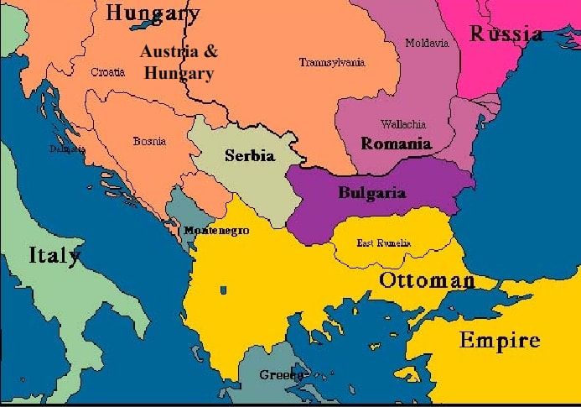
Balkans after Congress of Berlin (1878) – shows reduced Bulgaria, Ottoman territories, Austria's occupation of Bosnia-Herzegovina.

Slide 3
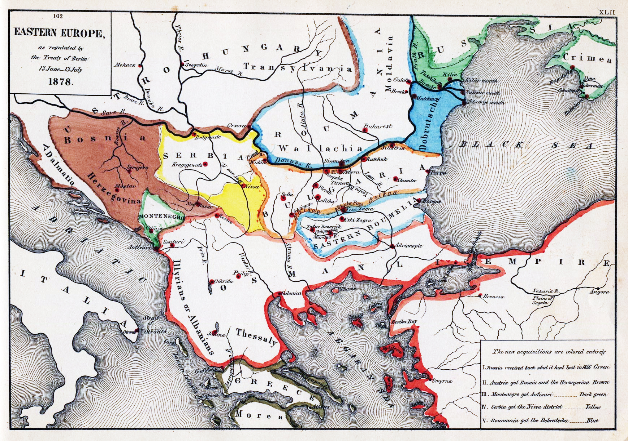
Treaty of Berlin (1878) – shows lost territories & new autonomous/independent states.

Slide 4
Rise of Nationalism & Young Turk Policies
Ethnic groups sought unification (e.g., Serbs in Bosnia/Novi Pazar, Greeks in Macedonia/Crete)
Young Turks (1908): Turkification → centralization, Turkish language/culture promotion
Discrimination & atrocities (Armenian massacres, suppression of Greeks/Macedonians) → revenge motive
Balkan states united despite rivalries against common Ottoman enemy

Slide 5
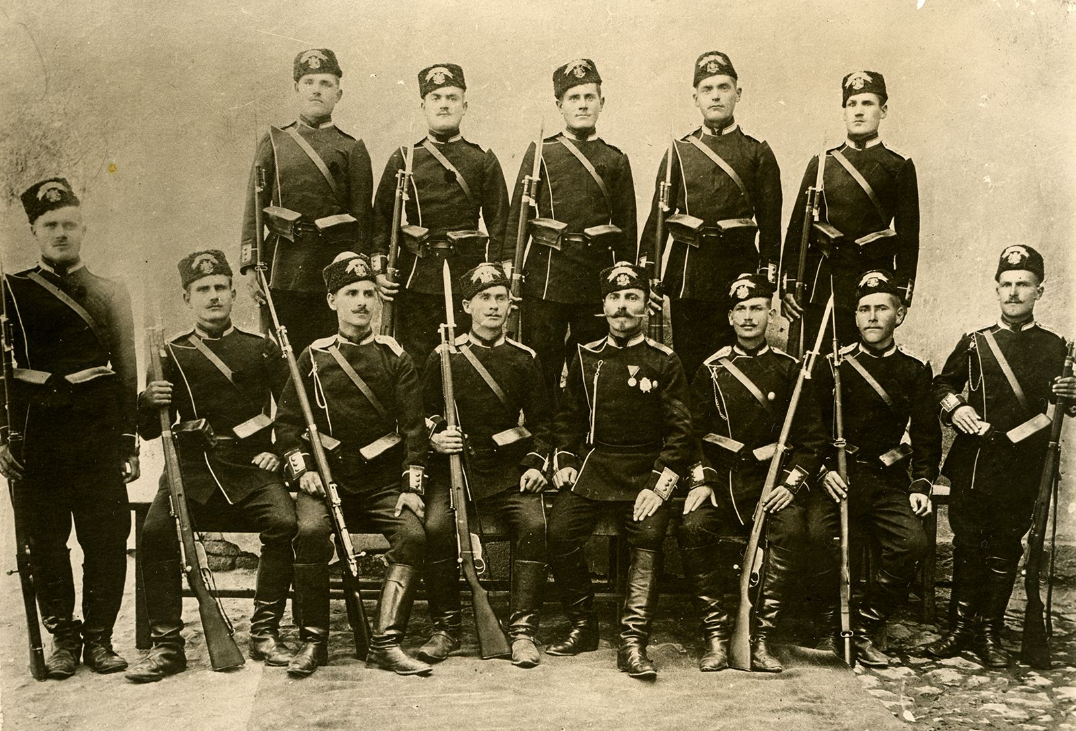
Bulgarian soldiers (Balkan League era) – historical group portrait of troops.

Slide 6
Formation of the Balkan League (1912)
Secret treaties: Serbia-Bulgaria (Feb 1912), Greece-Bulgaria, Montenegro joins
Goal: Expel Ottomans from Europe & divide territories
Enabled by Ottoman weakness (Italian-Turkish War 1911) & Russian encouragement

Slide 7
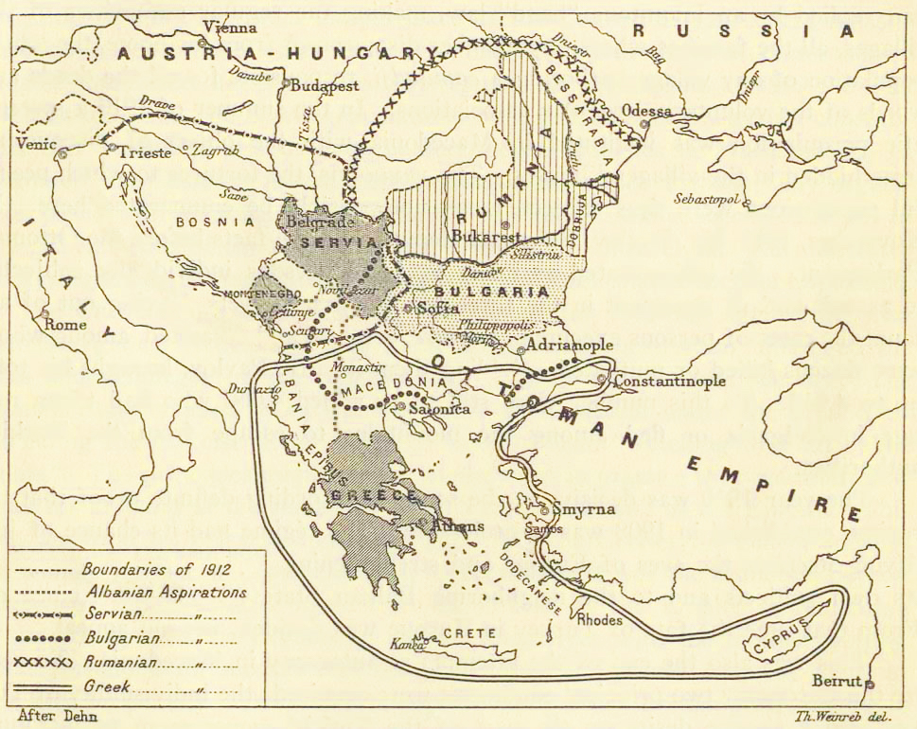
Territorial aspirations of Balkan states pre-1912 – shows overlapping claims in Macedonia.

Slide 8
Causes of the Balkan Wars – Summary
Ottoman decline & minority oppression under Young Turks
Nationalist irredentism (Serbia: South Slav union; Greece: Megali Idea; Bulgaria: San Stefano borders)
Atrocities & desire for revenge
Great Power rivalries (Russia pro-Slav; Austria anti-Serb expansion; Germany/Austria alliance)
Opportunity: Weakened Ottoman military

Slide 9
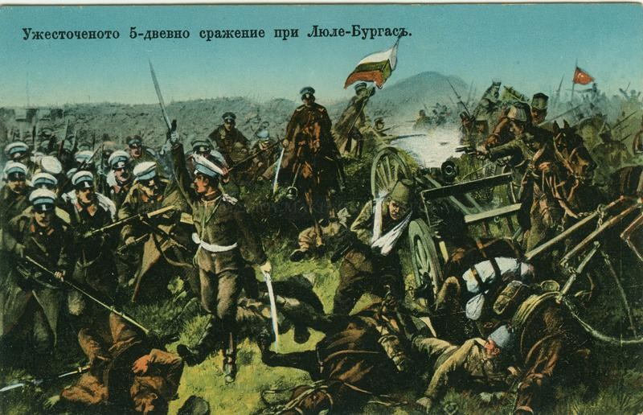
Battle scene from First Balkan War

Slide 10
The First Balkan War (Oct 1912 – May 1913)
Oct 1912: Declaration of war by Balkan League
Key victories: Kumanovo (Serbia), Kirk Kilisse/Lule Burgas (Bulgaria), Greek advance to Salonika
Ottomans reduced to Constantinople environs + Adrianople/Janina/Scutari
Dec 1912: Failed peace talks; war resumes March 1913

Slide 11
Treaty of London (May 30, 1913)
Main provisions:
Ottomans cede European territories west of Enos-Midia line (except Albania)
Crete to Balkan League; Aegean islands & Albania status to Great Powers
No specific division among victors → seeds of Second War

Slide 12
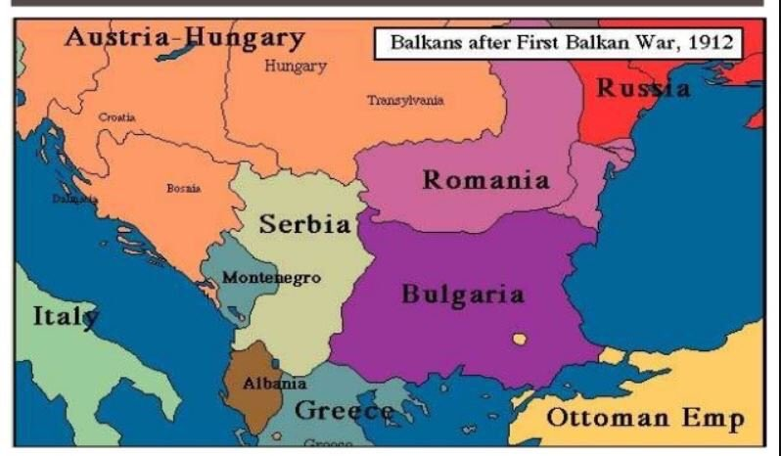

Slide 13
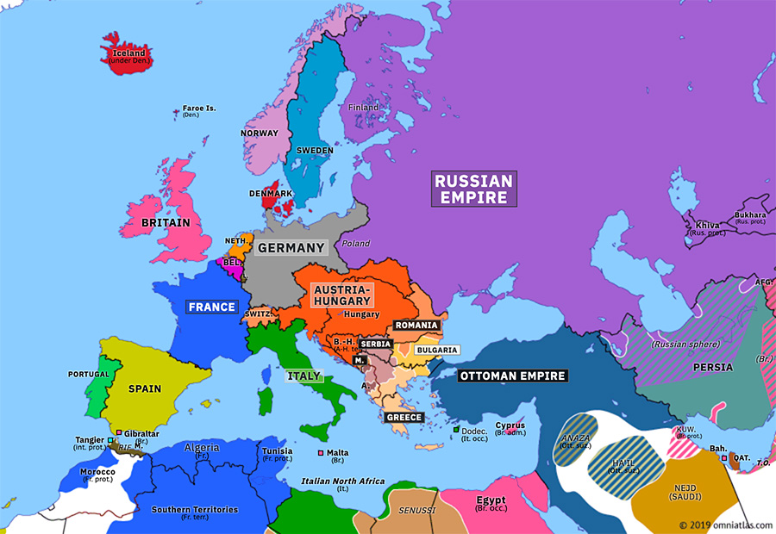
Europe July 31, 1913 (post-Second War) – shows final territorial changes.
Greece, Romania, Ottoman Empire join against Bulgaria
Rapid defeats: Romania takes Southern Dobruja; Ottomans retake Adrianople
Bulgaria surrenders after multi-front war

Slide 14
The Second Balkan War (June–August 1913)
Bulgaria attacks Serbia (June 29, 1913) over Macedonia division
Greece, Romania, Ottoman Empire join against Bulgaria
Rapid defeats: Romania takes Southern Dobruja; Ottomans retake Adrianople
Bulgaria surrenders after multi-front war

Slide 15
Treaty of Bucharest (August 10, 1913)
Bulgaria loses Macedonia (mostly to Serbia/Greece), Southern Dobruja to Romania
Gains small Aegean access (Dedeagach)
Serbia dominant in Macedonia; Greece gains Salonika region
Ottomans retain Adrianople & eastern Thrace

Slide 16
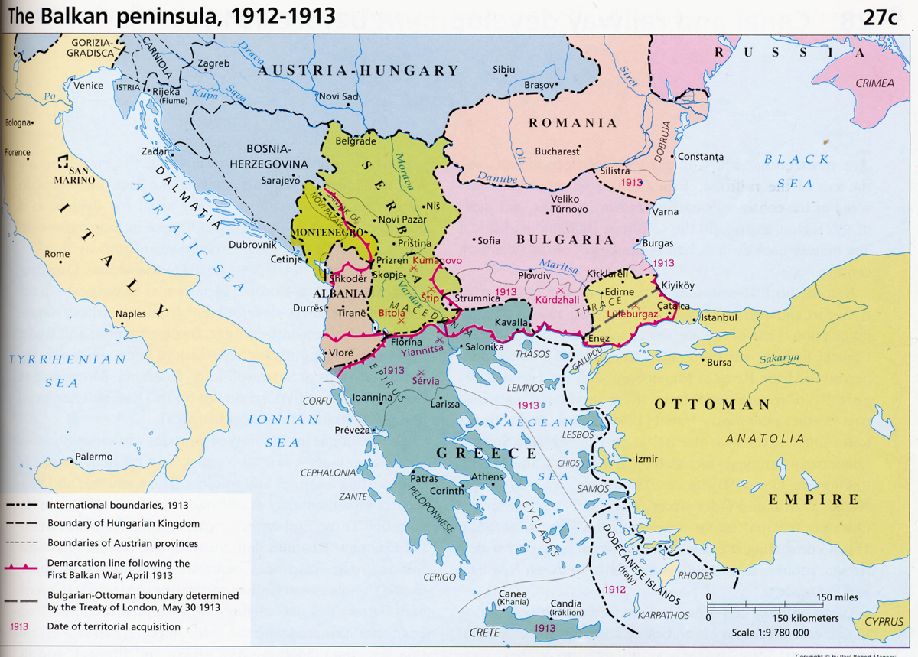

Slide 17
Results & Geopolitical Consequences
Ottoman Europe largely eliminated → major power shift
Serbia emerges strongest (gains Macedonia, blocks Austria to Adriatic)
Bulgaria resentful → later allies with Central Powers in WWI
Heightened Austria-Serbia rivalry → Sarajevo 1914 trigger
Russia backs Serbia; Germany/Austria align → alliance blocs solidify

Slide 18
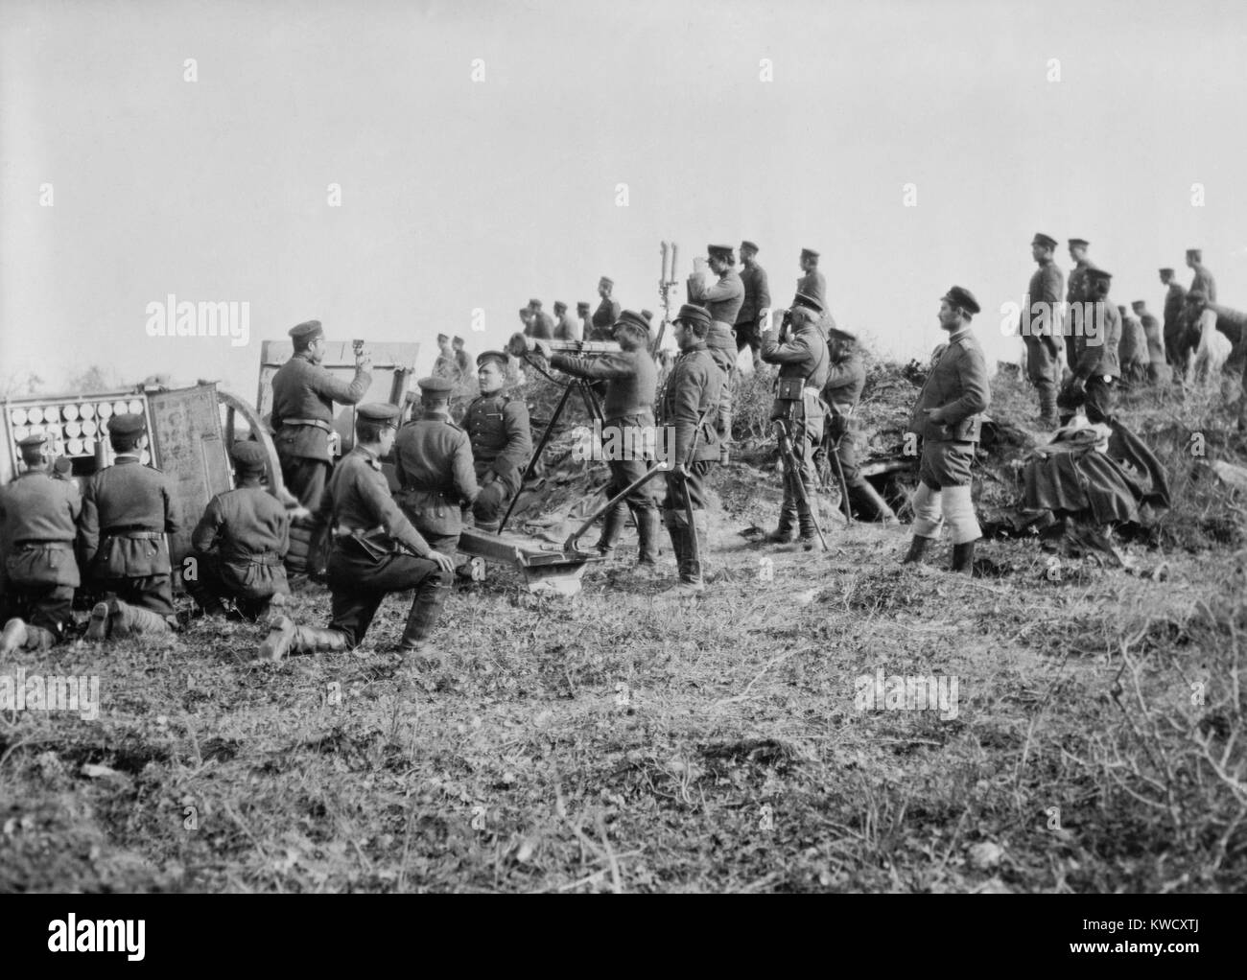
Ottoman/Balkan soldiers in trench (Catalca Lines, 1912–13)

Slide 19
The Balkan Wars as Prelude to WWI
Created unstable borders & revanchism (esp. Bulgaria)
Intensified Great Power proxy conflicts in Balkans
Serbia's rise threatened Austria-Hungary → Franz Ferdinand assassination (1914)
Shifted balance: Weakened Ottomans, strengthened Serbia/Russia axis

