Slide 1
Behavior Therapy
Understanding Behavior Change

Slide 2


Introduction
There was a student who once got laughed at during a presentation. After that, every time they had to speak in class… they started feeling anxious.
Even before speaking — just standing there — their heart would race. Nothing actually happened again… but the fear stayed.”
“Have you ever experienced something like that?”

Slide 3

01
Behavior Therapy Basics

Slide 4
What is Behavior Therapy?
Behavior Therapy focuses on modifying observable behaviors rather than thoughts or feelings. It works by using learning principles to help people change habits, reduce fears, or build new skills. The main idea is that behavior can be learned and unlearned through specific techniques tailored to individual needs.

Slide 5
Real-life Examples of Behavior Change
Imagine someone overcoming a fear of dogs by gradually spending time with gentle pets, or a student improving focus by rewarding study sessions. These examples show how Behavior Therapy applies practical steps to change daily actions effectively and confidently, leading to long-lasting improvements.

Slide 6

Visualizing Behavior Therapy
Think of Behavior Therapy as a pathway shaping how we act. Visuals often include charts showing behavior patterns before and after therapy, or illustrations of positive reinforcement like giving a child praise or tokens as rewards. These images help make the process clear and relatable.

Slide 7

01
Classical Conditioning – Phobias, Anxiety disorders

Slide 8
Definition and Everyday Example
Classical Conditioning is learning by association. It happens when a neutral stimulus starts triggering a response after being paired repeatedly with another stimulus. For example, hearing a bell before meal time can make a dog salivate, showing how behaviors get linked naturally over time.

Slide 9
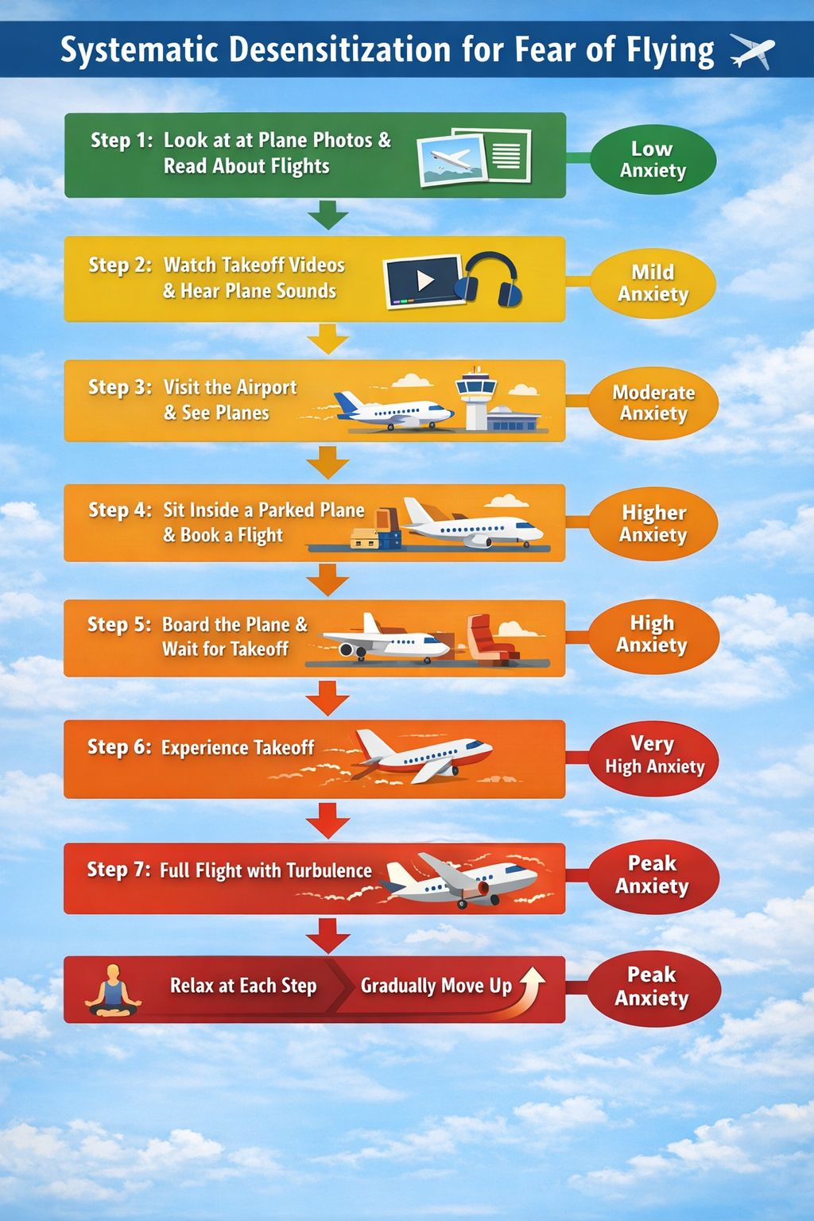
Systematic Desensitization Techniques – Phobias, OCD, Stage fear, Social anxiety
This technique helps reduce fear by gradual exposure to the feared object or situation, paired with relaxation. For example, someone scared of flying might start by imagining a plane, then watching videos, and finally taking a short flight. This step-by-step approach eases anxiety gently and effectively.

Slide 10

Aversion Therapy and Flooding Explained- Addiction, Nail biting,Panic related
Aversion Therapy pairs an unwanted behavior with an unpleasant stimulus to reduce it, like using a bad taste to discourage smoking.
Flooding involves intense exposure to a feared situation without escape, helping people face and overcome their fears quickly. Both techniques help break negative patterns by changing how we react to triggers.

Slide 11
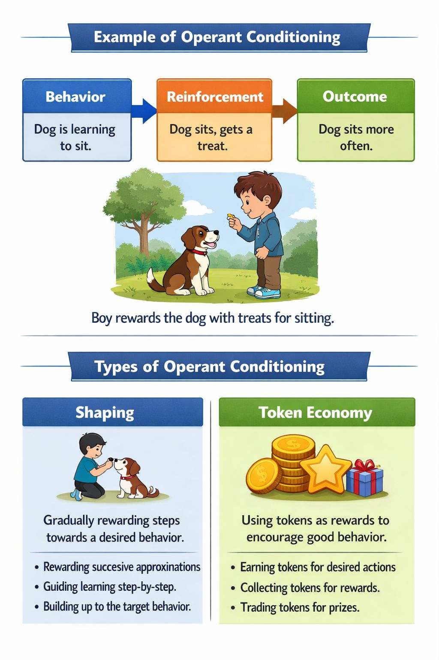
02
Operant Conditioning –Habit formation ,Classroom management

Slide 12
Understanding Operant Conditioning
Operant Conditioning is learning through consequences. Behaviors followed by rewards are likely to be repeated, while those followed by punishment tend to decrease. It helps shape behavior by using positive or negative reinforcements to encourage or discourage actions in everyday life.
Have you ever done something just because you knew you’d get a reward after it?”

Slide 13
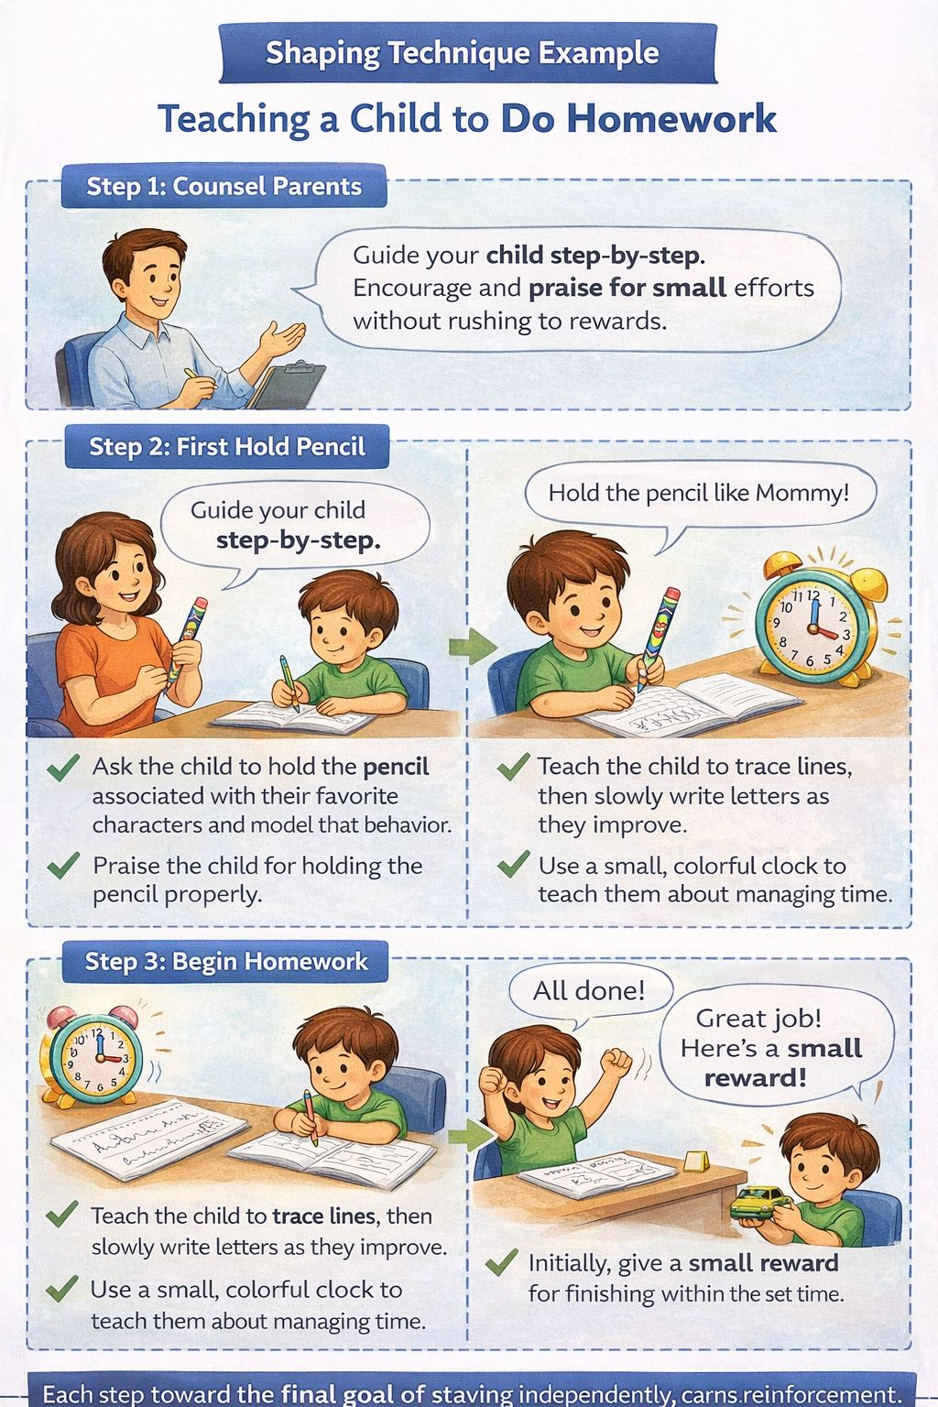
Shaping and Token Economy Techniques- ADHD,ASD, Classroom
Shaping breaks complex behaviors into small steps, rewarding progress along the way.
Token Economy gives tokens for good behavior, which can be exchanged for rewards. Both methods make learning new habits fun and motivating by celebrating every little success.

Slide 14


Play Therapy- Trauma, ABUSE, Bullying etc
Play Therapy uses play to help children express feelings and learn. Play Therapy is a technique used with children where they express their thoughts, feelings, and problems through play instead of words.”
A child who cannot express anger may use dolls to show fighting or sadness. That’s how therapists understand what the child is feeling.”

Slide 15
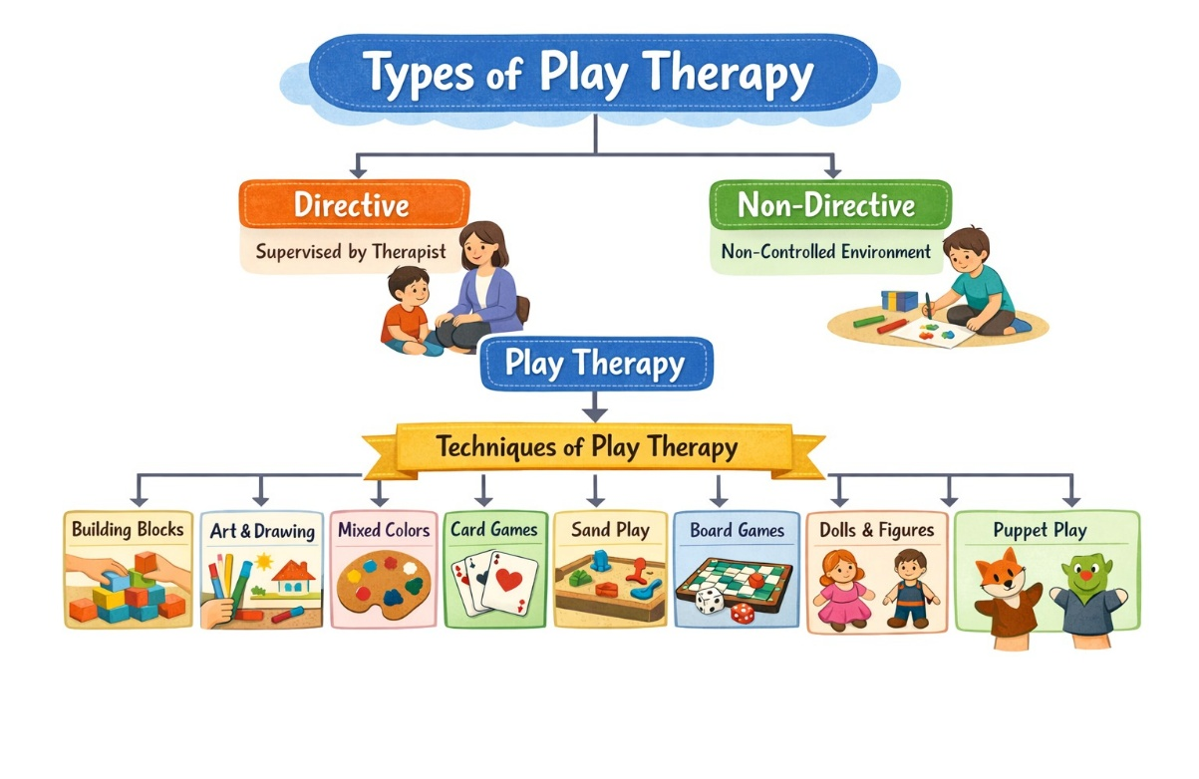
Play Therapy-

Slide 16
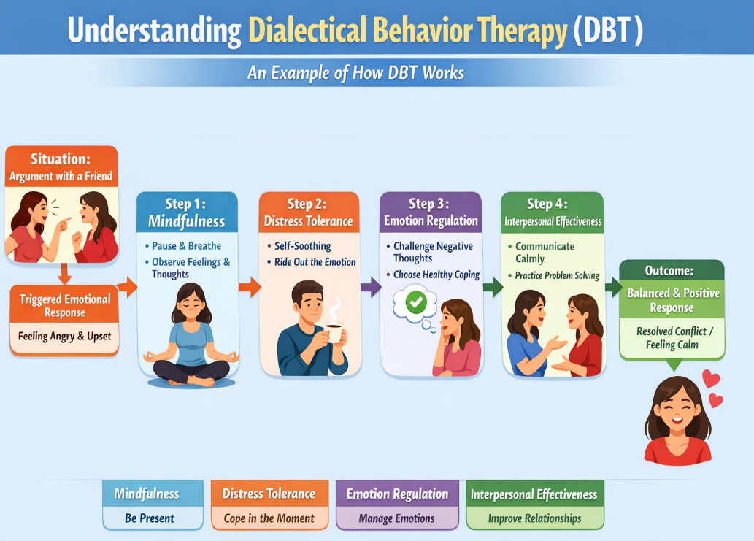
Dialectical Behavior Therapy
To manage intense emotions or develop coping skills by regulating them.

Slide 17
Role in Education
In education, Behavior Therapy helps improve classroom behavior and learning by rewarding positive actions. Techniques like token economies encourage students to stay motivated and engaged, creating a supportive learning environment.

Slide 18

Use in Counseling and Personal Growth
Counselors use Behavior Therapy to help clients manage stress, overcome fears, and build new skills. It also offers tools for personal growth by teaching us how to change habits and reinforce positive choices in daily life.

Slide 19
Thanks!
Do you have any questions?
psychologistjahnabi96@gmail.com
8638184247
psychologistjahnabi.in
- @psych_with_sharma

