Slide 1
Plato(428-347 B.C.)
Plato was a philosopher in Classical Greece.
Plato was a poet at heart, a mathematician, students of Socrates, founder of the Academy in Athens, the first higher learning institution in the western world his philosophical writings form a masterpiece of literature.
Along with his mentor, Socrates and his most famous student, Aristotle , Plato help to lay foundation of Western Philosophy.

Slide 2
None of the predecessors of Plato had constructed a system of philosophy. What they had produced, and in great abundance, were isolated philosophical ideas, theories, hints, and suggestions.
Plato was the first person in the history of the world to produce a great all embracing system of philosophy, which has its ramifications in all departments of thought and reality.
In doing this, Plato laid all previous thought under contribution
He gathered the entire harvest of Greek philosophy.

Slide 3
Plato derived the concept of imortality of soul and the doctrine of transmigration of the soul.
Fron Parmenides, Plato derived the doctrine of eternity and changelessness of idea.
From Heraclitus, Plato accepted the doctrine of the flux of sensible things.
But the influence of Socrates remained with him as an abiding element of thought.

Slide 4
Plato took the thought of Socrates, specially his own doctrine of idea of the Goodas the crowing of his thought under the influence of the Socrates teachings of virtue as knowledge through the concept of Good.
They are the foundations, below ground, upon which he builds the palace of philosophy. In his hands, all previous thought becomes transfigured under the light of a new and original principle.

Slide 5
Platos sophistication as a writer is evident in his Socratic dialogue; Plato wrote more than twenty dialogues covering a number of topics.
Plato's Dialogues have been used to teach a range of subjects, including Philosiophy, logic, ethics, rhetoric, religion and mathematics.
Plato is one of the most founding figures in Western philosophy.
Platonic dialogue consists of Socrates asking question of another and proving, through the questions, that the other person has the wrong idea of the subject.
Plato initially have carried the philosophy of Socrates concentrating on the dialectical examination of basic ethical issues; what is virtue? What ids friendship? Can virtue be taught?

Slide 6
In course of time Plato later began to develop his own philosophy.
Theb fundamental aspects of Platos thought is the theory of “idea”or “forms’’

Slide 7
Platos writtings are divided into Three periods
Early period: Apology, Charmides, Crito, Euthydemus ect
Middle period: Cratylus, Meno,,, Symposium, Theatatus ect
Later Period : Parmenides, Critias, law, Politicus, Timaeus, Republic, Phaedo, Sophist ect

Slide 8
PLATO'S THEORY OF KNOWLEDGE
Plato opens the discussion of knowledge
by telling first what knowledge is not. In defining knowledge his main object is to refute the false theories regarding knowledge.
The first false theory which Plato refutes is that knowledge is perception. To refute this is the main object of the “Theaetetus.”
The second false theory that he wants to refute is Knowledge is opinion

Slide 9
Knowledge is not perception
Protagoras is said to be the exponent of the theory that knowledge is perception
What appears to me is true for me and what appears to you in perception is true for you. Hence man is the measure of all things.
Plato criticizes this doctrine in Theatatus
According to Plato perception is just a joint product of perceived object and the percipient. So nobody know s what the perceived object is in itself

Slide 10
Knowledge is not perception
Each perception is relative to the percipients
Nobody is sure that what appears to you is the same which appears to another.
Even what appears to me is not the same to me in the next moment because I never remain in the same condition in the two moments
Thus perception yeiled self contradictory conclusions.
What appears to sour to a seek sick man is sweet to the healthy. The same thing becomes sour and sweet, which is opposed to each other.

Slide 11
Knowledge is not perception
That knowledge is perception is the theory of Protagoras and the Sophists. What it amounts to is that what appears to each individual true is true for that individual. In other words, what appears to me is true for me, and, what appears to you in perception is true for you. But this is at any rate false in its application to our judgement of future events.
For example, it may appear to me that I shall be Chief Justice next year. But instead of that I find myself, perhaps, in prison.

Slide 12
Knowledge is not perception
Perception yields contradictory impression. The same object appears large when near, small when removed to a distance. To know which is true, we must be able to exercise a choice to prefer one to another, to accept this and reject that. But if knowledge is perception, then we have no right to give one perception preference over another. For all perceptions are knowledge. All are true.
This doctrine renders all teachings, all discussion, proof, or disproof, impossible. Since all perceptions are equally true, the child's perceptions must be just as much the truth as those of his teachers. For if so, there is nothing to dispute about.

Slide 13
Knowledge is not perception
If perception is truth, man is the measure of all things, in his character as a percipient being. But since animals are also percipient beings, the lowest brute must be, equally with man, the measure of all things.
The theory of Protagoras contradicts itself. For Protagoras admits that what appears to me true is true. If, therefore, it appears to me true that the doctrine of Protagoras is false, Protagoras himself must admit that it is false.

Slide 14
Knowledge is not perception
It destroys the objectivity of truth and renders the distinction between truth and falsehood wholly meaningless.
If perception is knowledge and memory is not, and then it results is absurd. If a man shuts his eyes after seeing something, but remembers it, then he has no knowledge of what he remembers.

Slide 15
KNOWLEDGE IS NOT OPINION
The second false theory that Plato seeks to refute is that knowledge is opinion.
Wrong opinion is clearly not knowledge. But even right opinion cannot be called knowledge.
We often feel intuitively, or instinctively, that something is true, though we cannot give any definite grounds for our belief. The belief may be quite correct, but it is not, knowledge according to Plato. It is only right opinion.
To possess knowledge, one must not only know that a thing is so, but why it is so. One must know the reasons. Knowledge must be full and complete understanding, rational comprehension, and not mere instinctive belief. It must be grounded on reason, and not on faith. It may chance that my belief or opinion turns out to be true.

Slide 16
KNOWLEDGE IS NOT OPINION
Only true belief is not knowledge.
Again, opinion or belief may be true or false. But knowledge is always true. Again the object of opinion or belief is particular things and beings.
But the object of knowledge is reality, the Ideas, or the Forms. The false theories being refuted, Plato passes on to the positive side of his theory of knowledge.

Slide 17
KNOWLEDGE IS NOT OPINION
Suppose I believe that it will rain tomorrow. Tomorrow it rains. But still my belief is not knowledge, because I based my belief on intuition or instinct, not on reason-Right opinion or belief may often be a blind guess.
According to Plato, it is not knowledge. To possess knowledge, one must not only know that a thing is so, but why it is so. One must know the reasons. Belief is false when it does not correspond to fact. It is true when it corresponds to facts.
But even true belief is not always knowledge, in the proper sense of the terms.
Belief, when supported by evidence and rational justification only, rises to the level of knowledge

Slide 18
ALL KNOWLEDGE IS KNOWLEDGE THROUGH CONCEPT
These are the same as definitions. Concepts are not subjective. These do not vary with individuals. This gives us objective truth.
Knowledge is founded on reason, and reason is the faculty of concepts.
Plato thus believed that genuine knowledge means knowledge of concepts. But he differs from Socrates when he says that these concepts not only belong to our minds, but they really exist outside our mind.
Our concepts are true according as they correspond to the real concepts or Ideas or Forms.
Knowledge is for Plato "the correspondence of thought and reality or being."

Slide 19
  ALL KNOWLEDGE IS KNOWLEDGE THROUGH CONCEPT
Plato adopts without alteration, the Socratic doctrine that all knowledge is knowledge through concepts.
A concept, being the same thing as a definition, is something fixed and permanent, not liable to mutation according to the subjective impressions of the individual. It gives us objective truth.
The concept 'man' does not change with individual human beings. Individual man may come and go, but the concept 'man' remains unchanged- knowledge has for its objects these concepts which are fixed and permanent.

Slide 20
  FOUR GRADES OF KNOWLEDGE:
In 'Republic' Plato speaks of four grades of knowledge corresponding to four knowing abilities of human mind. These are following:
The first two levels make the level of opinion or belief (perception). The second two levels are super-sensible levels of reason.
The lowest grade of knowledge is connected with our imagination. It deals with illusion and dream images of particular things and beings, e.g., the so called knowledge of the image or copy of particular 'man'- this or that man. This level of knowledge is not at all 'knowledge' in the true sense.
The next higher level of knowledge consists in perceptual belief and opinion, e.g., knowledge of a particular man. This we get through perception. Individual man is the copy of the Idea 'man'. Here the object of knowledge is copy of concepts.

Slide 21
According to Plato neither of these two levels are knowledge proper.
The next higher level of knowledge consists in knowledge of numbers and figures as is found in Mathematics and Geometry. Here the knowing ability is understanding or intellect. Which is inferior to reason according to Plato. This knowledge, though rational, is based on some self-evident principles that intellect cannot justify categorically but takes them for granted hypothetically.
The highest level of knowledge is based on Pure Reason. Here we have knowledge of the Ideas or Forms e.g., the knowledge of 'man' in general, or the Idea or Form 'Man'. This knowledge is infallible, and is of Reality.

Slide 22
Plato’s myth of the Cave
In the Republic, Plato uses a vivid allegory to explain his two-realms philosophy. He invites us to imagine a cave in which some prisoners are bound so that they can look only at the wall in front of them. Behind them is a fire whose light casts shadows of various objects on the wall in front of the prisoners. Because the prisoners cannot see the objects themselves, they regard the shadows they see as the true reality. One of the prisoners eventually escapes from the cave and, in the light of the sun, sees real objects for the first time, becoming aware of the big difference between them and the shadow images he had always taken for reality. The cave, obviously, represents the world we see and experience with our senses, and the world of sunlight represents the realm of Forms.The prisoners represent ordinary people, who, in taking the sensible world to be the real world, are condemned to darkness, error, ignorance, and illusion.The escaped prisoner represents the philosopher, who has seen light, truth, beauty, knowledge, and true reality. Of course, if the philosopher returns to the cave to tell the prisoners how things really are, they will think his brain has been addled. This difficulty is sometimes faced by those who have seen the truth and decide to tell others about it.

Slide 23
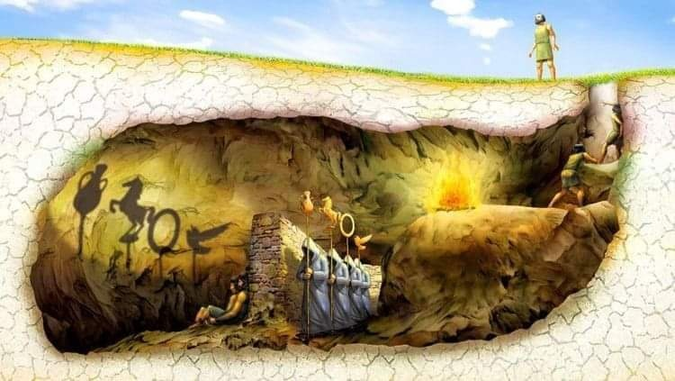
Plato’s allegory of the cave

Slide 24
FOUR GRADES OF KNOWLEDGE:
In 'Republic' Plato speaks of four grades of knowledge corresponding to four knowing abilities of human mind. These are following:
The first two levels make the level of opinion or belief (perception). The second two levels are super-sensible levels of reason.
1. The lowest grade of knowledge is connected with our imagination. It deals with illusion and dream images of particular things and beings, e.g., the so called knowledge of the image or copy of particular 'man'- this or that man. This level of knowledge is not at all 'knowledge' in the true sense.
2. The next higher level of knowledge consists in perceptual belief and opinion, e.g., knowledge of a particular man. This we get through perception. Individual man is the copy of the Idea 'man'. Here the object of knowledge is copy of concepts.

Slide 25
FOUR GRADES OF KNOWLEDGE:
According to Plato neither of these two levels are knowledge proper.
3. The next higher level of knowledge consists in knowledge of numbers and figures as is found in Mathematics and Geometry. Here the knowing ability is understanding or intellect. Which is inferior to reason according to Plato? This knowledge, though rational, is based on some self-evident principles that intellect cannot justify categorically but takes them for granted hypothetically.
4. The highest level of knowledge is based on Pure Reason. Here we have knowledge of the Ideas or Forms e.g., the knowledge of 'man' in general, or the Idea or Form 'Man'. This knowledge is infallible, and is of Reality.

Slide 26
FOUR GRADES OF KNOWLEDGE:
Thus we pass through four basic steps and eventually arrived at perfact knowlwdge; full remembrance - an explanation which Plato develops by way of the simile of the line. also in the Republic.
At first our knowledge of things are but vague, shadowy and blurred. Then we gradually pass from inferior knowledge through our "imagination" to clearer, more direct experience of objects. This is the level of firm assent of faith. Next is the stage where our faculty of reasoning comes into play, as we begin to argue and make comparisons. Finally, the highest level of knowledge, the realm of pure intellectual activity, where we contemplate the Ideas and their interconnections.

Slide 27
KNOWLEDGE AS JUSTIFIED TRUE BELIEF
One most widely held definition of knowledge is knowledge is justified true belief. Plato in his book "Theaetetus" discussed this definition of knowledge. This definition of knowledge entails three conditions of knowledge.
The first condition is that truth condition of knowledge. This condition simply implies that what we claim to know must be true.
The second condition of knowledge is belief condition. We must not only know that something is true but we must also believe that it is true. One cannot legitimately say that I know that P is true, but I don't believe it.

Slide 28
KNOWLEDGE AS JUSTIFIED TRUE BELIEF
The third condition of knowledge is the justification condition. If someone claims that he knows P than he must have a evidence for P or he must have a reason to believe P. we may formulate these conditions as follows _ " If S knows that P" then s is completely justified in believing that P".
But the definition of knowledge as justified true believe is criticised by various philosopher. The most famous criticism was put forwarded by the Edmund Gettier in his paper "Is Justified True Belief Knowledge?" which is published in 1963. In this paper Gettier through various counter examples tried to show that even though all the three conditions of knowledge are satisfied, we cannot claim to have knowledge.

Slide 29
Theory of Forms
Constant and Absolute
Intelligible world
World of Forms (ideas)
Knowledge lies in understanding
Imperfect or incomplete Version or copy of
Visible World
World of appearance
Change and Variation

Slide 30
PLATO'S CONCEPT OF FORM OR IDEAS
While discussing the Plato's concept of Ideas or form, one point is to be very clear that his doctrine of ideas was very much influenced by two doctrines. One of them is the Socratic doctrine of concepts and the other is the Eleatic doctrine of being. According to Heraclitus, an Eleatic philosopher, reality is a constsant flux. He further said that one cannot step in to same water of a river twice. Because it is constantly in the flowing mood, same is the case with reality too. From Heraclitus, Plato has learnt that the visible universe is in a state of constant flux.
Plato concluded that truth is not a thing that is to be found in the world of senses. Truth is rather to be found in the world of ideas. According to Plato truth is rather to be found in the world of ideas. It is remarked by many later philosophers that Plato's theory of idea is nothing but the modification of Socratic theory of concepts.

Slide 31
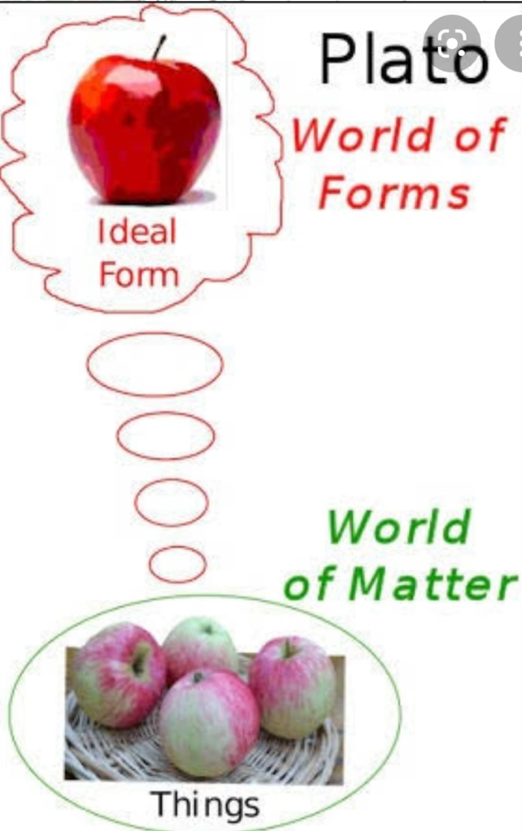
PLATO'S CONCEPT OF FORM OR IDEAS
World
Sensible things
Appearance
openion
Idea
Real
Knowledge

Slide 32
PLATO'S CONCEPT OF FORM OR IDEAS
That is why for Plato, the forms or ideas are those changeless, eternal and non-material essences or patterns of which the actual visible objects that we see are only poor copies. As for example, we can mention about an apple. Actually there is a form or idea of an apple and all we see is the mere form of that apple.
So far as pre-Socratic philosophers are concerned, for them reality is a material stuff of some sort, Plato now designated the non-material Ideas or forms as the true reality. The cognition of the ideas alone can be called knowledge. The world of ideas is not the visible world. It is the intelligible world. So far as ideas are concerned, ideas or forms are the entities, which are neither present in space nor in time. It is already been discussed that ideas or forms are not spatio-temporal entities.

Slide 33
PLATO'S CONCEPT OF FORM OR IDEAS
One important point which is to be mentioned here is that according to Plato, for their existence, ideas do not have to depend on our mind. They are totally independent of our knowing mind. They live in their own heaven of ideas. From this point of view, it can be said that Plato's theory of ideas has quality of both idealism and realism. It can be regarded to be Idealism in the sense that only ideas are real and whatever we perceive is the mere copies of those ideas or forms.
Again it can be regarded to be realism in the sense that ideas have nothing to do with our mind. They are totally independent of our knowing mind and reside in their own heaven of ideas. So form the above interpretation, it is found that Plato's theory of idea or form is in itself a very unique theory as it possessed the quality of both idealism and realism.

