Slide 1
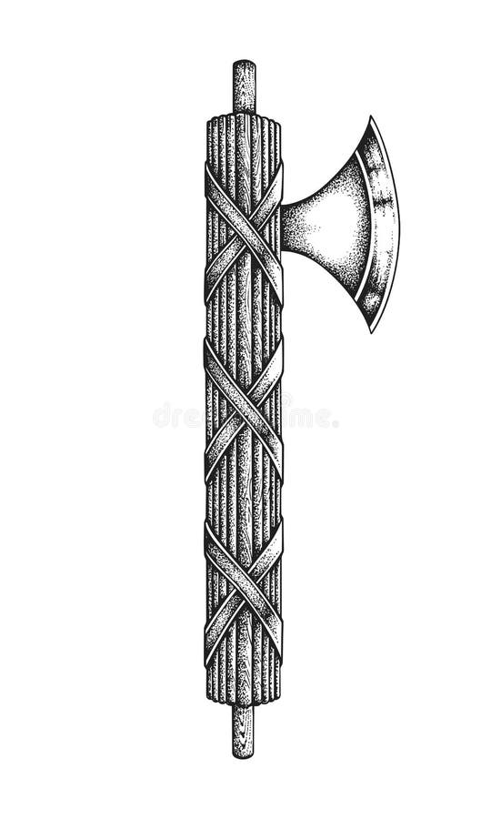
What is Fascism?
Term “Fascism” comes from Mussolini’s party: Fasci di Combattimento
Fasces = bundle of sticks → symbol of unity and strength
Originally a party name, later became an ideology
Mussolini came before Hitler (Italy first fascist state)
Nazi Party did not use the word “fascist,” but historians classify it as fascist

Slide 2
Why Do Fascist Ideologies Rise?
Fascism emerges during economic, social, and political crises
People lose faith in democracy → shift to extreme right or extreme left
Fascism = counter-revolution against socialism and communism

Slide 3
Background - Italy After World War I
Italy’s “Mutilated Victory”
Fought on Allied side but got fewer territories than promised
Felt betrayed at Paris Peace Conference (1919)
Treaty of London (1915) Promised:
South Tyrol, Trentino, Istria
Dalmatian Coast, African colonies, Balkan influence
Reality (1919):
Did not get most of Dalmatia or Balkan dominance which led to national humiliation and anger

Slide 4
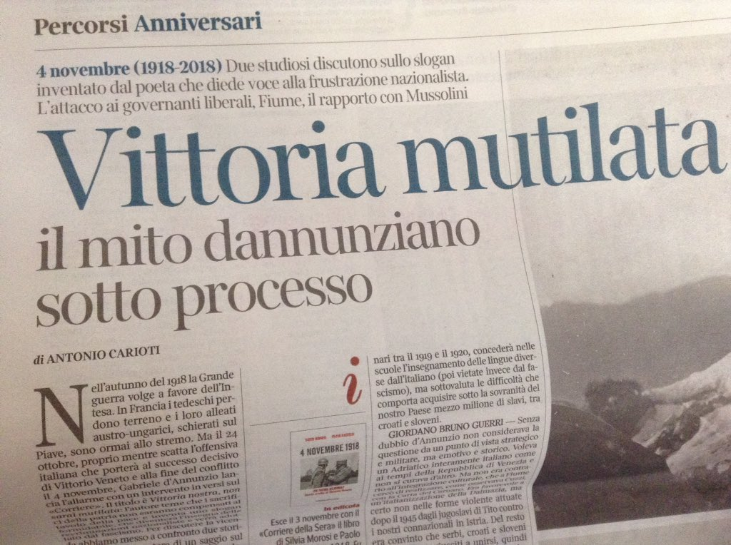

Slide 5
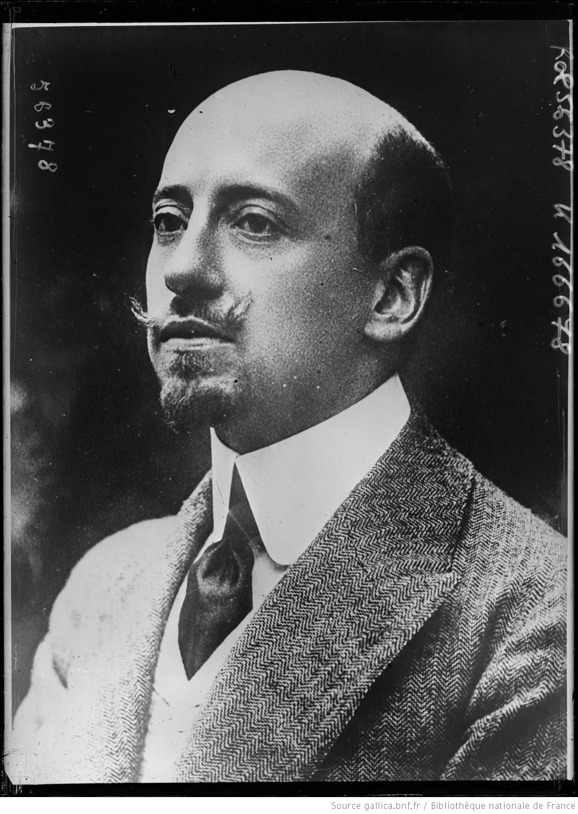
D’Annunzio and the Fiume Episode
Gabriele D’Annunzio: poet, nationalist, proto-fascist leader
Led volunteers to seize Fiume (Rijeka) in 1919
Declared nationalist state, expelled Allied troops
Government failed to stop him → state authority weakened

Slide 6
Post-War Crisis in Italy
Economic Crisis
War debts, inflation, unemployment
Returning soldiers without jobs
Factories closed, social unrest
Social Crisis (Red Biennium 1919-20)
Strikes, factory occupations
Inspired by Russian Revolution
Political Crisis
Frequent government changes
Corruption, weak parliament
Loss of faith in democracy

Slide 7
Fear of Communism
Russian Revolution (1917) shocked Europe
Factory occupations in Italy scared elites
Middle class, professionals, farmers feared social revolution
➡ Supported fascism as protection

Slide 8
Weak Democratic Tradition
Italy unified from above (kings, elites, generals)
People not involved in nation-building
Quote: “We have made Italy; now we must make Italians.”
Democracy shallow, collapsed easily

Slide 9
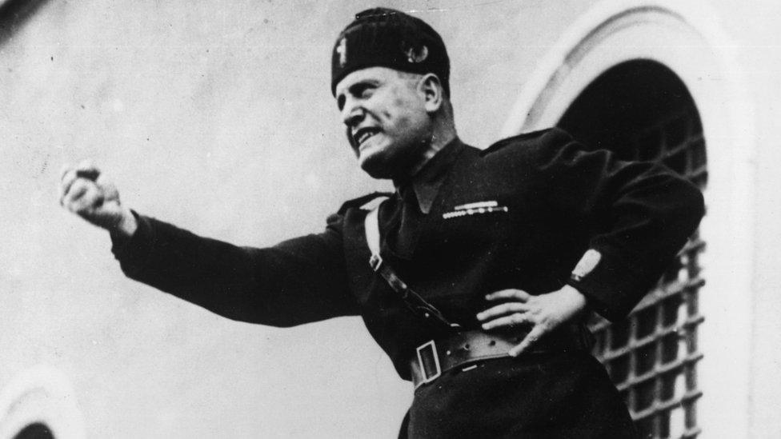
Who Was Mussolini?
Teacher, journalist, socialist agitator
Editor of Avanti! (socialist newspaper)
Turned nationalist and founded Fascist Party in 1919
Recruited veterans, students, middle class
Blackshirts used violence against socialists

Slide 10
Reasons for Mussolini’s Rise
1. Nationalism
Promised Roman glory and empire
2. Economic Promises
Jobs, stability, end strikes (mostly propaganda)
3. Strong Leadership
One leader, one party, one nation
4. Mass Propaganda
Dramatic speeches, uniforms, symbols
5. Opportunism
Shifted from socialism to fascism for power
6. Contradictory Promises
To capitalists, workers, nationalists, middle class simultaneously

Slide 11
How Mussolini Came to Power (1922)
Fascists won only 35 seats in 1921 elections
Used street violence (Blackshirts)
March on Rome (1922) – political blackmail
King Victor Emmanuel III invited him PM
➡ “Coup by invitation”

Slide 12
What is Fascism? - Three Levels
1. Ideological Level
Ultra-nationalism, dictatorship, anti-democracy, violence
2. Political Level
Fascist party in elections, alliances with elites
3. Street Violence
Paramilitary gangs, intimidation, terror
➡ Essential for fascist success

Slide 13
Social Base of Fascism
Unemployed youth
War veterans
Lower middle class
Nationally humiliated people
➡ Fascism gave identity, discipline, purpose

Slide 14
Regimentation of Power (Totalitarianism)
Concentration of Power
Mussolini dictator by mid-1920s
Parliament weakened, parties banned
Media censored, opposition crushed
State = Party = Leader

Slide 15
Administrative & Economic Policies
Achievements (Propaganda)
Public works, towns, roads
Education expanded, crime reduced
Failures
Land reforms failed
Workers’ problems ignored
Stability through force, not reform

Slide 16
Indoctrination & Social Control
School curriculum glorified fascism
Secret police (OVRA)
Youth organisations (Balilla, GIL)
Worker leisure organisation (Dopolavoro)
➡ Control minds and daily life

Slide 17
Lateran Pact (1929)
Vatican recognised as independent
Catholicism declared state religion
Gained Church and popular support

Slide 18
Corporatism - Fascist Economy
Corporatism
State-controlled organisations of workers and employers
Strikes banned, state arbitrated disputes
Parliament replaced by Chamber of Corporations
➡ Class conflict replaced by state control

Slide 19
Fascist Social Philosophy
Nation above individual
Society as a family with Mussolini as father
Militarisation of youth and education
War glorified as duty

Slide 20
Final Outcome of Fascist Regime
Totalitarian state
Democracy destroyed
Opposition eliminated
Economic problems unresolved
Collapsed during WWII

