Slide 1

RISE OF HITLER

Slide 2
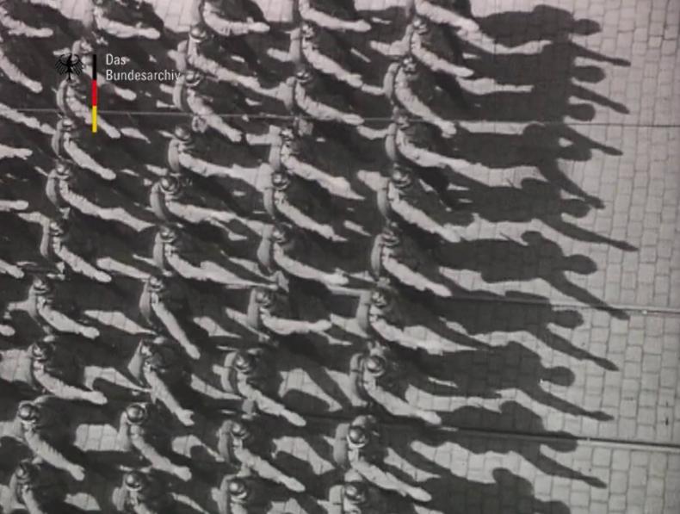
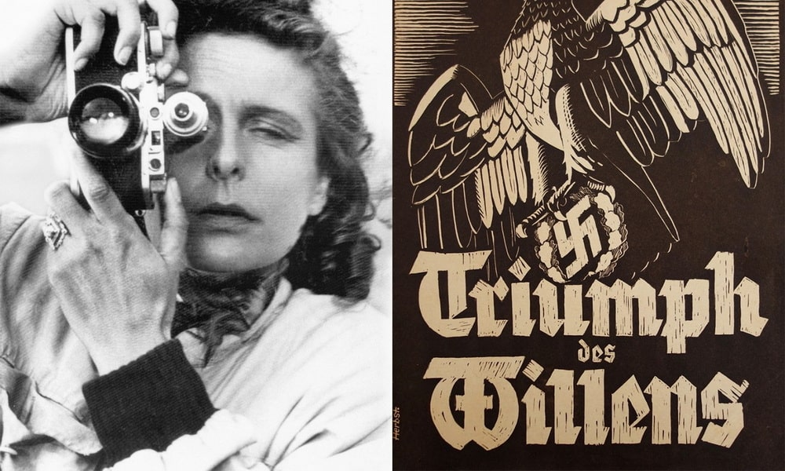
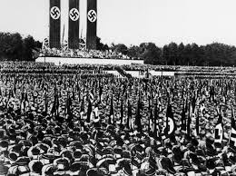
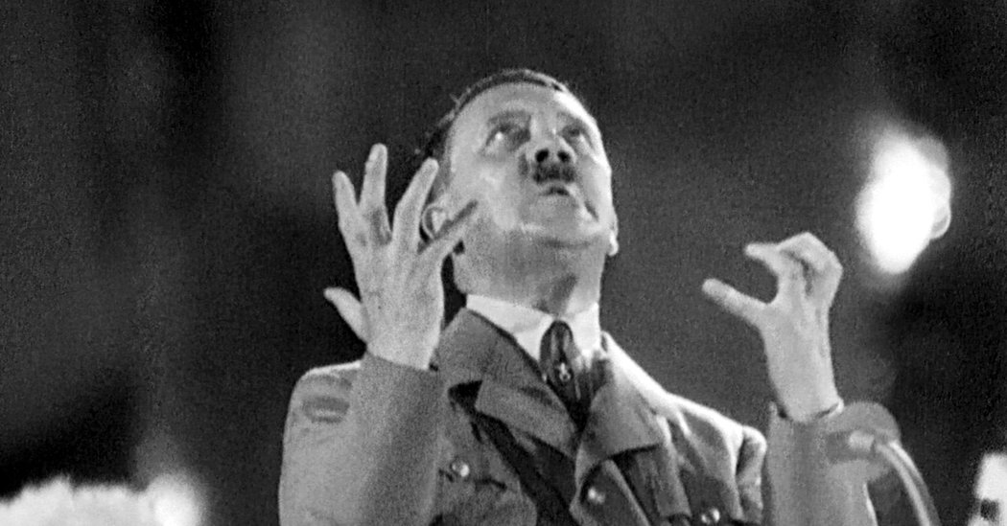
How does democracy elect a dictator?

Slide 3
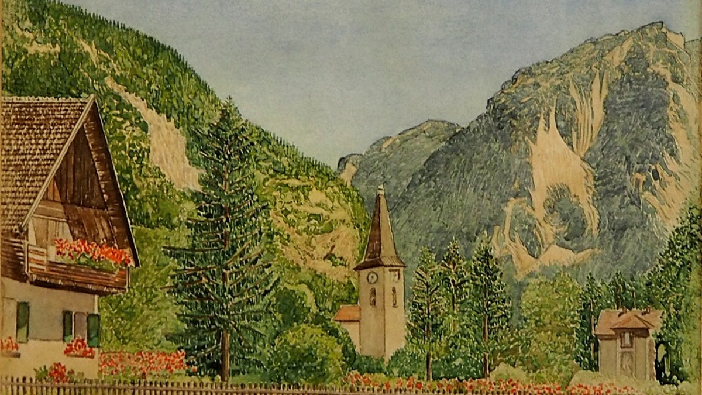
Hitler’s early life
Wanted to be painter
Rejected twice (1907, 1908)
Lived selling postcards

Slide 4
WW1 was a turning point
Bavarian army volunteer
Iron Cross (1914, 1918)
Gas attack, hospital
Defeat = radicalization

Slide 5
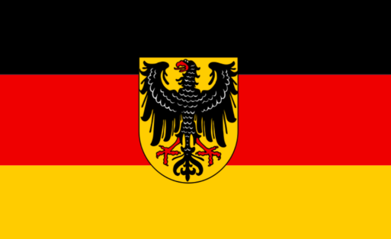
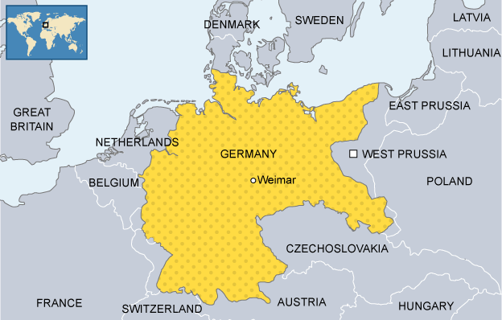
What was the Weimar Republic?
Germany’s first democracy (1919–1933)
Liberal constitution
Welfare state + universal suffrage

Slide 6
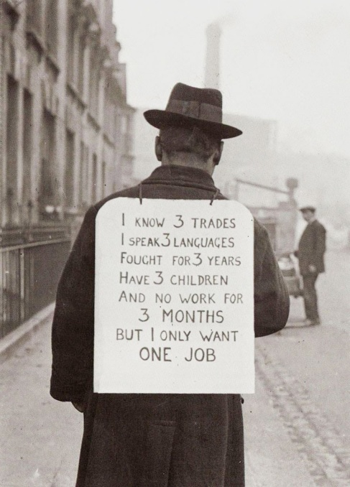
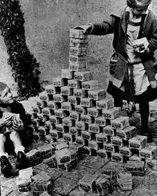
Why did Weimar Republic fail?
Versailles humiliation
Hyperinflation 1923
Great Depression 1929
Political fragmentation

Slide 7
How hyperinflation led to formation of Hitler’s support base
Germany experienced severe hyperinflation in 1923, where prices could rise several times within a single day.
Currency lost value so rapidly that people carried wheelbarrows of banknotes to buy basic goods like bread or potatoes.
The middle class was hit the hardest, their savings, pensions, and fixed incomes became worthless.
Middle-class Germans, who prided themselves on property, savings, and social status, feared downward mobility and proletarianization.
This economic collapse destroyed trust in the Weimar Republic and created social resentment and insecurity.
Some groups benefited from inflation, including speculators, bankers, industrialists, and those with foreign currency or mortgages, who could repay debts cheaply.
Hitler and the Nazis exploited this resentment by scapegoating Jews, portraying Jewish bankers and traders as profiteers and “betrayers of the nation.”
The economically traumatized middle class later became a crucial support base for Nazism.

Slide 8
Golden years
Still, there was a temporary respite from 1924-1929. Golden years of Weimar Republic.
Chancellor Gustav Stresemann's policies brought some recovery.
Dawes' plan in 1924 helped stabilize the German economy.
Locarno treaties ensured peaceful relations with the neighbors

Slide 9
The Great Depression
The Great Depression of 1929 reversed the fragile economic recovery of the Weimar Republic.
Germany was heavily dependent on American loans and investments (Dawes and Young Plans), making its economy extremely vulnerable to the U.S. crash.
When the American economy collapsed, loans were withdrawn, industries shut down, and banks failed in Germany.
Unemployment rose dramatically—nearly one in three Germans was unemployed by the early 1930s.
Industrial production collapsed, and many people were pushed back into subsistence agriculture and informal work.
The state lacked sufficient welfare resources, leading to mass poverty, hunger, and social despair.
Economic crisis intensified political radicalization, increasing support for extremist parties, especially the Nazis and Communists.
Many historians argue that without the Great Depression, Hitler might have remained politically marginal.

Slide 10
Why Nazism appealed?
Militarism
Anti-Versailles nationalism
Fear of communism
Elite support

Slide 11
Why Nazism appealed contd.
The Nazis set themselves up as representatives of ‘the people’ and claimed to express popular opposition to a corrupt and foreign political establishment – potentially a very broad appeal indeed. They were able to channel the resentment of small shopkeepers into attacks on ‘Jewish’ department store owners. They won the support of many workers by incorporating the symbols used by the Left. This nationalist anticapitalism had the advantage of being relatively attractive to many employers, too, for it potentially spared German capitalists the blame for the workers’ plight. The appeal of fascism in class terms is best understood as the product of an interaction between the strategies of fascist activists and the circumstances of particular groups.

Slide 12
Points on the post WWI ambience
A lot of scholarship has pointed out that post War political adjustment was far from easy.
More than WW1, it was the consequence of post War politics that pushed fascism into the mainstream.
For one, weak democracies emerged in several new states (Lithuania, Latvia, etc.) that were born post the War.
Had the post War years been years of constant economic and social stability, the prospects of European democracy could have been different…the fascist challenge may never have appeared. In this vein, democracy to many right-wing attackers appeared as intrinsically weak.

Slide 13
Points on the post WWI ambience contd.
Given the socio-economic problems, right-wing attackers successfully made scapegoats of Jews, communists, other nations, the liberal governments. Indeed, a major source of concern for democracy’s critics was democracy’s relationship with a newly powerful political Left.
There was fear of Bolshevism being promoted in name of tolerance towards Left-wing trade unionism and social democracy.
We also have the brutalization of political life during and after WW1 – a new acceptance of and higher level of endurance for violence.

Slide 14
Hitler’s popularity
Charisma
Anti-Semitism
Anti-Weimar
Myth of past glory
Spread his base in the rural countryside

Slide 15
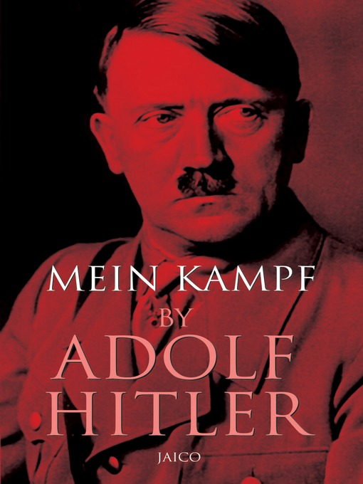
Hitler’s failed coup
1923 coup failed
Prison → Mein Kampf
Turn to elections

Slide 16
WHAT IS NAZISM?
Nazism, also known as National Socialism (German: Nationalsozialismus), refers primarily to the ideology and political practices of the Nazi Party under Adolf Hitler, as well as the policies implemented by the government of Nazi Germany. Although several historical groups used the term “National Socialism,” the Nazis emerged as the most prominent and influential such group in the 1920s. Scholars generally classify Nazism as a form of fascism. While it incorporated ideas from both left- and right-wing political traditions, the movement largely formed its alliances with conservative and right-wing forces.

Slide 17
Among the key elements of Nazism were anti-parliamentarism, ethnic nationalism, racism, collectivism, eugenics, antisemitism, opposition to economic liberalism and political liberalism, anti-communism, and totalitarianism.
Nazism was not a monolithic movement, but rather a (mainly German) combination of various ideologies and groups, sparked by anger at the Treaty of Versailles and what was considered to have been a Jewish/Communist conspiracy

Slide 18
RISE TO POWER (1928-1933)
In 1928 Hitler’s Nazi Party was a small, insignificant party. They enjoyed little success in elections and were viewed as little more than thugs by the political elite. By 1933 however Hitler was the chancellor of Germany. The Nazi’s had risen from obscurity to power.

Slide 19
FACTORS INFLUENCING THE RISE
Stresemann’s death
The Wall Street Crash
Economic instability
Failure of the Weimar Government to cope with problems
Weakness of the constitution
Force used against opponents
Wide ranging populist policies
Visible strength at a time of weakness

Slide 20
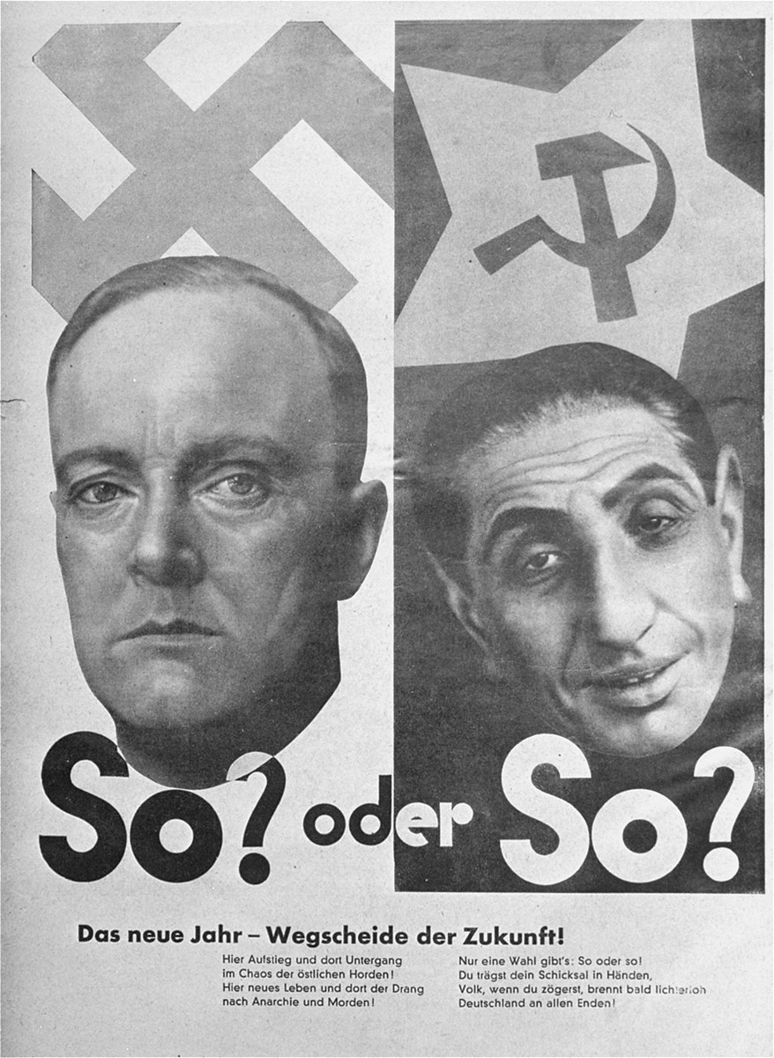
This is a Nazi propaganda poster from early 1930s Germany (Weimar Republic period, just before Hitler took full power).
It shows two faces side by side.
“So? oder So?”
Meaning: “This way? Or that way?”
Below, the German text roughly means:
“The new year-crossroads of the future!”
It suggests Germany must choose between Nazism and Communism.
Germany has only two choices: Nazi order or Communist chaos.
No democracy. No middle path.

Slide 21
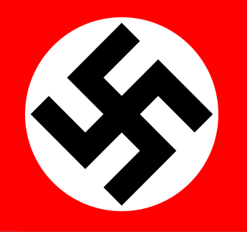
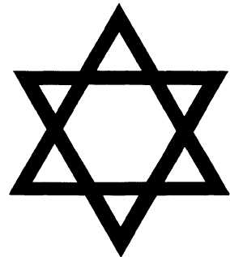
The Nazis And The Jews
The Nazis hated the Jews because of the following main reasons-
Religious hatred (Christ killer myth)
Blamed for WWI defeat
Racial discrimination (inferior race theory)
Blamed for economic crisis of 1929
The Nazi Symbol
The Jewish Symbol

Slide 22
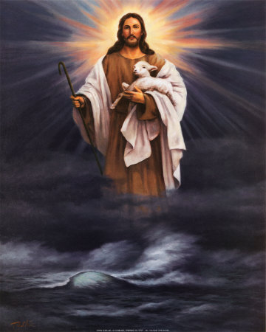
‘Christ killer’ Myth
Right from the crucifixion of Jesus, Jews were blamed in Christian religious narratives for this event. According to many historians, this accusation contributed to the beginning of systematic persecution of Jews across Europe. Extreme instances of Jewish persecution include the First Crusade of 1096, the expulsion of Jews from England in 1290, the Spanish Inquisition, the expulsion from Spain in 1492, and the expulsion from Portugal in 1497. The Holocaust is often regarded as the climax of this centuries-old hatred that developed within Christian Europe.

Slide 23
2.Defeat of Germany in World War I
After the signing of the Treaty of Versailles at the end of World War I, the state of war between Germany and the Allied Powers was formally ended. However, many Germans rejected the treaty, considering it humiliating and unfair. They believed it imposed harsh territorial losses, military restrictions, and heavy reparations on Germany.
After World War I, many Germans believed that they were close to winning the war during the Spring Offensive of 1918. However, they claimed that strikes in the arms industry and internal unrest weakened the German army at a critical moment. Jews and left-wing groups were falsely blamed for these strikes, giving rise to the “stab-in-the-back” myth, which was later widely used in Nazi propaganda.

Slide 24
3.Inferior race
According to historians, Hitler believed that Germans belonged to a superior Aryan race. He regarded Jews, Roma (Gypsies), and other groups as inferior races. This racial ideology was one of the key reasons behind the Holocaust and the persecution of various minority communities.

Slide 25
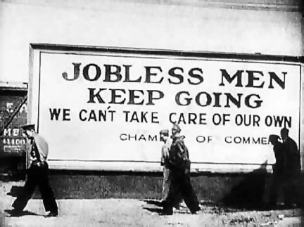
4.Great depression of 1929
The Great Depression of 1929 began after the stock market crash on October 29, 1929, known as Black Tuesday. Germany was severely affected by this economic crisis, and nearly six million people became unemployed. During this period, some Jews were perceived as economically successful, which made them targets of suspicion. Nazi propaganda portrayed Jews as responsible for the economic downturn, even though this claim was false.

Slide 26
Concentration Camps
.
Nazi Germany maintained concentration camps (in German, Konzentrationslager or KZ) throughout the territories it controlled. The first Nazi concentration camps were established in Germany and were greatly expanded after the Reichstag Fire in 1933. These camps were initially intended to hold political prisoners and opponents of the Nazi regime.
The number of camps increased rapidly, and between 1939 and 1942 their number quadrupled to more than 300. Jews, political prisoners, criminals, Roma (Gypsies), the mentally ill, and other groups from across Europe were imprisoned as slave laborers, usually without any judicial process or trial.
Holocaust scholars distinguish between concentration camps and extermination camps. Extermination camps were specifically established by the Nazis for the industrial-scale mass murder of Jews and other victims from ghettos and concentration camps.

Slide 27
Regimentation of Power
1. Suppression of Political Opposition
The Reichstag Fire (1933) was the burning of the German parliament building, which Hitler used to suspend civil liberties and crush political opposition, paving the way for Nazi dictatorship.
Fundamental freedoms such as press, speech, and assembly were abolished.
Hitler blamed the Communists, justifying mass arrests and repression.
Germany was transformed into a one-party state, with all political parties except the Nazi Party banned.
The Gestapo (secret police) was established to suppress dissent and terrorize the population.
A culture of surveillance developed, where citizens, including children, informed on their own families.

Slide 28
2. Propaganda and Mass Mobilization
Hitler used systematic propaganda to shape public opinion and demonize enemies.
Nazi propaganda focused on simple slogans repeated constantly, reflecting Hitler’s belief that repetition makes lies believable.
Joseph Goebbels, Minister of Propaganda, controlled media, literature, film, radio, and art.
Media censorship ensured that only the Nazi narrative was disseminated.
A cult of personality was created around Hitler as the infallible Führer.
Mass rallies, parades, and spectacles were organized to generate emotional loyalty and unity.
Walter Benjamin described this as the “aestheticization of politics”, where power was staged as spectacle.

Slide 29
3. Legal and Institutional Nazification (Gleichschaltung)
Hitler invoked Article 48 to declare a national emergency and rule by decree.
After President Hindenburg’s death in 1934, Hitler merged the offices of Chancellor and President, becoming Führer.
Gleichschaltung (coordination) brought all institutions-civil service, judiciary, education, and cultural bodies-under Nazi control.
This eliminated institutional autonomy and ensured total loyalty to the regime.

Slide 30
4. Internal Purges and Absolute Control
Hitler eliminated internal rivals during the Night of the Long Knives (1934), purging his political opponents.
This secured complete control over the Nazi Party and the state apparatus.
5. Economic and Labour Policies
Independent trade unions were abolished and replaced by the German Labour Front, bringing workers under state control.
Hitler adopted state-led economic intervention (proto-Keynesian policies) to reduce unemployment through public works and military spending.
Economic recovery helped win popular support and reduce resistance.

Slide 31
Nazi Economic Policy
Nazi Economic Policy: Key Phases
1932–36:
Hjalmar Schacht’s state-led recovery, public works, reduced unemployment
1936–39:
Four-Year Plan, autarky (economic self-suffieciency), rearmament, welfare to secure loyalty
1939–45:
Total war economy, forced labour, military-industrial mobilization

Slide 32
The Racial State (social policies)
Nazi Germany aimed to create a racial state (Rassenstaat) where society was organized based on racial hierarchy, purity, and loyalty to the Führer.
The state controlled education, culture, bodies, reproduction, and everyday life → historians call this biopolitics (state control over life itself).

Slide 33
Education & Culture
Educational curriculum was Nazified; scholars and artists were encouraged to glorify Hitler and the Nazi Party.
Modernist art, jazz, experimental literature labeled “Degenerate Art” (Entartete Kunst) and censored.
State promoted heroic Aryan bodies, rural peasants, militarism, and masculinity in art and culture.
Women and Gender Policy
Women were restricted to Kinder, Kirche, Küche (Children, Church, Kitchen).
Motherhood portrayed as a national duty to produce Aryan children.
Marriage loans given; loan partially forgiven for each child.
Medals awarded to mothers with many Aryan children.
Abortion banned for Aryan women but encouraged/forced for Jews and disabled women → racialized reproduction.

Slide 34
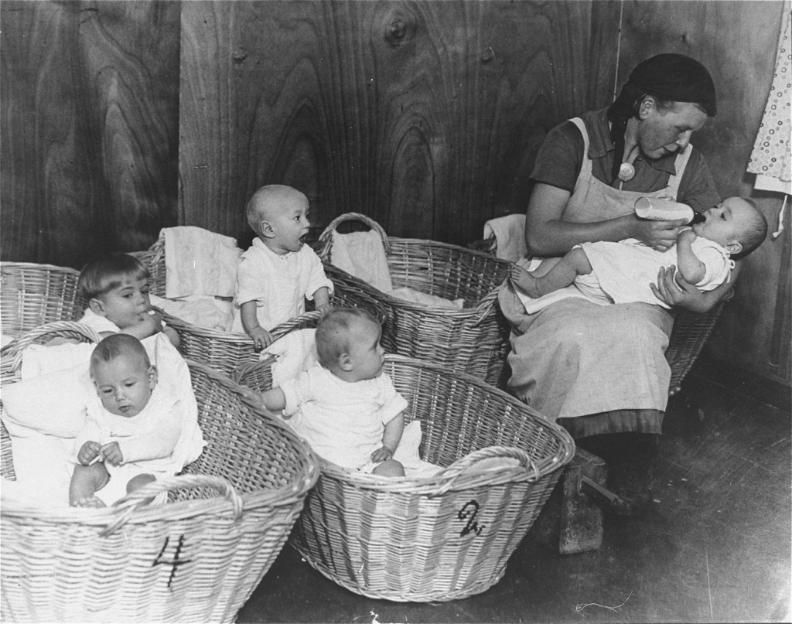
German propaganda photograph of a kindergarten for German infants promotes the nurturing role of women on the home front. Germany, 1941.

Slide 35
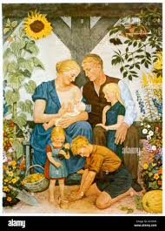
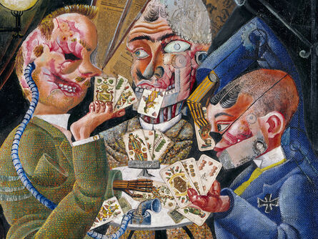
Nazi art
“Degenerate art”

Slide 36
Youth Indoctrination
Hitler Youth and League of German Girls created to indoctrinate children with Nazi ideology.
Emphasis on physical fitness, militarism, discipline, racial purity, and Führer worship.
Eugenics and Racial Purity
Eugenics (good genes) became central state policy.
Government encouraged reproduction among “pure” German peasants (white skin, blue eyes) and funded rural Aryan families.
Blood-and-soil ideology: racial purity linked to land and fertility.

Slide 37
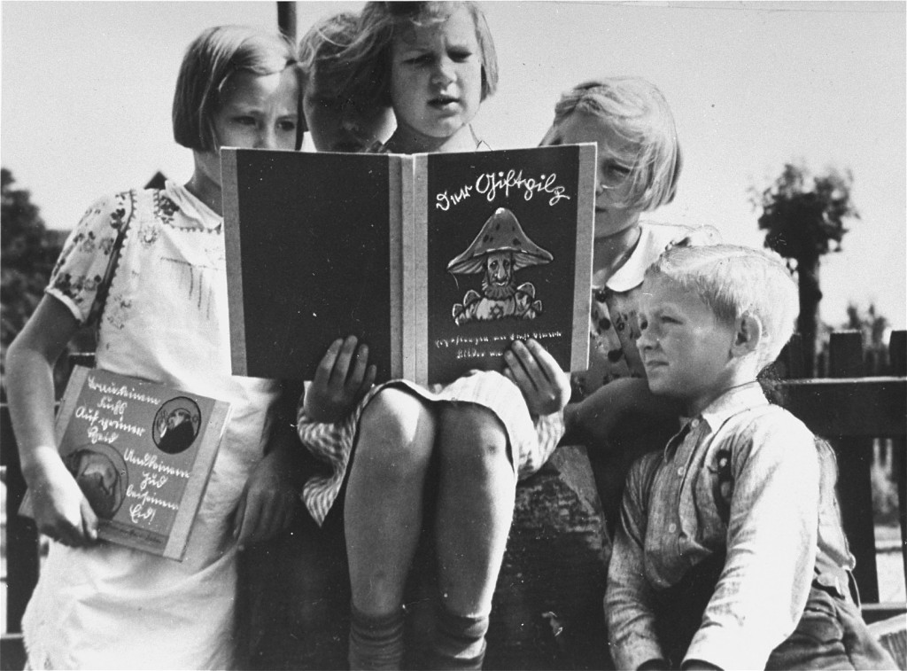
German children read an anti-Jewish propaganda book for children titled Der Giftpilz (The Poisonous Mushroom). The girl on the left holds a companion volume, the translated title of which is "Trust No Fox." Germany, ca. 1938

Slide 38
Sterilization and Euthanasia
Law for the Prevention of Hereditarily Diseased Offspring (1933) → forced sterilization of people with hereditary diseases/disabilities.
T4 Euthanasia Program → systematic killing of mentally ill and disabled people using mobile gas chambers and hospitals.
Considered a precursor to Holocaust techniques.
Anti-Jewish Laws and Social Death
Nuremberg Laws (1935):
  -Jews stripped of citizenship
  -Interracial marriage banned
  -Jews excluded from public life
1938 onwards: violent riots (Kristallnacht) and escalating persecution.
Jews subjected to “social death” → dehumanized, treated as non-human, denied rights (sociologically comparable to slavery/caste exclusion).

Slide 39
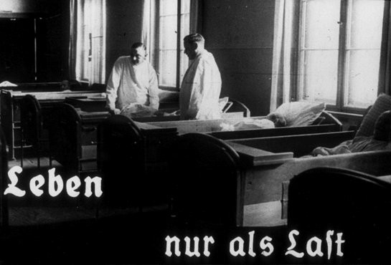
This photo originates from a film produced by the Reich Propaganda Ministry. It shows two doctors in a ward in an unidentified asylum. The existence of the patients in the ward is described as "life only as a burden." Such propaganda images were intended to develop public sympathy for the Euthanasia Program.

Slide 40
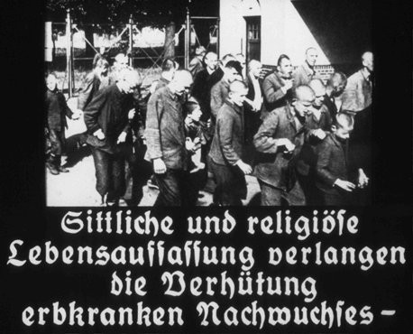
This image originates from a film produced by the Reich Propaganda Ministry. It is captioned: "A moral and religious conception of life demands the prevention of hereditarily ill offspring." Nazi propaganda aimed to create public support for the compulsory sterilization effort.

Slide 41
Lebensraum
Lebensraum (German for "habitat" or literally "living space") was one of the major political ideas of Adolf Hitler, and an important component of Nazi ideology. It served as the motivation for the expansionist policies of Nazi Germany, aiming to provide extra space for the growth of the German population, for a Greater Germany. In Hitler's book Mein Kampf, he detailed his belief that the German people needed Lebensraum ("living space", i.e. land and raw materials), and that it should be found in the East. It was the stated policy of the Nazis to kill, deport, or enslave the Polish, Russian and other Slavic populations, whom they considered inferior, and to repopulate the land with Germanic peoples. The entire urban population was to be exterminated by starvation, thus creating an agricultural surplus to feed Germany and allowing their replacement by a German upper class.

Slide 42
Militarization and Expansionist Policy
Hitler initiated massive rearmament and militarization, openly violating the Treaty of Versailles, which had restricted Germany’s military capacity.
The regime invested heavily in the army (Wehrmacht), air force (Luftwaffe), and navy, turning Germany into a war-oriented state.
Nazi foreign policy was driven by the ideology of Lebensraum (living space)- the belief that Germans needed territorial expansion, especially in Eastern Europe, to survive and flourish.
Expansionism aimed at establishing German hegemony over Europe, creating a racially pure German empire.
Key steps in expansion:
Remilitarization of the Rhineland (1936)
Anschluss with Austria (1938)
Annexation of Sudetenland and later Czechoslovakia (1938-39)
These aggressive policies directly triggered the outbreak of World War II in 1939, beginning with the invasion of Poland.
Militarization also served a domestic purpose: reducing unemployment, stimulating industry, and consolidating nationalist support through war propaganda.

Slide 43
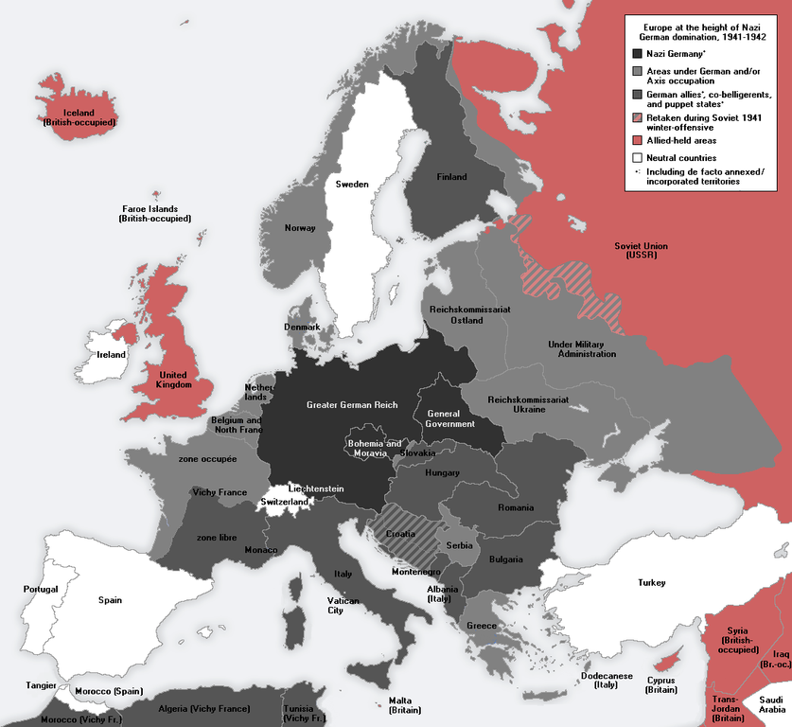
GERMAN OCCUPIED EUROPE

Slide 44
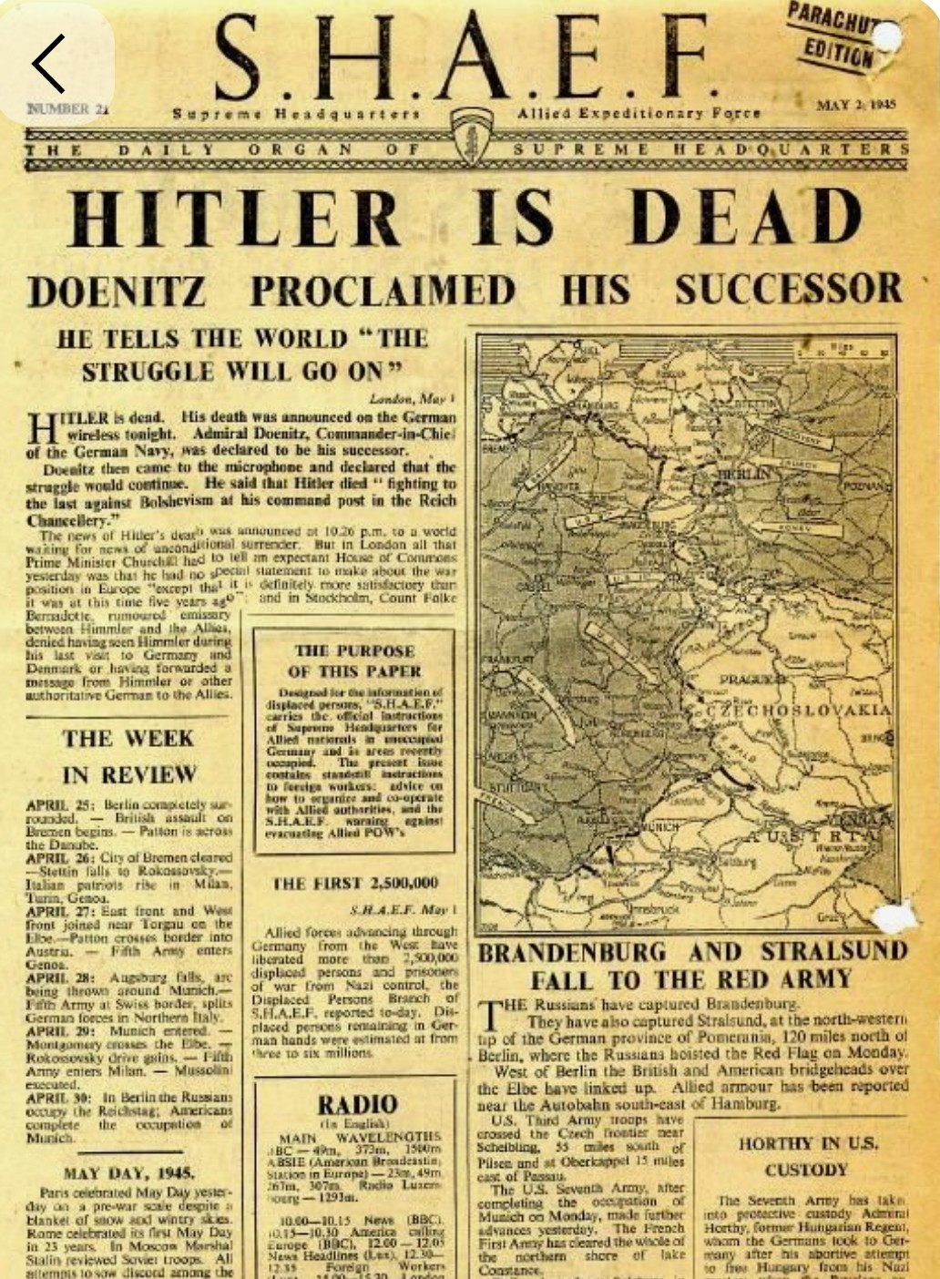

Slide 45
Death of Hitler
Adolf Hitler committed suicide by gunshot on Monday, 30 April 1945 in his Führerbunker in Berlin. His wife Eva, committed suicide with him by ingesting cyanide.That afternoon, in accordance with Hitler's prior instructions, their remains were carried up the stairs through the bunker's emergency exit, doused in petrol and set alight in the Reich Chancellery garden outside the bunker. The Soviet archives record that their burnt remains were recovered and interred in successive locations until 1970 when they were again exhumed, cremated and the ashes scattered.

Slide 46
Suggested readings
Hayes, C.J.H. Contemporary Europe Since 1870. Macmillan Company. 1953.
Lipson, E. Europe in 19th and 20th Centuries. A & C. Black. 1960
Evans, Richard J. The Coming of the Third Reich. New York: Penguin Press, 2003.
Bullock, Alan. Hitler: A Study in Tyranny. New York: Harper & Row, 1962.
Taylor, A. J. P. The Origins of the Second World War. London: Hamish Hamilton, 1961.
Arendt, Hannah. The Origins of Totalitarianism. New York: Harcourt, Brace & Company, 1951.

